Slide 1

Senior Challenge 4
Bronze

Slide 2
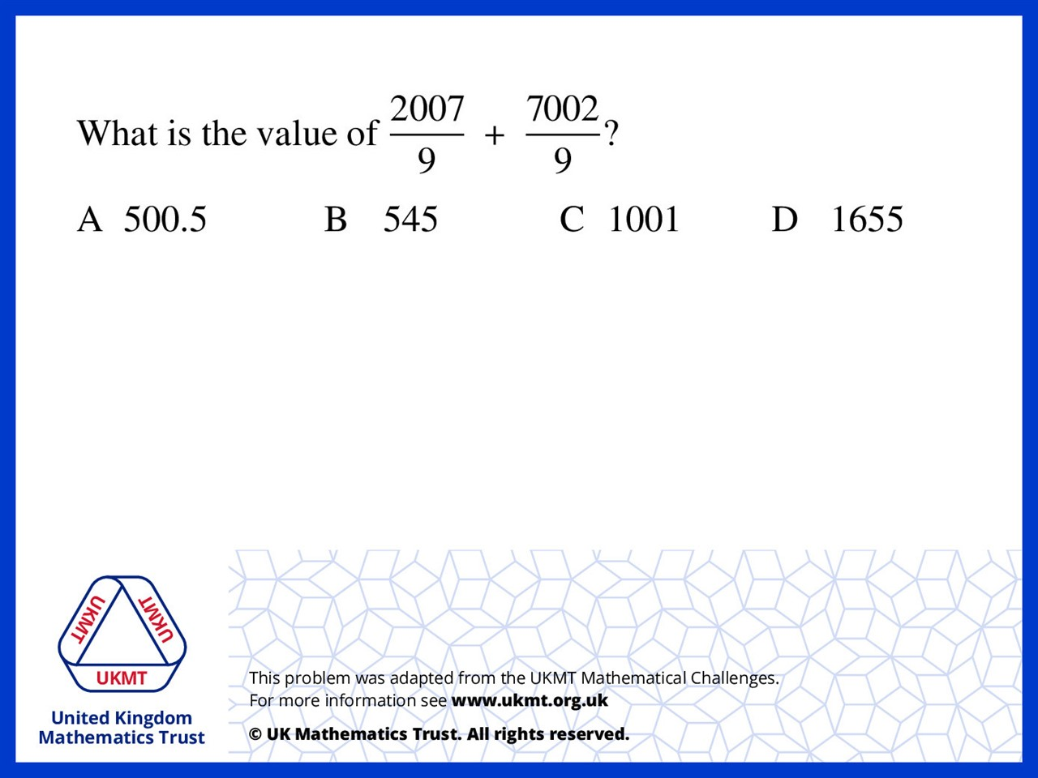
Q1.
2007 + 7002 = 9009
9009 ÷ 9 = 1001

Slide 3
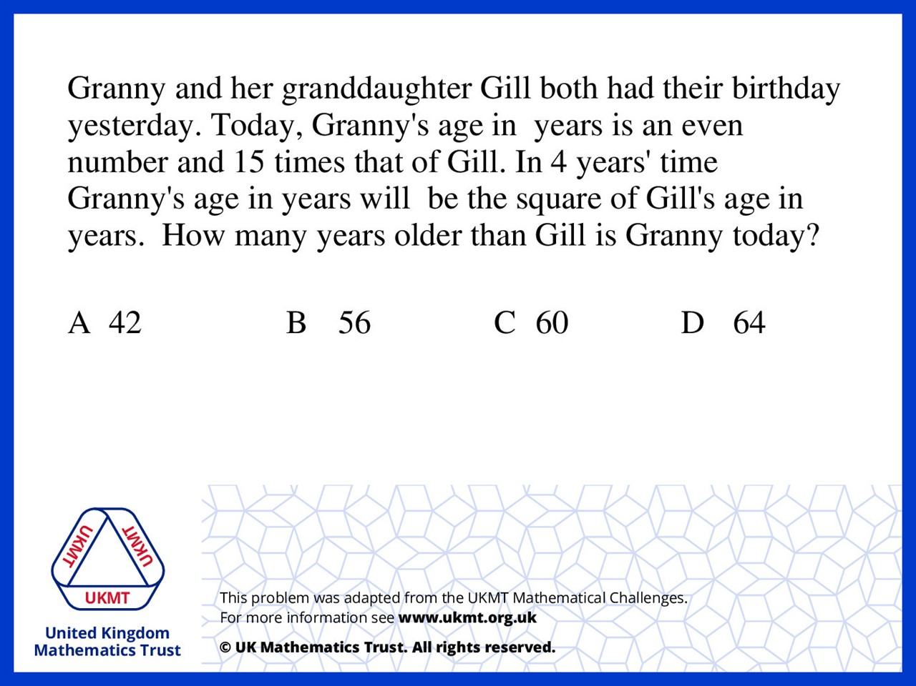
Q2.
Solve simultaneous equations to get two answers
G = 60, g = 4 and G = 45, g = 3
G cannot equal 45 as G must be even
therefore 60 – 4 = 56

Slide 4
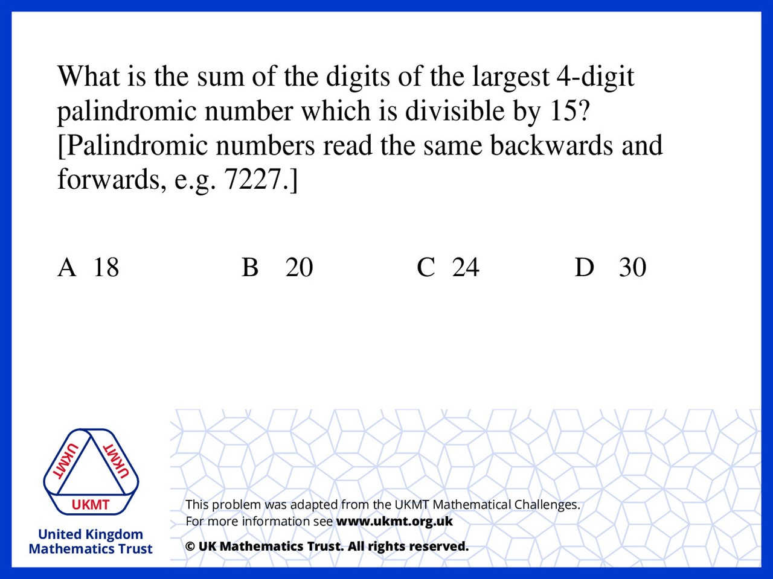
Q3.
Multiples of 15 either end in 5 or 0 so the first number must be 5 or 0. As we are after the largest number, we know it starts with a 5. So we know it is 5??5. 6000 is a multiple of 15 and if you work backwards taking off 15 each time, the first palindromic number is 5775. 5+7+7+5=24.

Slide 5
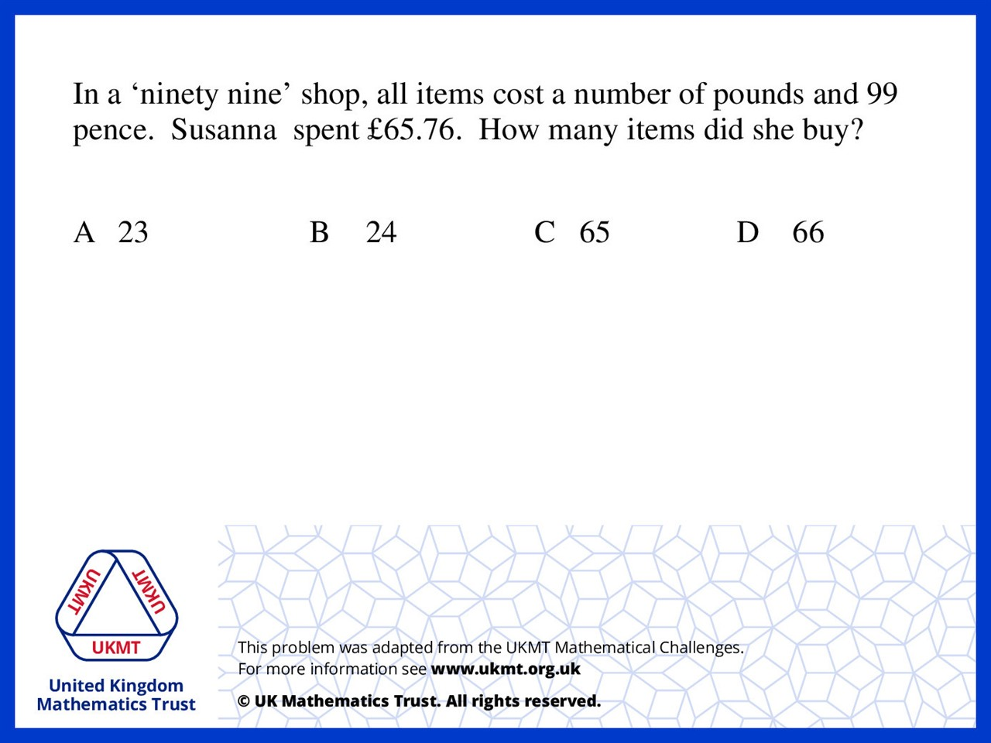
Q4.
99p = £1 minus a penny.
If you count to the nearest pound from £65.76
there is 0.24p which means 24 items were purchased.

Slide 6
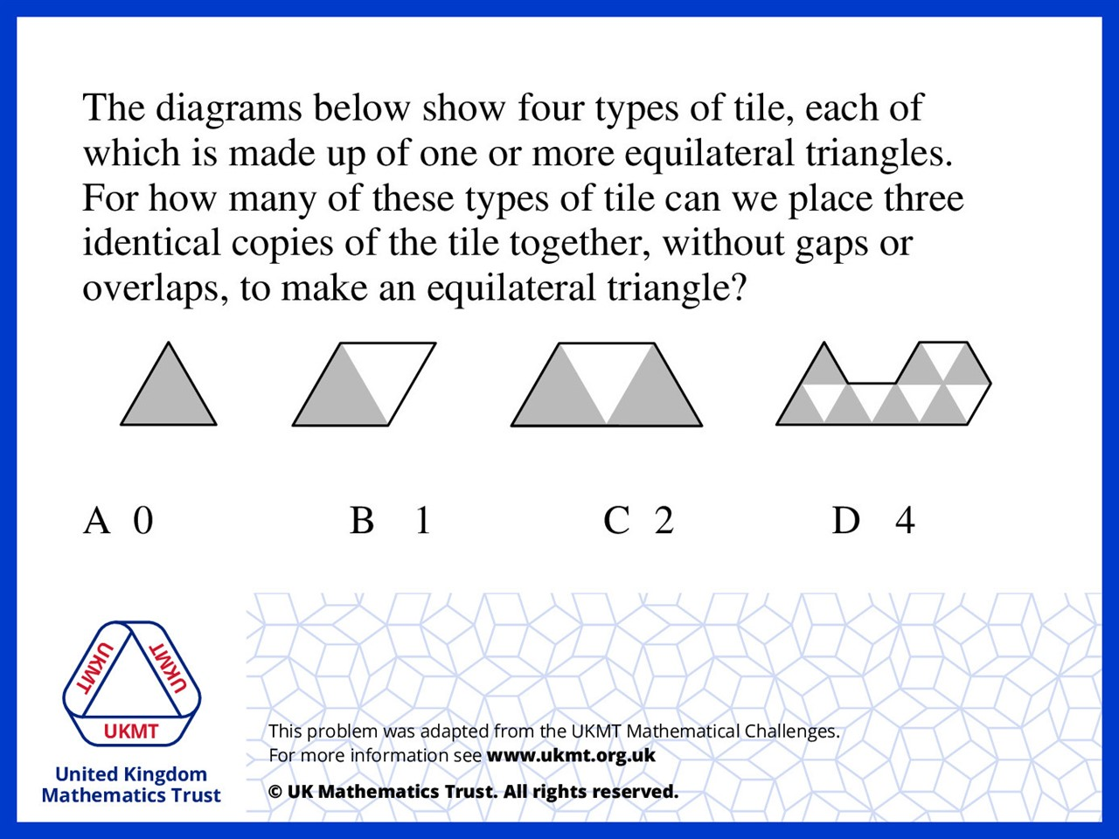
Q5.

