Slide 1
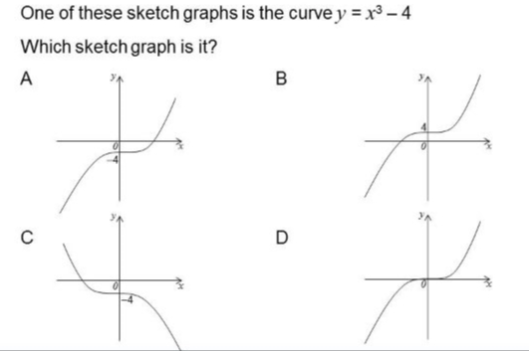
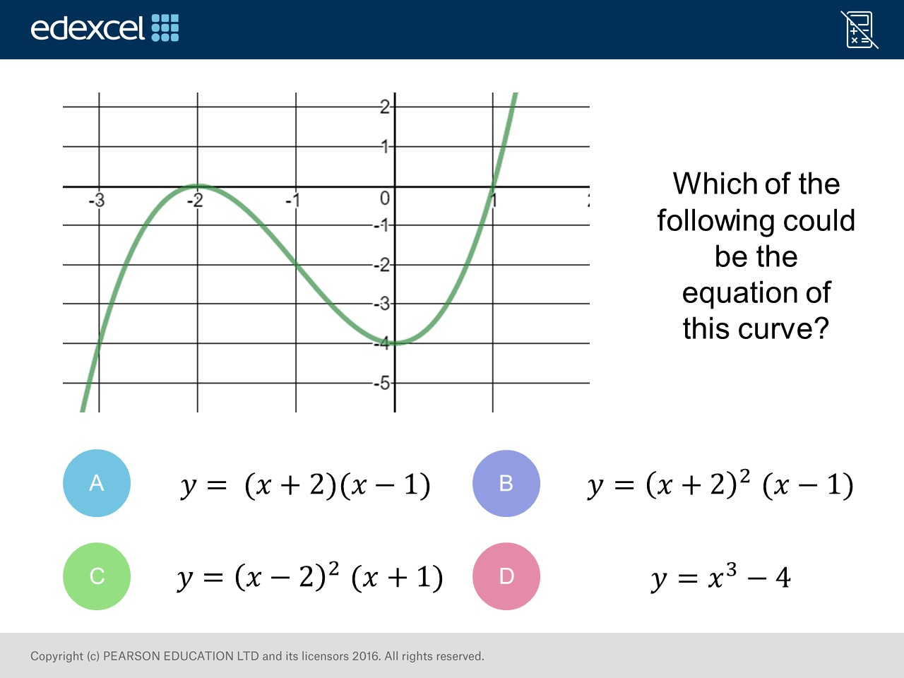
Worst answered question?
Most common wrong answer?

Slide 2
ANSWERS

Slide 3
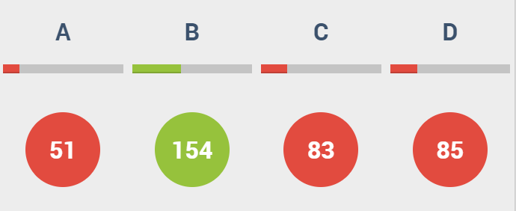
D
They only focused on the graph going through -4.

Slide 4
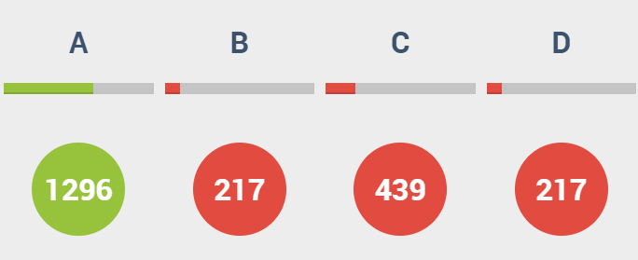
C
Negative Gradient.

