Slide 1
Integration
Reverse Chain Rule
Chapter 11
(Part 3 of 12)

Slide 2
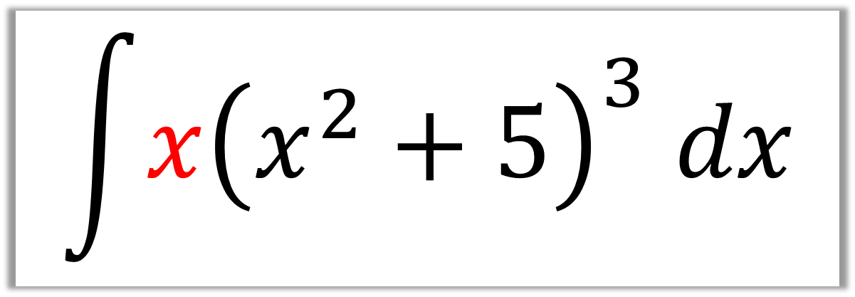
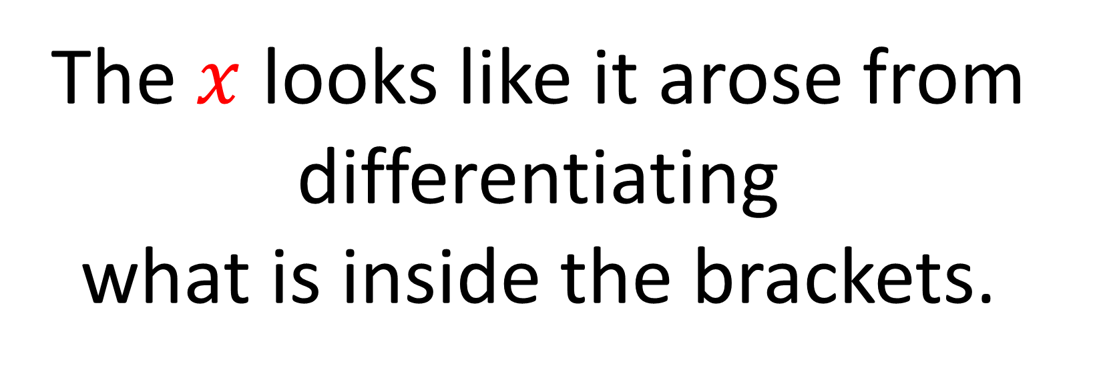
$$\int{x{\left(x^{2}+5\right)}^{3} dx}$$
The $x$ looks like it arose from differentiating
what is inside the brackets.

Slide 3
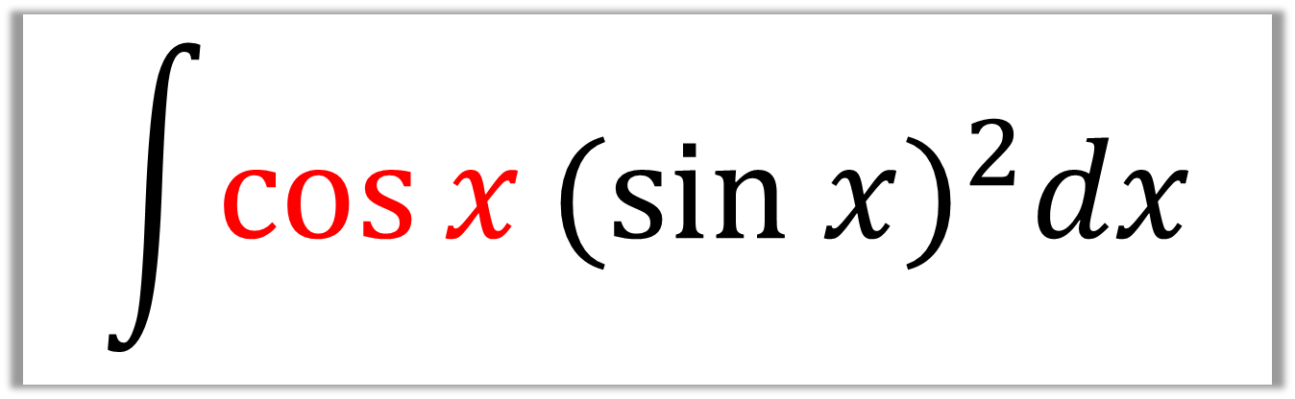
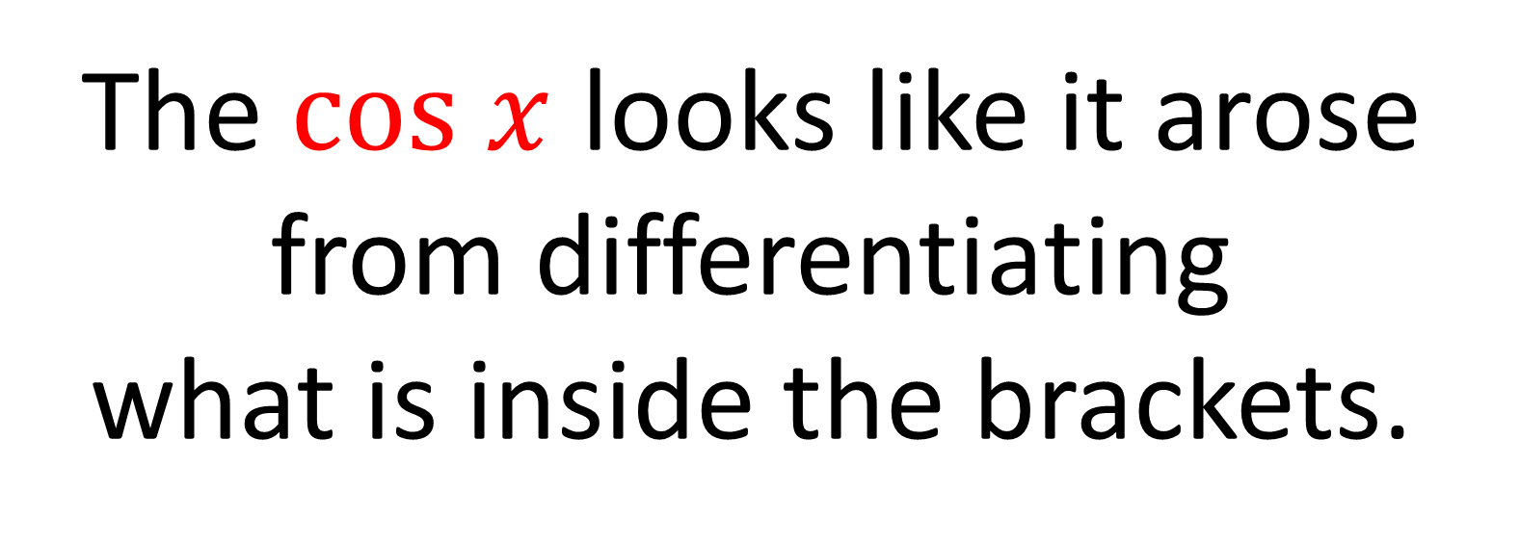
$$\int{\cos{x}{(sin x)}^{2}dx}$$
The $cos x$ looks like it arose from differentiating
what is inside the brackets.

Slide 4
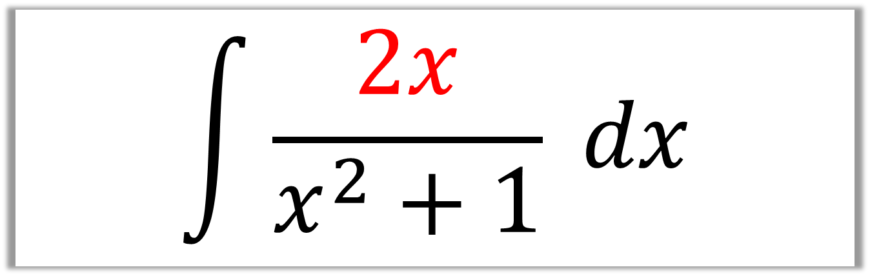
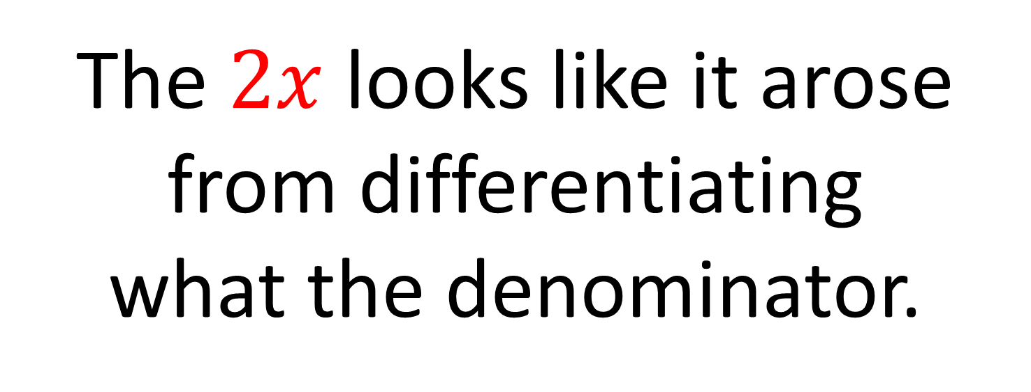
$$\int{\frac{2x}{x^{2}+1} dx}$$
The $2x$ looks like it arose from differentiating
what the denominator.

Slide 5
If there is a
differentiation connection,
then you can use the
reverse chain rule.

Slide 6
When doing the reverse chain rule:
Consider a possible answer.
Then adjust any multipler.

Slide 7
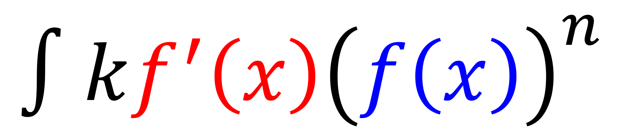
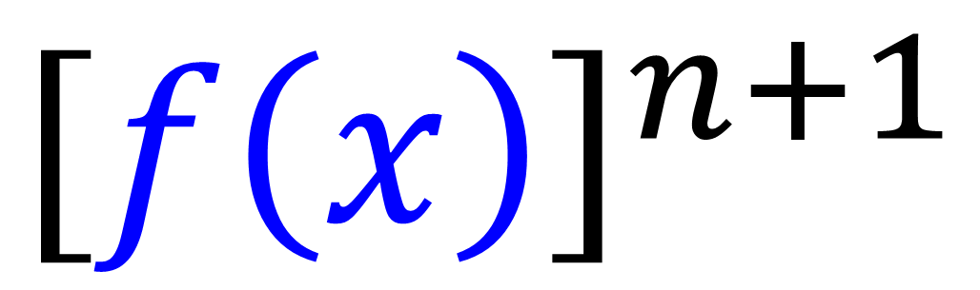
$$∫kf^{′}\left(x\right){\left(f\left(x\right)\right)}^{n}$$
Possible Answer:
$${\left[f\left(x\right)\right]}^{n+1}$$

Slide 8

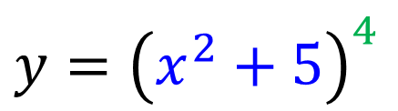
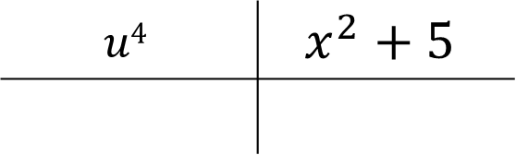
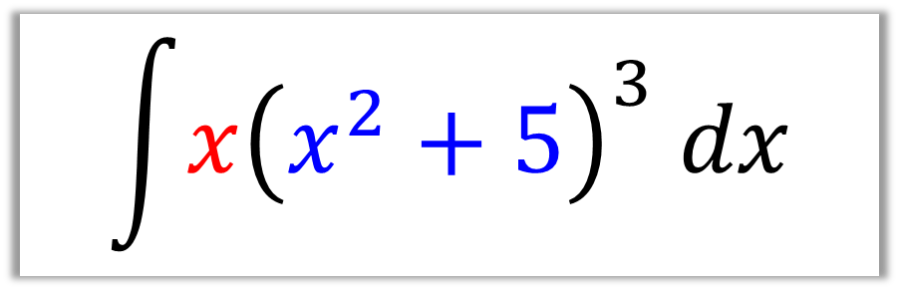
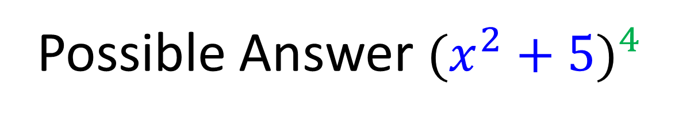
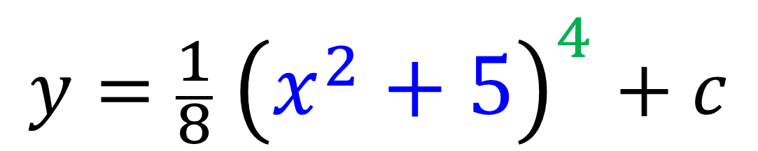
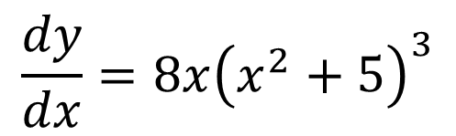

$$\int{x{\left(x^{2}+5\right)}^{3} dx}$$
Possible Answer ${(x^{2}+5)}^{4}$
Check
Adjust
$$y={\left(x^{2}+5\right)}^{4}$$
$$y={\frac{1}{8} \left(x^{2}+5\right)}^{4}+c$$
$$u4$$ | $$x^{2}+5$$
$$5u4$$ | $$12x3+1$$
$$4u^{3}$$
$$2x$$
$$\frac{dy}{dx}=8{x\left(x^{2}+5\right)}^{3}$$

Slide 9

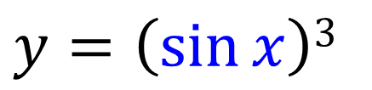
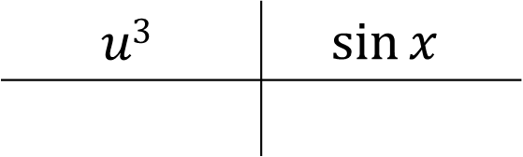
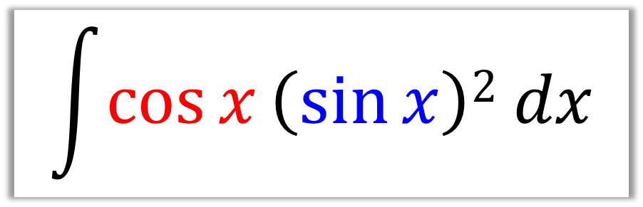
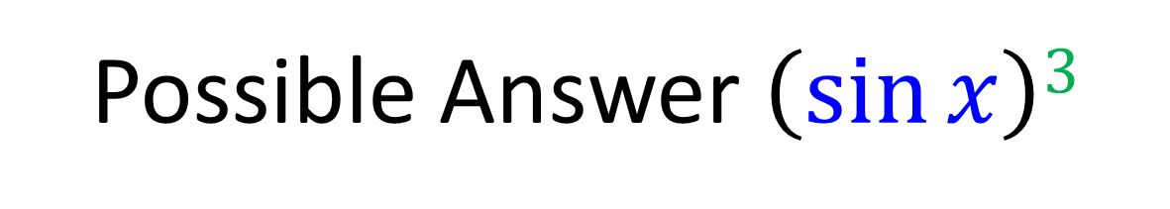
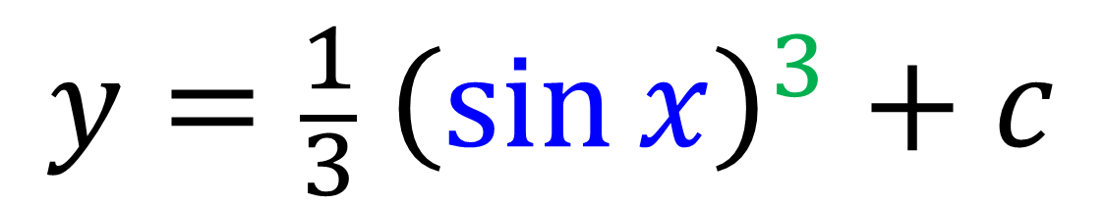
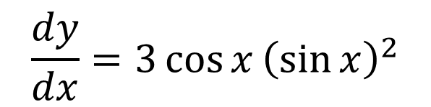

$$\int{\cos{x}\left(\sin{x}\right)2 dx}$$
Possible Answer $\left(\sin{x}\right)3$
Check
Adjust
$$y=\left(\sin{x}\right)3$$
$$y={\frac{1}{3} \left(\sin{x}\right)}^{3}+c$$
$$u3$$ | $$\sin{x}$$
$$5u4$$ | $$12x3+1$$
$$3u^{2}$$
$$\cos{x}$$
$$\frac{dy}{dx}={3\cos{x}\left(\sin{x}\right)}^{2}$$

Slide 10

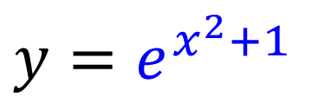
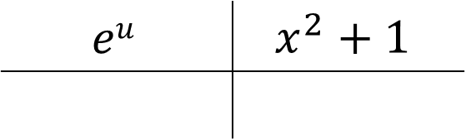
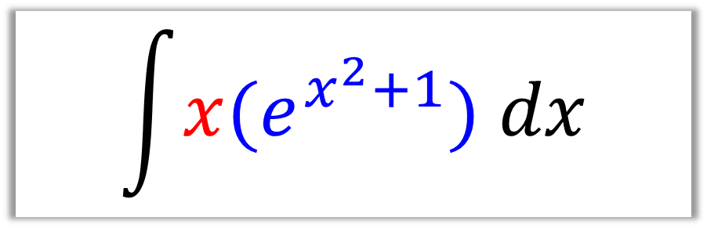
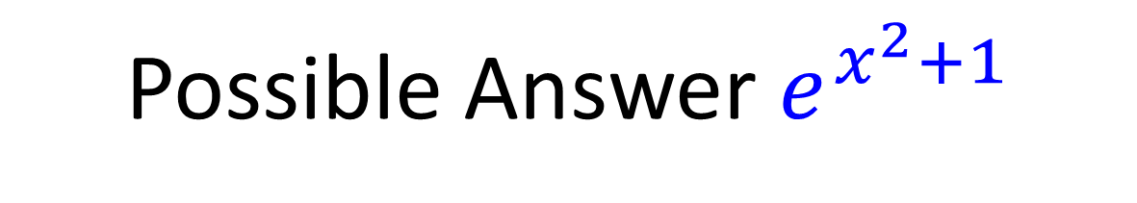
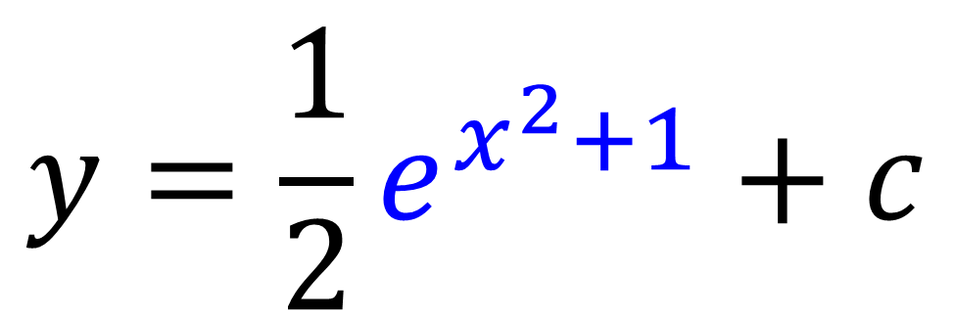
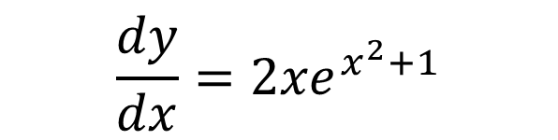

$$\int{x{(e}^{x^{2}+1}) dx}$$
Possible Answer $e^{x^{2}+1}$
Check
Adjust
$$y=e^{x^{2}+1}$$
$${y=\frac{1}{2}e}^{x^{2}+1}+c$$
$$eu$$ | $$x^{2}+1$$
$$5u4$$ | $$11$$
$$eu$$
$$2x$$
$$\frac{dy}{dx}={2xe}^{x^{2}+1}$$

Slide 11

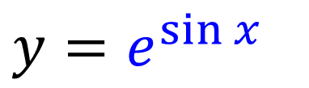
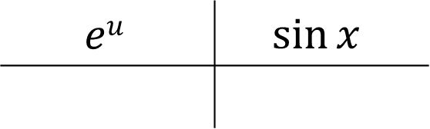
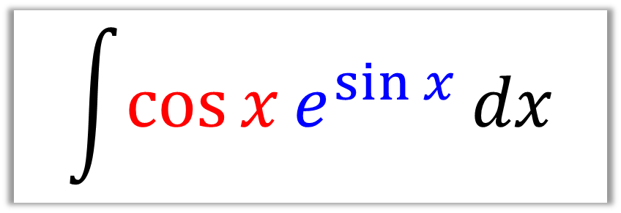
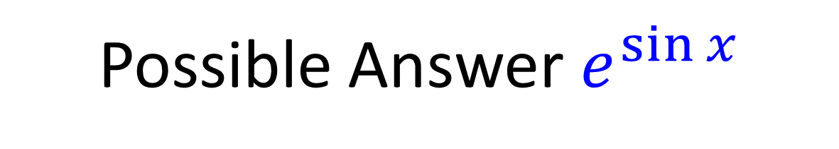
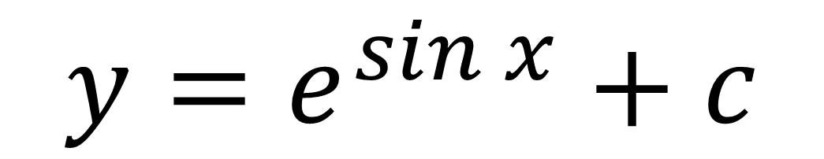
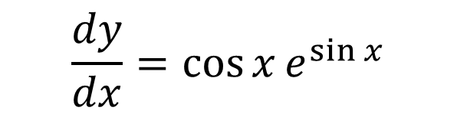

$$\int{\cos{x}e^{\sin{x}}}dx$$
Possible Answer $e^{\sin{x}}$
Check
Adjust
$$y=e^{\sin{x}}$$
$${y=e}^{\sin{x}}+c$$
$$eu$$ | $$\sin{x}$$
$$5u4$$ | $$11$$
$$eu$$
$$\cos{x}$$
$$\frac{dy}{dx}={\cos{x}e}^{\sin{x}}$$

Slide 12

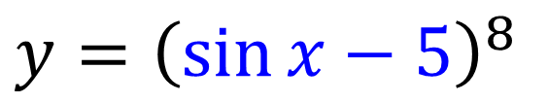
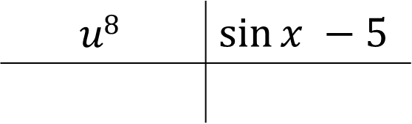
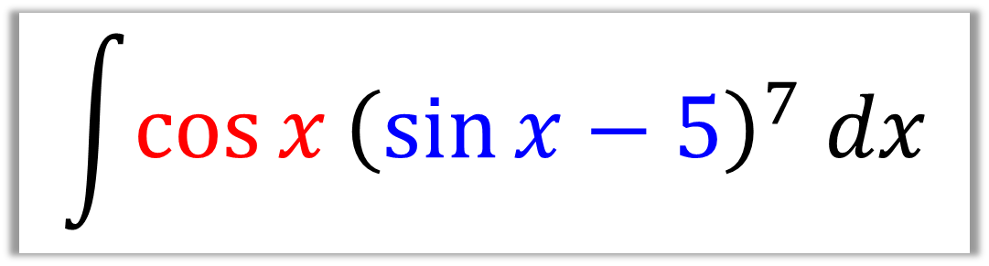
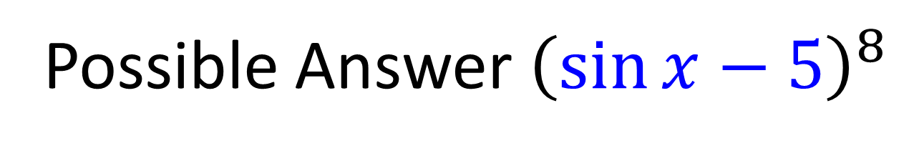
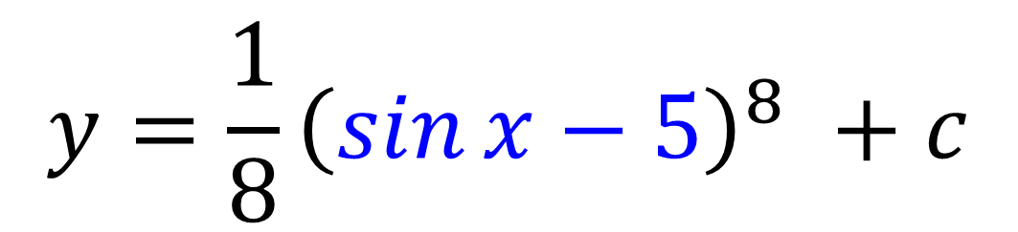
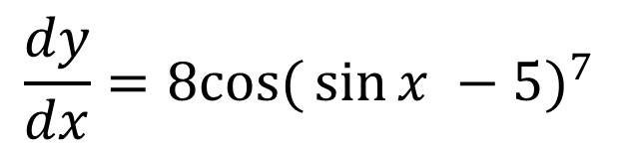

$$\int{\cos{x}{\left(\sin{x}−5\right)}^{7} dx}$$
Possible Answer ${\left(\sin{x}−5\right)}^{8}$
Check
Adjust
$$y={\left(\sin{x}−5\right)}^{8}$$
$$y=\frac{1}{8}{\left(\sin{x}−5\right)}^{8} +c$$
$$u8$$ | $$\sin{x −5}$$
$$5u4$$ | $$11$$
$$8u7$$
$$\cos{x}$$
$$\frac{dy}{dx}={8cos({\sin{x −5}})}^{7}$$

Slide 13

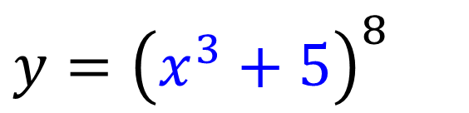
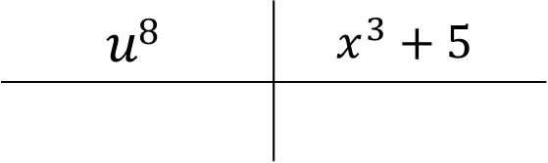
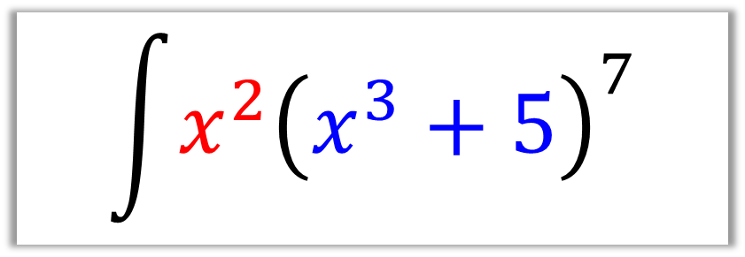
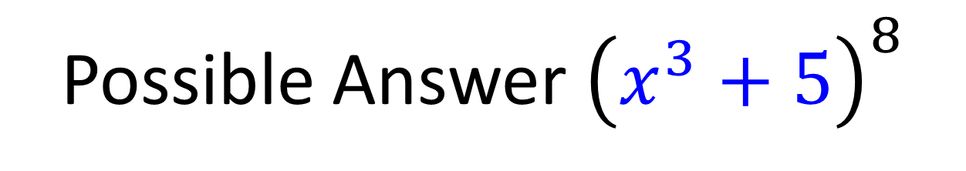
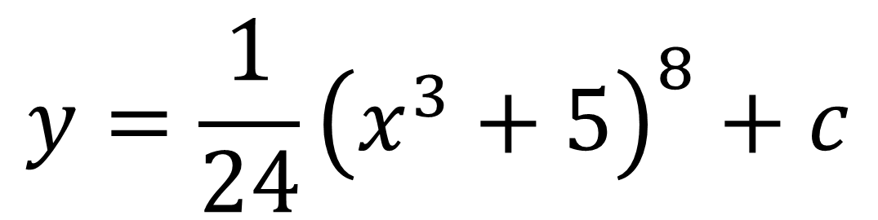
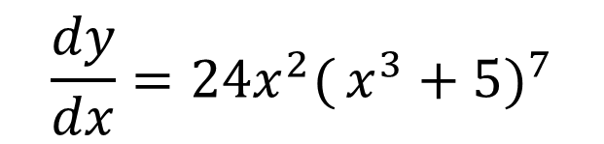

$$\int{x^{2}{\left(x^{3}+5\right)}^{7}}$$
Possible Answer ${\left(x^{3}+5\right)}^{8}$
Check
Adjust
$$y={\left(x^{3}+5\right)}^{8}$$
$$y=\frac{1}{24}{\left(x^{3}+5\right)}^{8}+c$$
$$u8$$ | $$x^{3}+5$$
$$5u4$$ | $$11$$
$$8u7$$
$$3x^{2}$$
$$\frac{dy}{dx}={24x^{2}({x^{3}+5})}^{7}$$

Slide 14
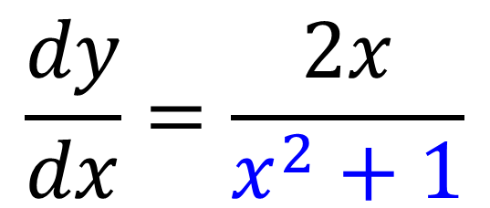
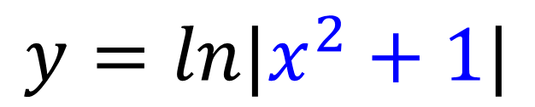
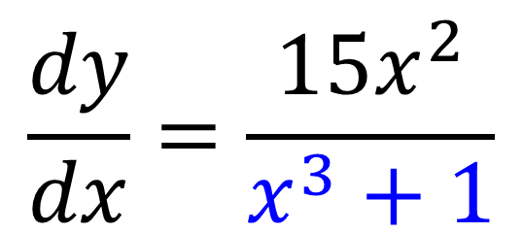
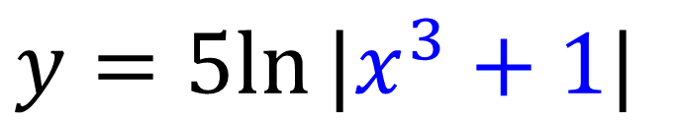
Differentiate the following equations
$$\frac{dy}{dx}=\frac{2x}{x^{2}+1}$$
$$y=ln|x^{2}+1|$$
$$\frac{dy}{dx}=\frac{15x^{2}}{x^{3}+1}$$
$$y=5ln⁡|x^{3}+1|$$

Slide 15
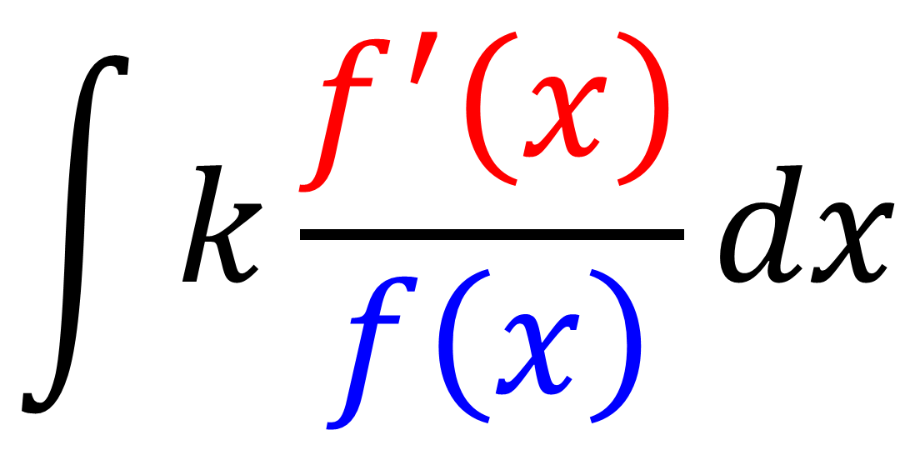
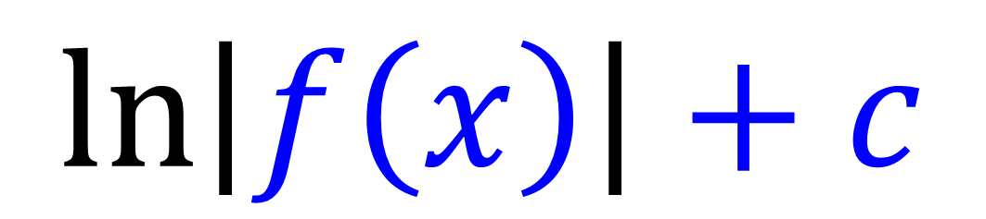
$$\int{k\frac{f^{′}\left(x\right)}{f\left(x\right)}dx}$$
Possible Answer:
$$\ln\left|f\left(x\right)\right|+c$$

Slide 16





$$\int{\frac{2x}{x^{2}+1} dx}$$
$$\text{P}\text{ossible} \text{A}\text{nswer} ln|x^{2}+1|$$
Check
Adjust
$$y=ln|x^{2}+1|$$
$$y=ln|x^{2}+1|+c$$
$$\frac{dy}{dx}=\frac{2x}{x^{2}+1}$$

Slide 17





$$\int{\frac{x^{2}}{x^{3}+1} dx}$$
$$\text{P}\text{ossible} \text{A}\text{nswer} ln|x^{3}+1|$$
Check
Adjust
$$y=ln⁡|x^{3}+1|$$
$$y =\frac{1}{3}ln\left|x^{3}+1\right|+c$$
$$\frac{dy}{dx}=\frac{3x^{2}}{x^{3}+1}$$

Slide 18





$$\int{\frac{4x^{3}}{x^{4}−1}dx}$$
$$\text{P}\text{ossible} \text{A}\text{nswer} ln|x^{4}−1|$$
Check
Adjust
$$y=ln⁡|x^{4}−1|$$
$$y =\ln\left|x^{4}−1\right|+c$$
$$\frac{dy}{dx}=\frac{4x^{3}}{x^{4}−1}$$

Slide 19





$$\int{\frac{\cos{x}}{\sin{x}+2}dx}$$
$$\text{P}\text{ossible} \text{A}\text{nswer} ln|\sin{x}+2|$$
Check
Adjust
$$y=ln⁡|\sin{x}+2|$$
$$y=ln\left|\sin{x}+2\right|+c$$
$$\frac{dy}{dx}=\frac{\cos{x}}{\sin{x}+2}$$

Slide 20




$$\int{\frac{\sec^{2}{2x}}{\tan{2x}+1} dx}$$
$$\text{P}\text{ossible} \text{A}\text{nswer} ln|\tan{2x}+1|$$
Check
Adjust
$$y=ln⁡|\tan{2x}+1|$$
$$y=\frac{1}{2}ln{|\tan{2x}+1|}+c$$
$$\frac{dy}{dx}=\frac{{2 sec}^{2}{2x}}{\tan{2x}+1}$$

Slide 21



Watch out for these sneaky questions
$$\int{\frac{4x^{3}}{{{(x}^{4}−1)}^{4}}dx}=$$
$$\int{{{4x^{3}(x}^{4}−1)}^{−4}dx}$$
$${=−\frac{1}{3}{(x}^{4} − 1)}^{−3}+ c$$

