Slide 1
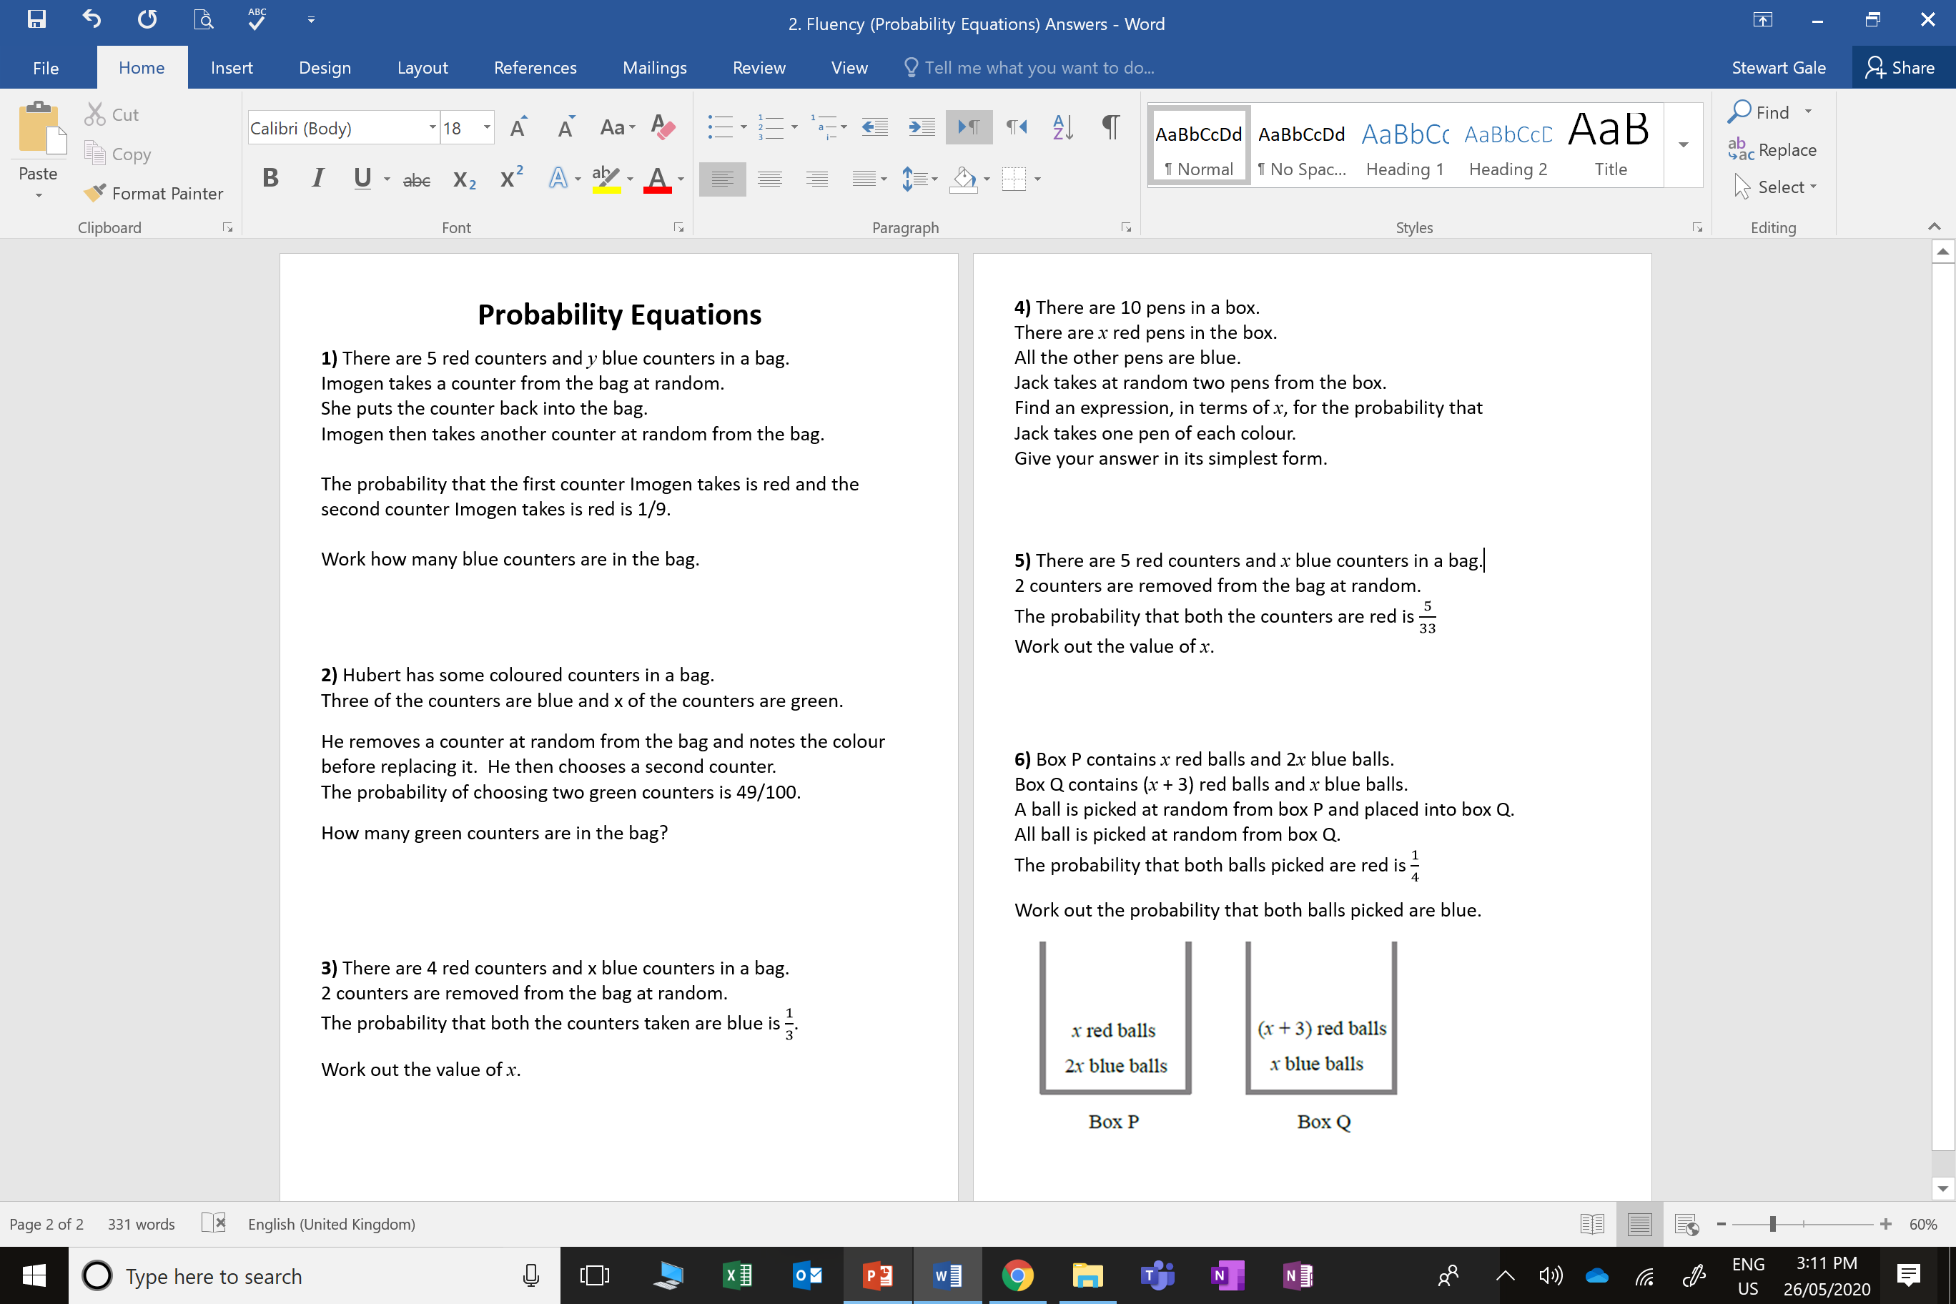

Slide 2
ANSWERS

Slide 3
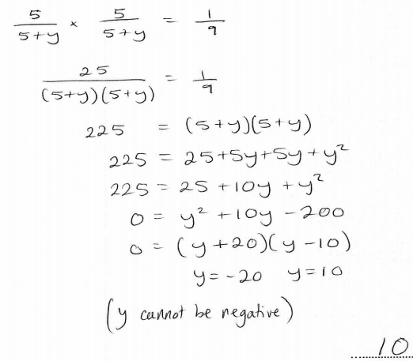
1) There are 5 red counters and y blue counters in a bag.
Imogen takes a counter from the bag at random.
She puts the counter back into the bag.
Imogen then takes another counter at random from the bag.
The probability that the first counter Imogen takes is red and the second counter Imogen takes is red is 1/9.
Work how many blue counters are in the bag.

Slide 4
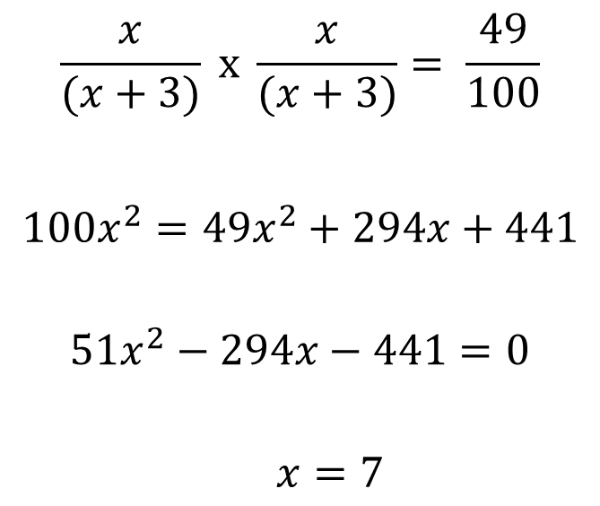
2) Hubert has some coloured counters in a bag. Three of the counters are blue and x of the counters are green. He removes a counter at random from the bag and notes the colour before replacing it. He then chooses a second counter. The probability of choosing two green counters is 49/100
How many green counters are in the bag?

Slide 5
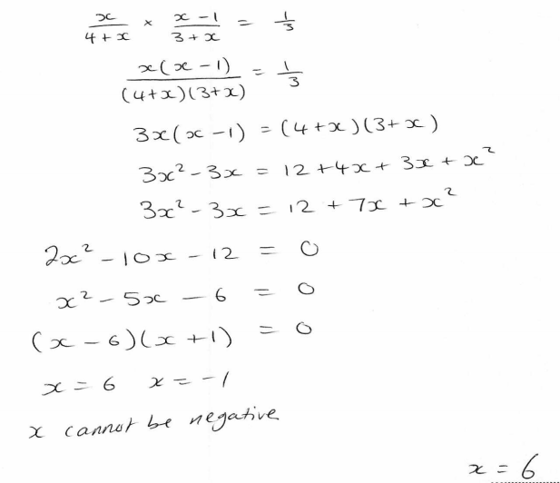
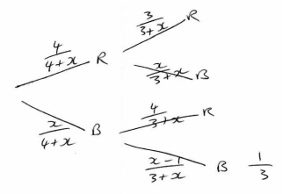
3) There are 4 red counters and x blue counters in a bag.
2 counters are removed from the bag at random.
The probability that both the counters taken are blue is 1/3.
Work out the value of x.

Slide 6
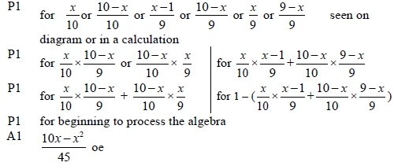
4) There are 10 pens in a box.
There are x red pens in the box.
All the other pens are blue.
Jack takes at random two pens from the box.
Find an expression, in terms of x, for the probability that Jack takes one pen of each colour.
Give your answer in its simplest form.

Slide 7
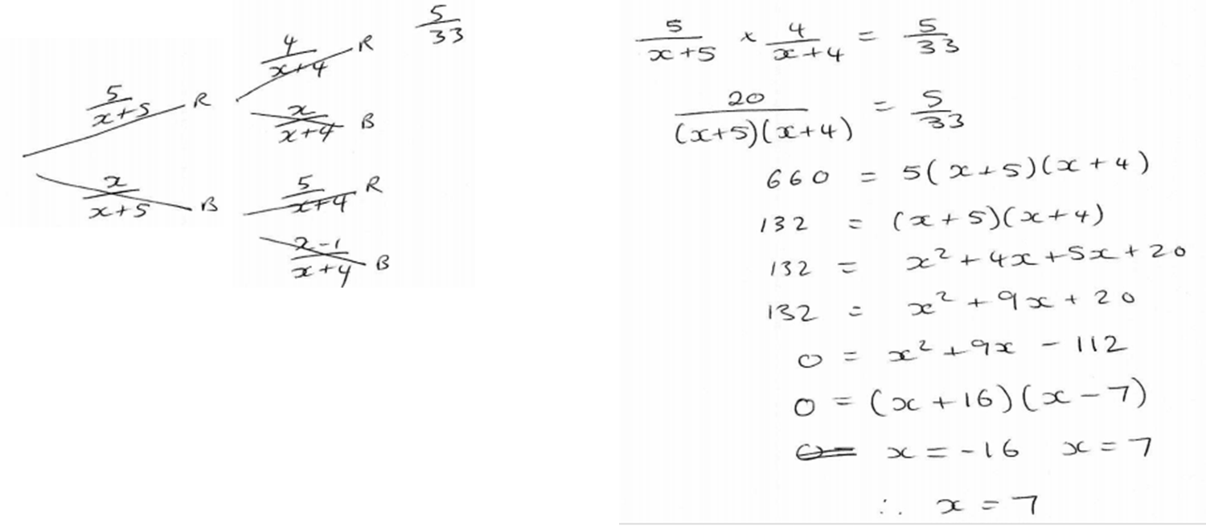
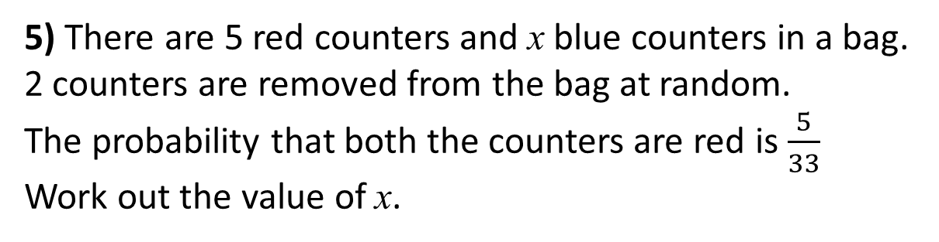
5) There are 5 red counters and x blue counters in a bag.
2 counters are removed from the bag at random.
The probability that both the counters are red is $\frac{5}{33}$
Work out the value of x.

Slide 8
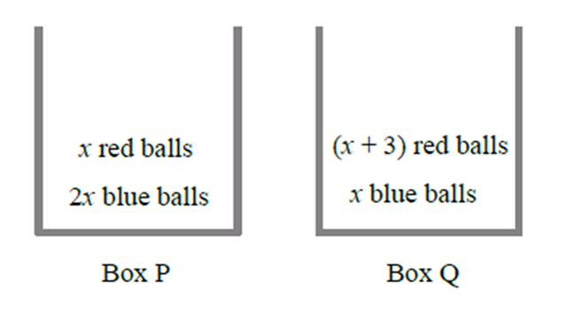
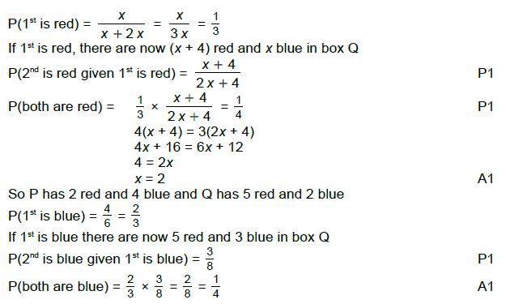
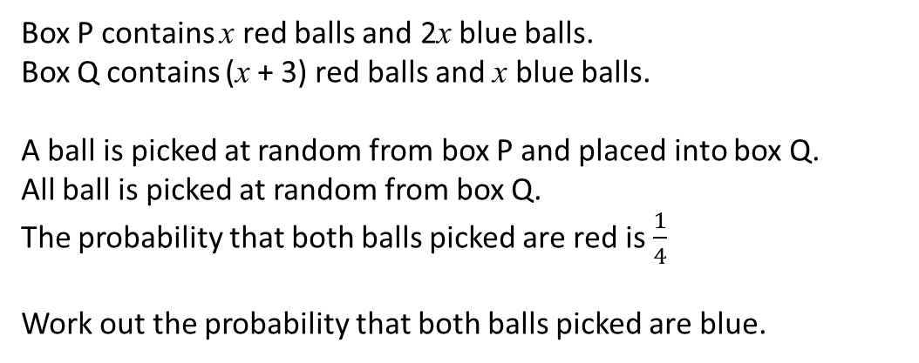
6)
Box P contains x red balls and 2x blue balls.
Box Q contains (x + 3) red balls and x blue balls.
A ball is picked at random from box P and placed into box Q.
All ball is picked at random from box Q.
The probability that both balls picked are red is $\frac{1}{4}$
Work out the probability that both balls picked are blue.

