Slide 1
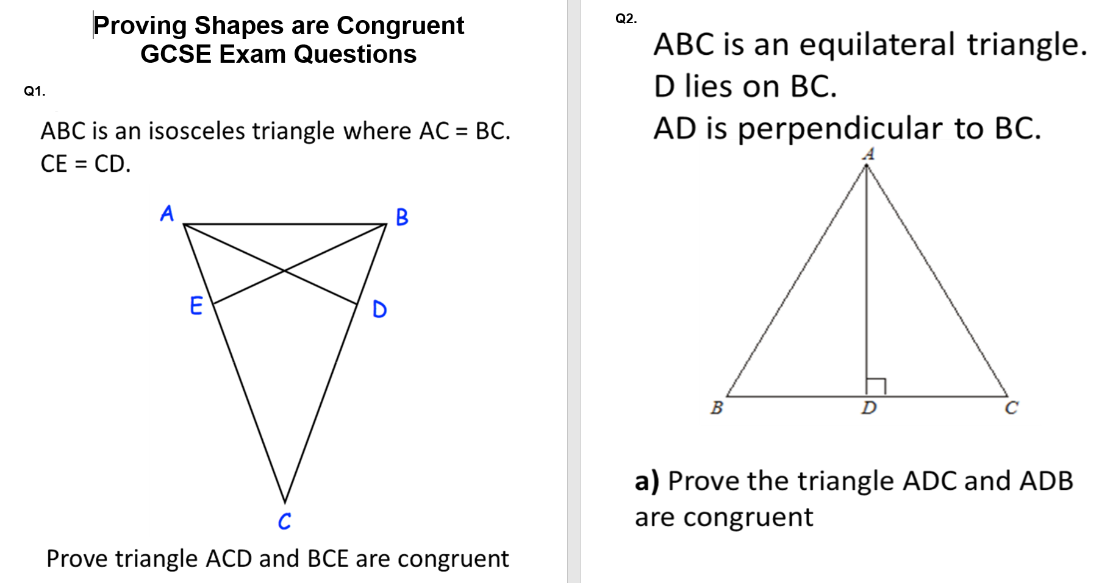

Slide 2
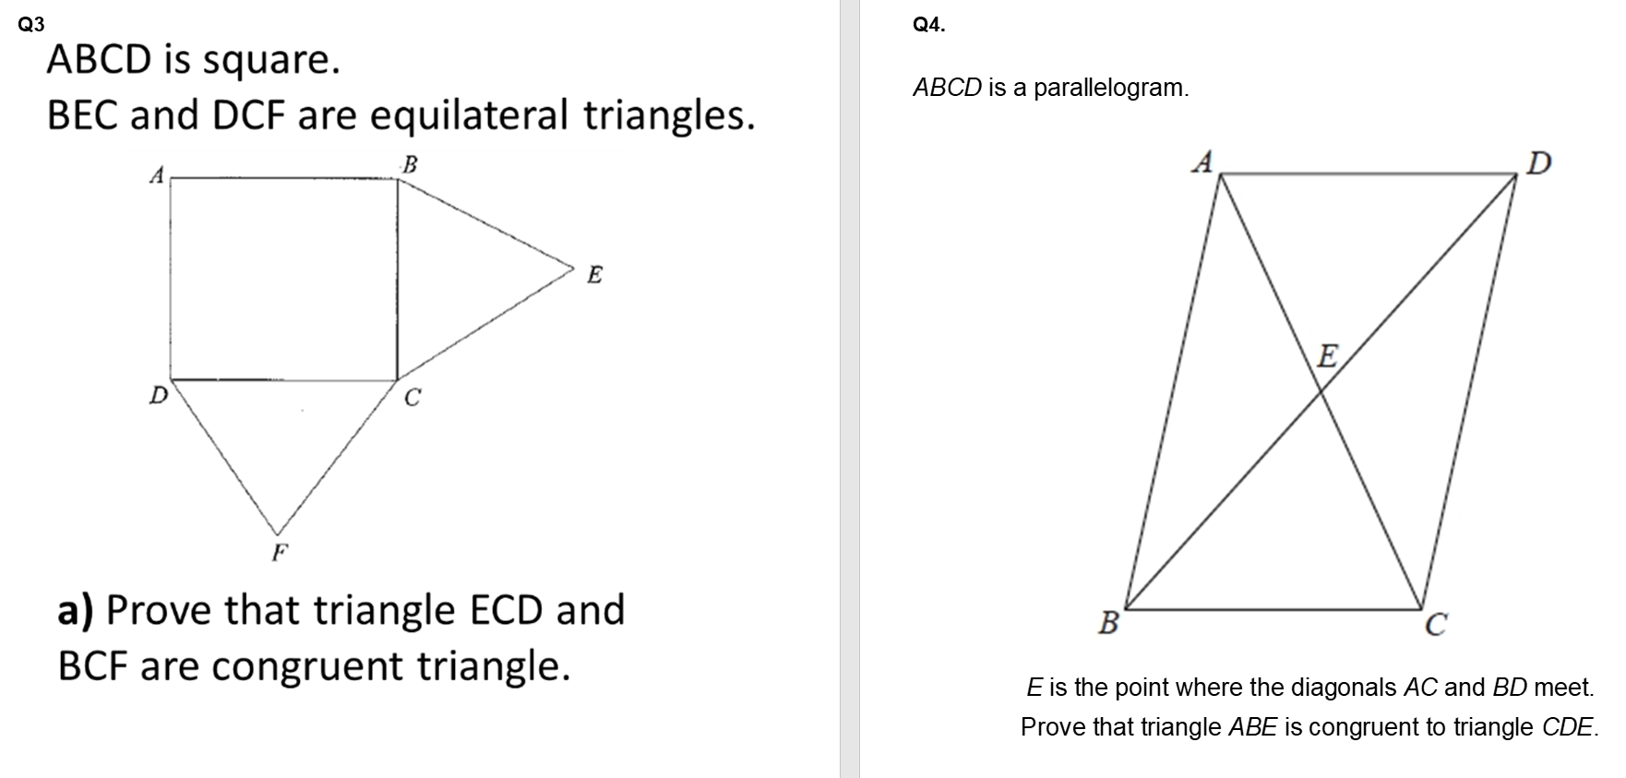

Slide 3
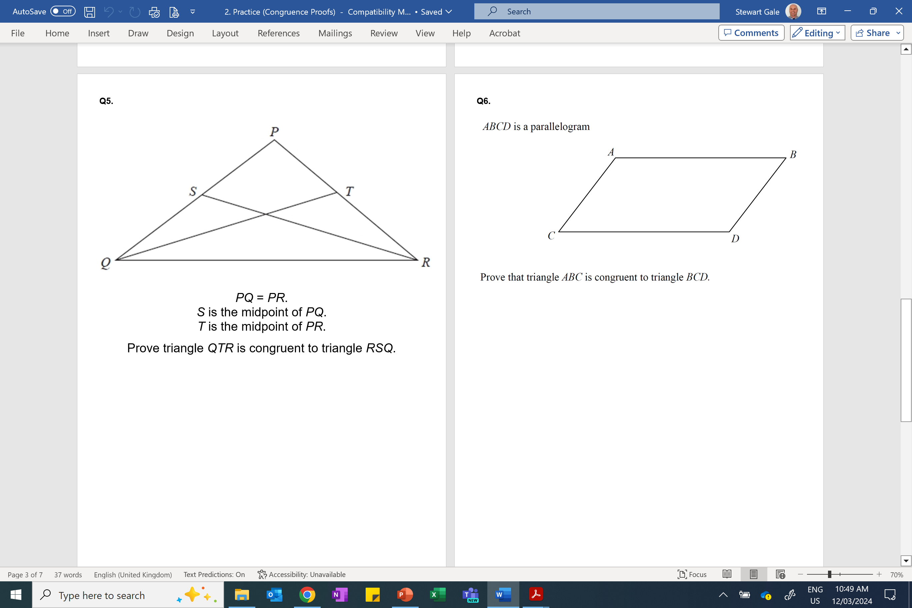

Slide 4
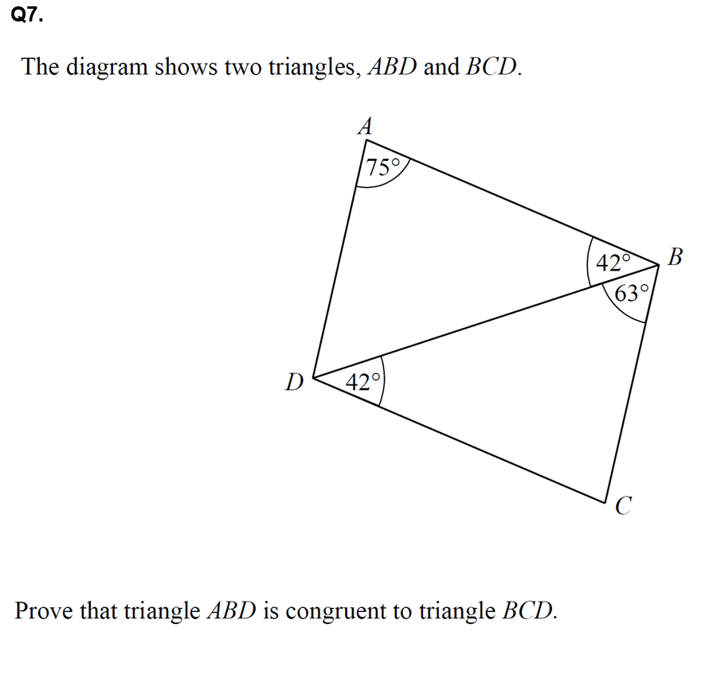

Slide 5
ANSWERS

Slide 6
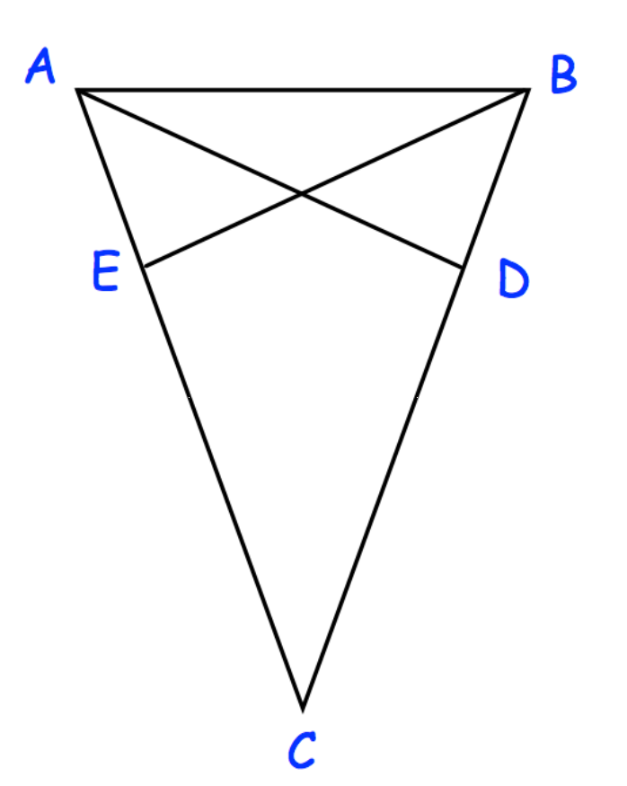
1)
ABC is an isosceles triangle where AC = BC.
CE = CD.
S: AC = BC
sides of an isosceles triangle are equal
A: ACD = BCE
shared angle
S: CE = CD
given in question information
Triangles ACD and BCE
are congruent
because SAS
Prove triangle ACD and BCE are congruent

Slide 7
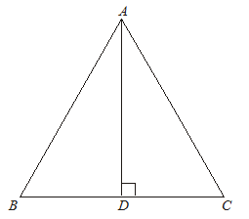
2)
ABC is an equilateral triangle.
D lies on BC.
AD is perpendicular to BC.
R: ADC = ADB
angles are 90˚
H: AB = AC
all sides of equilateral triangle are equal.
S: AD
common sides
Triangles ADC and ADB
are congruent
because RHS
Prove the triangle ADC and ADB are congruent

Slide 8
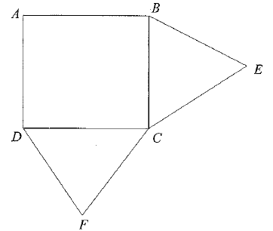
3)
ABCD is square.
BEC and DCF are equilateral triangles.
S: BC = CE
sides of an equilateral triangle are equal
A: BCF = DCE
Both angles are 90˚ + 60˚ = 150˚
S: CF = CD
sides of an equilateral traingel are equal
Triangles BFC and ECD
are congruent
because SAS
Prove that triangle ECD and BCF are congruent triangle.

Slide 9
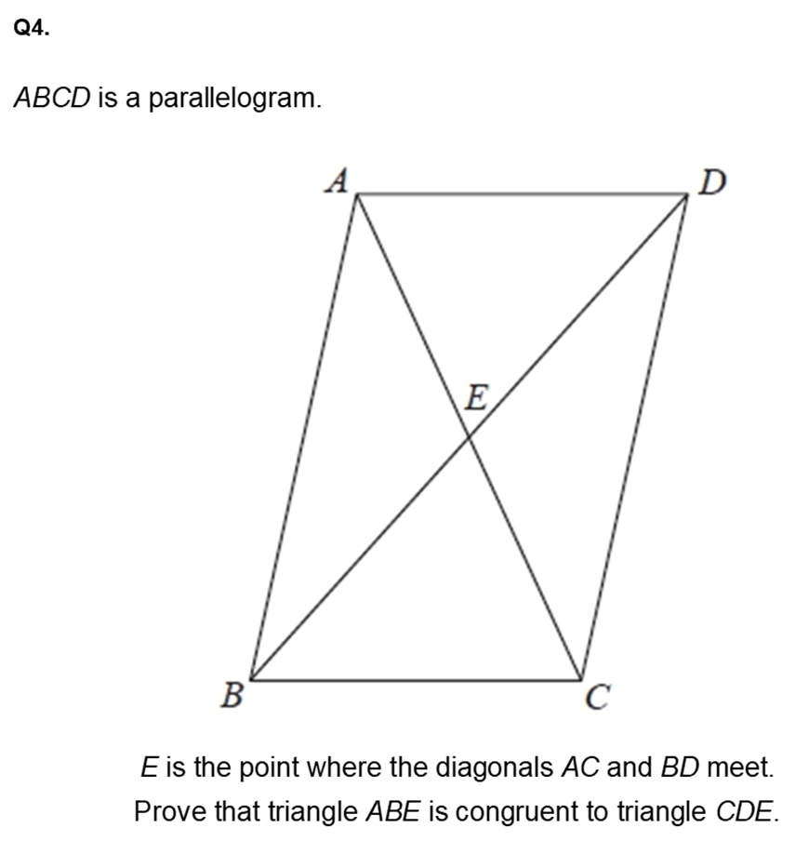
A: BAE = ACD
Alternate angels are equal
A: ABE = EDC
Alternate angles are equal
S: AB = DC
Opposite sides of a parallelogram are equal
Triangles BFC and ECD
are congruent because AAS

Slide 10
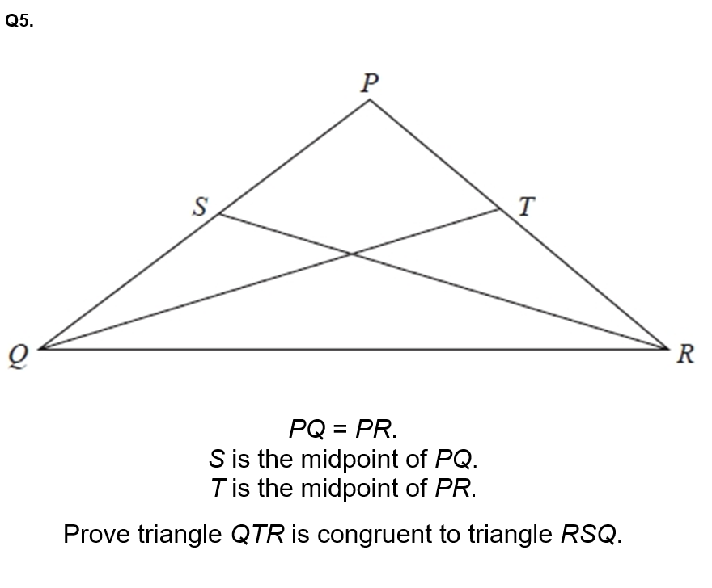
S: QT = RS
Isosceles triangle two sides are equal
Midpoints also equal
A: QTR = RSQ
Isosceles triangle two sides are equal
S: QR = QR
Two angles in an isosceles triangle are equal
Triangles QTR and RSQ
are congruent because SAS

