Slide 1
LO: Trigonometry
(Finding Missing Angles)

Slide 2
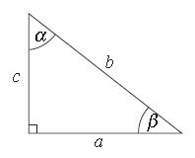
What is
A
B
C
D

Slide 3
What is
A
B
C
D

Slide 4
cos
What is
A
B
C
D

Slide 5
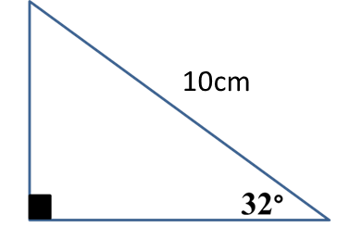
Information needed
- Right Angle
- Two Sides
x
8 cm

Slide 6
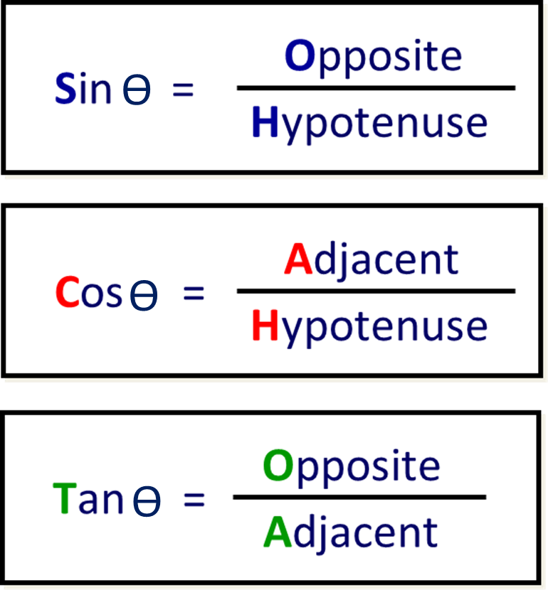
ϴ = angle
SOHCAHTOA

Slide 7
To find the size of an angle
you need to follow 4 steps.
Step 1: Label the sides
Step 2: Choose a rule
Step 3: Substitute in your values
Step 4: Calculate the missing angle

Slide 8
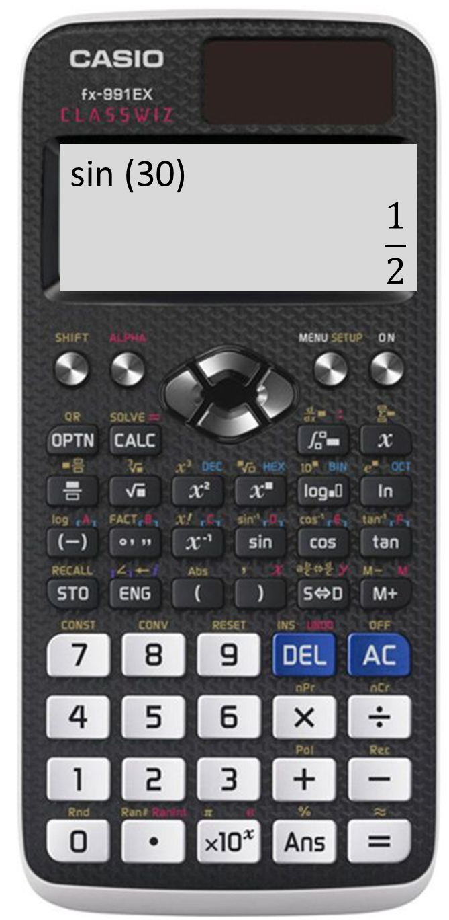
Step 4: Calculate the missing angle

Slide 9
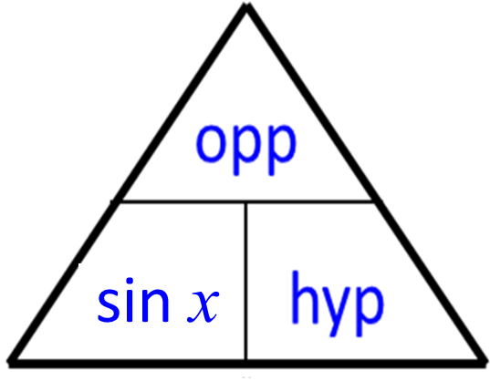
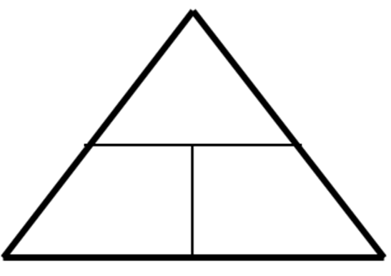
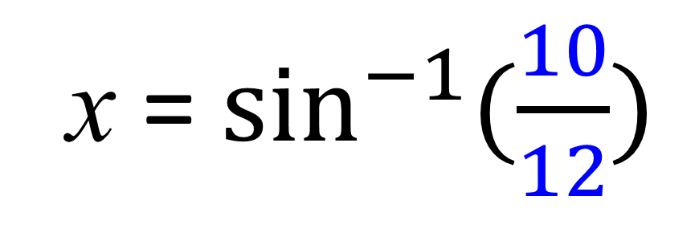
HYP
x
12
10
sin x
12
10
OPP
x = $\sin^{−1}{(\frac{10}{12})}$
x = 56.4˚ to 1 dp

Slide 10
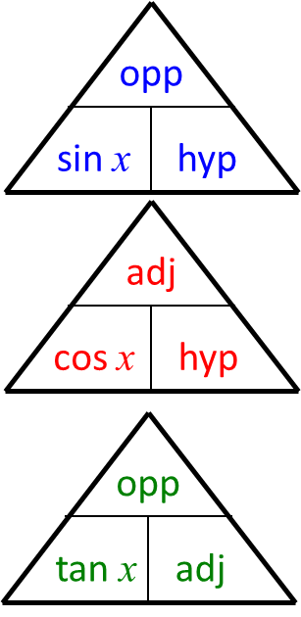
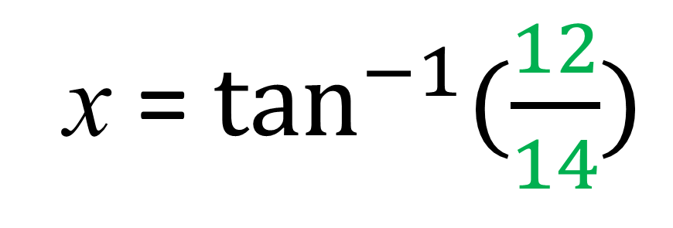
x
ADJ
12
14
tan x
14
12
x = $\tan^{−1}{(\frac{12}{14})}$
OPP
x = 40.6˚ to 1 dp

