Slide 1
FM: Exponential Graphs

Slide 2

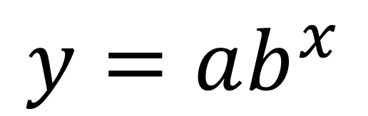
Exponential equation is when
the x variable is a power.
y
$$y=ab^{x}$$
$$a$$
x
The y-intercept is $a$ because $a(b^{0})=a(1)=a$

Slide 3
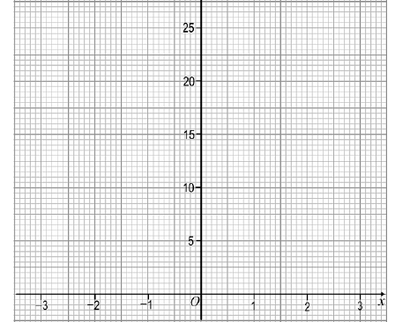
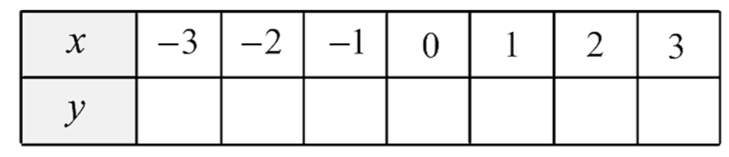
Plotting Exponential Graphs
y = 3^{x}
0.04
0.11
0.33
1
3
9
27

Slide 4
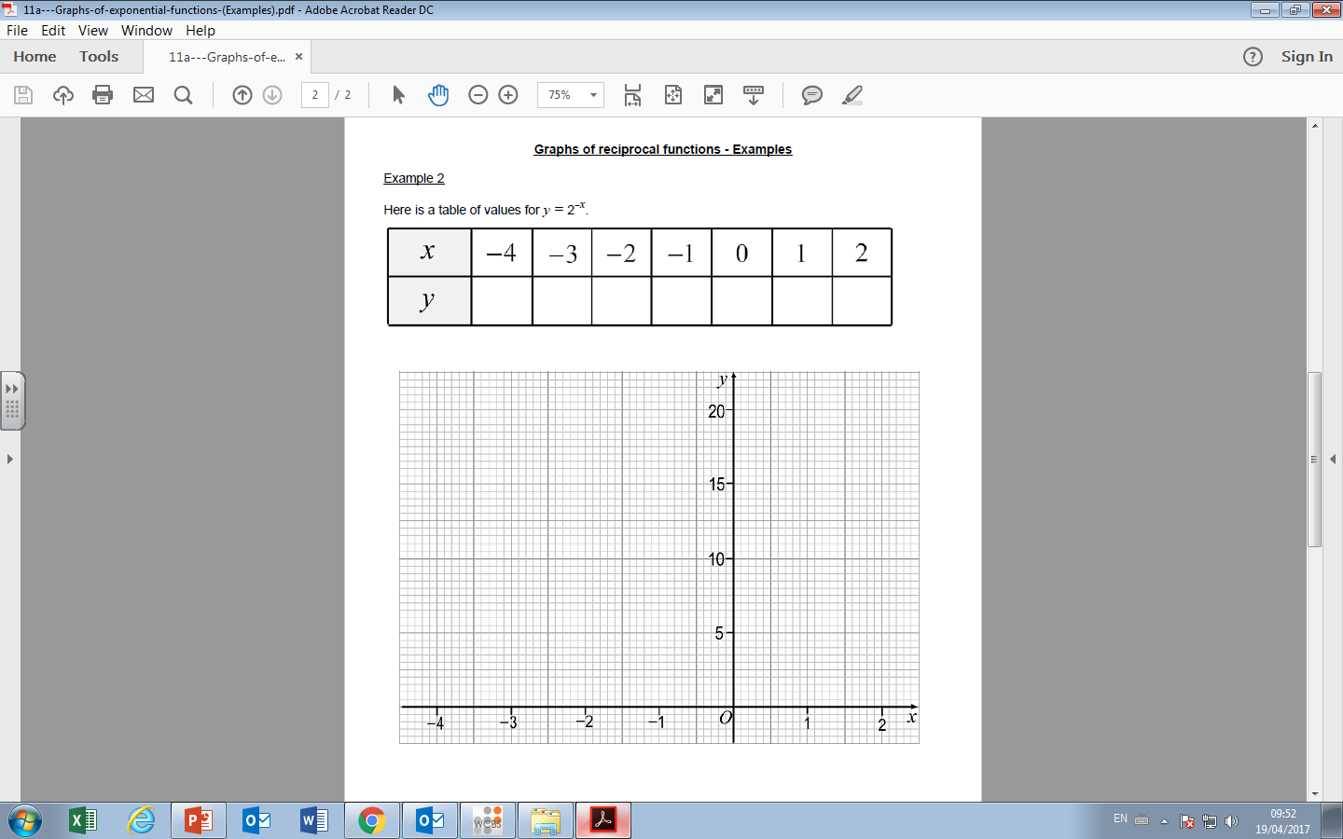
y = 2^{-x}
16
8
4
2
1
0.5
0.25

Slide 5
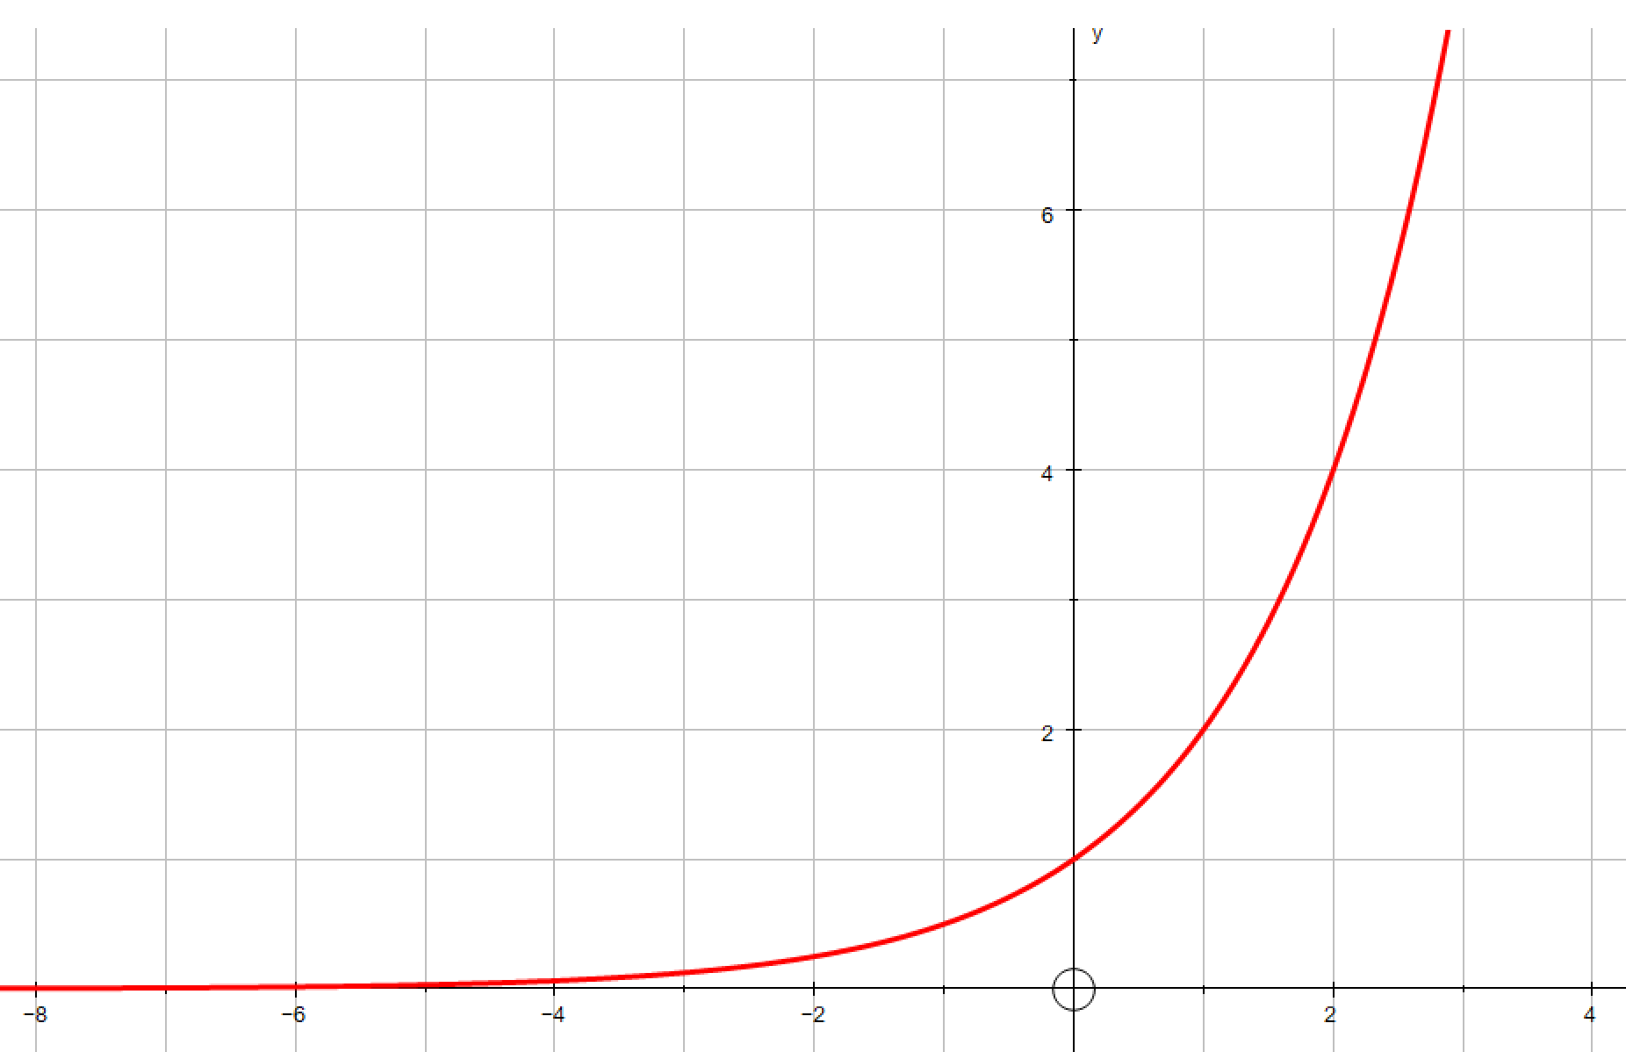

Exponential Graph or Not

Slide 6


Exponential Graph or Not

Slide 7
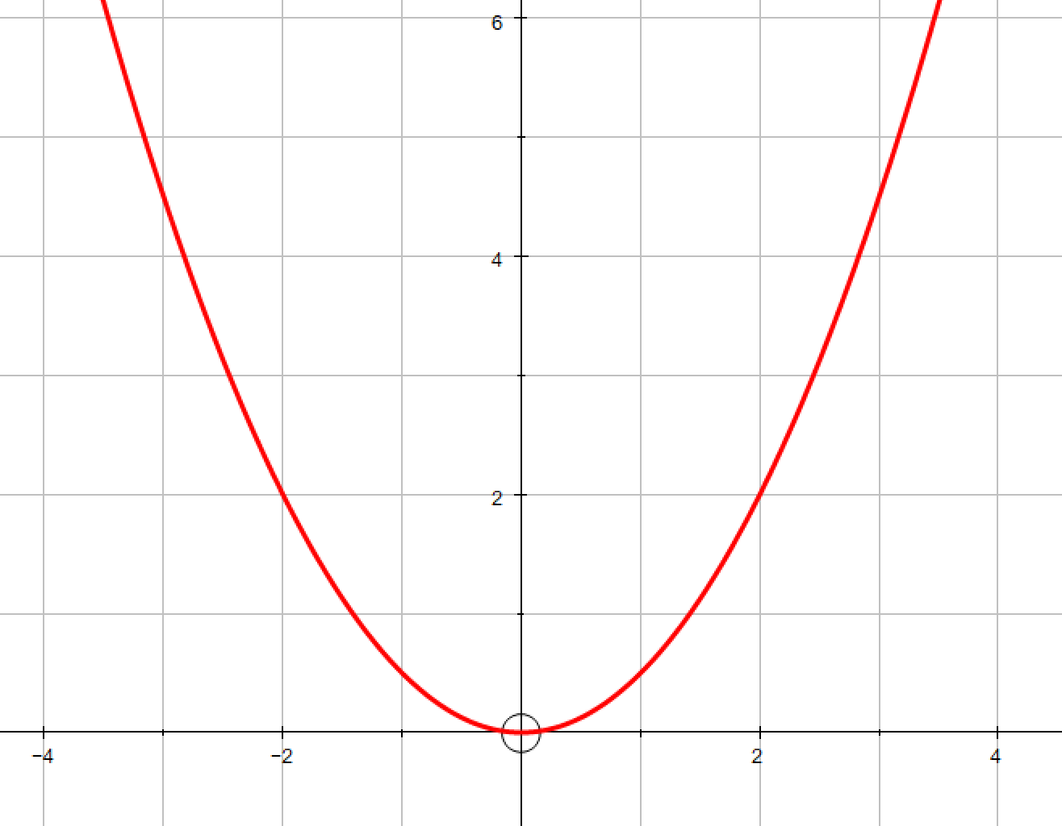
Exponential Graph or Not

Slide 8
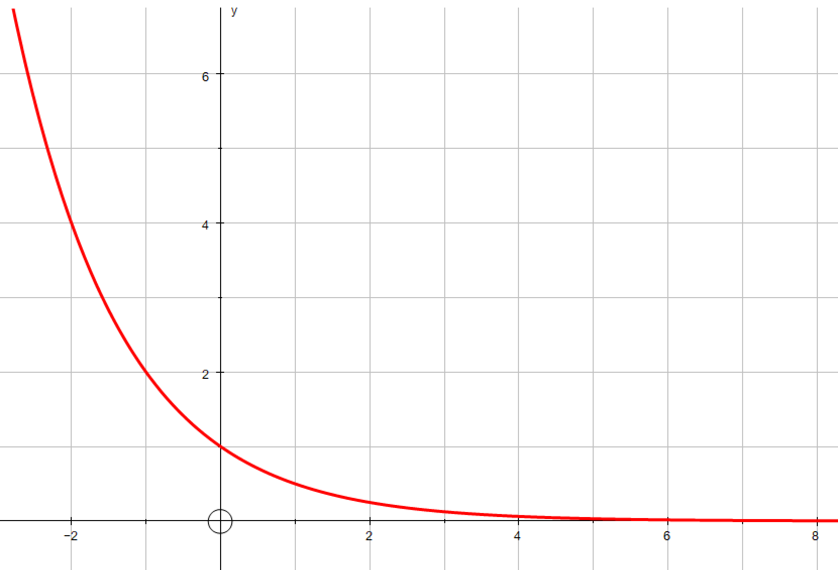
Exponential Graph or Not

Slide 9
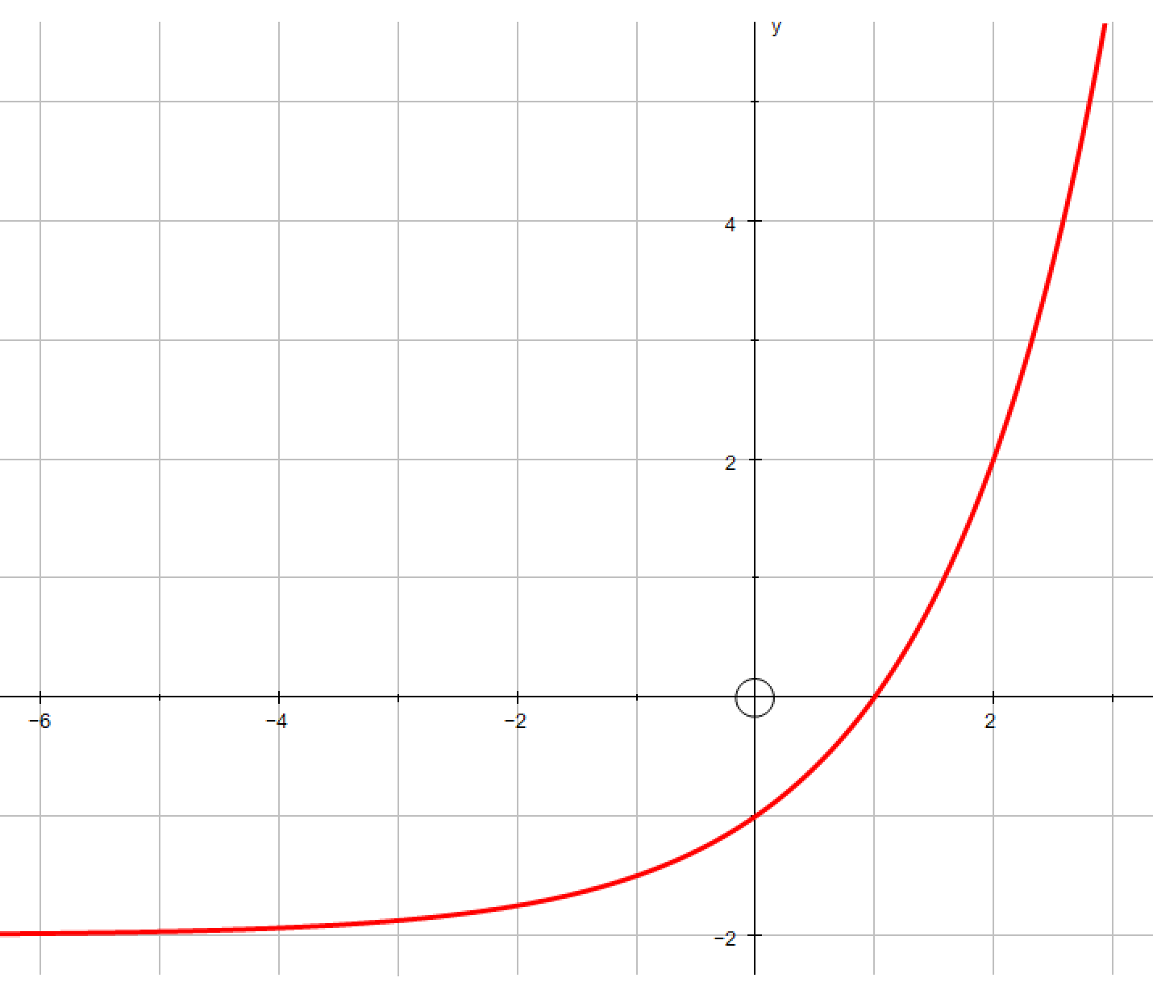
Exponential Graph or Not

Slide 10
Exponential Equation or Not
y = 3^{x}

Slide 11
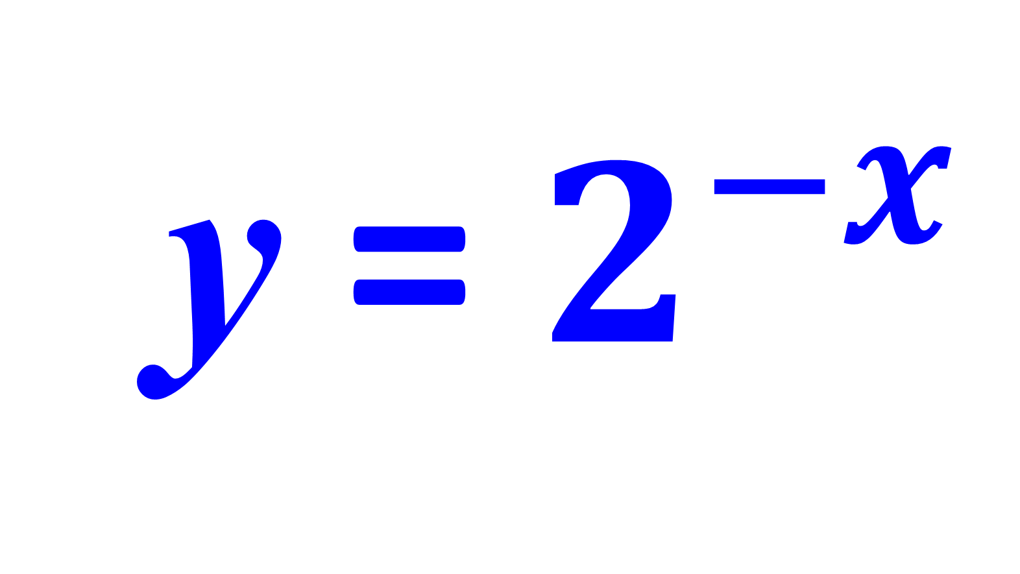
Exponential Equation or Not
y = $2^{−x}$

Slide 12
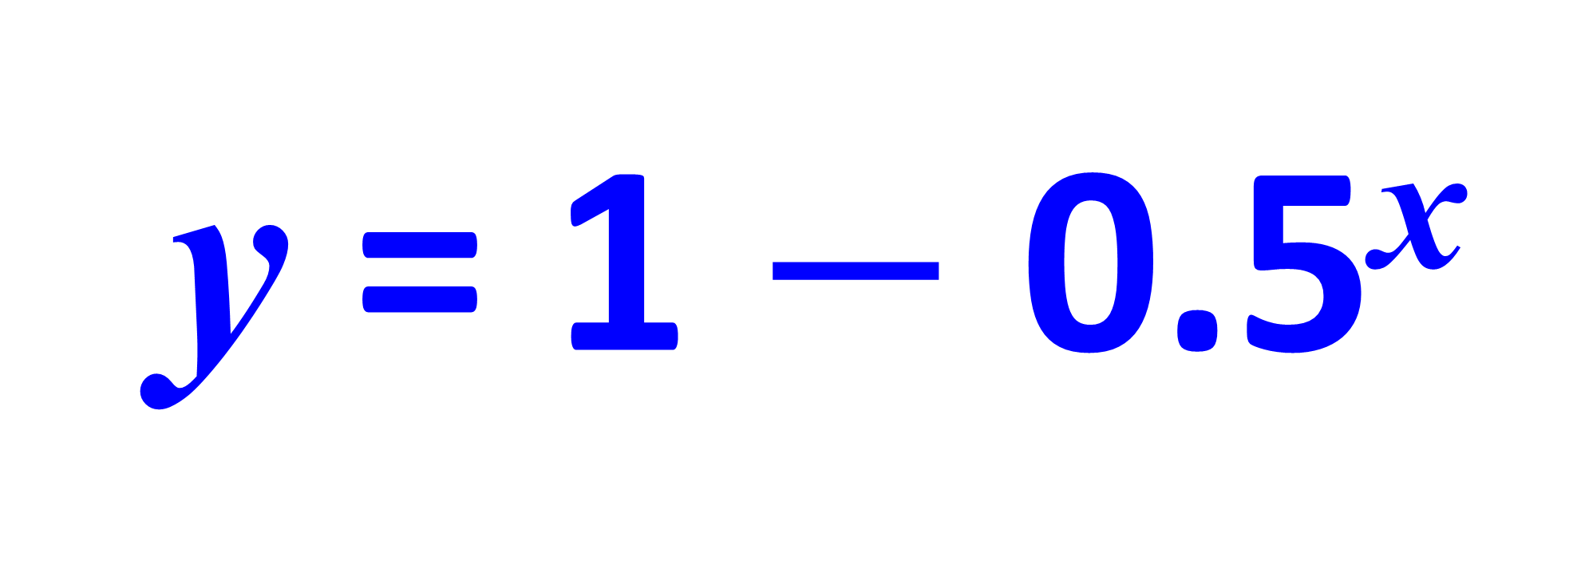
Exponential Equation or Not
y = 1 $−$ 0.5^{x}

Slide 13
Exponential Equation or Not
y = x²

Slide 14
Exponential Equation or Not
y = a^{x}

Slide 15
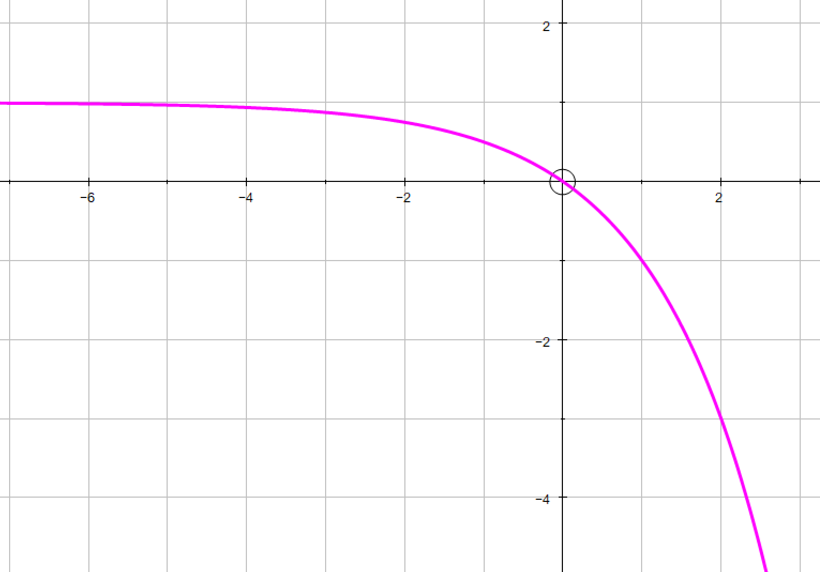
Growth or Decay
Decay

Slide 16
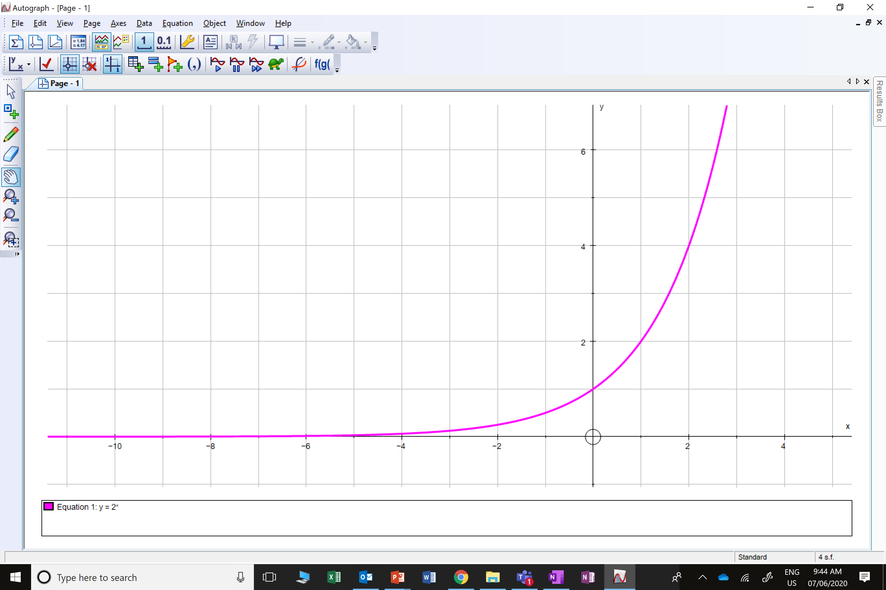
Growth or Decay
Growth

Slide 17
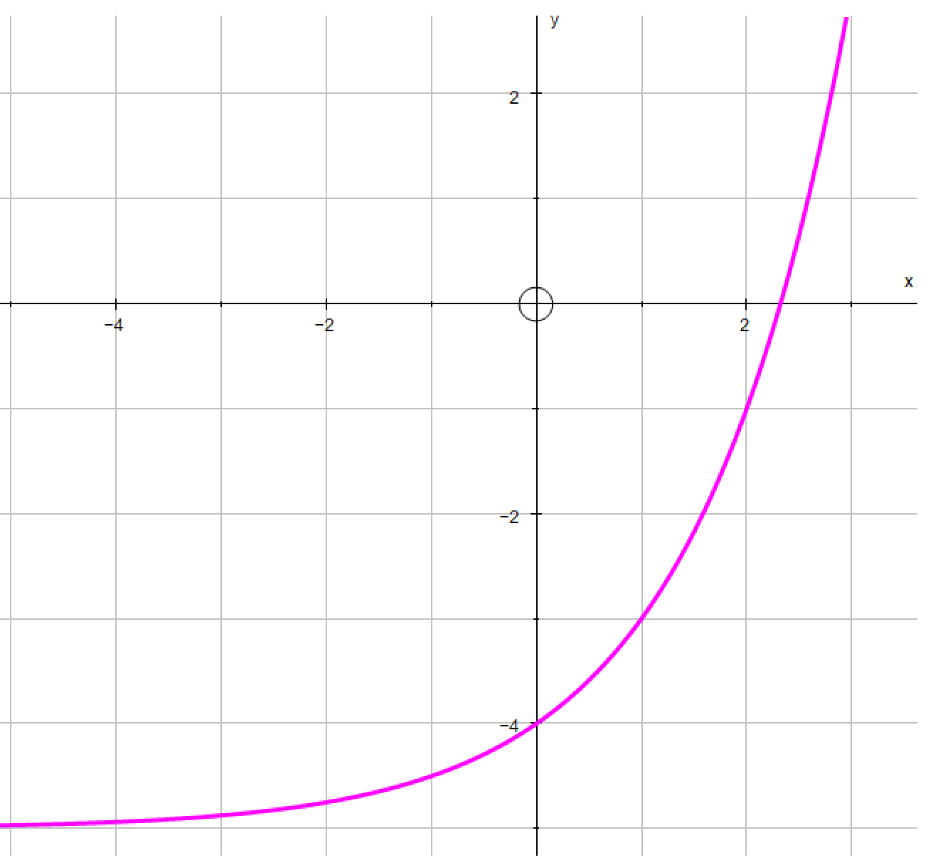
Growth or Decay
Growth

Slide 18
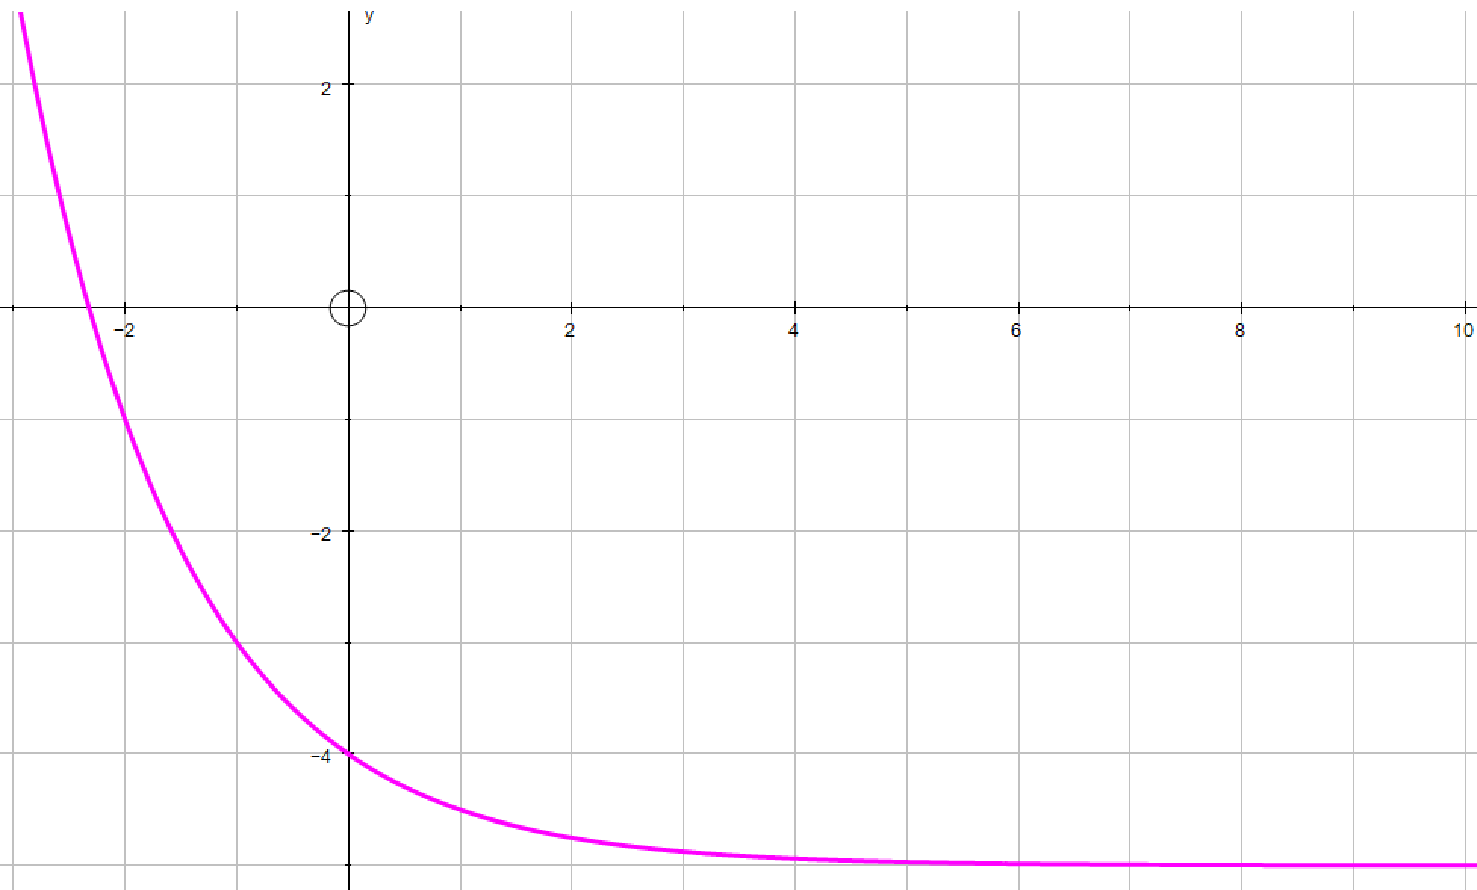
Growth or Decay
Decay

Slide 19

Can you think of possible situations that might produce a exponential growth and decay graph?

Slide 20
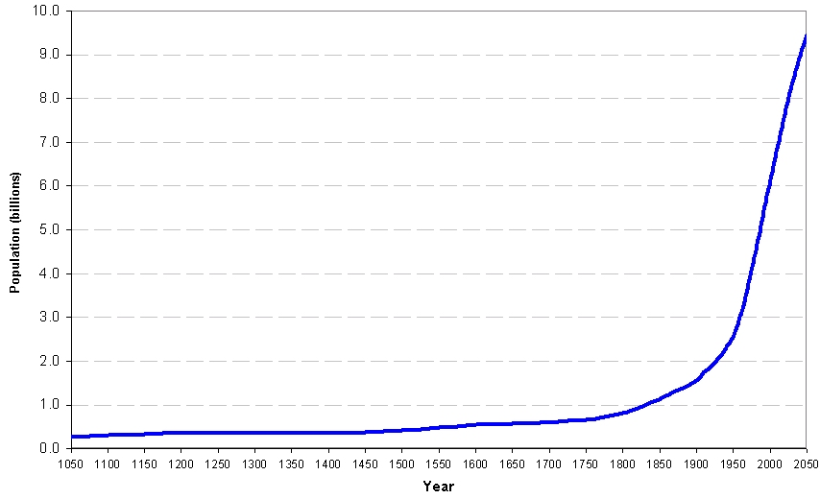
World Population Growth Rate

Slide 21
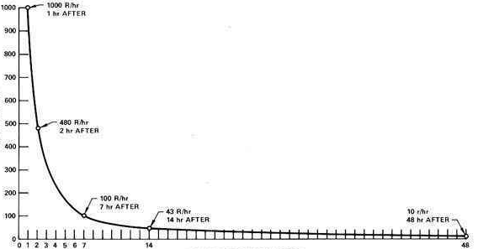
Decay of Radiation From Explosion of Chernobyl
Dose Rate (R/hr)
Hours After The Explosion

Slide 22
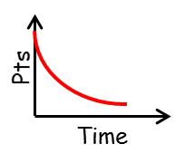
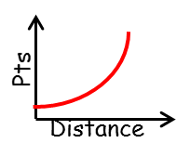
The heptathlon is an Olympic competition consisting of 7 events:
100m Hurdles, 200m, 800m, Javelin, Shot Put, Long Jump, High Jump
The points system for the heptathlon is based on the following two graphs.
Why do you think they use two different graphs?

Slide 23
An exponential equation is
where the x value is an exponential.
y = a^{-x}
y = a^{x}
Decay
Growth

