Slide 1
Elastic Collisions in 1D
Successive Collisions
Chapter 4
(Part 5 of 5)

Slide 2
Successive Direct Impacts
There are no new concepts
introduced in this section.
However, the problems become
significantly more complex because
there may be two or more
successive collisions.

Slide 3
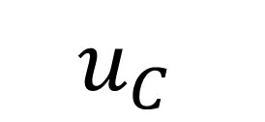
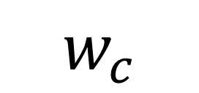
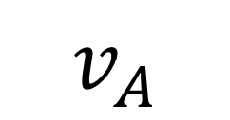
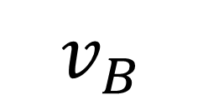
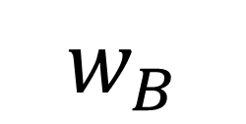
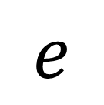
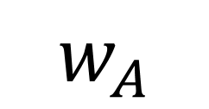
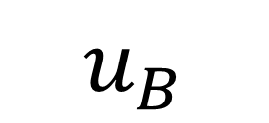
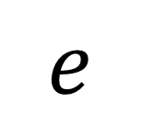
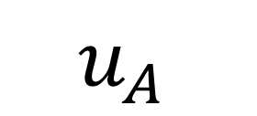
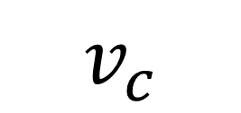
It’s good to develop a consistent system
for naming velocities.
$$u_{A }$$
$$u_{B}$$
$$u_{C }$$
m
$$e$$
2m
$$e$$
3m
$$v_{A}$$
$$v_{B}$$
$$v_{c}$$
$$w_{A}$$
$$w_{B}$$
$$w_{c}$$

Slide 4
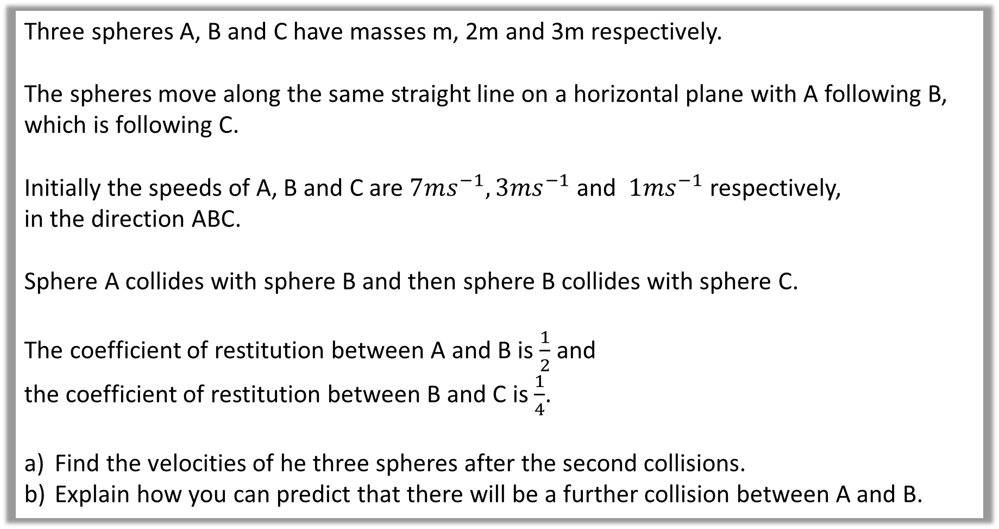
Question A
Three spheres A, B and C have masses m, 2m and 3m respectively.
The spheres move along the same straight line on a horizontal plane with A following B, which is following C.
Initially the speeds of A, B and C are $7ms^{−1}, 3ms^{−1}$ and $1ms^{−1}$ respectively,
in the direction ABC.
Sphere A collides with sphere B and then sphere B collides with sphere C.
The coefficient of restitution between A and B is $\frac{1}{2}$ and
the coefficient of restitution between B and C is $\frac{1}{4}$.
Find the velocities of he three spheres after the second collisions.
Explain how you can predict that there will be a further collision between A and B.

Slide 5
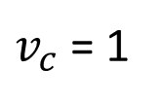
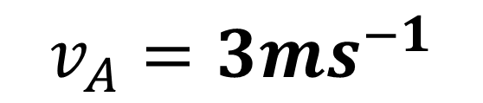
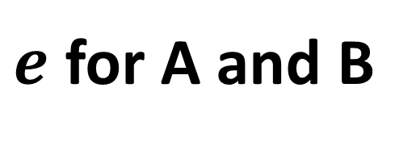
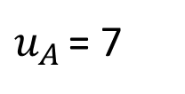
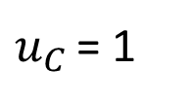
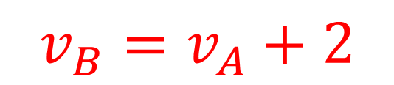
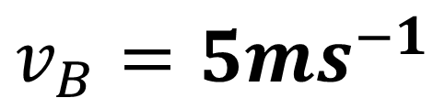

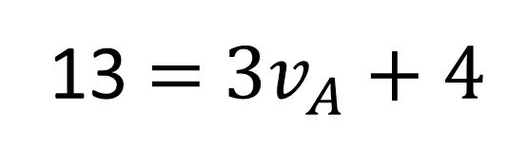

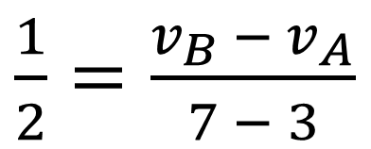
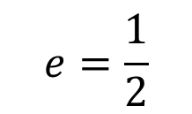
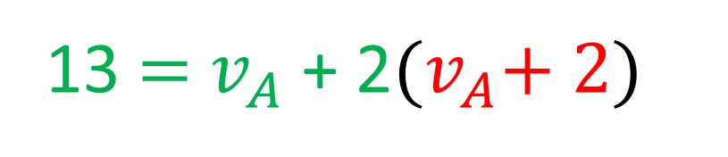
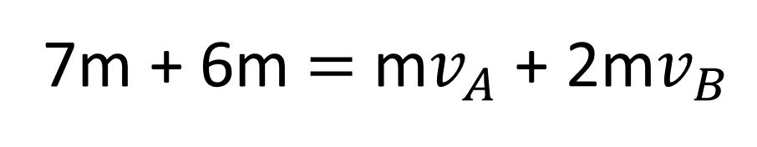
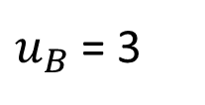
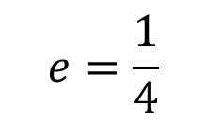
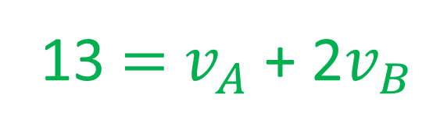
$u_{A }$= 7
$u_{B}$= 3
$u_{C }$= 1
CoM for A and B:
$$e=\frac{1}{2}$$
$$e=\frac{1}{4}$$
m
2m
3m
7m + 6m $=$ m$v_{A}$+ 2m$v_{B}$
$$v_{A}$$
$$v_{B}$$
$v_{c}$= 1
13 $=$ $v_{A}$+ 2$v_{B}$
Sub
a.
$e$ for A and B
13 $=$ $v_{A}$+ 2${(v}_{A}+ 2)$
$\frac{1}{2}=\frac{v_{B }− v_{A}}{7 − 3}$
13 $=$ ${3v}_{A}+4$
$$v_{A}=3ms^{−1}$$
$$v_{B}=v_{A}+2$$
$$v_{B}=5ms^{−1}$$

Slide 6

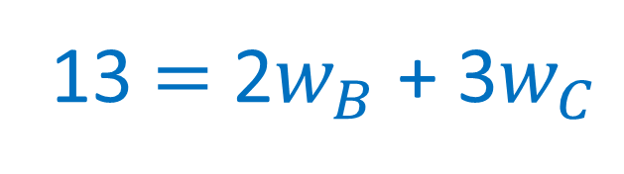
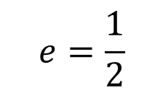

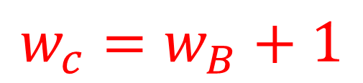

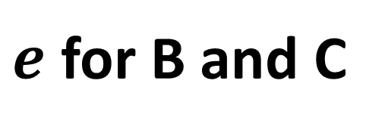
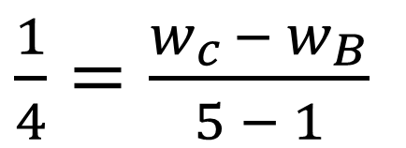
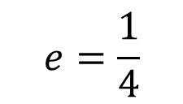
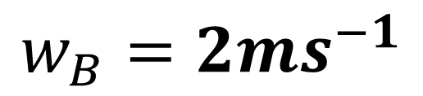
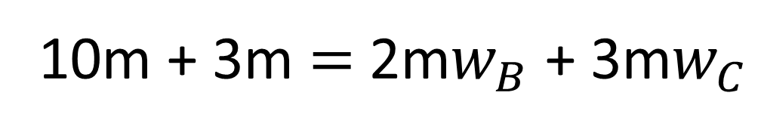

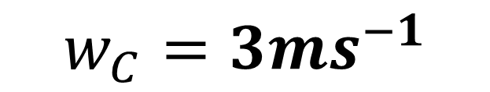
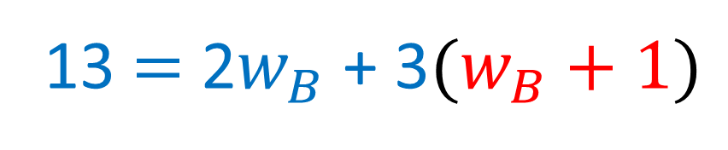
CoM for B and C:
$$e=\frac{1}{2}$$
$$e=\frac{1}{4}$$
m
2m
3m
10m + 3m $=$ 2m$w_{B}$ + 3m$w_{C}$
$$3$$
$$5$$
1
13 $=$ 2$w_{B}$ + 3$w_{C}$
$$w_{B}$$
$$w_{c}$$
a.
$e$ for B and C
13 $=$ 2$w_{B}$ + 3${(w}_{B} + 1)$
$\frac{1}{4}=\frac{w_{c }− w_{B}}{5 − 1}$
$$w_{B}=2ms^{−1}$$
$$w_{c}=w_{B}+1$$
$$w_{C}=3ms^{−1}$$

Slide 7
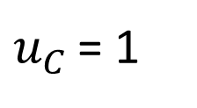




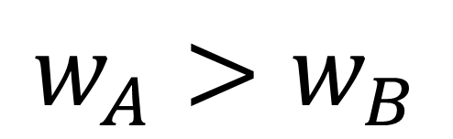
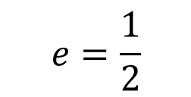

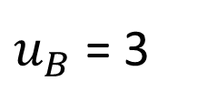
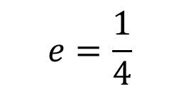
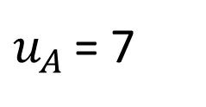
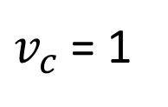
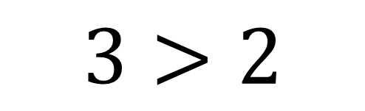
$u_{A }$= 7
$u_{B}$= 3
$u_{C }$= 1
$$e=\frac{1}{2}$$
$$e=\frac{1}{4}$$
m
2m
3m
$$v_{A}=3$$
$$v_{B}=5$$
$v_{c}$= 1
$$w_{A}=3$$
$$w_{B}=2$$
$$w_{c}=2$$
b.
Explain how you can predict that there will be a further collision between A and B.
$$w_{A}>w_{B}$$
$$3>2$$

Slide 8
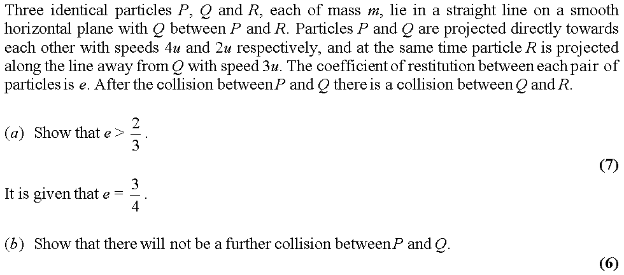
Question B

Slide 9






















$$u_{p}=4u$$
$$u_{q}=−2u$$
$$u_{r}=3u$$
CoM for $p$ and $q$
$$P$$
m
$$e$$
$$Q$$
m
$$e$$
$$R$$
$$4um−2mu=mv_{p}+mv_{q}$$
m
$$v_{p}$$
$$v_{q}$$
$$v_{r}=3u$$
$$2u=v_{p}+v_{q}$$
$$2u={\left(v_{q}−6eu\right)+ v}_{q}$$
a.
$e$ for $p$ and $q$
$$v_{q}=u+3eu$$
$e=\frac{v_{q }− v_{p}}{4u − (−2u)}$
For Q and R to collide $v_{q}>3u$
$$6eu=v_{q}−v_{p}$$
$$u+3eu>3u$$
$$e>\frac{2}{3}$$

Slide 10
















$$u_{p}=4u$$
$$u_{q}=−2u$$
$$u_{r}=3u$$
$$v_{q}=u+3eu$$
b.
$$P$$
m
$$Q$$
m
$$e=\frac{3}{4}$$
$$R$$
$$e=\frac{3}{4}$$
m
$$v_{q}=u+3(\frac{3}{4})u$$
$$v_{p}$$
$$v_{q}$$
$$v_{r}=3u$$
$$v_{q}=\frac{13}{4}u$$
$$2u=v_{p}+v_{q}$$
$$v_{p}=−\frac{5}{4}u$$

Slide 11


















CoM for $q$ and $r$
$$P$$
m
$$Q$$
m
$$e=\frac{3}{4}$$
$$R$$
$$e=\frac{3}{4}$$
m
$$\frac{13}{4}um+3um=mw_{q}+mw_{r}$$
$v_{p}$ $=−\frac{5}{4}u$
$v_{q}$ $=\frac{13}{4}u$
$$v_{r}=3u$$
$$\frac{25}{4}u=w_{q}+w_{r}$$
$$w_{q}$$
$$w_{r}$$
$e$ for $q$ and $r$
b.
$$\frac{25}{4}u=w_{q}+\frac{3u}{16}+w_{q}$$
$\frac{3}{4}=\frac{w_{r }− w_{q}}{\frac{13}{4}u − 3u}$
$$w_{q}=\frac{97u}{32}$$
$$\frac{3u}{16}=w_{r}−w_{q}$$
P and Q are going in opposite directions
so, no further collisions.

