Slide 1

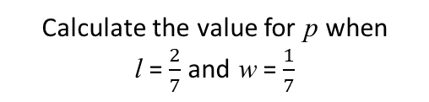



$$p=2l+2w$$
$$p=2(l+w)$$
Make l the subject of the formula.
Make w the subject of the formula.
$$p=2l+2w$$
$$p=2l+2w$$
Calculate the value for p when
l = $\frac{2}{7}$ and w = $\frac{1}{7}$
Calculate the value for p when
w = 0.4 and l = 0.1

Slide 2

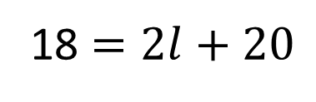

18 $=2l+20$
$$2l+2w$$
Solve the equation.
Evaluate the value of the expression when l = -3 and w = 5
Write a formula for the
perimeter (p) and area (a) of the rectangle.
$$p=2l+2w$$
The above formula is for calculating
the perimeter of a rectangle.
Calculate area of the rectangle
when l = 3 and p = 8
w
2w

Slide 3
ANSWERS

Slide 4
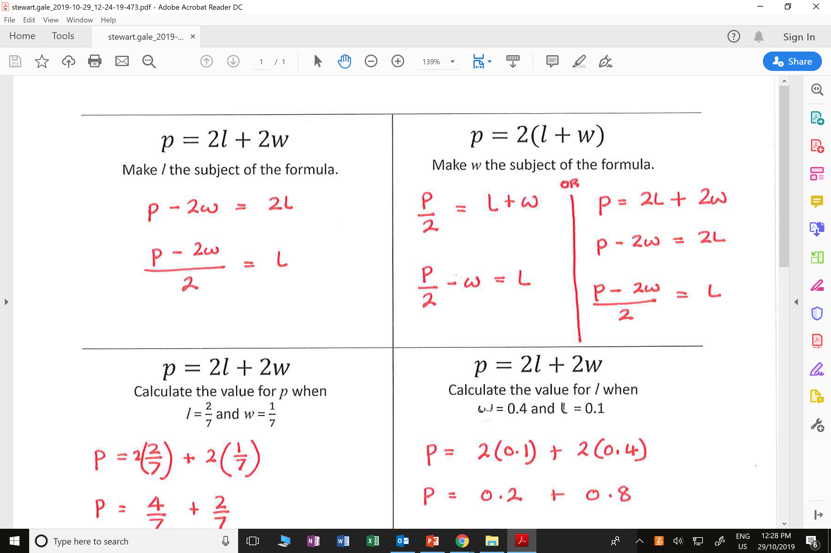
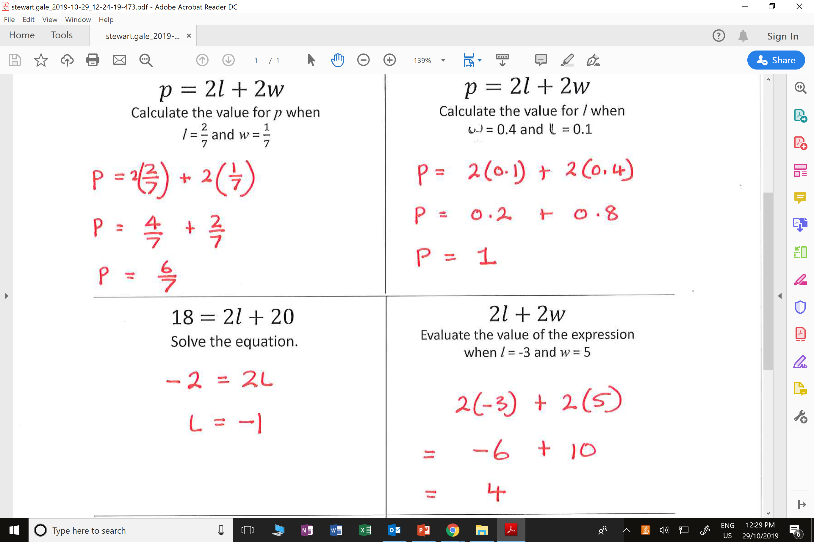
$$p=2l+2w$$
$$p=2(l+w)$$
Make l the subject of the formula.
Make w the subject of the formula.
$$p=2l+2w$$
$$p=2l+2w$$
Calculate the value for p when
l = $\frac{2}{7}$ and w = $\frac{1}{7}$
Calculate the value for l when
w = 0.4 and l = 0.1

Slide 5
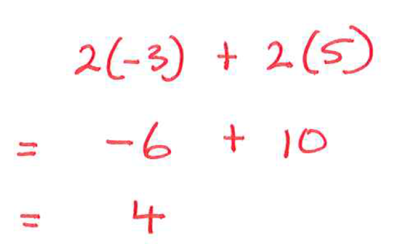
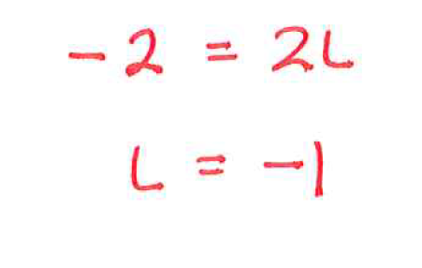
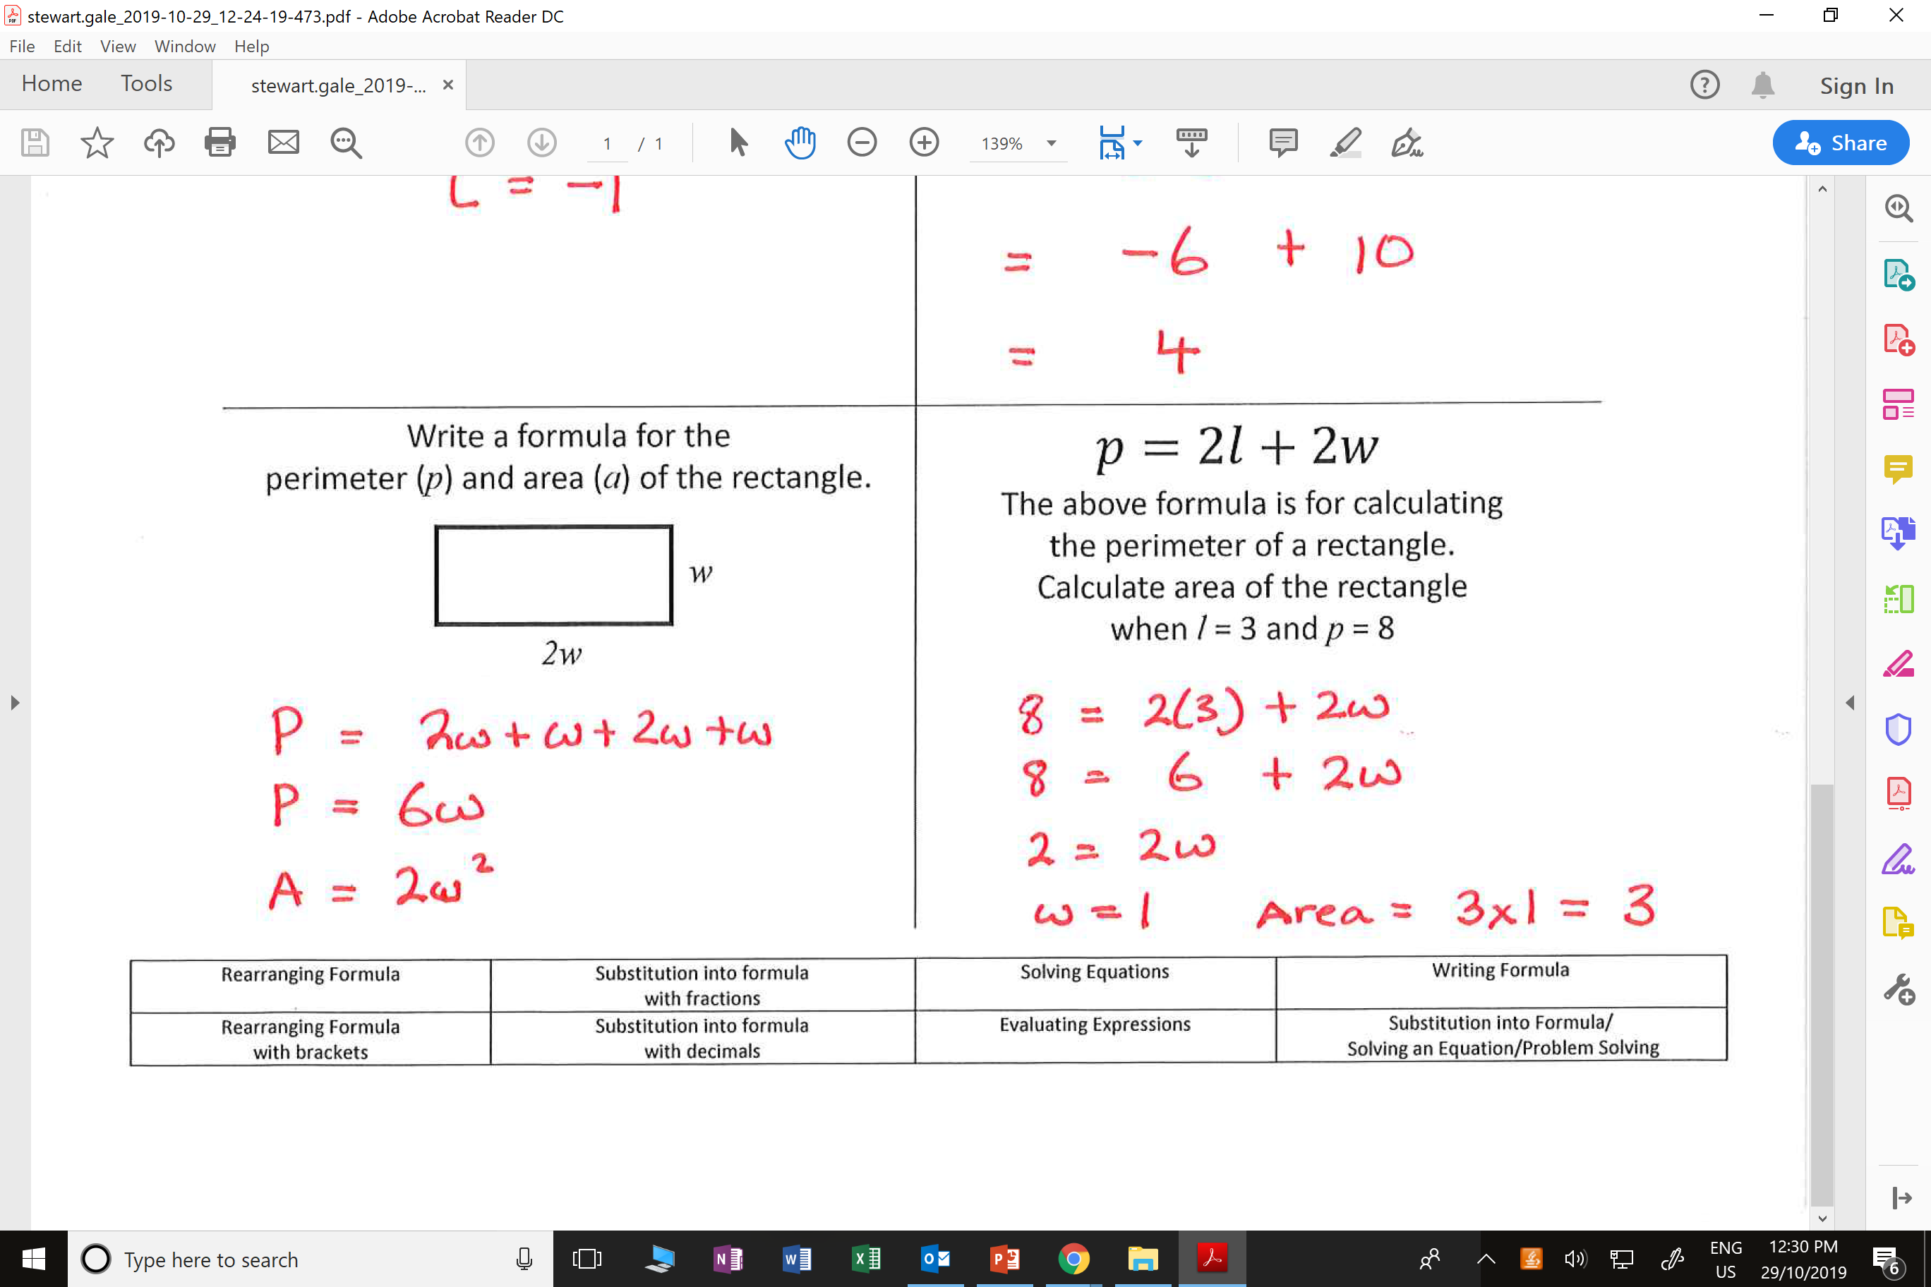
18 $=2l+20$
$$2l+2w$$
Solve the equation.
Evaluate the value of the expression when l = -3 and w = 5
Write a formula for the
perimeter (p) and area (a) of the rectangle.
$$p=2l+2w$$
The above formula is for calculating
the perimeter of a rectangle.
Calculate area of the rectangle
when l = 3 and p = 8
w
2w

