Slide 1
LO: Frequency
Polygons

Slide 2
Give examples of
Discrete Data.
Only uses certain numbers.

Slide 3
Give examples of
Continuous Data.
All numbers are possible.

Slide 4
Times in seconds
Frequency
In which group would you place the
following number?
85 ≤ t < 90
90 ≤ t < 95
95 ≤ t < 100
95
100 ≤ t < 105
105 ≤ t < 110

Slide 5
Times in seconds
In which group would you place the
following number?
Frequency
85 < t ≤ 90
90 < t ≤ 95
95
95 < t ≤ 100
100 < t ≤ 105
105 < t ≤ 110

Slide 6
Times in seconds
In which group would you place the
following number?
Frequency
85 ≤ t < 90
90 ≤ t < 95
100
95 ≤ t < 100
100 ≤ t < 105
105 ≤ t < 110

Slide 7
Times in seconds
In which group would you place the
following number?
Frequency
85 ≤ t < 90
90 ≤ t < 95
105
95 ≤ t < 100
100 ≤ t < 105
105 ≤ t < 110

Slide 8
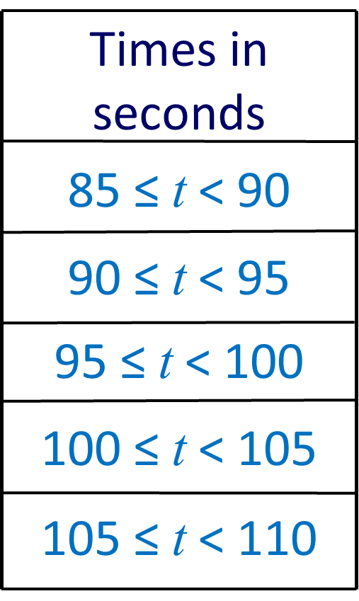
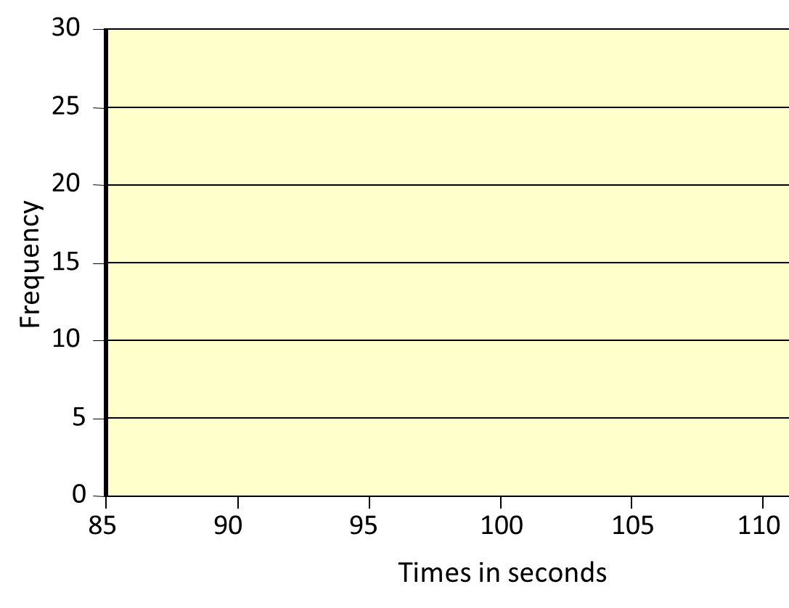
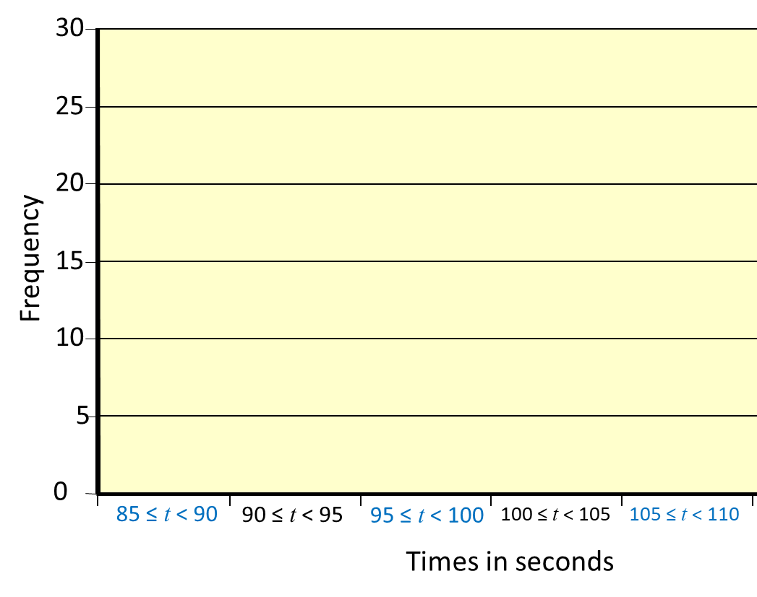


Which scale is correct
for this table?

Slide 9
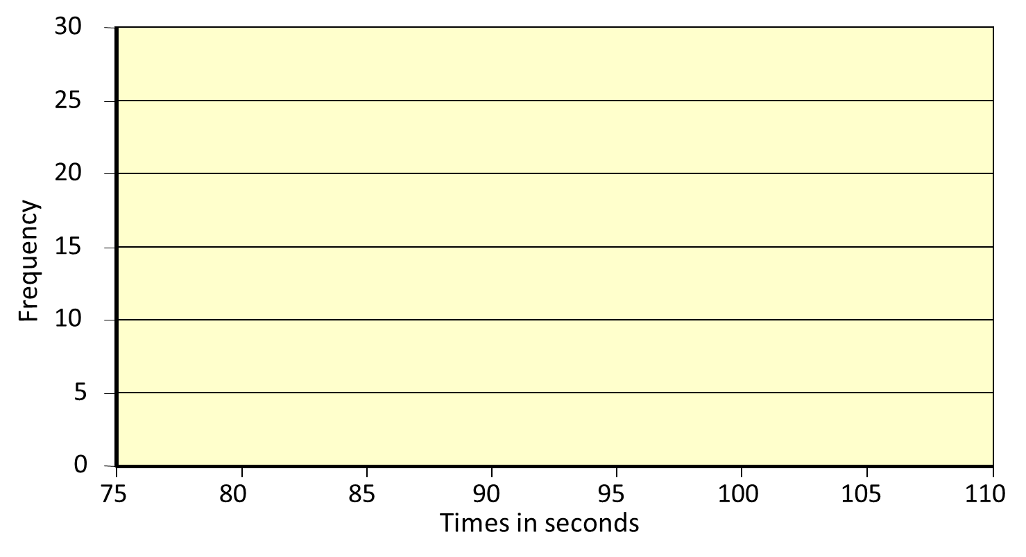
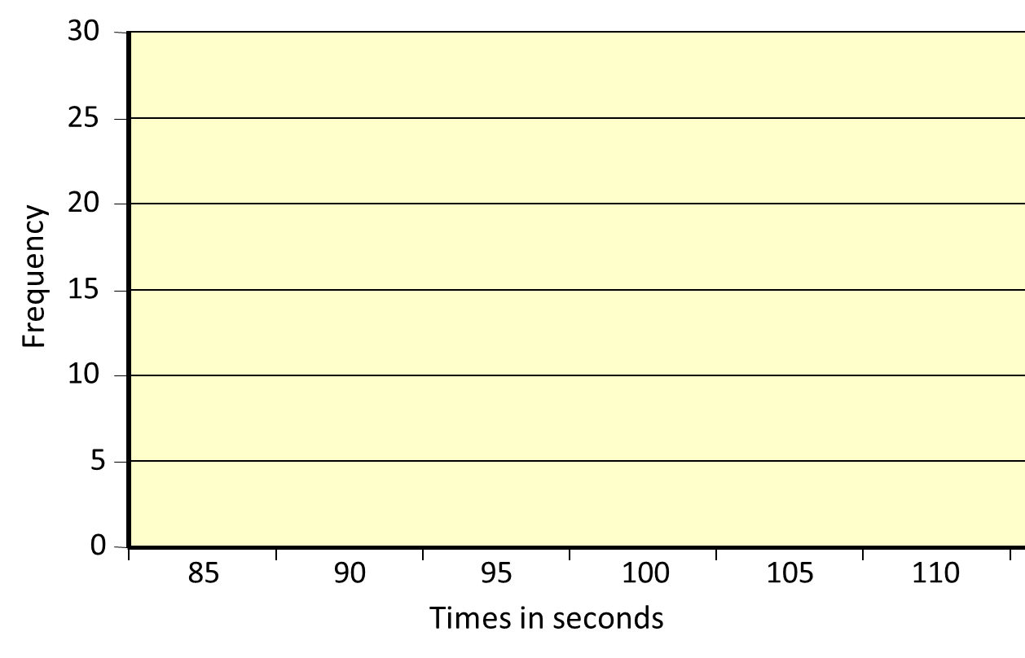
Which scale is correct
for this table?

Slide 10
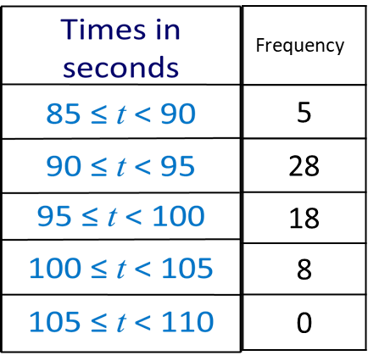
A frequency polygon is like a bar chart but
the midpoints of each bar and joined together.
30
25
20
Frequency
15
10
5
0
75
80
85
90
95
100
105
110
Times in seconds

Slide 11
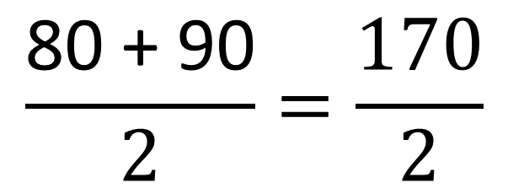
What is the mid-point of
the class interval?
Time in Seconds | Mid Point
80 ≤ t < 90
85
$$\frac{\text{80 + 90}}{2}=\frac{\text{170}}{2}$$

Slide 12
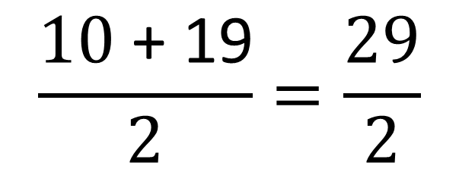
What is the mid-point of
the class interval?
Time in Seconds | Mid Point
10 ≤ t < 19
14.5
$$\frac{\text{10}\text{ + }\text{1}\text{9}}{2}=\frac{\text{29}}{2}$$

Slide 13
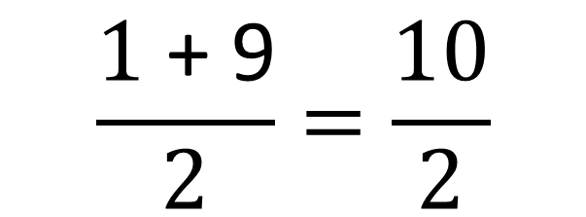
What is the mid-point of
the class interval?
Time in Seconds | Mid Point
1 ≤ t < 9
5
$$\frac{\text{1}\text{ + 9}}{2}=\frac{\text{10}}{2}$$

Slide 14
What are the co-ordinates of the points needed for the frequency polygon?
Time in Seconds | Frequency
80 ≤ t < 90 | 2
90 ≤ t < 100 | 5
100 ≤ t < 110 | 5
110 ≤ t < 120 | 3
(85, 2)
(95, 5)
(105, 5)
(115, 3)

Slide 15
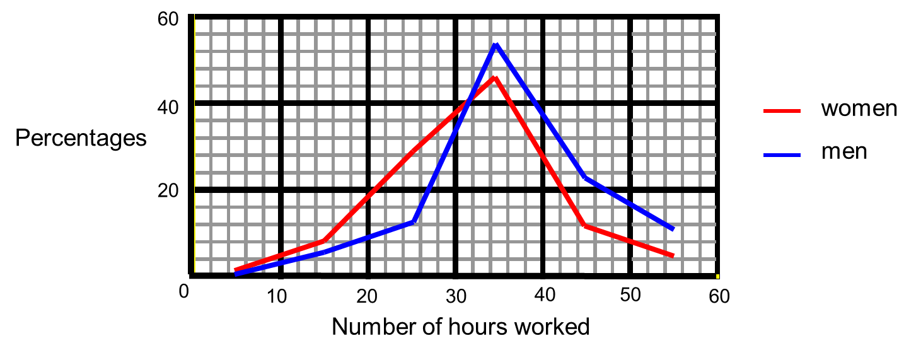
Comparing Frequency Polygons
Make a comparison between the two sets of data.

