Slide 1
FM: Expanding
and Factorising

Slide 2
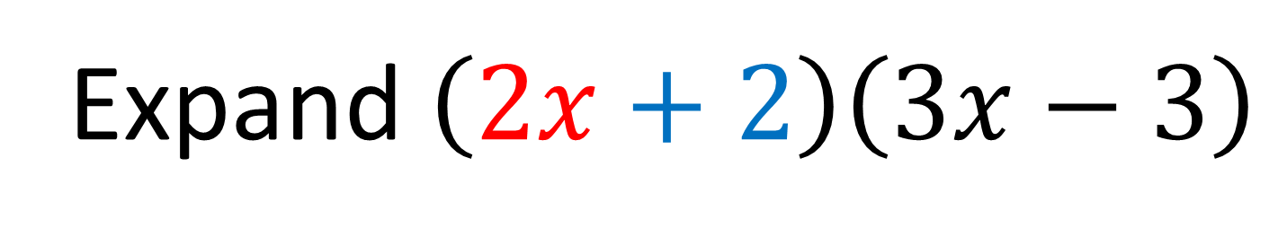
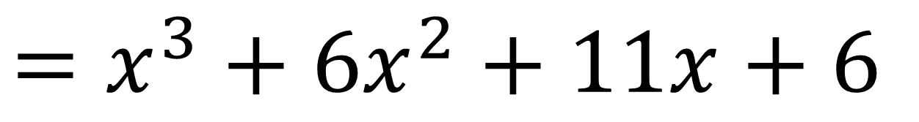
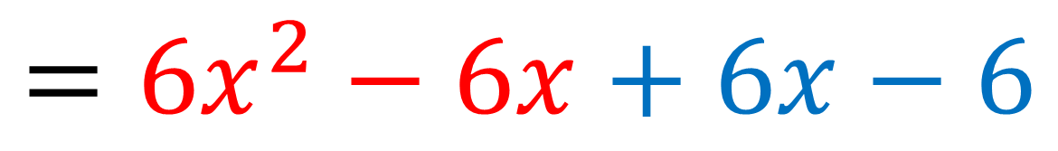
Expand $\left(2x+2\right)\left(3x−3\right)$
$$={6x}^{2}−6x+6x−6$$
$$=x^{3}+6x^{2}+11x+6$$

Slide 3
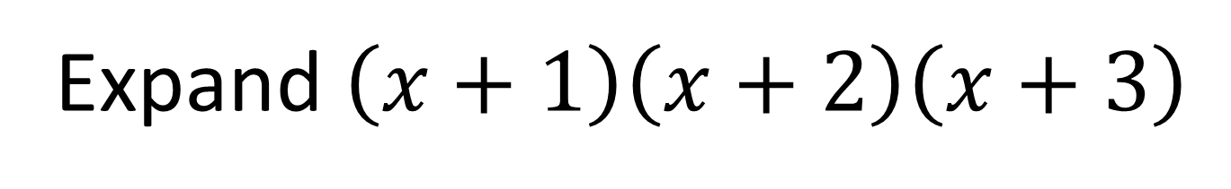
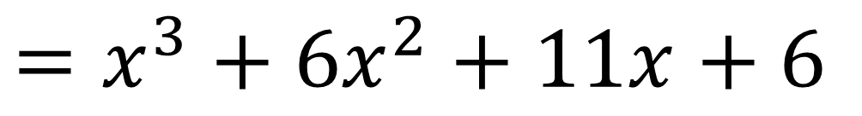
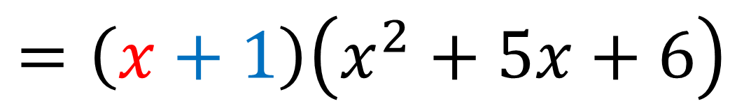
Expand $\left(x+1\right)\left(x+2\right)\left(x+3\right)$
$$=\left(x+1\right)\left(x^{2}+5x+6\right)$$
$$=x^{3}+5x^{2}+6x+x^{2}+5x+6$$
$$=x^{3}+6x^{2}+11x+6$$

Slide 4
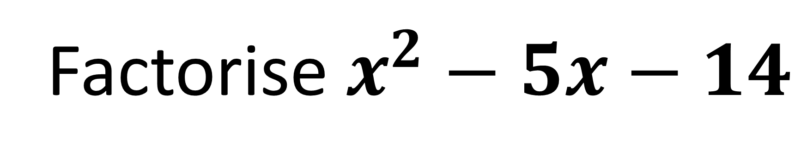


Factorise $x^{2}−5x−14$
Sum $−5$
Product $−14$
$$=\left(x−7\right)\left(x+2\right)$$

Slide 5


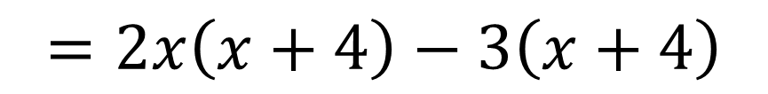

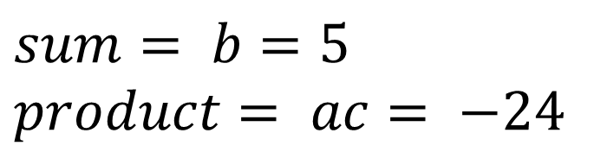
Factorise completely:
$${2x}^{2}+5x−12$$
Formal way
$$sum= b=5 \\ product= ac= −24$$
8 and - 3
STEP 1
$$=2x^{2}+8x−3x−12$$
STEP 2: Split the middle term.
STEP 3: Factorise in pairs
$$=2x\left(x+4\right)−3\left(x+4\right)$$
$$=(x+4)(2x−3)$$
STEP 4: Factorise out bracket.

Slide 6
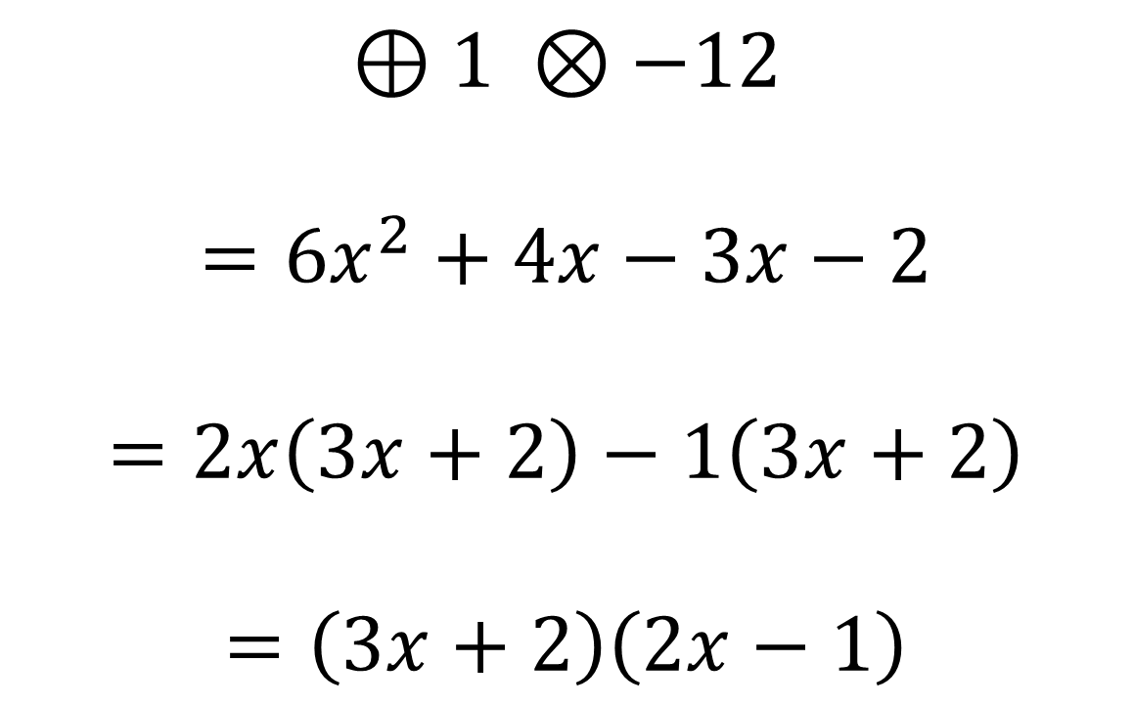

Factorise completely:
$$6x^{2}+x−2$$
$$⊕1 ⊗−12$$
$$=6x^{2}+4x−3x−2$$
$$=2x\left(3x+2\right)−1\left(3x+2\right)$$
$$=\left(3x+2\right)\left(2x−1\right)$$

Slide 7


Factorise completely:
$$x^{2}−16$$
Difference of two squares:
$$=\left(x+4\right)\left(x−4\right)$$

Slide 8


Factorise completely:
$$4x^{2}−9$$
Difference of two squares:
$$=\left(2x+3\right)\left(2x−3\right)$$

Slide 9

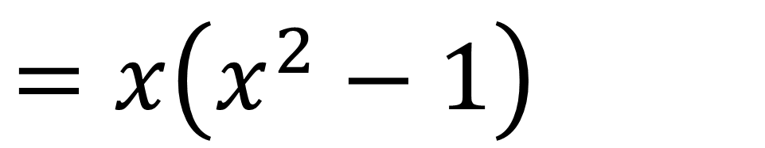
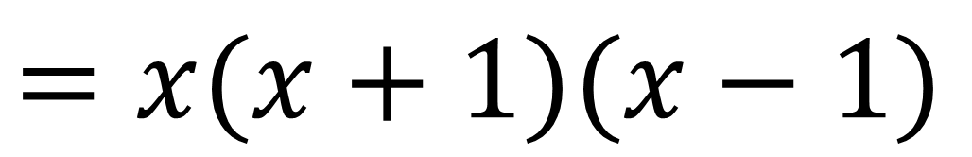
Factorise completely
$$x^{3}−x$$
$$=x\left(x^{2}−1\right)$$
$$=x(x+1)(x−1)$$

Slide 10
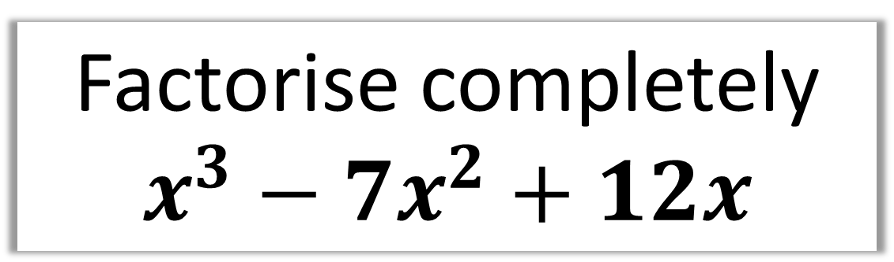
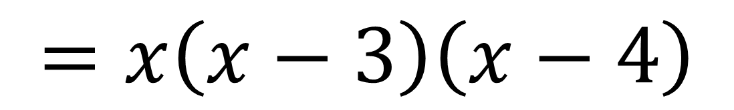
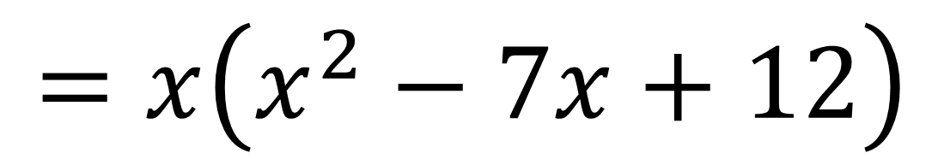
Factorise completely
$$x^{3}−7x^{2}+12x$$
$$=x\left(x^{2}−7x+12\right)$$
$$=x\left(x−3\right)\left(x−4\right)$$

