Slide 1
LO: Understanding Fractions

Slide 2
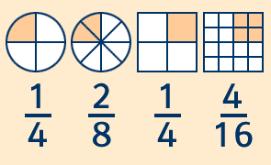
Fractions are part of a whole.

Slide 3

$$\frac{1}{4}$$
Numerator
Denominator

Slide 4




You are very hungry.
What size slice of pizza would you like?
$$\frac{1}{4}$$
$$\frac{1}{5}$$
$$\frac{1}{6}$$

Slide 5
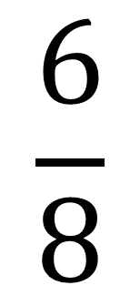
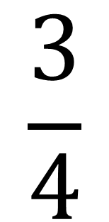
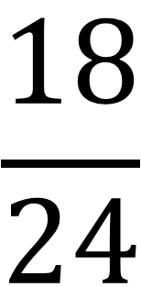
What do you notice about the follow shapes?
$$\frac{3}{4}$$
$$\frac{6}{8}$$
$$\frac{18}{24}$$
=
=

Slide 6

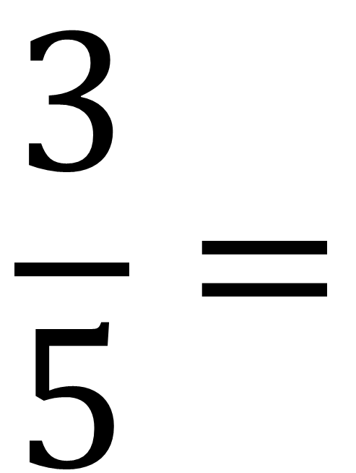
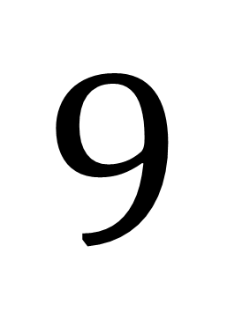
Equivalent Fractions
x3
$$\frac{3}{5}=$$
$$\frac{9}{15}$$
$$9$$
x3
What you do to the top you must do to the bottom.

Slide 7

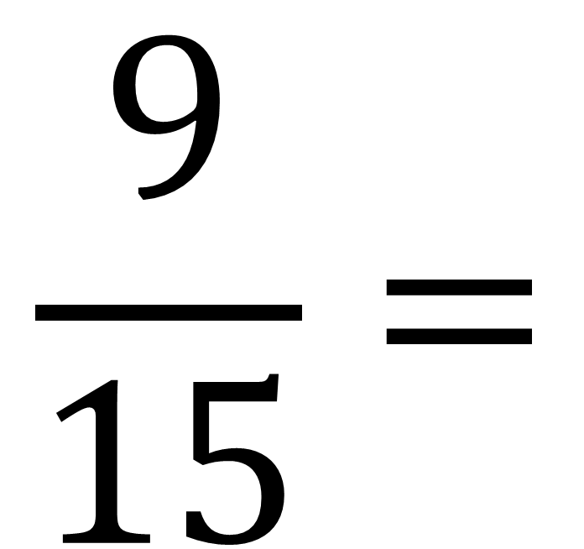
Simplifying Fractions
÷3
$$\frac{9}{15}=$$
$$\frac{3}{5}$$
÷3
Divide by the HCF

Slide 8
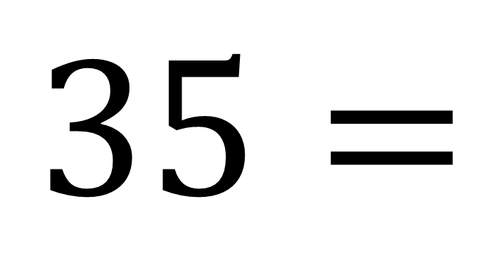
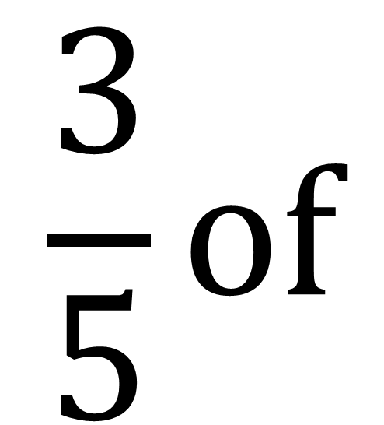

Fraction of an Amount
$$\frac{3}{5}of$$
$$35=$$
$$21$$
Divide by 5 and Multiply by 3

