Slide 1
LO: Identical
and Equal

Slide 2
=
What does this symbol mean?
Equal To

Slide 3
True or False
x + y = y + x
True

Slide 4
True or False
x – y = y - x
False

Slide 5
True or False
xy = yx
True

Slide 6
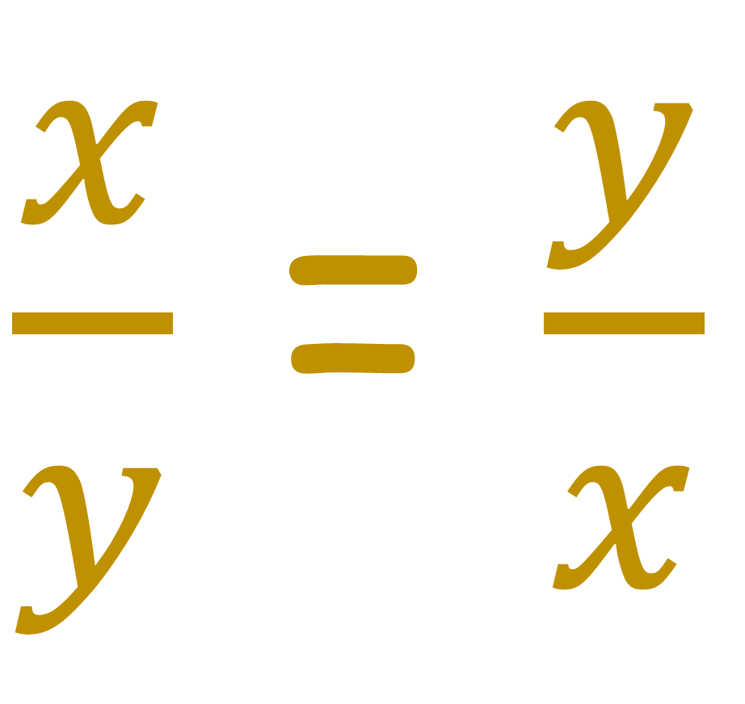
True or False
$\frac{x}{y}$ = $\frac{y}{x}$
False

Slide 7
True or False
(x + y)²= x²+ y²
False

Slide 8
True or False
(x – y)(x + y) = x²- y²
True

Slide 9
≡
What does this symbol mean?
Identical To

Slide 10
This is called an
Equation
3x = 2x + 5
Both sides are equal for
certain of values x.

Slide 11
True or False if x = 1
7x = 2x + 5
True
True or False if x = 3
7x = 2x + 5
False

Slide 12
This is called an
Identity
3x ≡ 2x + x
Both sides are equal for
ALL values of x.

Slide 13
True or False if x = 5
3x ≡ 2x + x
True
True or False if x = 3
3x ≡ 2x + x
True

Slide 14
Identical or Equal?
5x = 4x + 1
=

Slide 15
Identical or Equal?
5x = 4x + x
≡

Slide 16
Identical or Equal?
=
4x + 1 = 4(x + 1)

Slide 17
Identical or Equal?
≡
4x + 4 = 4(x + 1)

Slide 18
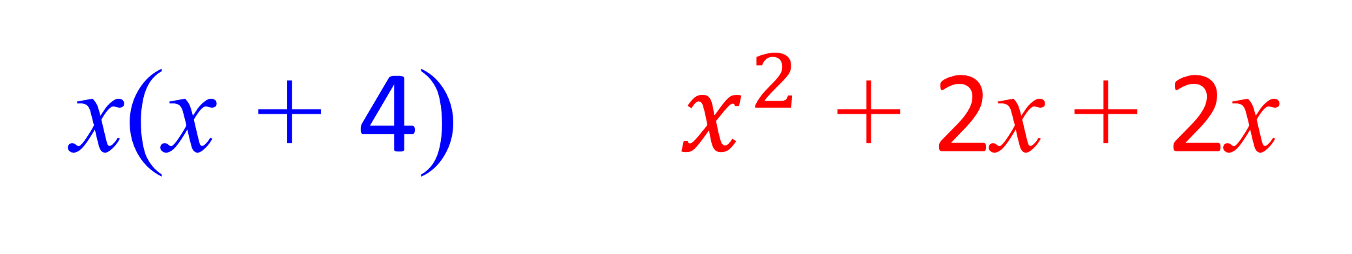
Identical or Equal?
≡
x(x + 4) $x^{2}$ + 2x + 2x

Slide 19
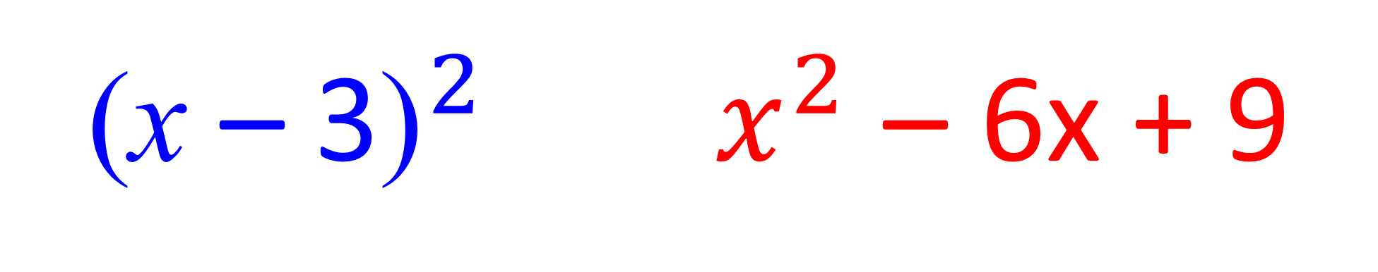
Identical or Equal?
≡
${\text{(}\text{x} \text{–} \text{3}\text{)}}^{2} x^{2}$ – 6x + 9

Slide 20
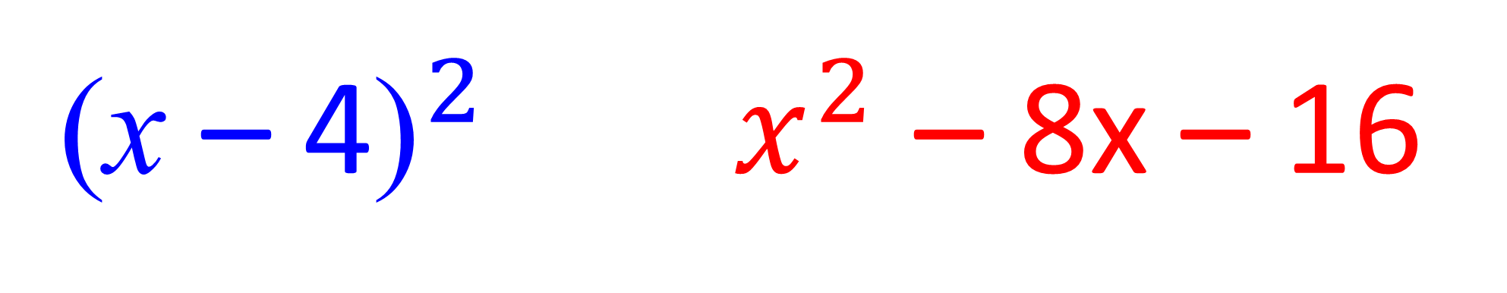
Identical or Equal?
=
${\text{(}\text{x} \text{–} \text{4}\text{)}}^{2} x^{2}$ – 8x – 16

