Slide 1
FM: Solving Quadratics by Factorising

Slide 2
What makes a quadratic equation a quadratic?
A quadratic equations has
a power of 2 and nothing higher.

Slide 3
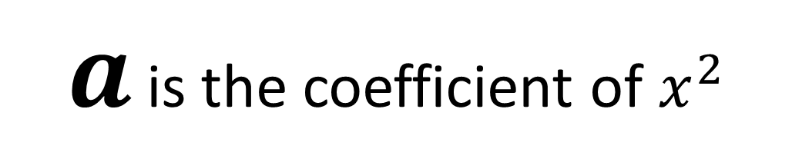
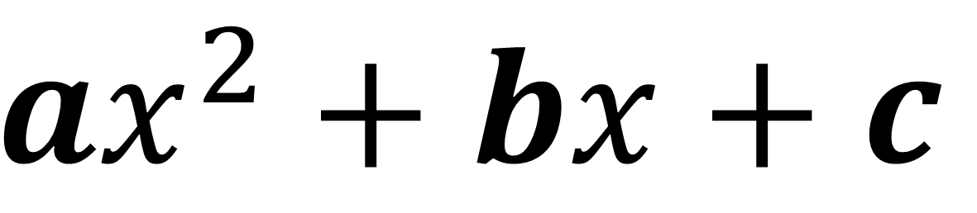

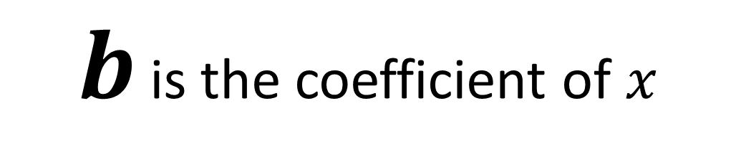
Standard format of a quadratic.
$$ax^{2}+bx+c$$
$a$ is the coefficient of $x^{2}$
$b$ is the coefficient of $x$
$c$ is the constant

Slide 4

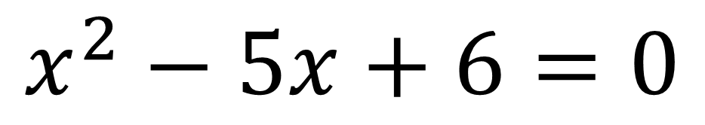
It is easiest to solve a quadratic equation when it is equal to what value?
Zero
$$x^{2}= 5x−6$$
$$x^{2}−5x+6=0$$

Slide 5
Solving the following.
(x – 1)(x + 2) = 0
x(x – 6) = 0
(6 – x)(5 + x) = 0
(2x + 1)(x – 3) = 0
(3x – 2)(5x + 1) = 0
(1 – 4x)(3x + 2) = 0
x = 1 or x = -2
x = 0 or x = 6
x = 6 or x = -5
x = -0.5 or x = 3
x = 2/3 or x = -1/5
x = 1/4 or x = -2/3

Slide 6
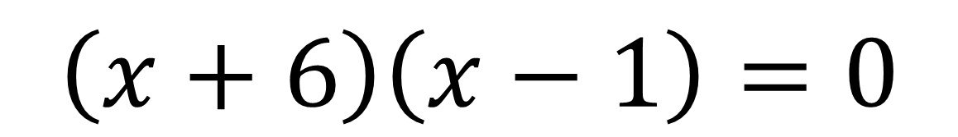

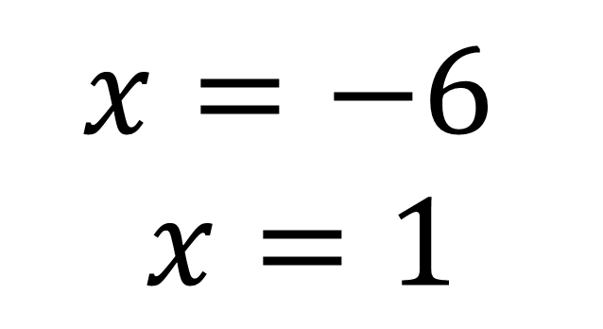
Solve the quadratic by factorising
$x^{2}+5x=6$
$$\left(x+6\right)\left(x−1\right)=0$$
$$x=−6$$
$$x=1$$

Slide 7
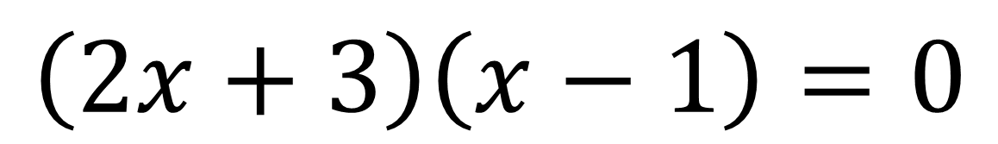

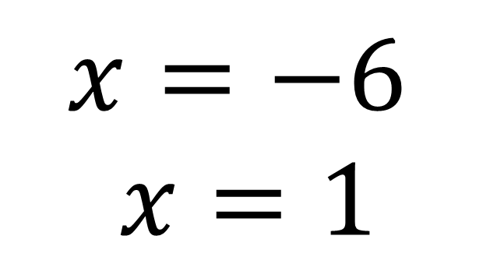
Solve the quadratic by factorising
${2x}^{2}+x−3=0$
$$\left(2x+3\right)\left(x−1\right)=0$$
$$x=−6$$
$$x=1$$

Slide 8
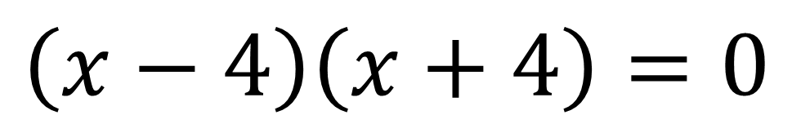


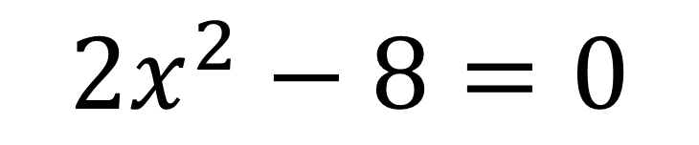
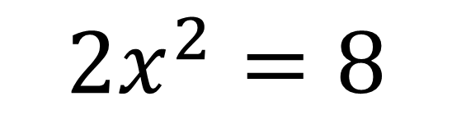
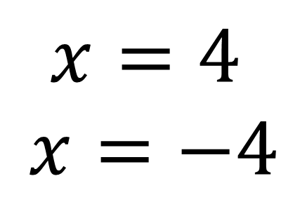
Solve the quadratic by factorising
$${2x}^{2}=8$$
$${2x}^{2}=8$$
$$\left(x−4\right)\left(x+4\right)=0$$
$${2x}^{2}−8=0$$
$$x=4$$
$$x=−4$$
$${2(x}^{2}−4)=0$$

Slide 9



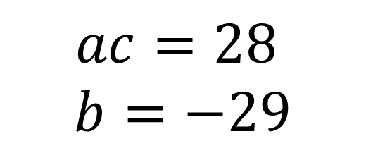
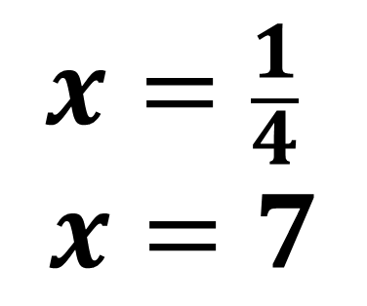
4x² + 7 = 29x
Solve the quadratic by factorising
$${4x}^{2}−29x+7=0$$
$$ac=28$$
$$b=−29$$
$${4x}^{2}−28x −1x+7=0$$
$$4x\left(x−7\right)−1(x−7)=0$$
$$x=\frac{1}{4}$$
$$x=7$$
$$\left(4x−1\right)\left(x−7\right)=0$$

