Slide 1
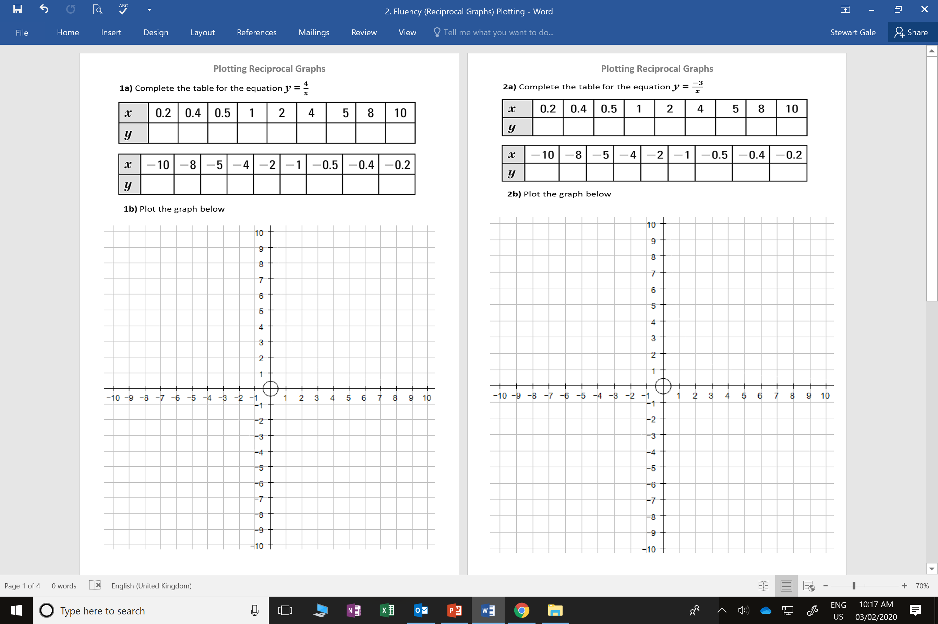

Slide 2
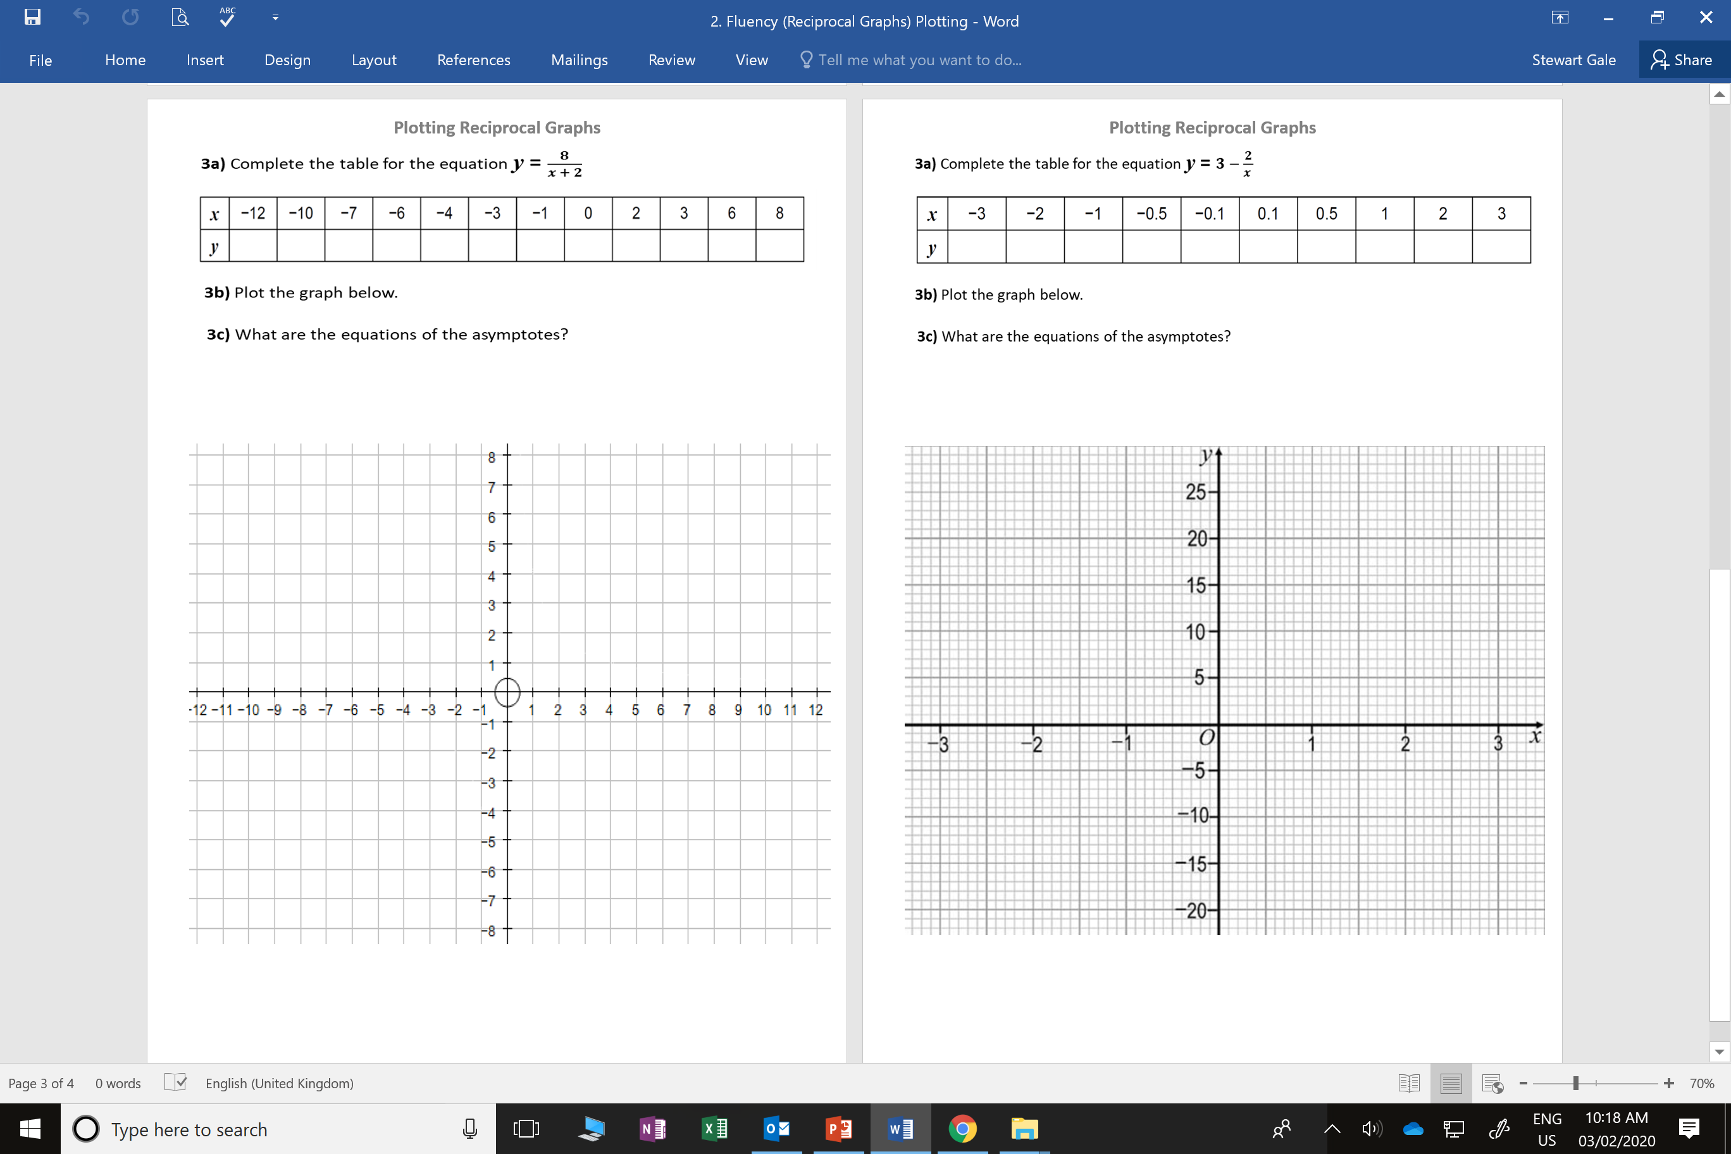

Slide 3
ANSWERS

Slide 4
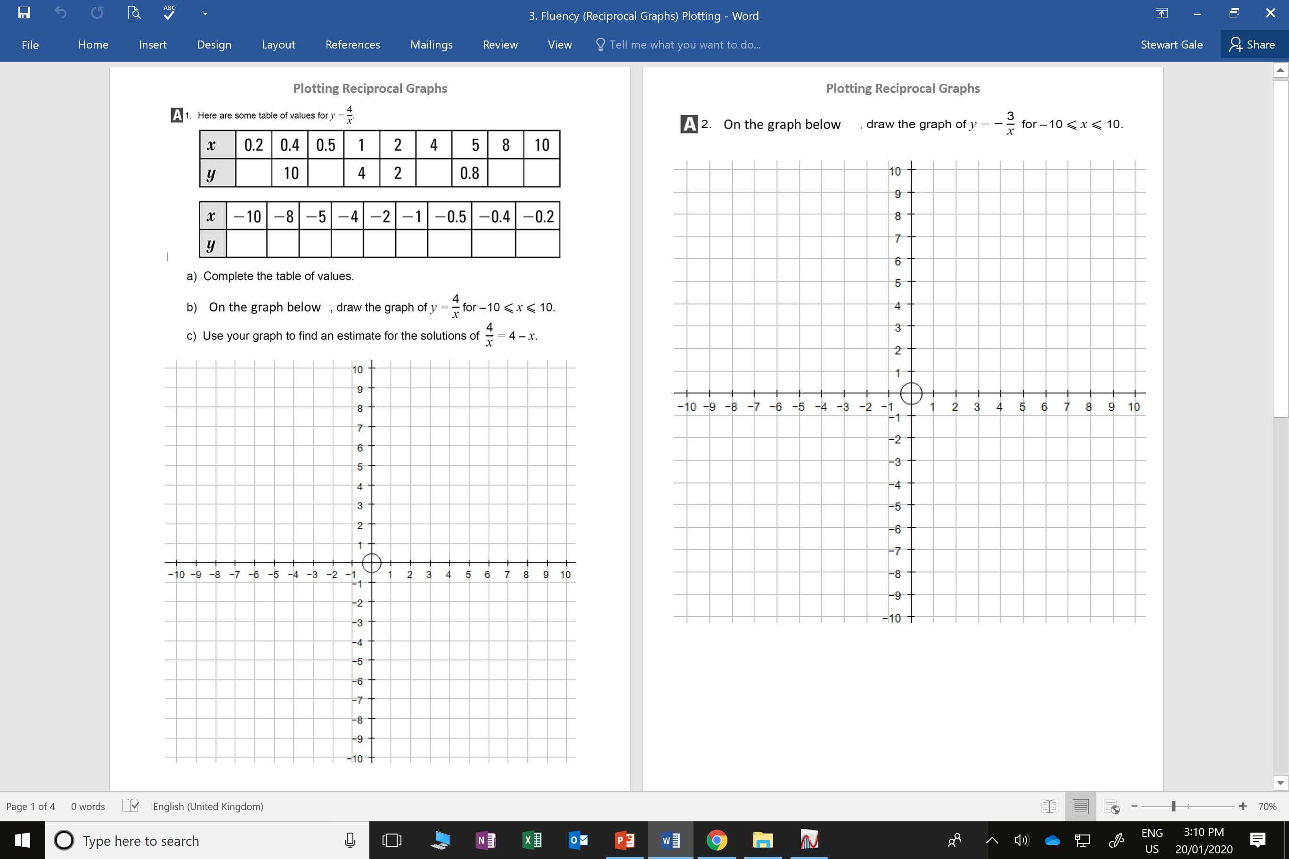
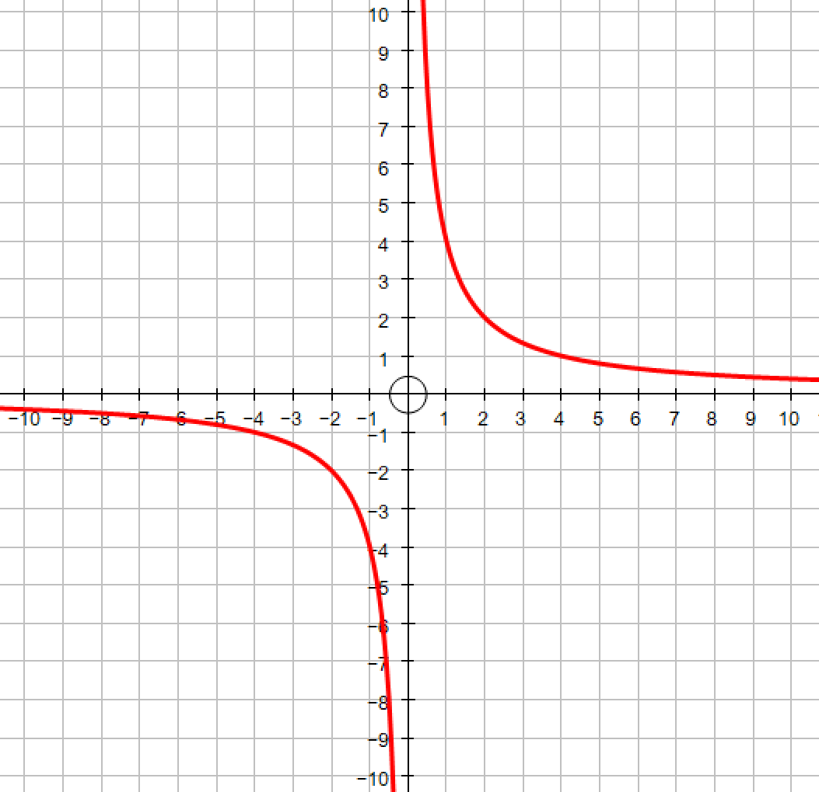
20
8
1
0.5
0.4
-0.4
-0.5
-0.8
-1
-2
-4
-8
-10
-20

Slide 5
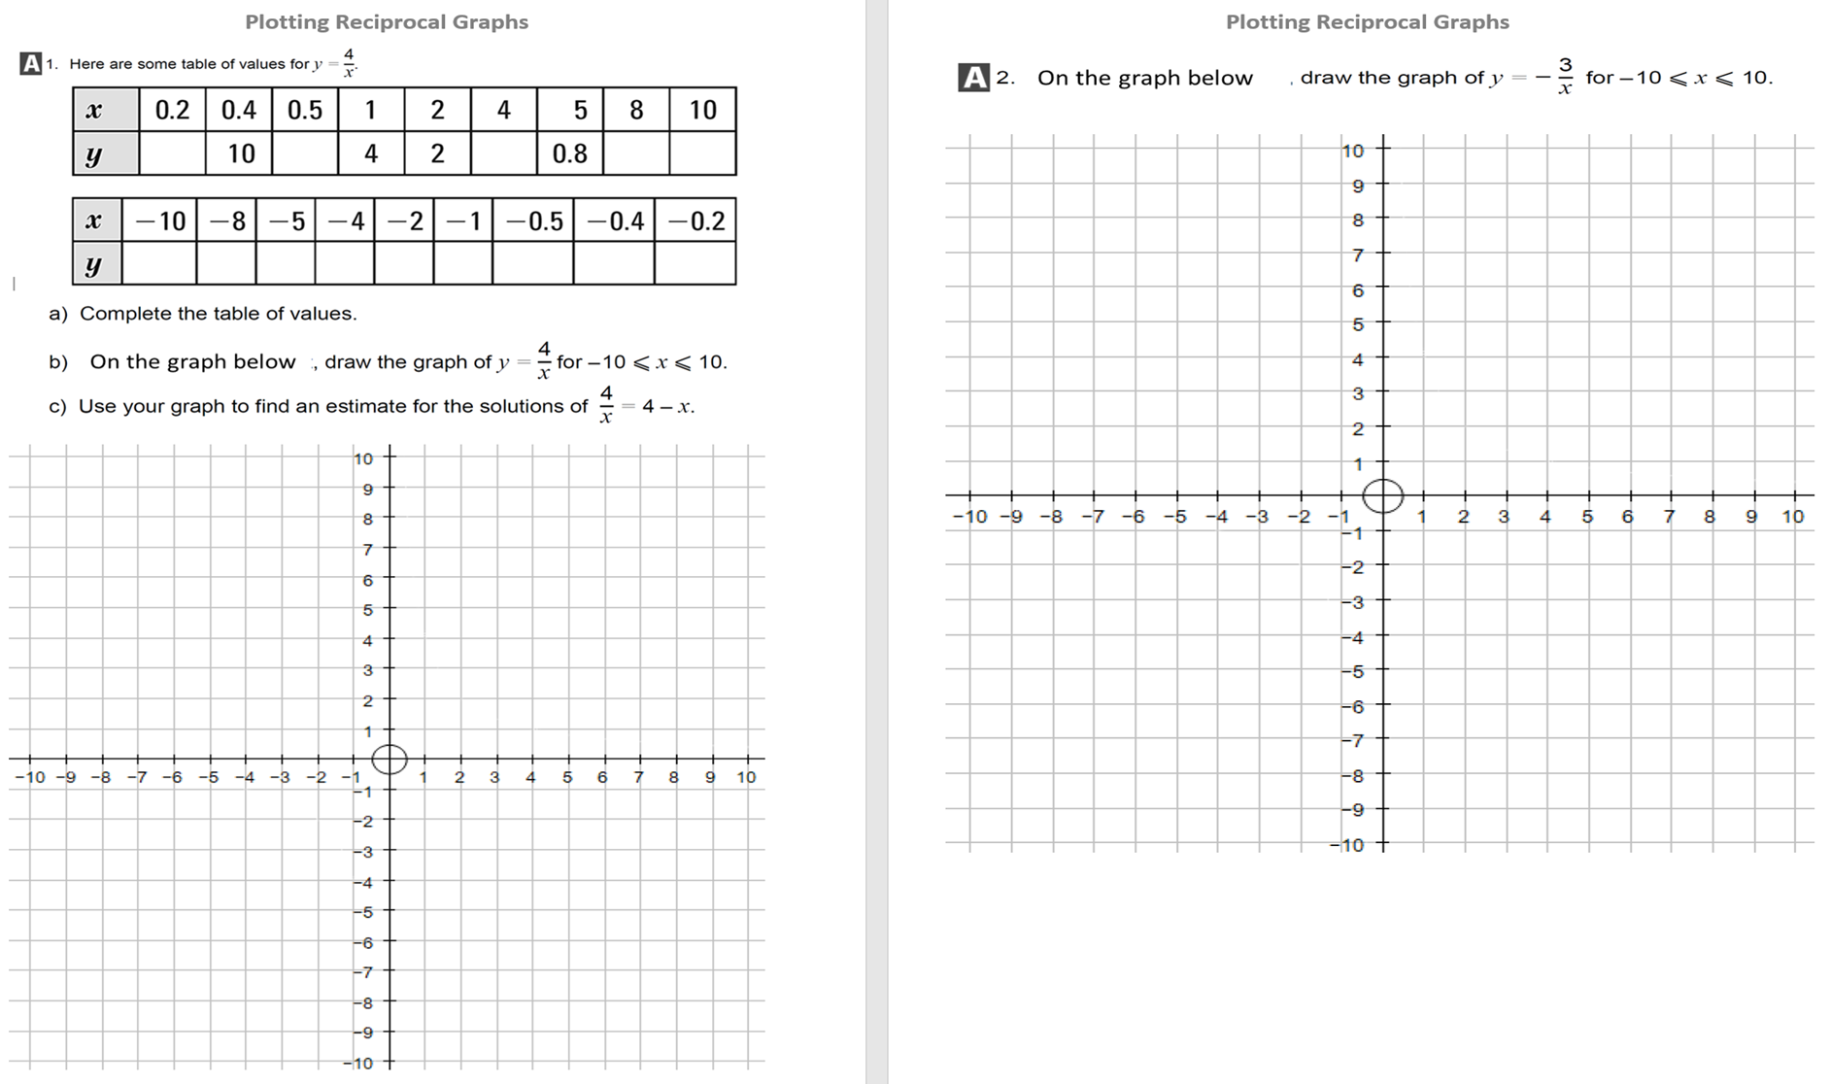
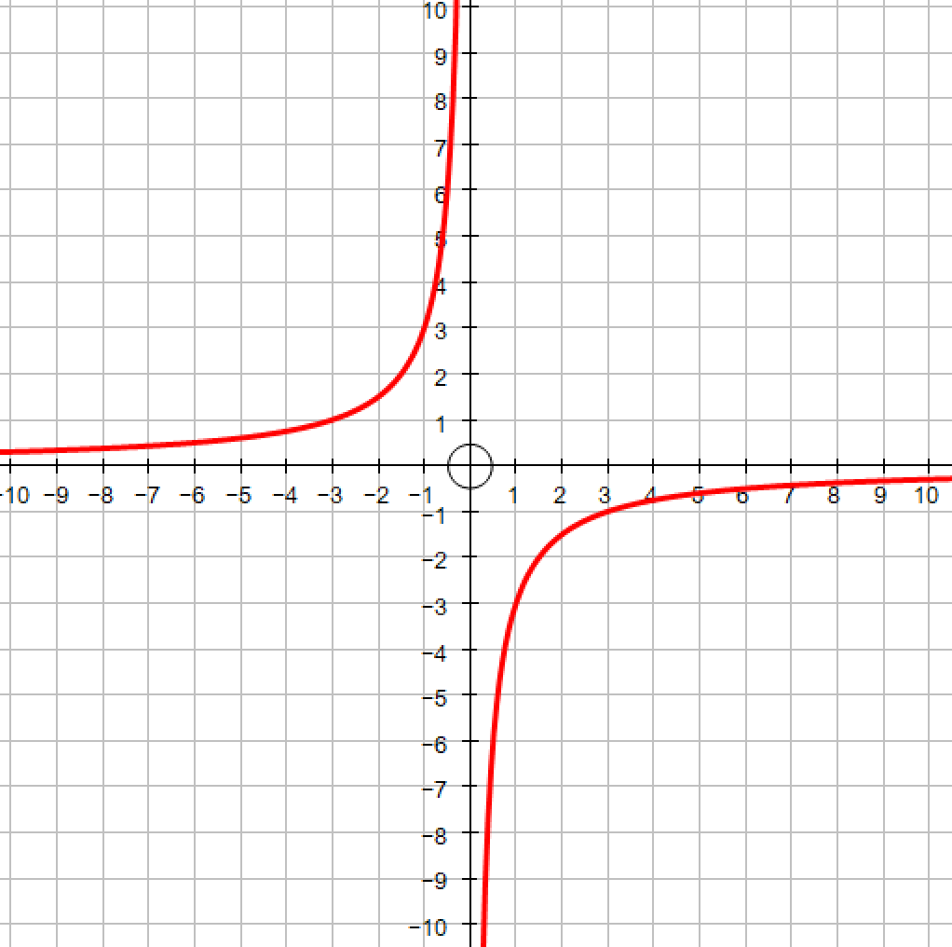

Slide 6
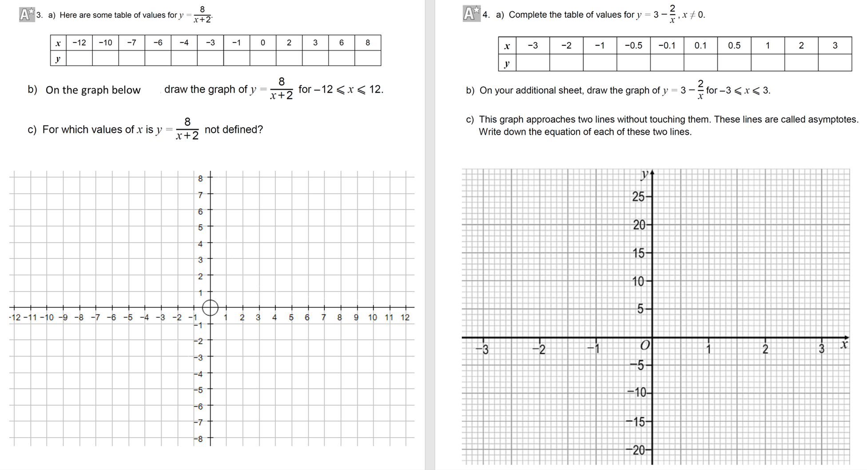
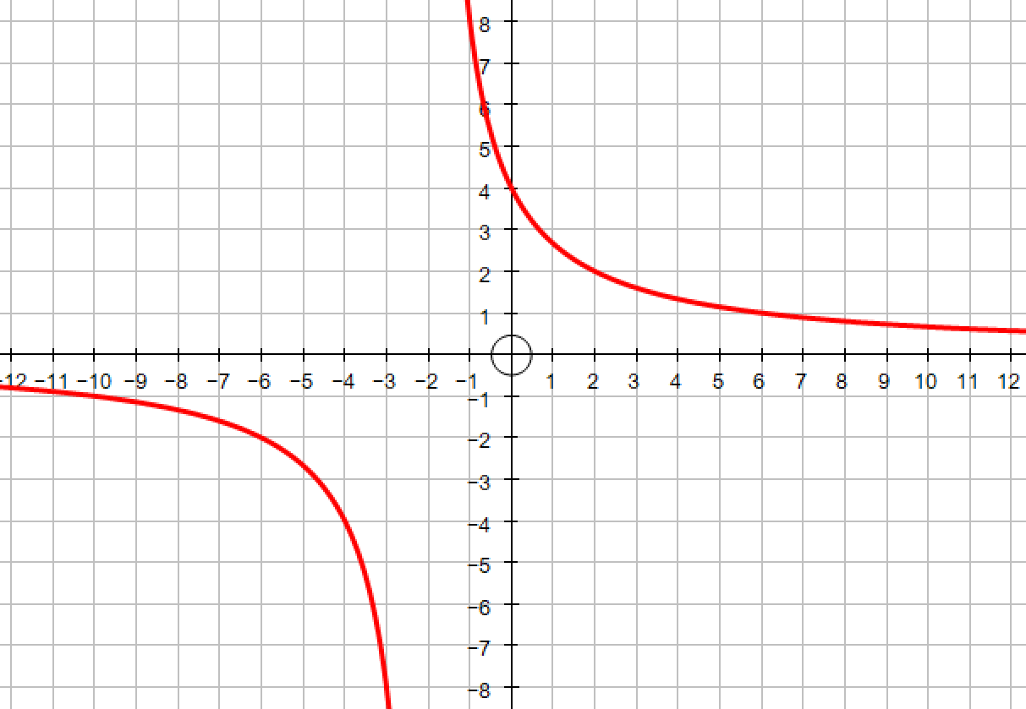
-0.8
-1
-1.6
-2
-4
-8
8
4
2
1.6
1
0.8
x = -2
and
y = 0

Slide 7
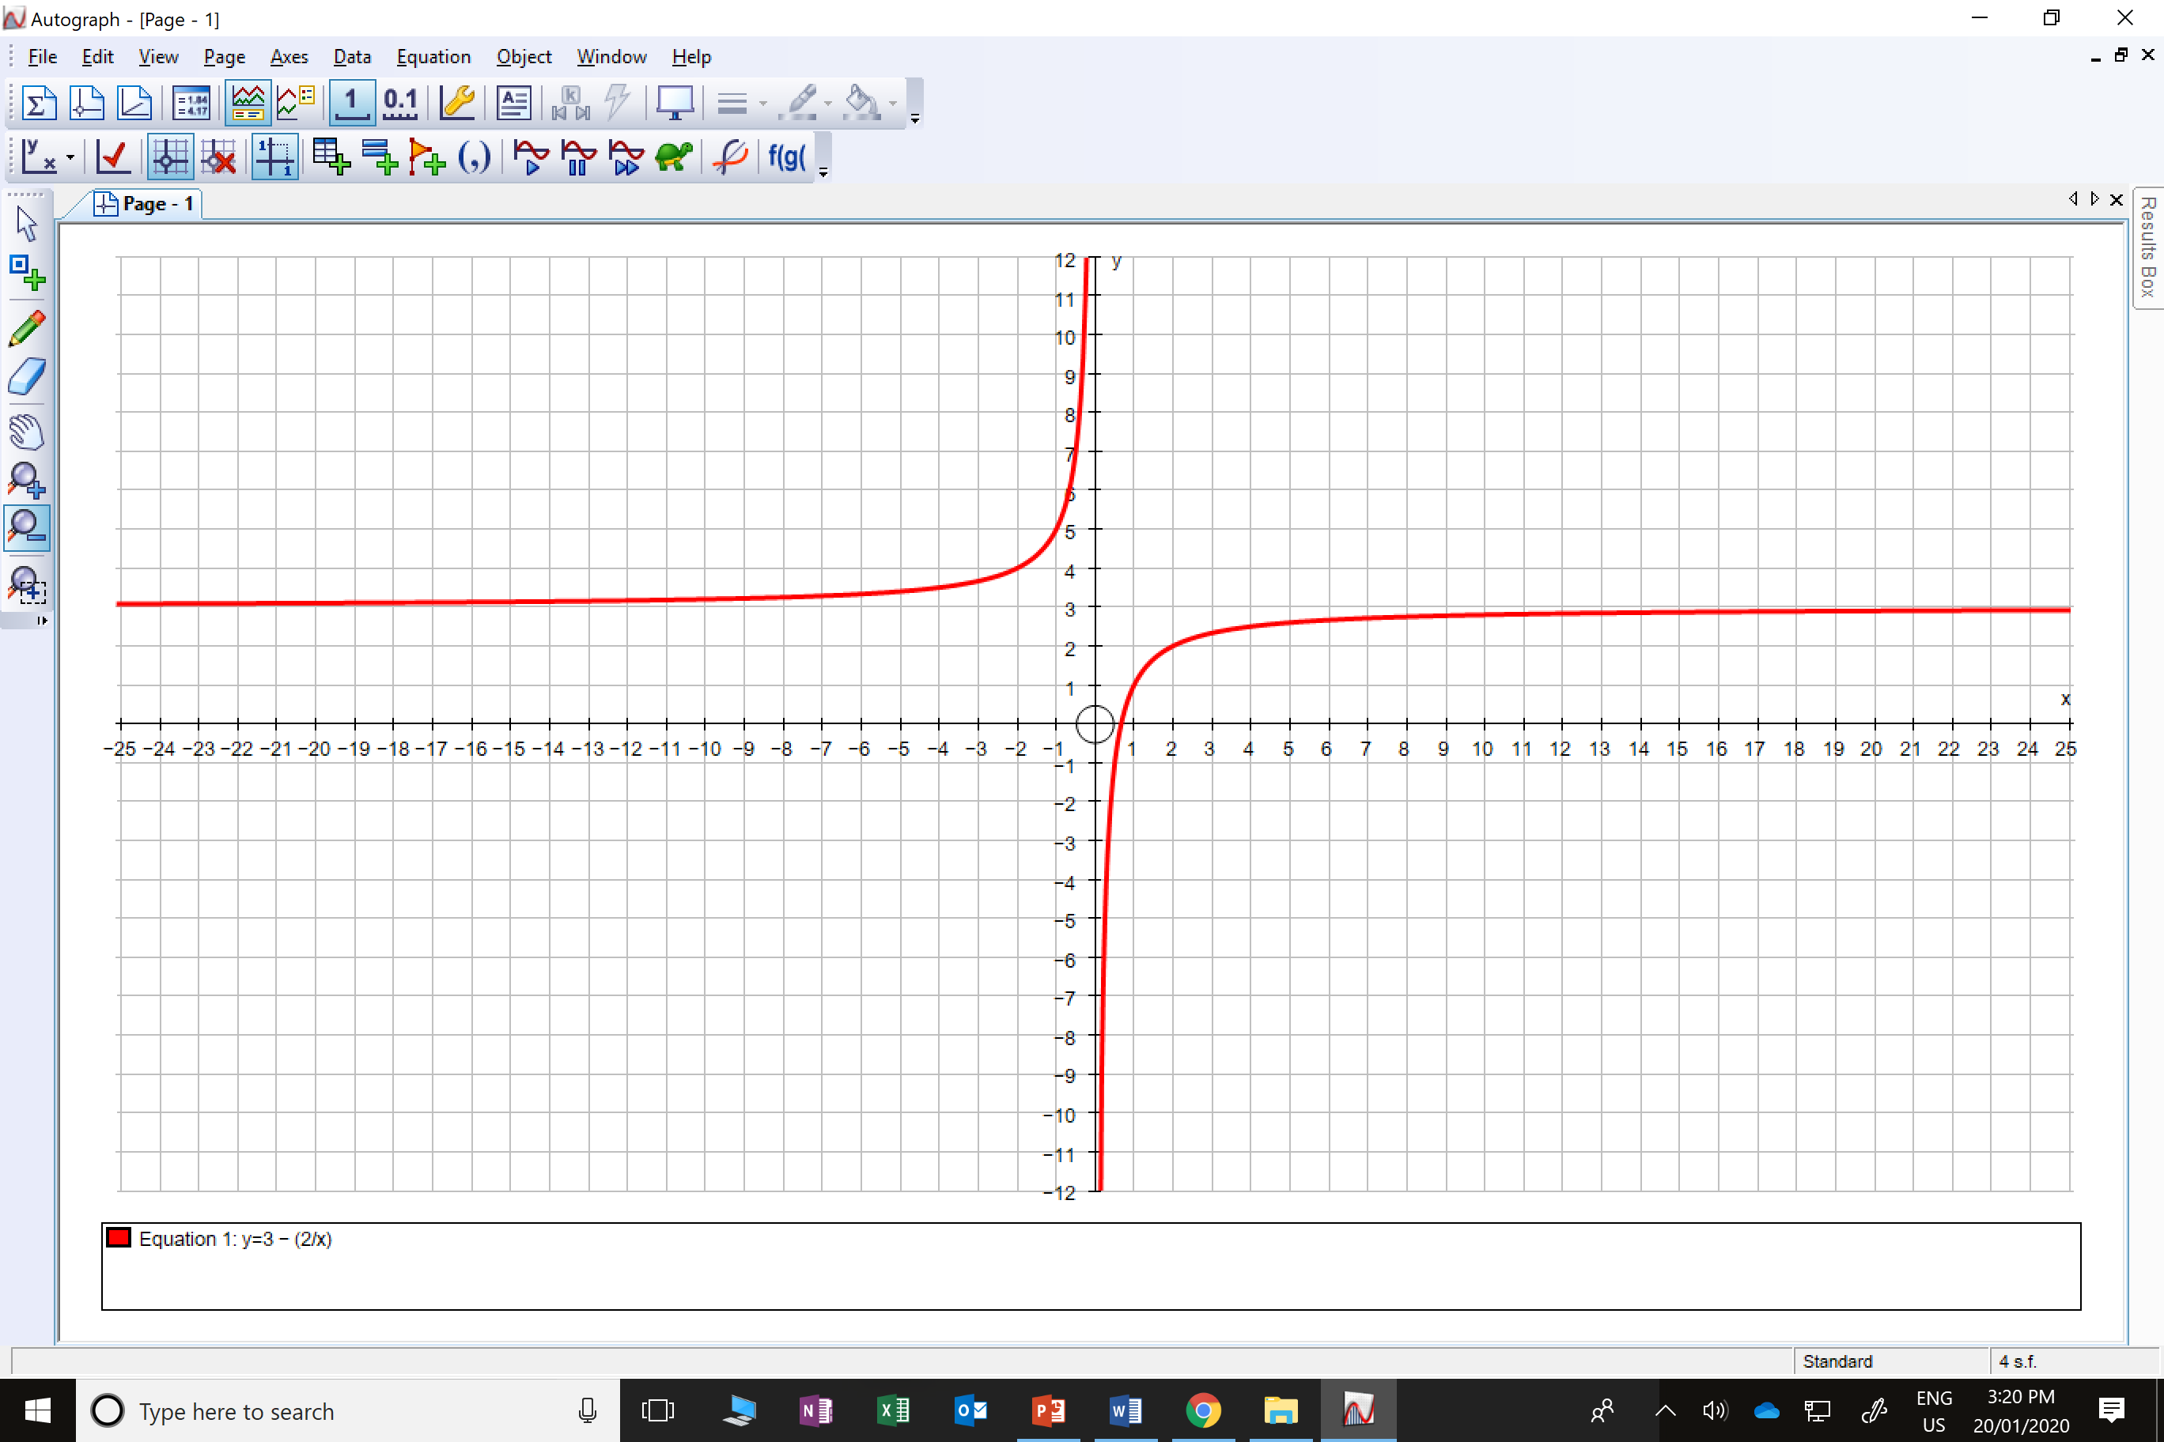
3.6
3
1
7
23
-17
-1
1
2
2.3
x = 0
and
y = 3

