Slide 1
LO: Substitution into Formulae

Slide 2
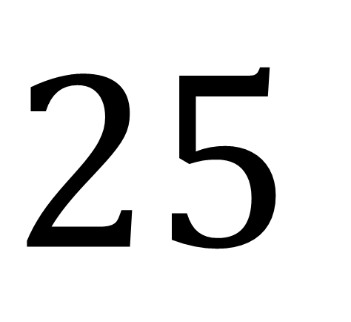
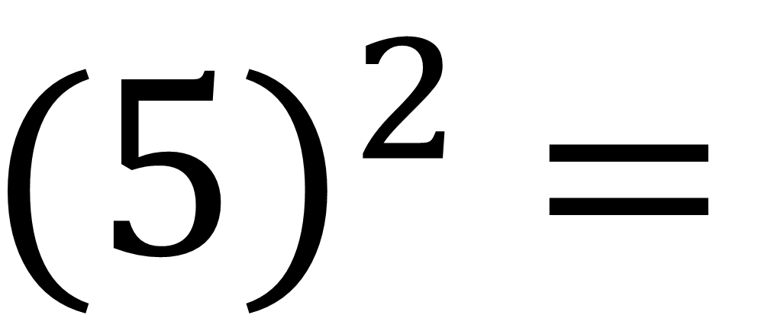
$${(5)}^{2} =$$
$$25$$

Slide 3
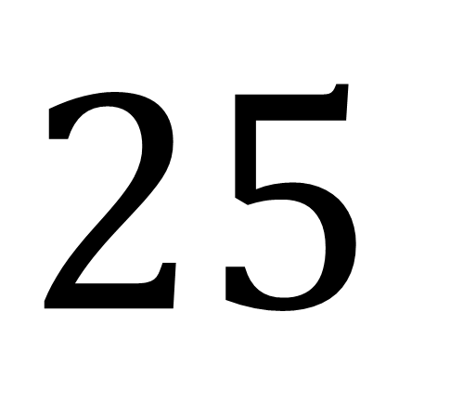
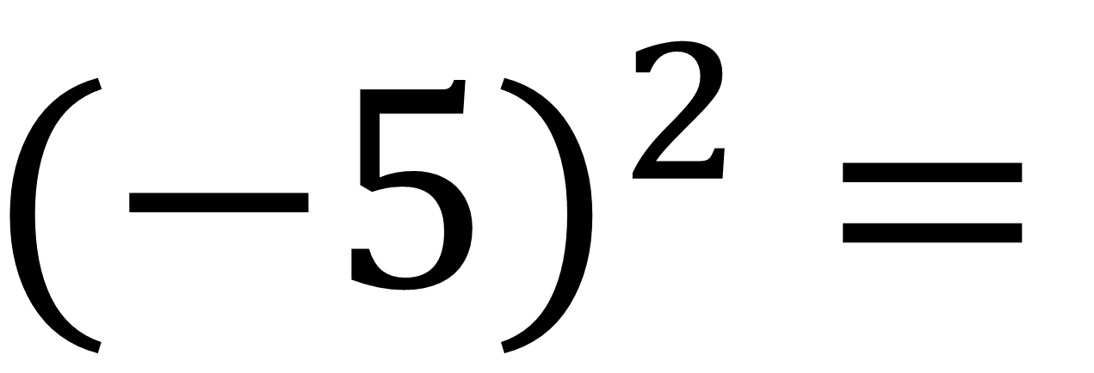
$${(−5)}^{2} =$$
$$25$$

Slide 4
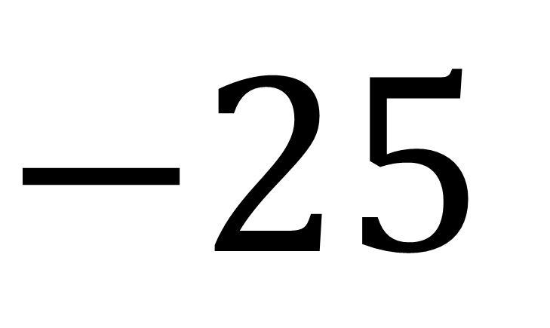
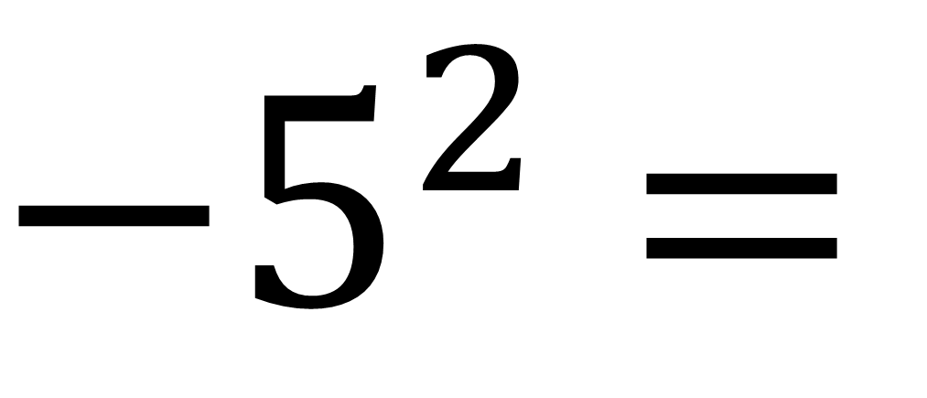
$${−5}^{2} =$$
$$−25$$

Slide 5

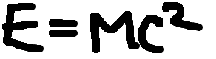
What is the value of the M?
E = 3(5²)
3
E = 75

Slide 6
What is the value of the C?
E = 3(5²)
5
E = 75

Slide 7
When doing calculations, you must do them in a certain order.

Slide 8
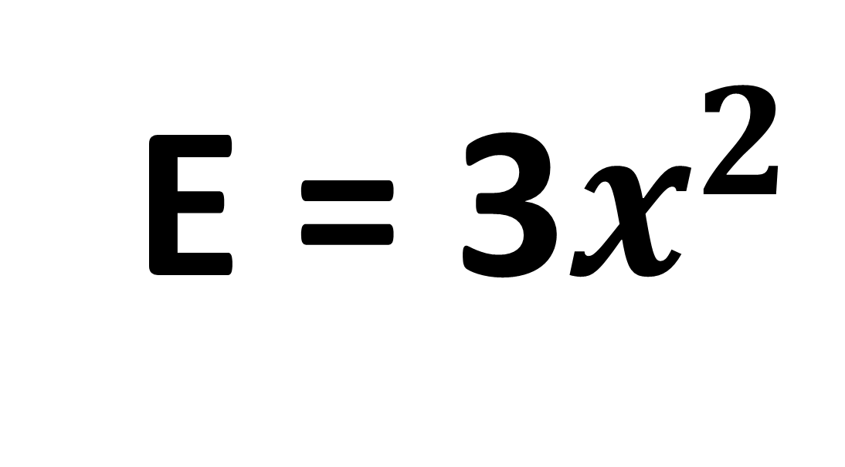
E = 3$x^{2}$
Find the value of E when x = 4
E = 48

Slide 9
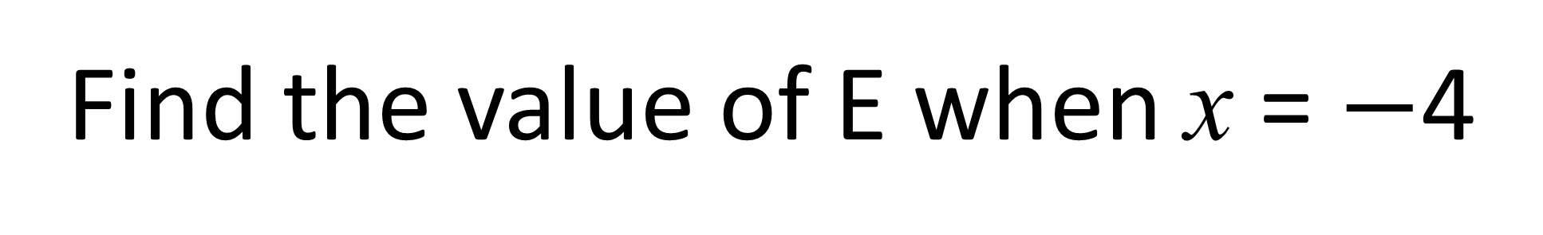
E = 3$x^{2}$
Find the value of E when x = $−$4
E = 48

Slide 10
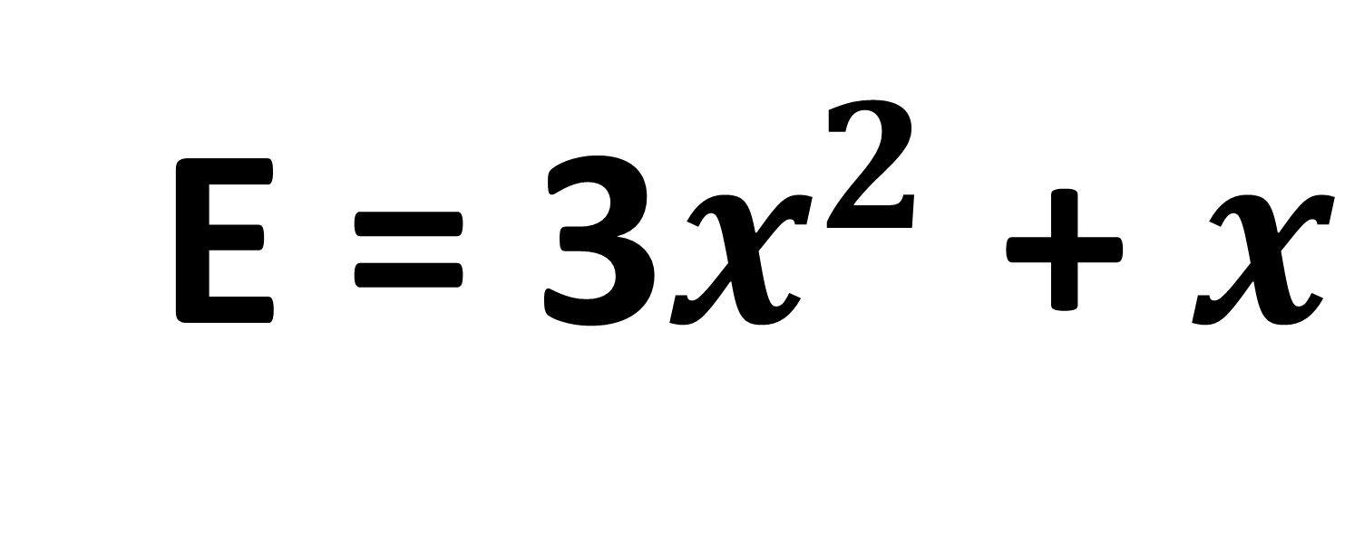
E = 3$x^{2}$ + $x$
Find the value of E when x = 2
E = 14

Slide 11
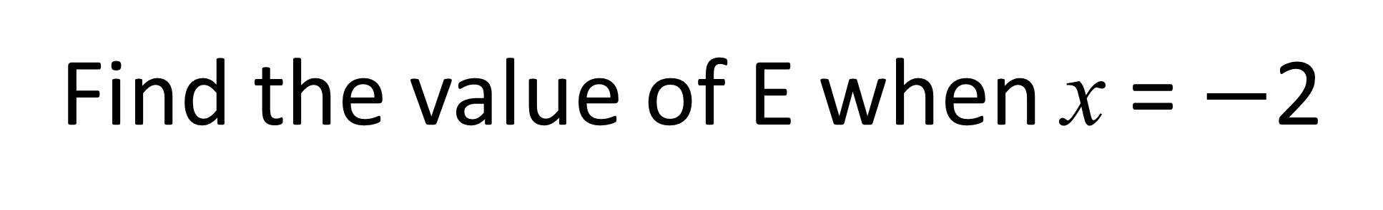
E = 3$x^{2}$ + $x$
Find the value of E when x = $−$2
E = 10

Slide 12
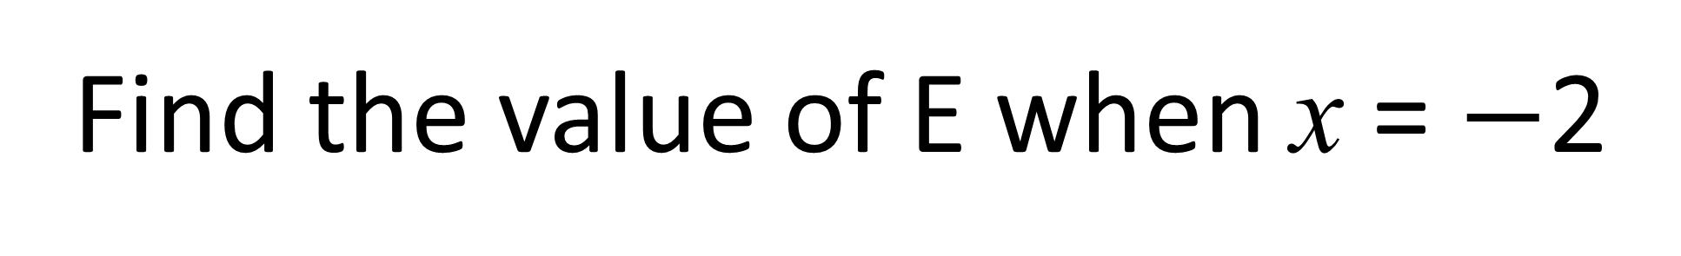
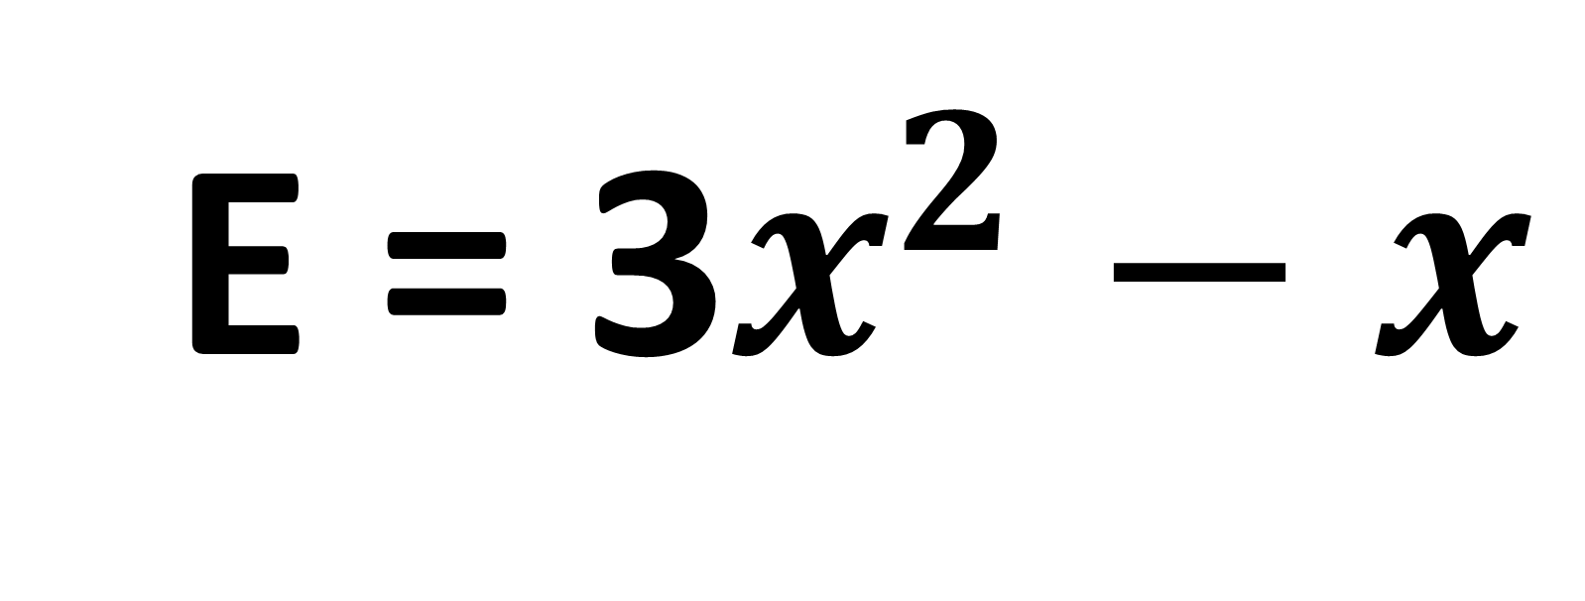
E = 3$x^{2}$ $−$ $x$
Find the value of E when x = $−$2
E = 14

Slide 13
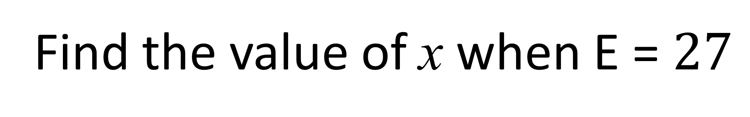
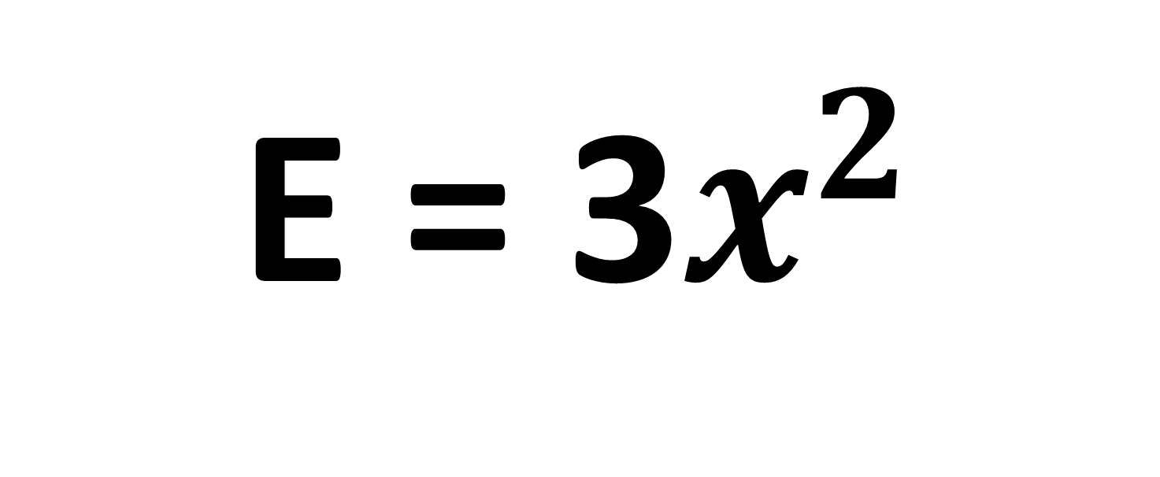
E = 3$x^{2}$
Find the value of x when E = $27$
x = 3

