Slide 1

Diagnostic Assessment .Delta 3
Unit 4
Data Collection
Frequency Polygons
Stem and Leaf
Averages – Group Frequency
Box Plots
CF Graphs
Histograms

Slide 2
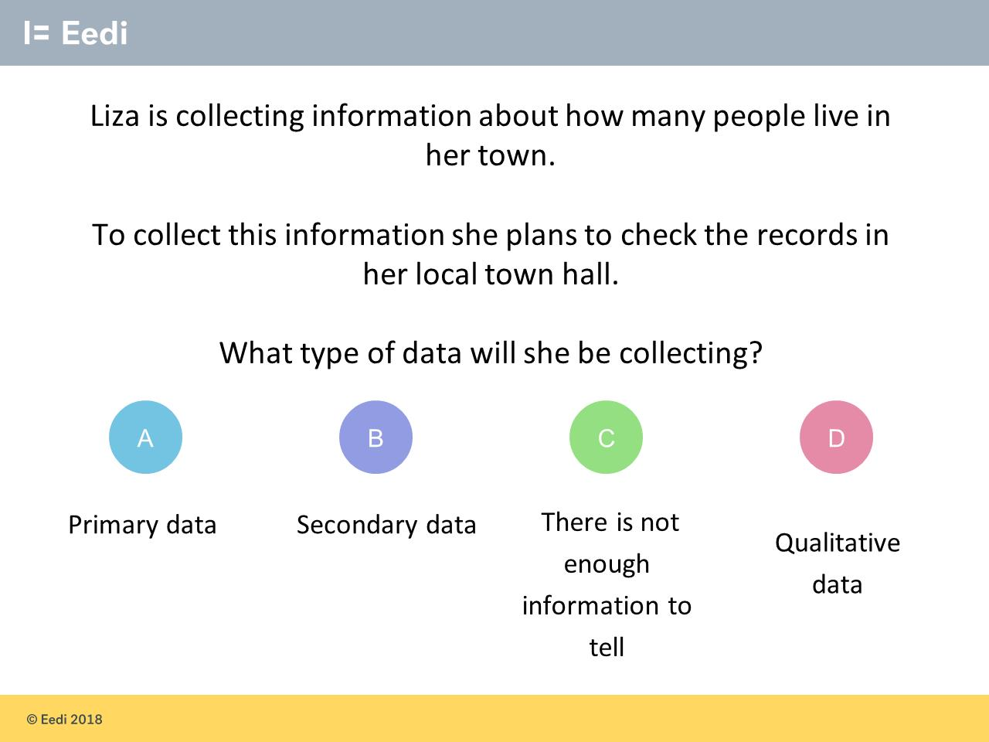
Question 1 – Data Collection

Slide 3
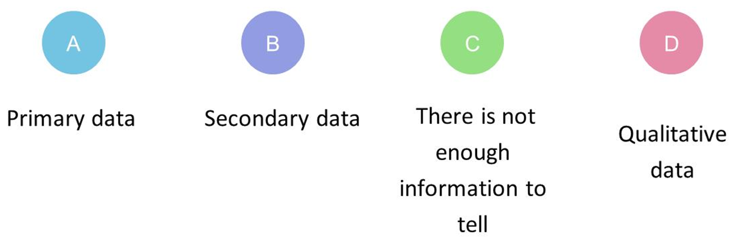
Answer 1 – Data Collection
CORRECT ANSWER | CORRECT EXPLANATION
B | This data is secondary, as she has not collected it herself.
COMMON MISTAKES | WHAT MIGHT BE YOUR MISTAKE
A | The student may be confusing primary and secondary data.
C | The student may benefit from revising data sources.
D | The student may be confusing quantitative and qualitative data.

Slide 4
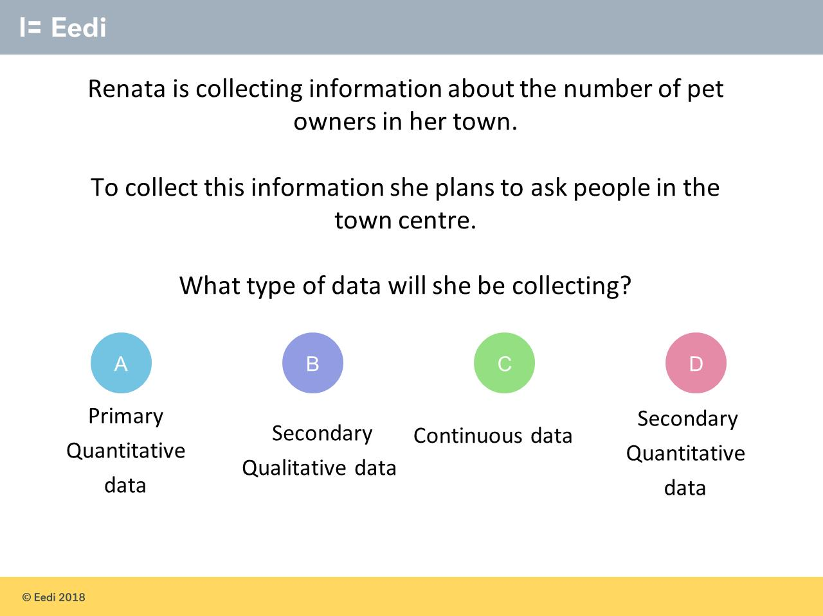
Question 2 – Data Collection

Slide 5
Answer 2 – Data Collection
CORRECT ANSWER | CORRECT EXPLANATION
A | This data is primary as the people were asked themselves, and it is quantitative as the data will be numbers.
COMMON MISTAKES | WHAT MIGHT BE YOUR MISTAKE
B | The student may have guessed. They may benefit from revising types of data.
C | The student has confused continuous and discrete data.
D | The student has confused primary and secondary data.

Slide 6
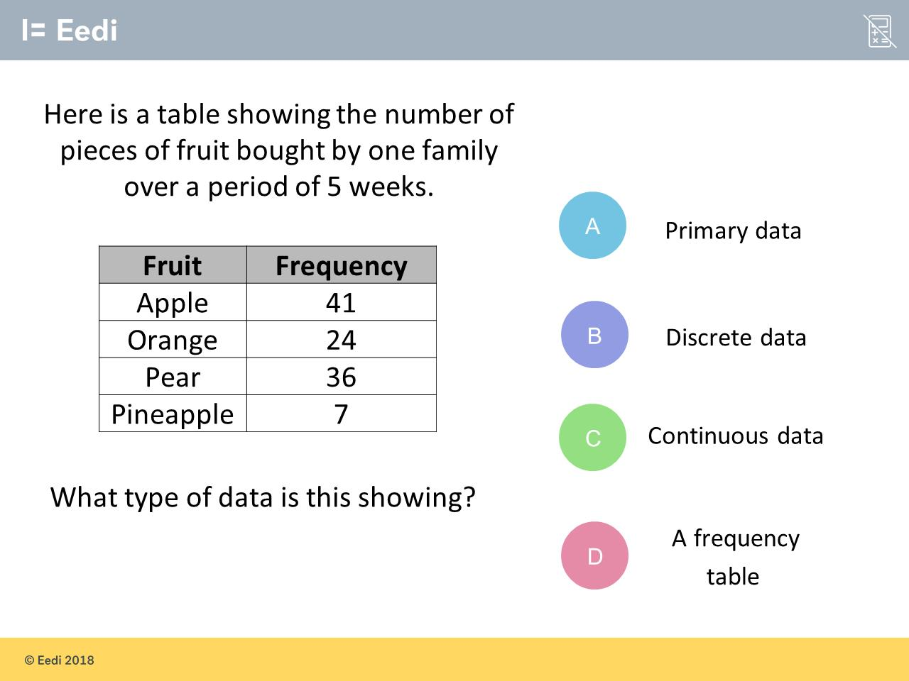
Question 3 – Data Collection

Slide 7
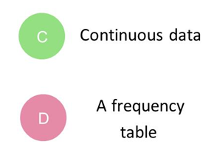
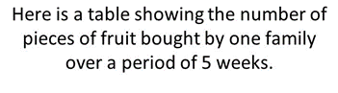
Answer 3 – Data Collection
CORRECT ANSWER | CORRECT EXPLANATION
B | This data is discrete, as we have distinct groups of fruits and we can only buy whole numbers.
COMMON MISTAKES | WHAT MIGHT BE YOUR MISTAKE
A | The student may have guessed a type of data.
C | The student may confuse discrete and continuous data.
D | The student has given the type of table, not the data.

Slide 8
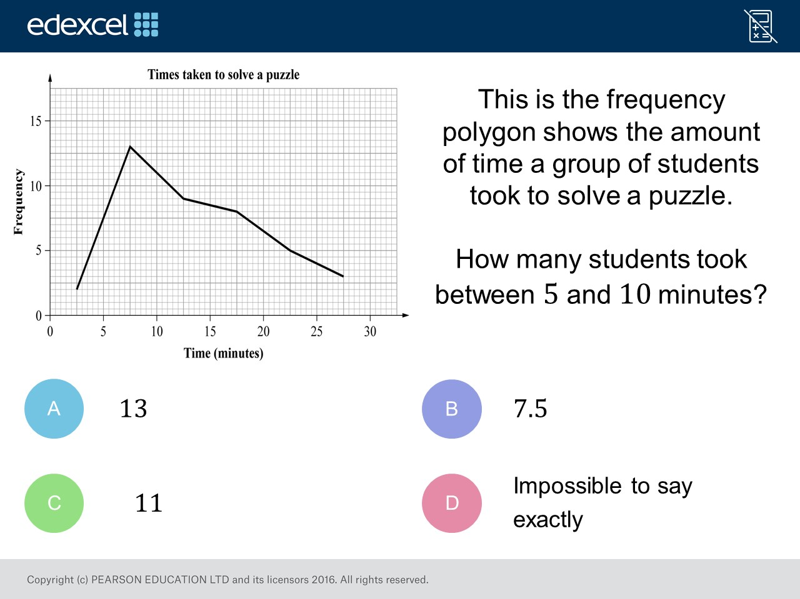
Question 4 – Frequency Polygons

Slide 9
Answer 4 – Frequency Polygons
CORRECT ANSWER | CORRECT EXPLANATION
13 | Read frequency value from the mid point value of 5 and 10
COMMON MISTAKES | WHAT MIGHT BE YOUR MISTAKE
7.5 | The student read off the x axis rather than the y axis.
11 | Read frequency value from the mid point value of 5 and 10
Impossible to say | The student needs to review frequency polygons

Slide 10
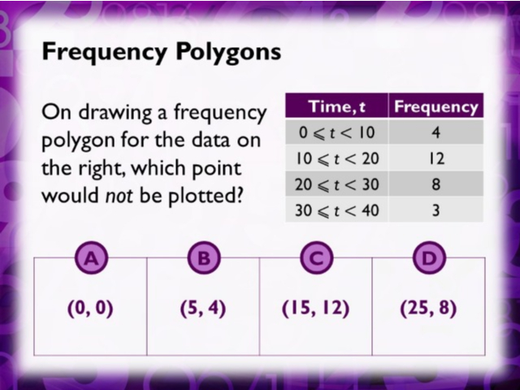
Question 4 – Frequency Polygons

Slide 11
Answer 4 – Frequency Polygons
CORRECT ANSWER | CORRECT EXPLANATION
A | The x co-ordinate is the mid point of the class width. The y co-ordinate is the frequency
COMMON MISTAKES | WHAT MIGHT BE YOUR MISTAKE
B | 5 is mid point of 0 to 10. 4 is the frequency
C | 15 is mid point of 10 to 20. 12 is the frequency
D | 25 is mid point of 20 to 30. 8 is the frequency

Slide 12
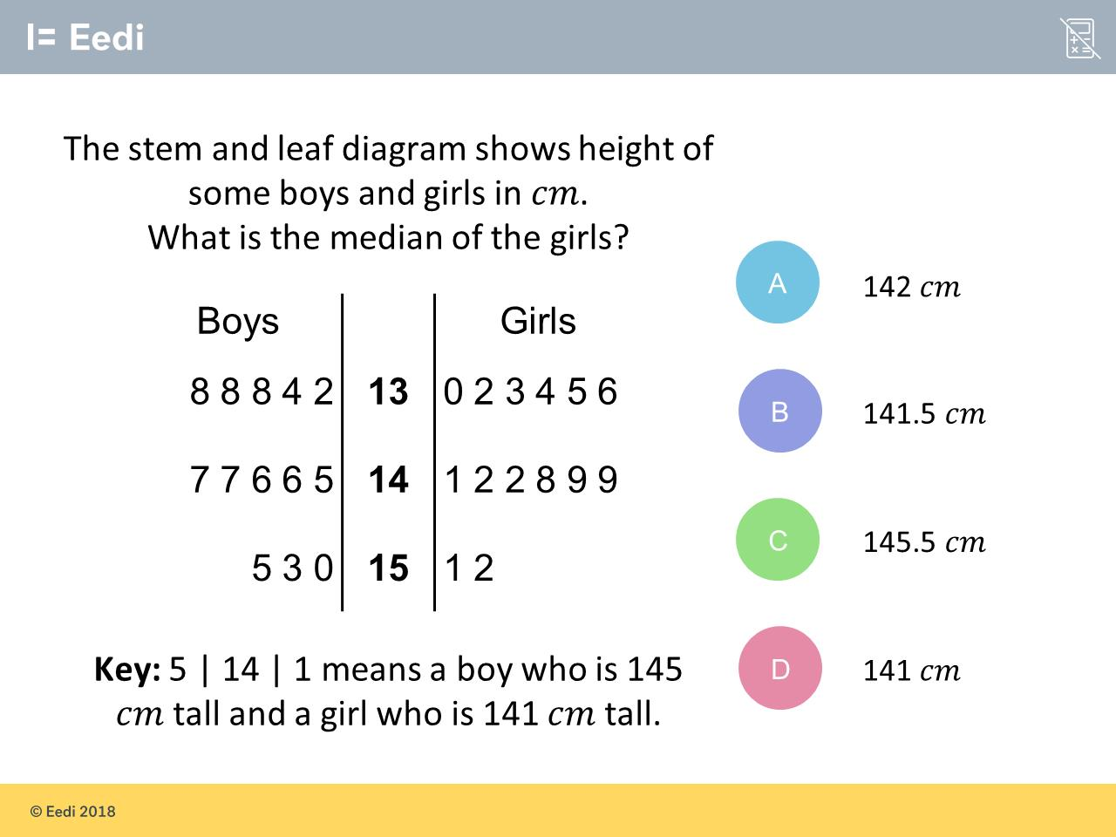
Question 5 – Stem and Leaf

Slide 13
Answer 5 – Stem and Leaf
CORRECT ANSWER | CORRECT EXPLANATION
141.5cm | There are 14 girls, so we need the average of the 7th and 8th girl. This is the average of 141 and 142, which is 141.5 cm.
COMMON MISTAKES | WHAT MIGHT BE YOUR MISTAKE
142cm | The student has taken one of the numbers either side of the median.
145.5cm | The student has found the median of the boys.
141cm | The student has taken one of the numbers either side of the median.

Slide 14
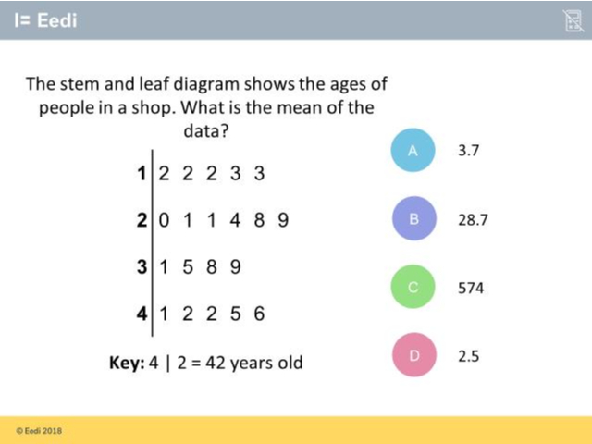
Question 6 – Stem and Leaf

Slide 15
Answer 6 – Stem and Leaf
CORRECT ANSWER | CORRECT EXPLANATION
28.2 | The total of the ages is 564. We then divide by 20 to get a mean of 28.2.
COMMON MISTAKES | WHAT MIGHT BE YOUR MISTAKE
3.7 | The student may have found the mean of the digits, rather than the ages.
574 | The student has given the total, not the mean.
2.5 | The student has found the mean of the stem numbers.

Slide 16
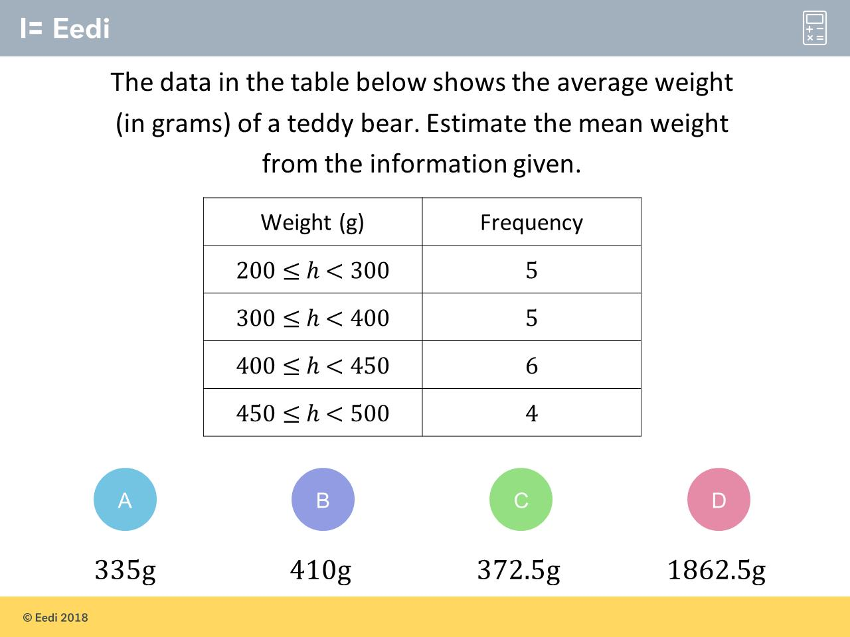
Question 7 – Averages (Group Frequency)

Slide 17
Answer 7 – Averages (Group Frequency)
CORRECT ANSWER | CORRECT EXPLANATION
372.5kg | We need to multiply the midpoints by the frequencies, which gives (250 × 5 + 350 × 5 + 425 × 6 + 475 × 4)/20 = 372.5.
COMMON MISTAKES | WHAT MIGHT BE YOUR MISTAKE
335kg | The student has used the lower bounds on the intervals, rather than the midpoint.
410kg | The student has used the upper bounds on the intervals, rather than the midpoint.
1862.5kg | The student may have divided by the number of groups, instead of the total frequency.

Slide 18
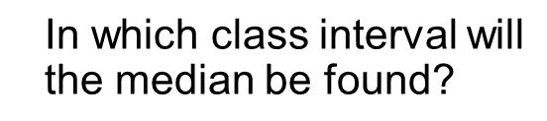
Question 8 – Averages (Group Frequency)

Slide 19
Answer 8 – Averages (Group Frequency)
CORRECT ANSWER | CORRECT EXPLANATION
15 – 19 | The total frequency is 50, so we require the 25th data point. This occurs in the 15 - 19 test score interval.
COMMON MISTAKES | WHAT MIGHT BE YOUR MISTAKE
25 | The student has given the median frequency.
10 – 14 | The student has given the middle test score interval.
17 | The student has given the frequency of the correct interval.

Slide 20
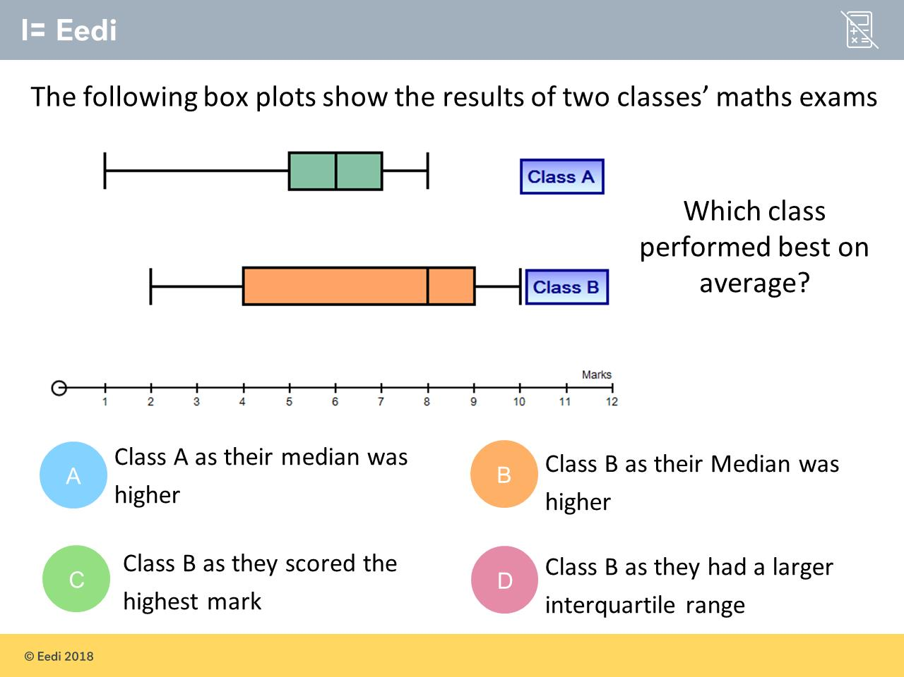
Question 9 – Box Plots

Slide 21
Answer 9 – Box Plots
CORRECT ANSWER | CORRECT EXPLANATION
B | Class B has median 8, whereas class A has median 6.
COMMON MISTAKES | WHAT MIGHT BE YOUR MISTAKE
A | The student has misread the medians.
C | The student is confusing highest mark with average performance.
D | The student may not recognise that IQR is not a measure of average performance.

Slide 22
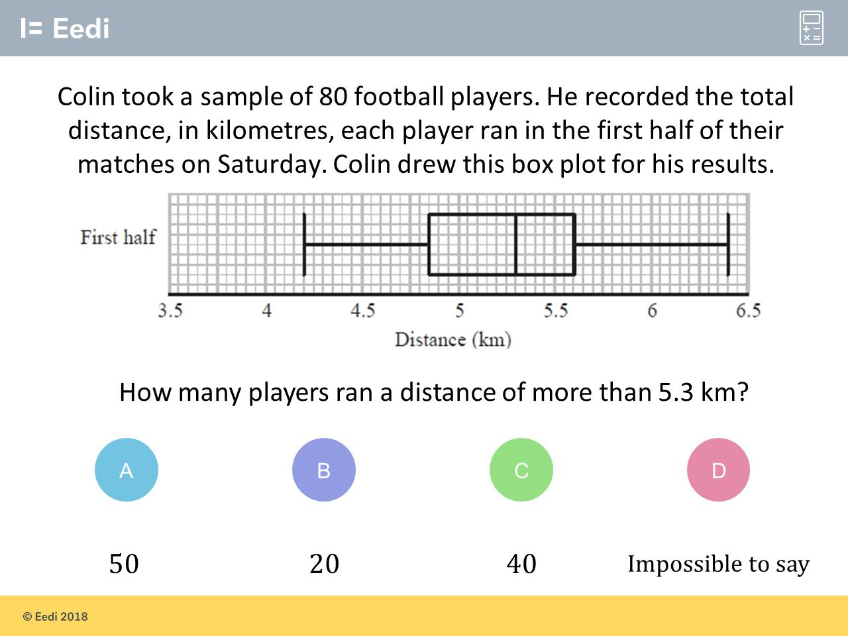
Question 10 – Box Plots

Slide 23
Answer 10 – Box Plots
CORRECT ANSWER | CORRECT EXPLANATION
40 | The median is 5.3, so we know that 50% ran more than that. 50% of 80 is 40.
COMMON MISTAKES | WHAT MIGHT BE YOUR MISTAKE
50 | The student has found the percentage above, not the number of players.
20 | The student may be confusing the median with the upper quartile.
Impossible to say | The student has not recognised that we know the number of players.

Slide 24
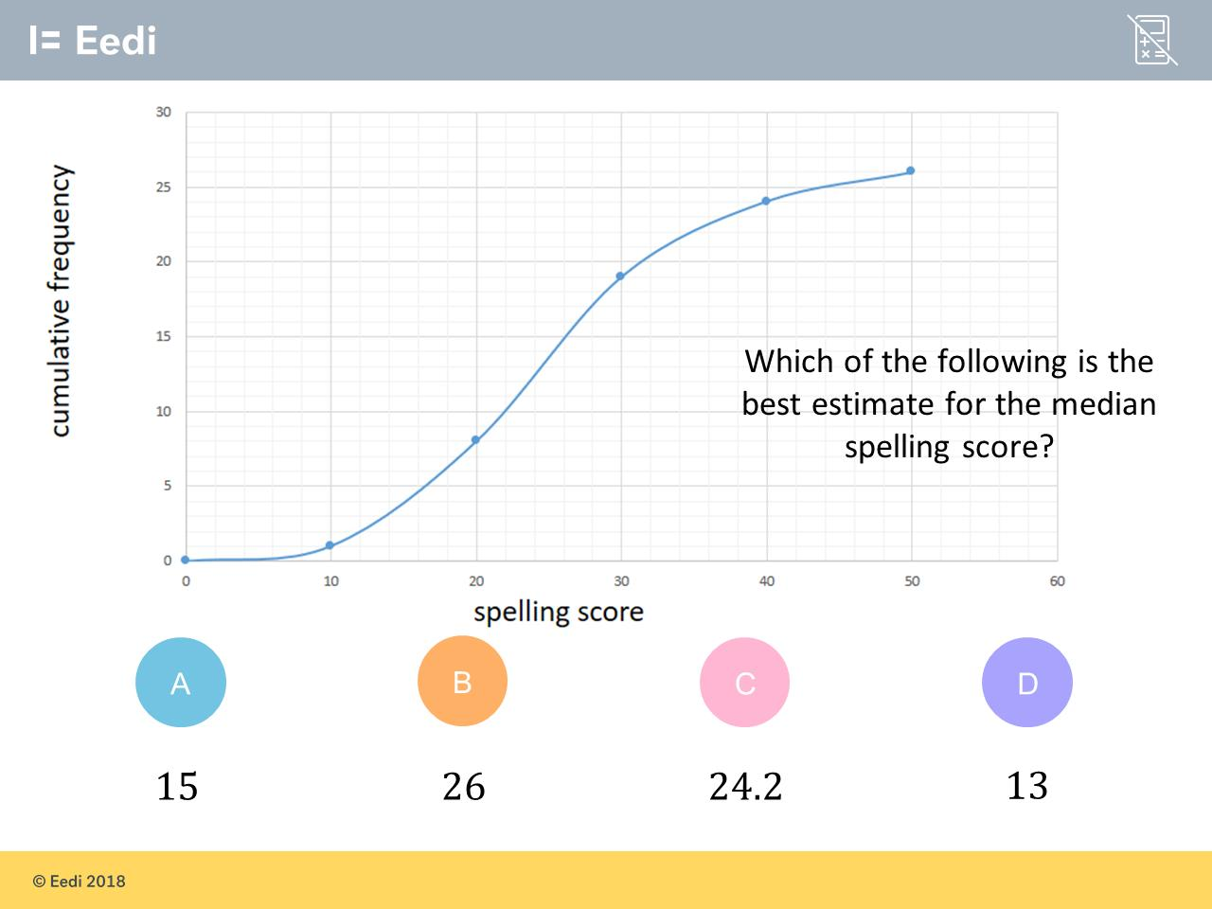
Question 11 – Cumulative Frequency Graphs

Slide 25
Answer 11 – Cumulative Frequency Graphs
CORRECT ANSWER | CORRECT EXPLANATION
C | The total frequency is 26, so we need to read off the graph at y = 13. This gives x = 24.2.
COMMON MISTAKES | WHAT MIGHT BE YOUR MISTAKE
A | The student has found half of 30, the highest cumulative number on the y axis.
B | The student has found the median as if the cumulative frequency was 30.
D | The student has found the frequency that gives the median.

Slide 26
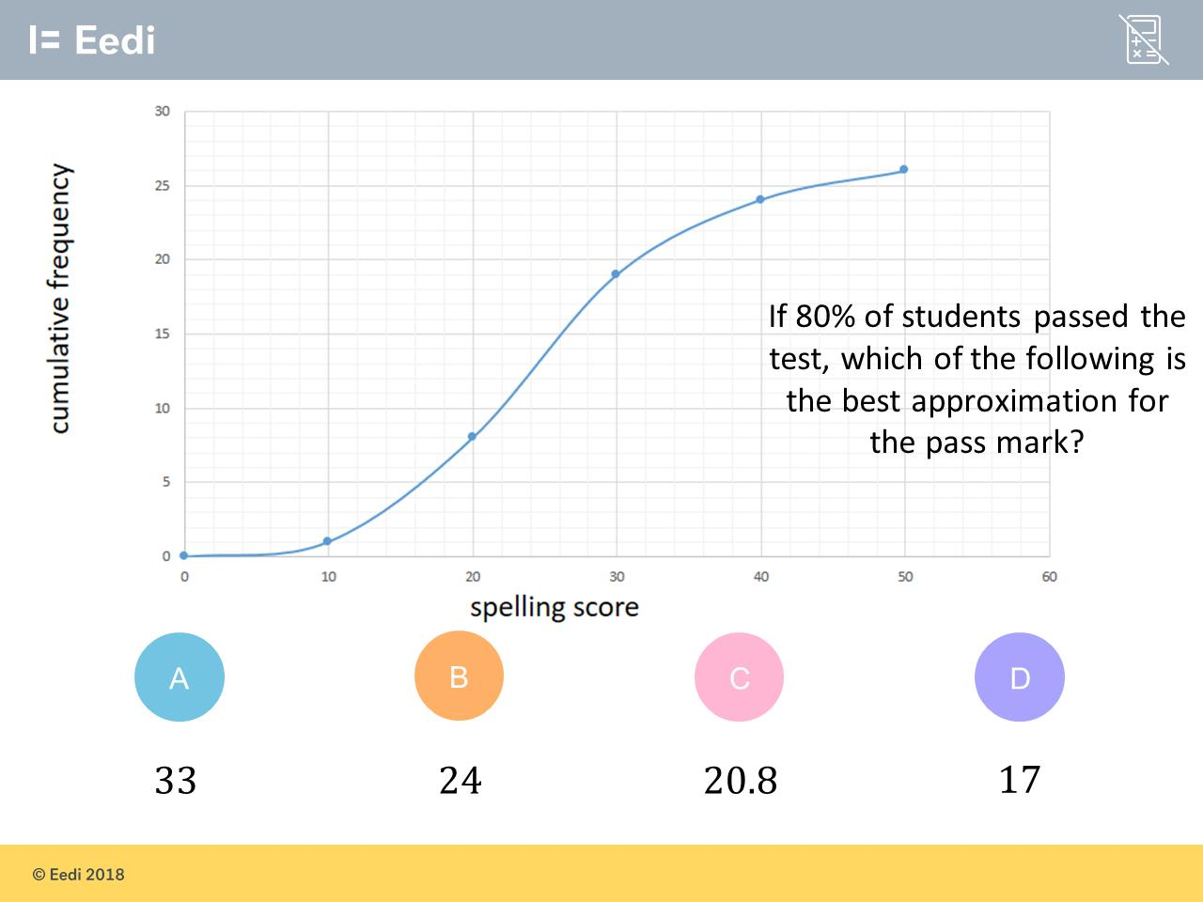
Question 12 – Cumulative Frequency Graphs

Slide 27
Answer 12 – Cumulative Frequency Graphs
CORRECT ANSWER | CORRECT EXPLANATION
D | 20% of 26 is 26 × 0.2 = 5.2. Reading off from the y axis at 5.2 gives a pass score of 17.
COMMON MISTAKES | WHAT MIGHT BE YOUR MISTAKE
A | The student has worked out the score for which 80% of students got below, not above.
B | The student has used 80% of 50, instead of 26. And head read the graph backwards.
C | The student has found 80% of 26.

Slide 28
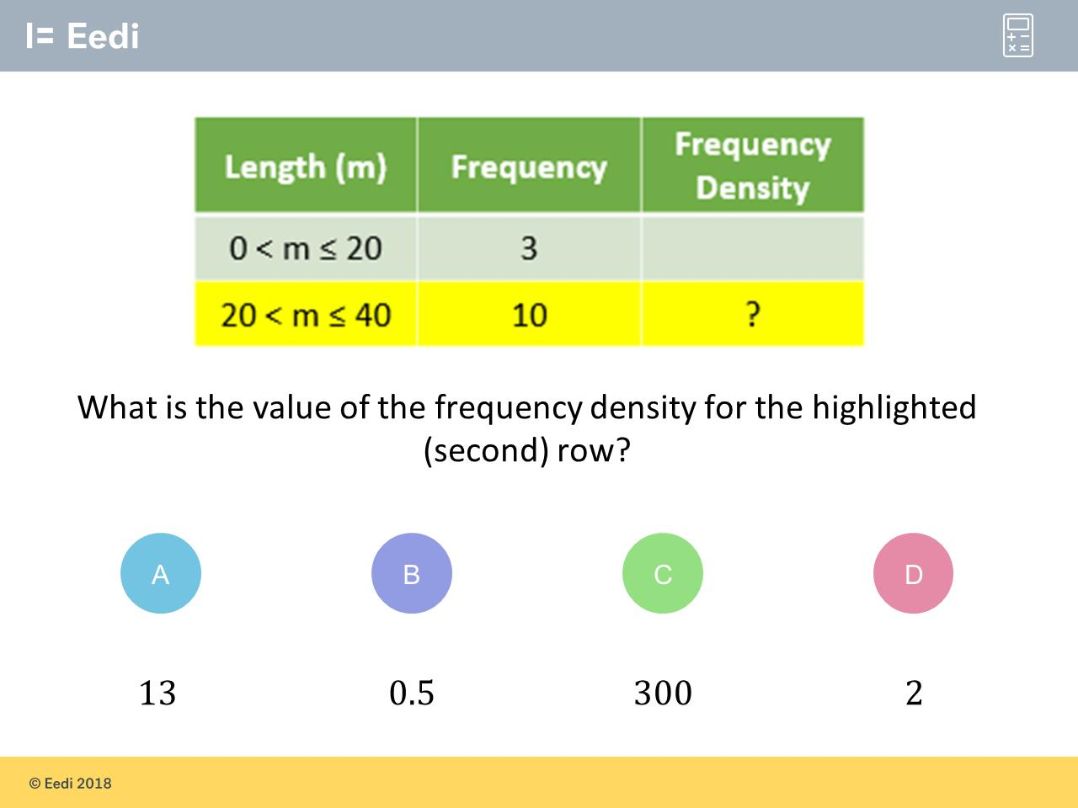
Question 13 – Histograms

Slide 29
Answer 13 – Histograms
CORRECT ANSWER | CORRECT EXPLANATION
0.5 | The frequency density is the frequency divided by the class width. So we have 10/20 = 0.5.
COMMON MISTAKES | WHAT MIGHT BE YOUR MISTAKE
13 | The student has found the cumulative frequency.
300 | The student has found the frequency × midpoint.
2 | The student has divided the wrong way around.

Slide 30
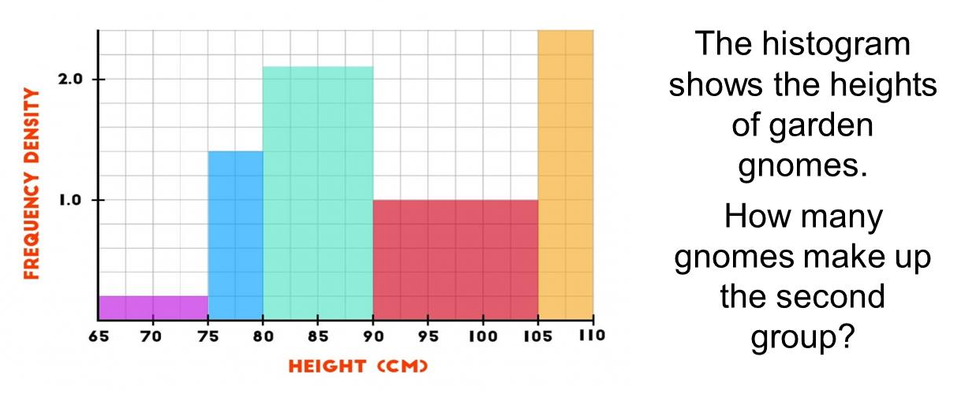
Question 14 – Histograms

Slide 31
Answer 14 – Histograms
CORRECT ANSWER | CORRECT EXPLANATION
7 | The frequency density is 1.4, and the width class is 5. Multiplying these two together gives 7.
COMMON MISTAKES | WHAT MIGHT BE YOUR MISTAKE
14 | The student has counted the number of squares.
1.4 | The student may have just read the scale on the y axis.
Not enough information | The student may be confusing histograms and pie charts.

Slide 32
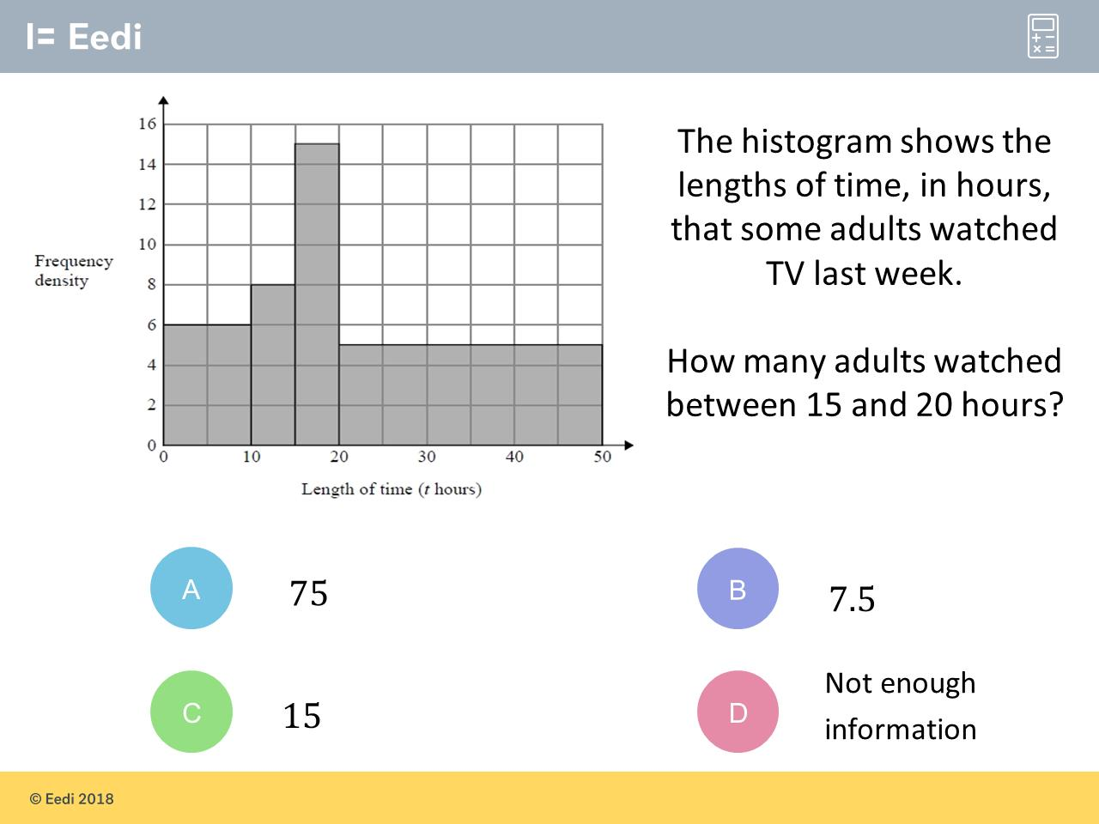
Question 15 – Histograms

Slide 33
Answer 15 – Histograms
CORRECT ANSWER | CORRECT EXPLANATION
75 | The frequency density for this period is 15, and the class width is 5. Multiplying the two together gives 75.
COMMON MISTAKES | WHAT MIGHT BE YOUR MISTAKE
7.5 | The student has counted the number of squares.
15 | The student may have just read the scale on the y axis.
Not enough information | The student may be confusing histograms and pie charts.

