Slide 1
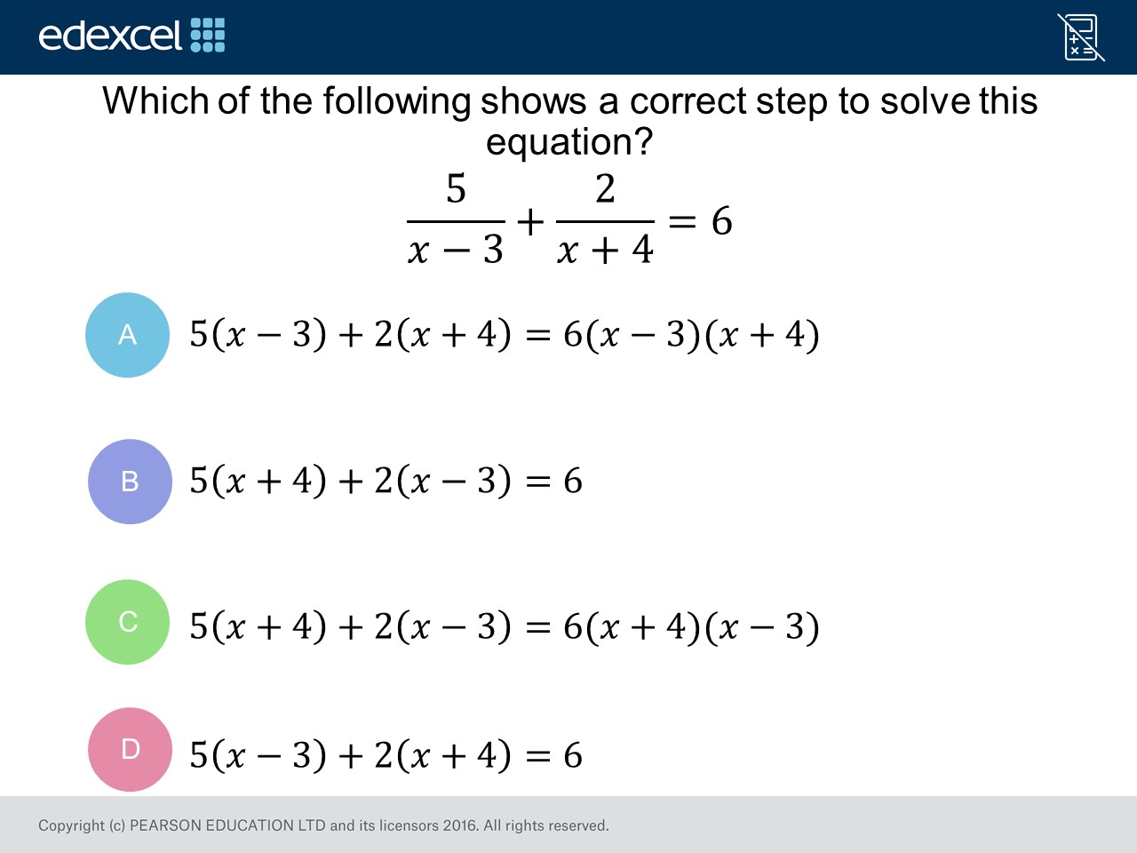
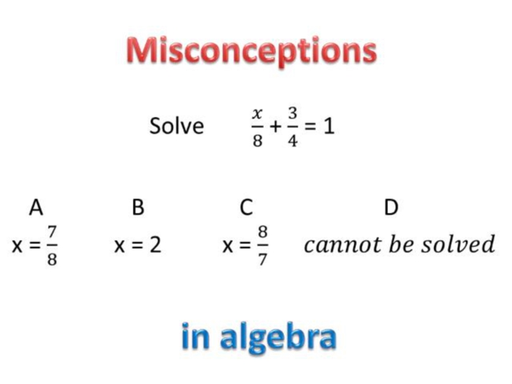
Worst answered question?
Most common wrong answer?

Slide 2
ANSWERS

Slide 3
Worst answered question?

Slide 4
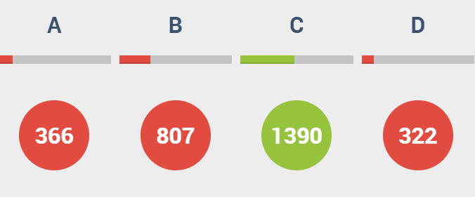
B
They forgot about the denominator.

Slide 5
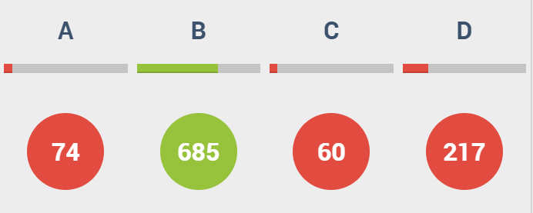
D
They don’t know how to add fractions.

