Slide 1

Junior Challenge 4
BRONZE

Slide 2
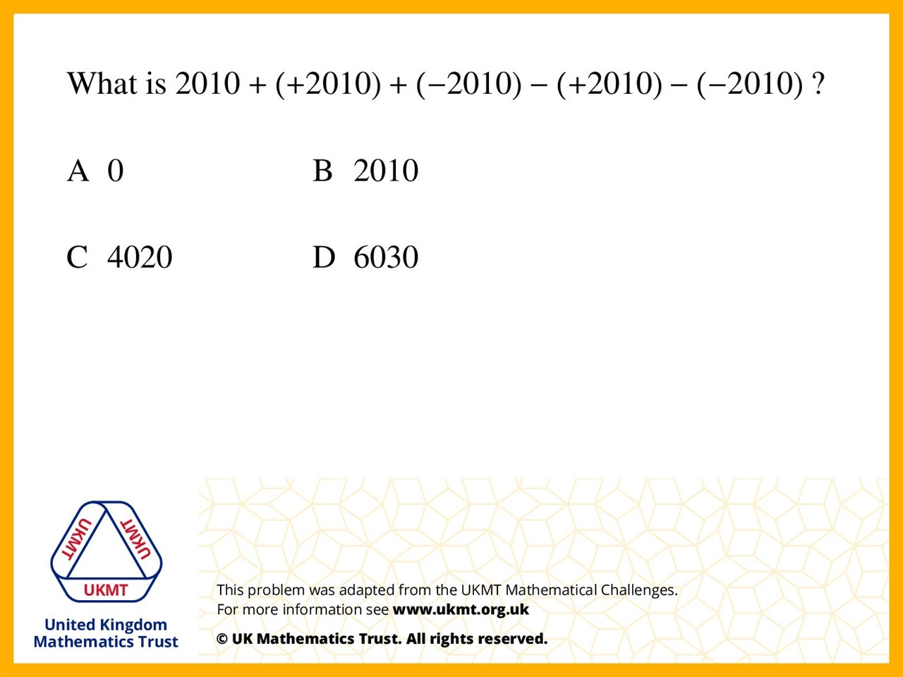
Q1.
2010 + 2010 – 2010 – 2010 + 2010 = 2010

Slide 3
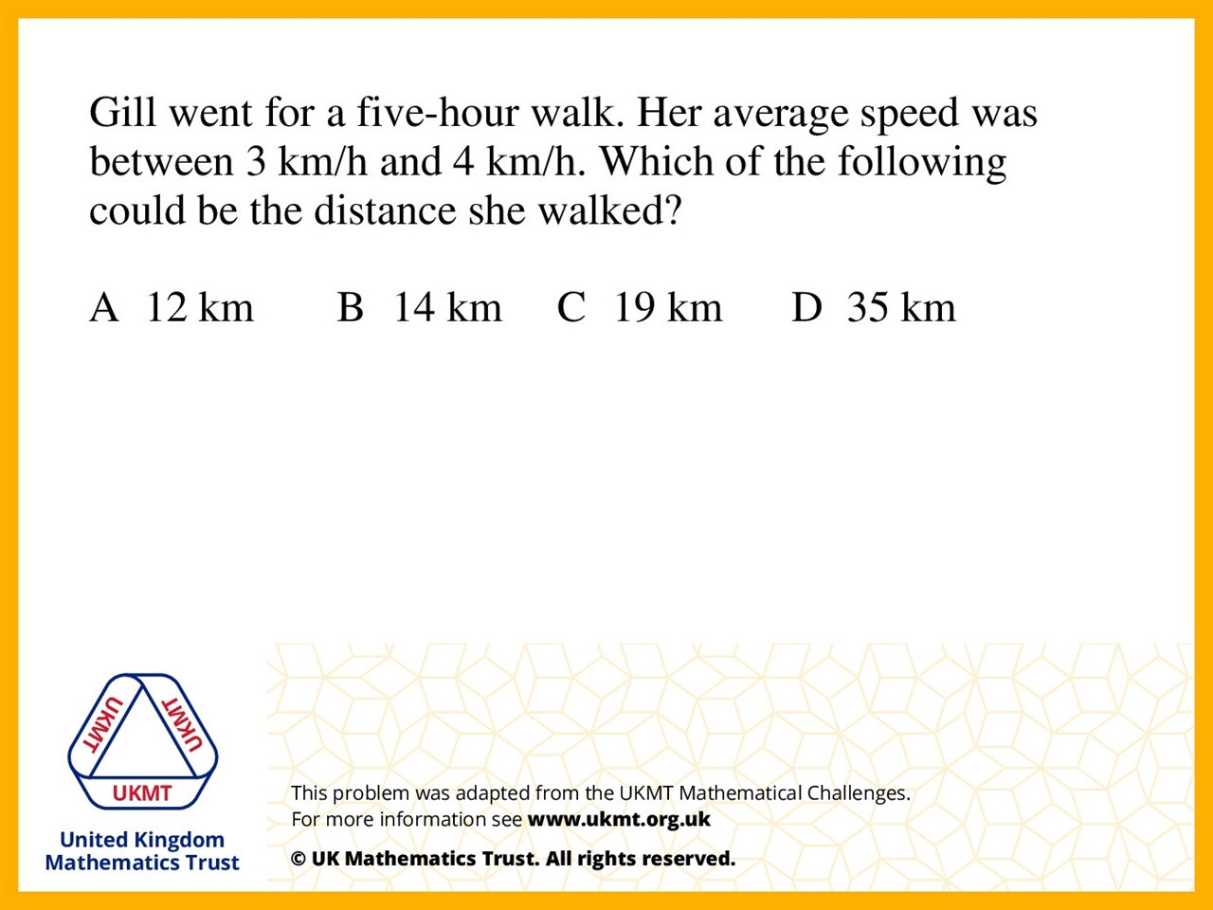
Q2.
3 x 5 = 15 4 x 5 = 20 so the answer has to be between 15 and 20 and the only answer between those numbers was 19, so the answer is 19

Slide 4
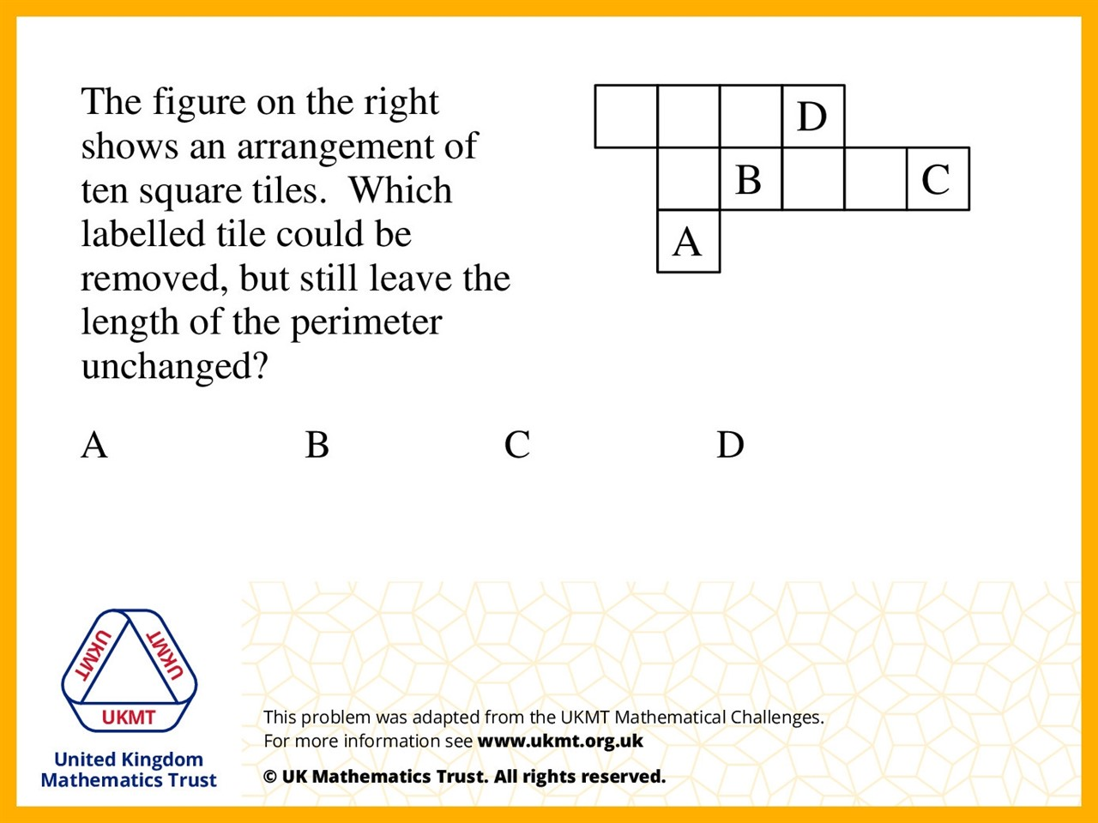
Q3.
The 2 lengths that make up the perimeter in the square D do not effect the overall perimeter if removed because the 2 remaining lengths of D are equal to the 2 lengths that make up the perimeter

Slide 5
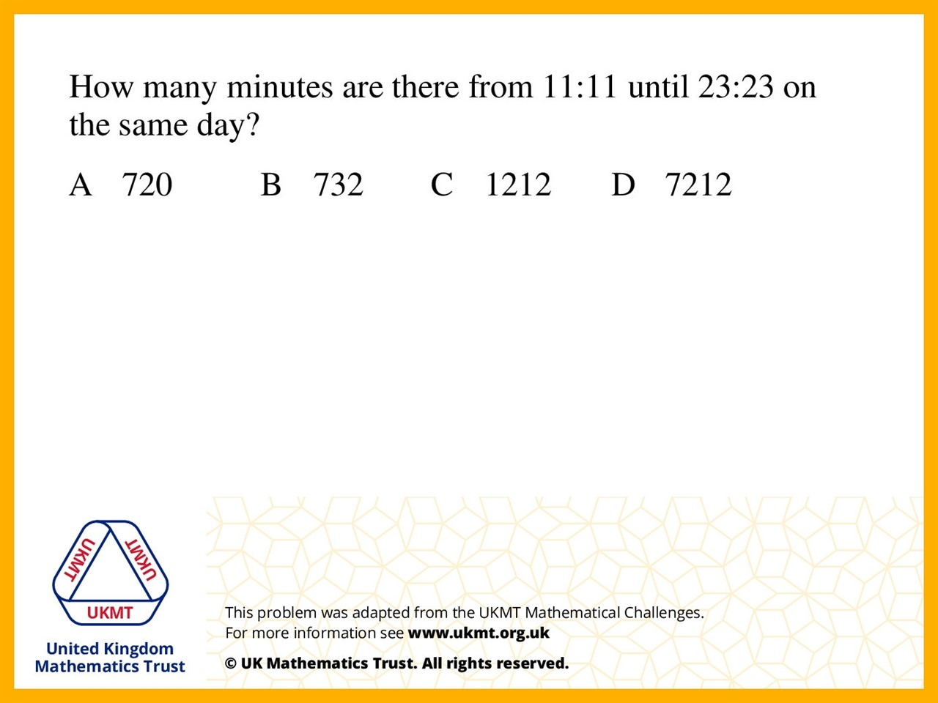
Q4.
12 times 60 = 720
720 + (23 – 11) = 732

Slide 6
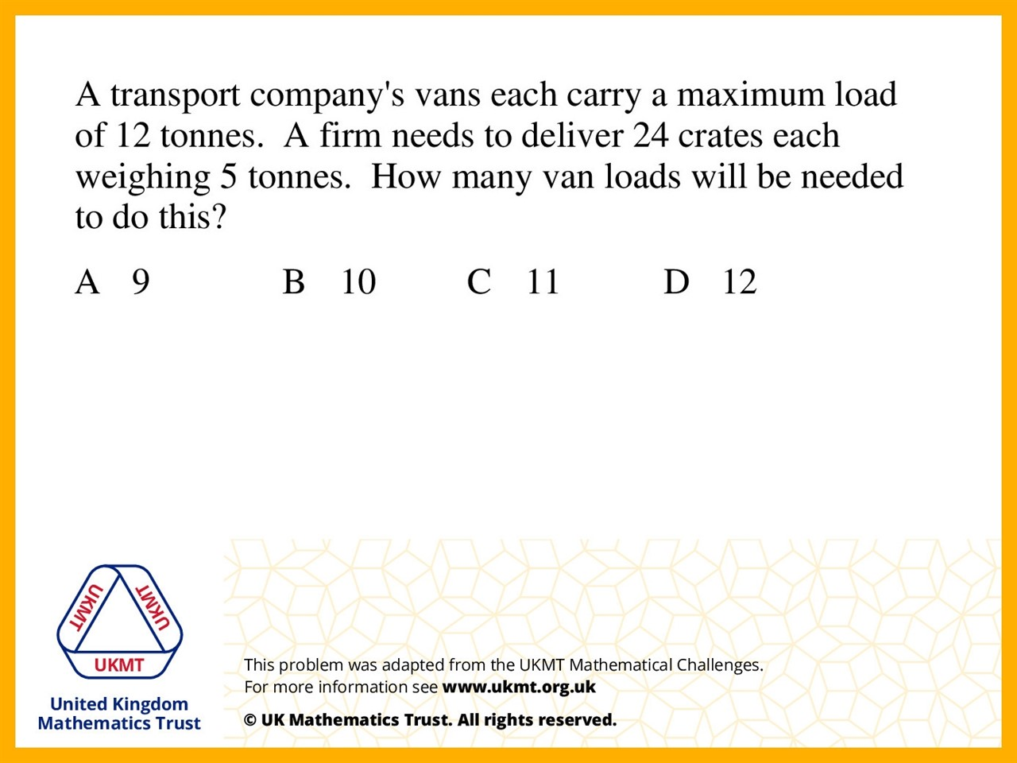
Q5.
Because 24 crates would weigh 120 tonnes .
Each one is 5 tonnes.
So the van only carry 12 tons.
The crates is 5 tonnes so 2 crates can carry at a time. That means it's divided by 10, and it's 12.

