Slide 1
Proof for Area of Circle Formula
Step 1) Cut out the circle that is divided up into 16 equal parts.
Step 2) Cut out all the sectors
Step 3) Stick all the sectors together to make a parallelogram.

Slide 2
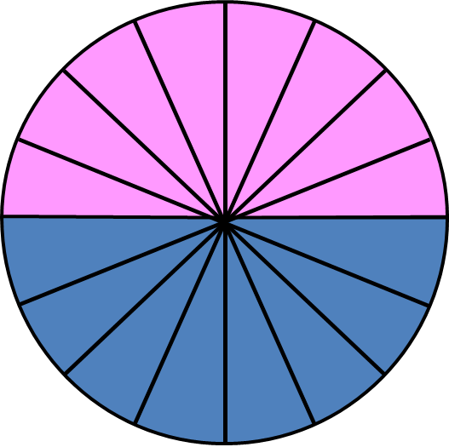

Slide 3
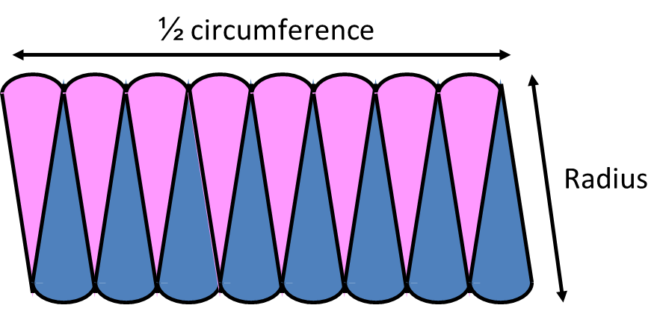

Slide 4
½ circumference
Radius
Area = | ½ | x | circumference |  |  |  |  | x | radius
Area = | ½ | x | pi | x | 2 | x | radius | x | radius
Area = |  |  | pi |  |  | x | radius | x | radius
Area = |  |  | pi |  |  | x | radius | 2

