Slide 1
LO: Linear Equations
from One Co-ordinate

Slide 2
What is the equation of line?
y
Gradient = 5
x
(0,0)
y = 5x

Slide 3
What is the equation of line?
y
Gradient = 5
(0,2)
x
y = 5x + 2

Slide 4
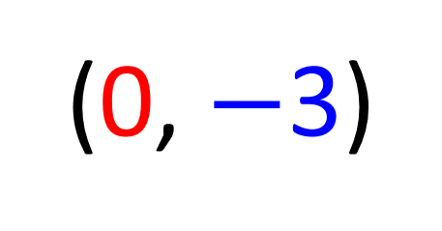
What is the equation of line?
y
Gradient = 3
x
(0, $−$3)
y = 3x – 3

Slide 5
What is the equation of line?
y
Gradient = –5
(0,3)
x
y = –5x + 3

Slide 6
What is the equation of line?
y
Gradient = 3
(2,6)
x
y = 3x

Slide 7
What is the equation of line?
y
Gradient = 3
(1, 5)
x
y = 3x + 2

Slide 8
What is the equation of line?
y
Gradient = 3
y = 3x + c
(3,7)
7 = 3(3) + c
x
7 = 9 + c
y = 3x – 2

Slide 9
What is the equation of line?
y
Gradient = 3
y = 3x + c
(1,8)
8 = 3(1) + c
x
8 = 3 + c
y = 3x + 5

Slide 10
What is the equation of line?
y
Gradient = 2
y = 2x + c
–5 = 2(–1) + c
x
–5 = –2 + c
(-1, -5)
y = 2x – 3

Slide 11
What is the equation of line?
y
Gradient = –3
y = –3x + c
(-2, 4)
4 = –3(–2) + c
x
4 = 6 + c
y = –3x – 2

