Slide 1
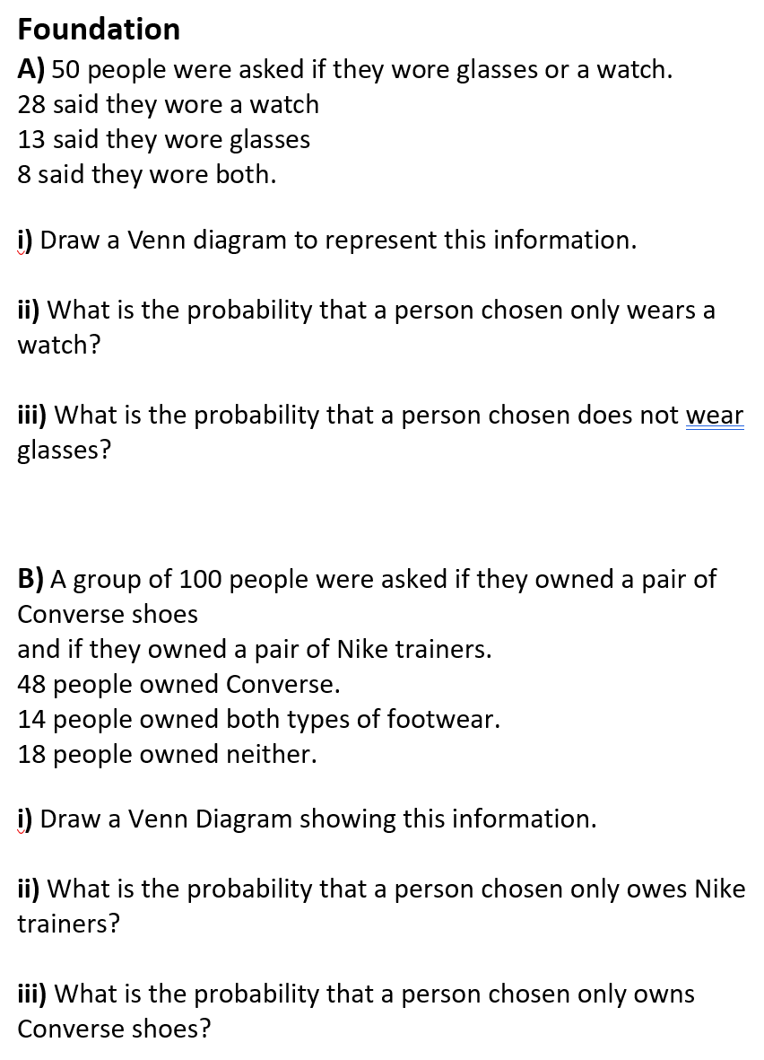
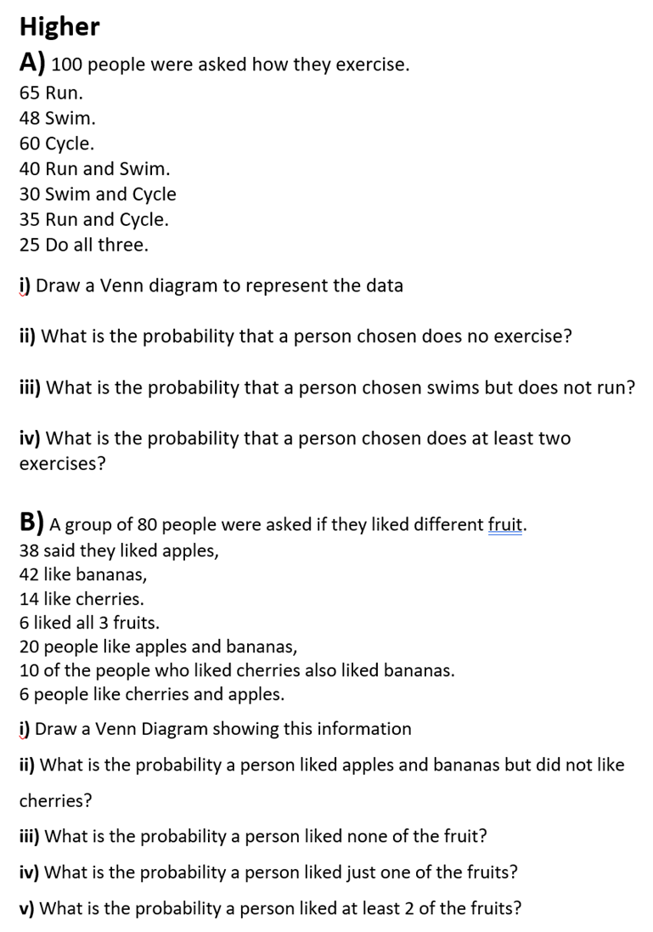

Slide 2
ANSWERS

Slide 3
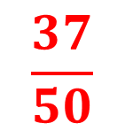
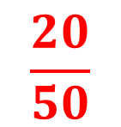
A) 50 people were asked if they wore glasses or a watch.
28 said they wore a watch
13 said they wore glasses
8 said they wore both.
i) Draw a Venn diagram to represent this information.
G
W
5
8
20
17
$$\frac{20}{50}$$
ii) What is the probability that a person chosen only wears a watch?
iii) What is the probability that a person chosen does not wear glasses?
$$\frac{37}{50}$$

Slide 4
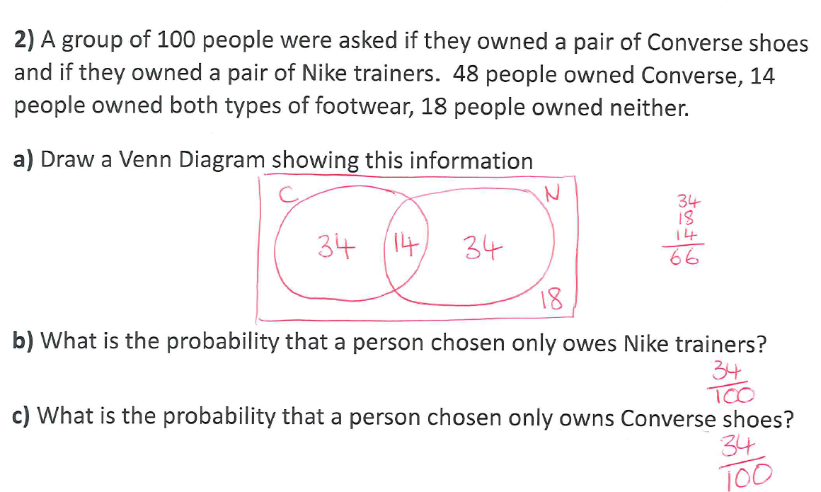
2) A group of 100 people were asked if they owned a pair of Converse shoes and if they owned a pair of Nike trainers. 48 people owned Converse, 14 people owned both types of footwear, 18 people owned neither.
a) Draw a Venn Diagram showing this information
b) What is the probability that a person chosen only owes Nike trainers?
c) What is the probability that a person chosen only owns Converse shoes?
B)

Slide 5
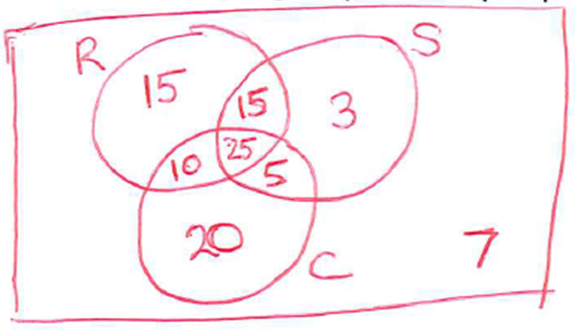
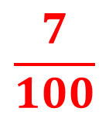
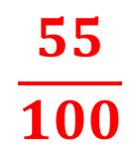
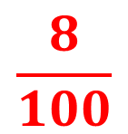
A) 100 people were asked how they exercise.
65 Run.
48 Swim.
60 Cycle.
40 Run and Swim.
30 Swim and Cycle
35 Run and Cycle.
25 Do all three.
i) Draw a Venn diagram to represent the data
$$\frac{7}{100}$$
ii) What is the probability that a person chosen does no exercise?
iii) What is the probability that a person chosen swims but does not run?
iv) What is the probability that a person chosen does at least two exercises?
$$\frac{8}{100}$$
$$\frac{55}{100}$$

Slide 6
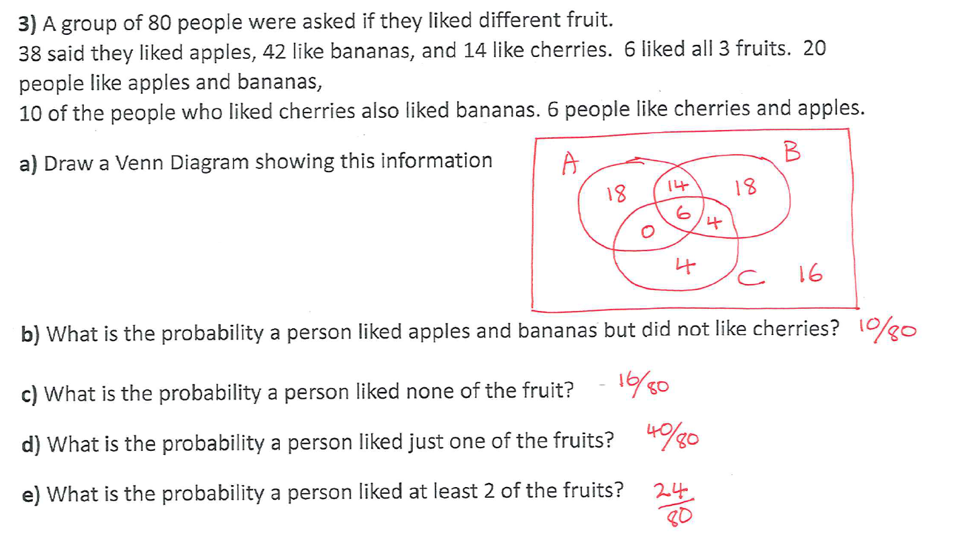
B)
14

