Slide 1
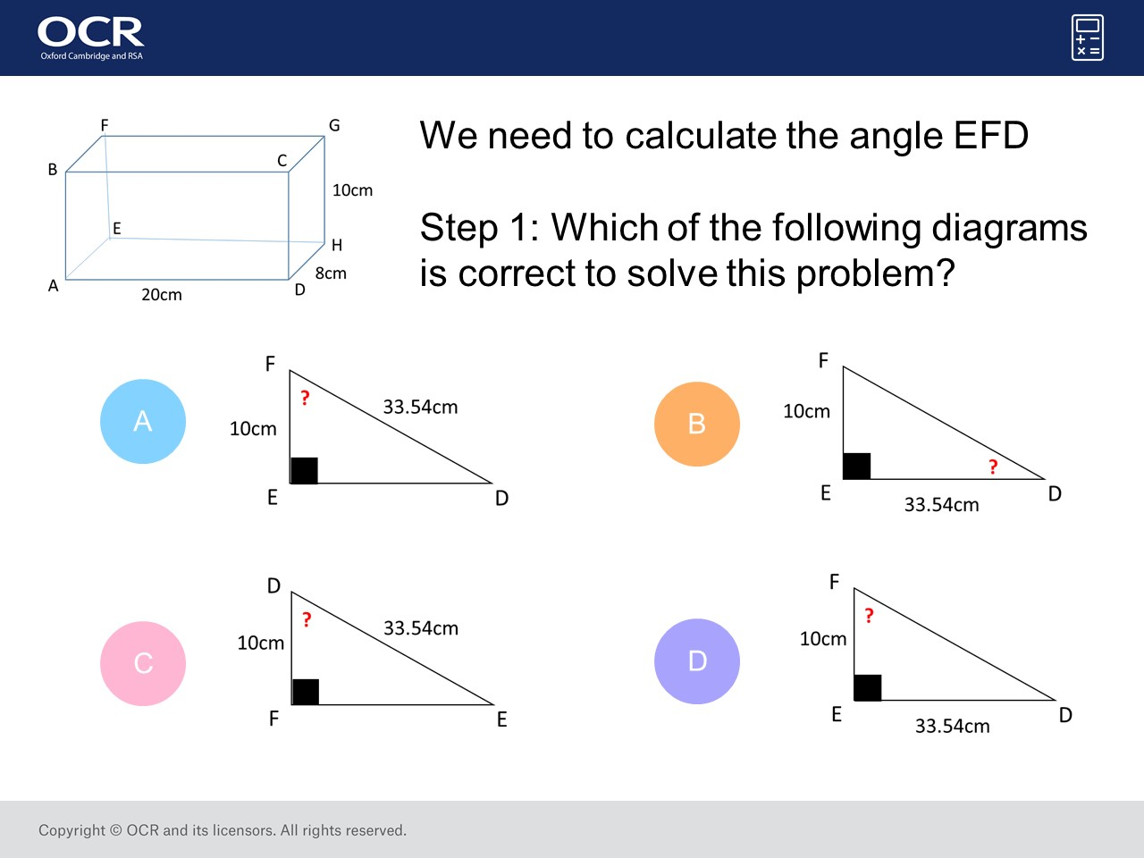
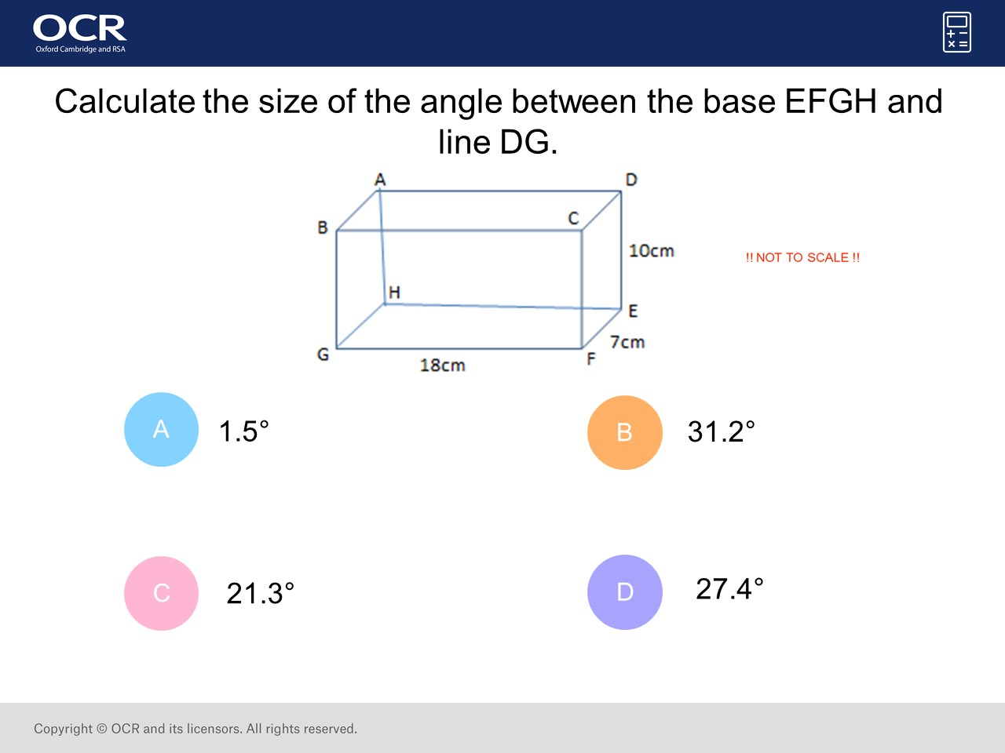
Worst answered question?
Most common wrong answer?

Slide 2
ANSWERS

Slide 3
Worst answered question?

Slide 4
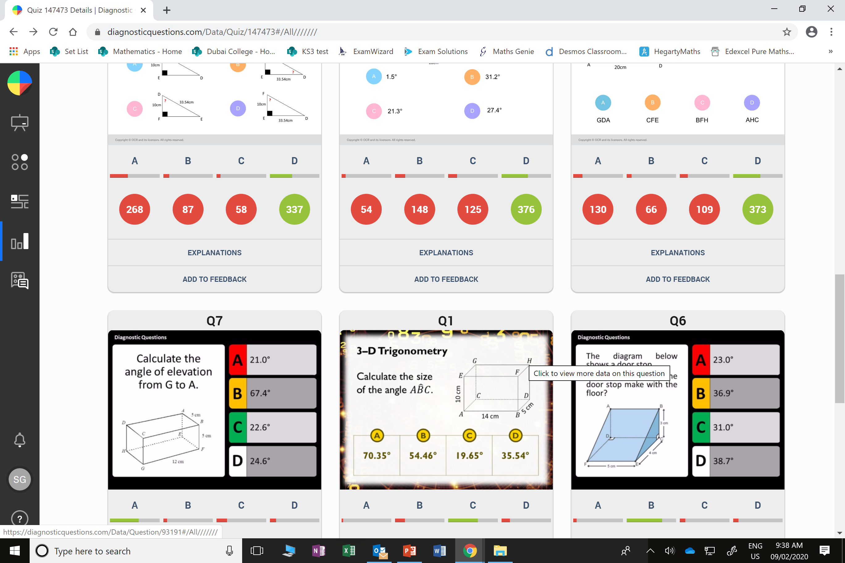
A
You need to work about 33.54cm before you can do this step.

Slide 5
B
Who knows!

