Slide 1
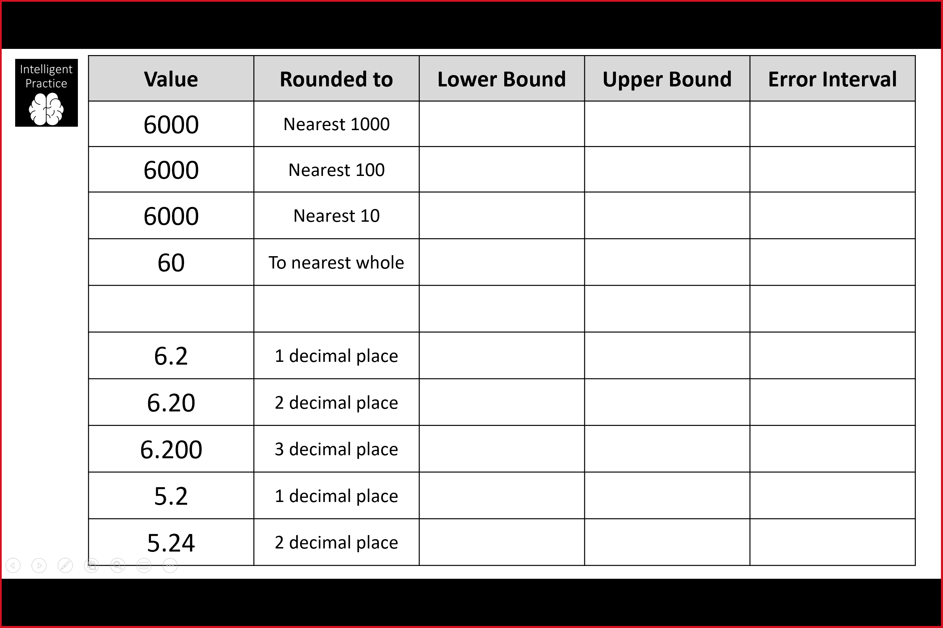
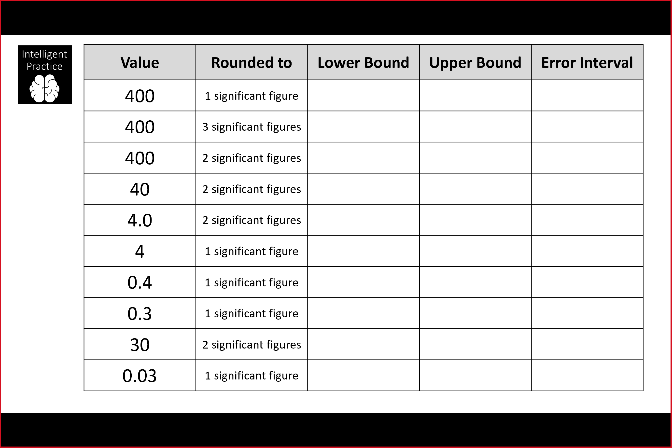

Slide 2
ANSWERS

Slide 3
5500 | 6500
350 | 450
5950 | 6050
399.5 | 400.5
5995 | 6005
395 | 405
59.5 | 60.5
39.5 | 40.5
3.95 | 4.05
6.15 | 6.25
3.5 | 4.5
6.195 | 6.205
0.35 | 0.45
6.1995 | 6.2005
0.25 | 0.35
5.15 | 5.25
29.5 | 30.5
5.235 | 5.245
0.025 | 0.035

