Slide 1
Probability
Full Laws of Probability
Chapter 2
(Part 3 of 4)

Slide 2
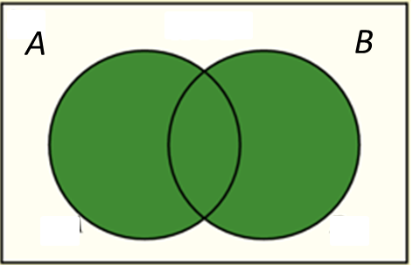
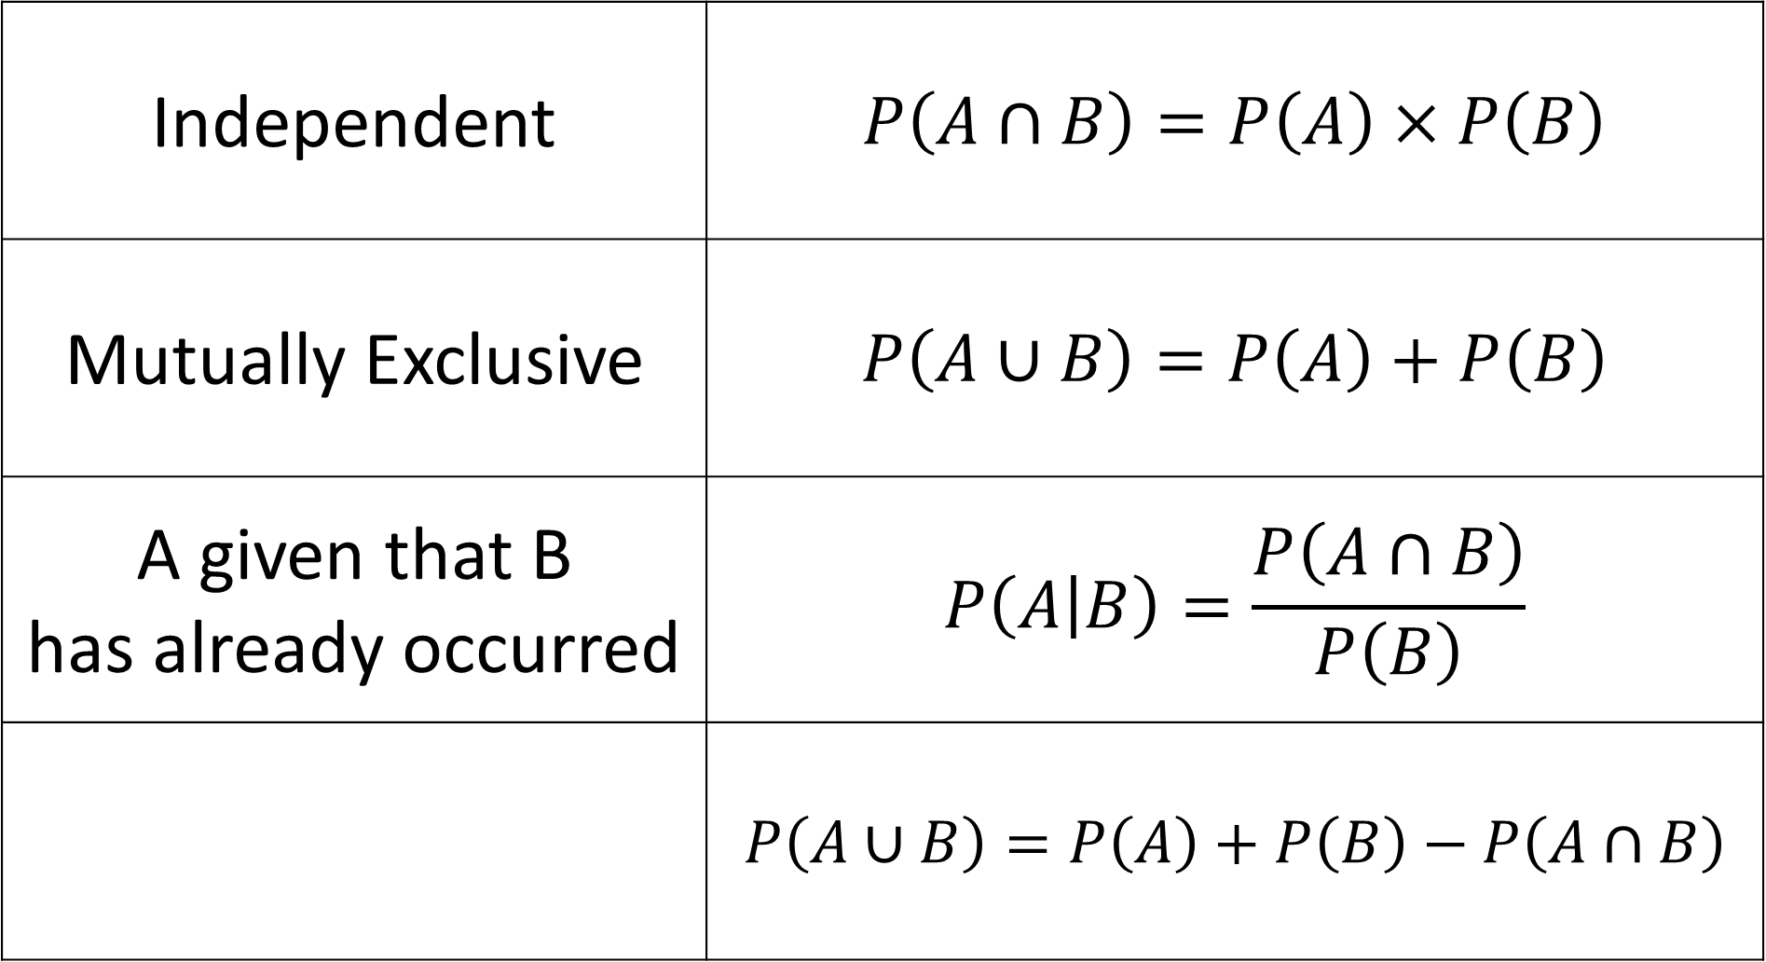
Independent | $$P\left(A∩B\right)=P\left(A\right)×P\left(B\right)$$
Mutually Exclusive | $$P\left(A∪B\right)=P\left(A\right)+P\left(B\right)$$
A given that B has already occurred | $$P\left(A | B\right)=\frac{P\left(A∩B\right)}{P\left(B\right)}$$
 | $$P\left(A∪B\right)=P\left(A\right)+P\left(B\right)−P\left(A∩B\right)$$

Slide 3
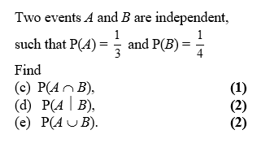
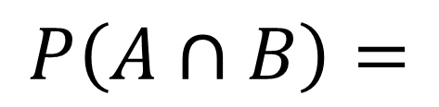
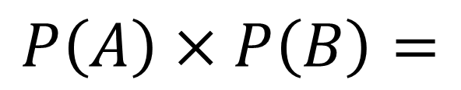
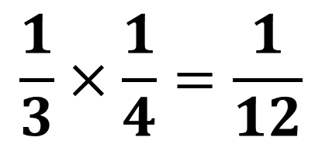
$$\frac{1}{3}×\frac{1}{4}=\frac{1}{12}$$
c
$$P\left(A∩B\right)=$$
$$P\left(A\right)×P\left(B\right)=$$

Slide 4
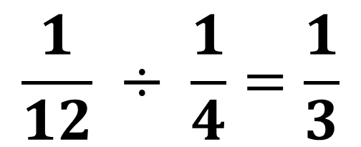
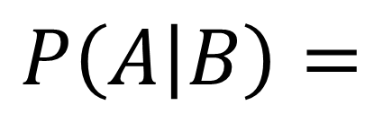
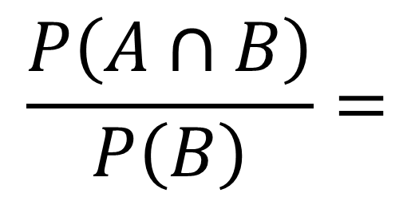
$$\frac{P\left(A∩B\right)}{P\left(B\right)}=$$
$$\frac{1}{12} ÷ \frac{1}{4}=\frac{1}{3}$$
d
$$P\left(A | B\right)=$$

Slide 5
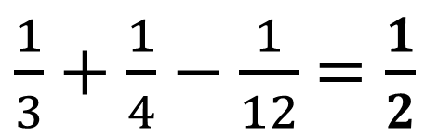
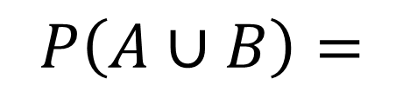
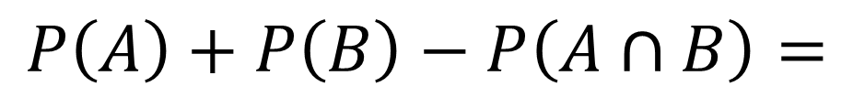
$$P\left(A∪B\right)=$$
$\frac{1}{3}+\frac{1}{4}−\frac{1}{12}$ $=\frac{1}{2}$
e
$$P\left(A\right)+P\left(B\right)−P\left(A∩B\right)=$$

Slide 6
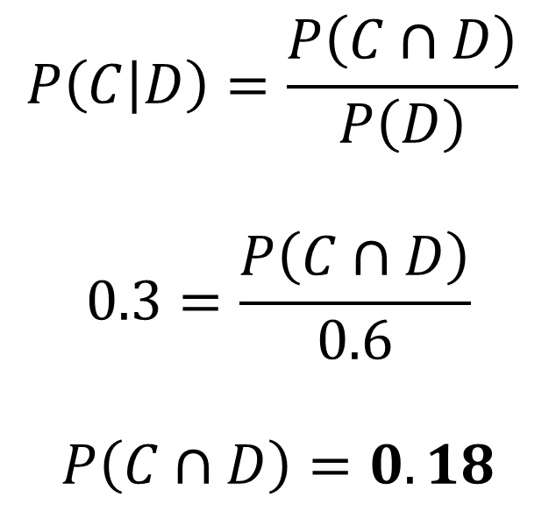
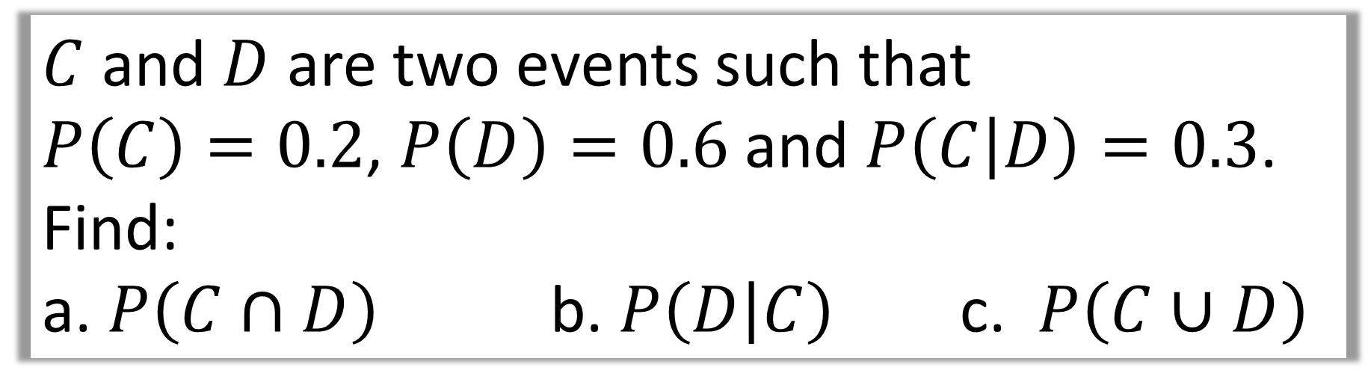
$C$ and $D$ are two events such that
$P\left(C\right)=0.2$, $P\left(D\right)=0.6$ and $P\left(C | D\right)=0.3$.
Find:
a. $P\left(C∩D\right)$ b. $P\left(D | C\right)$ c. $P\left(C∪D\right)$
$$P\left(C | D\right)=\frac{P\left(C∩D\right)}{P\left(D\right)}$$
$$0.3=\frac{P\left(C∩D\right)}{0.6}$$
$$P\left(C∩D\right)=0.18$$
a

Slide 7
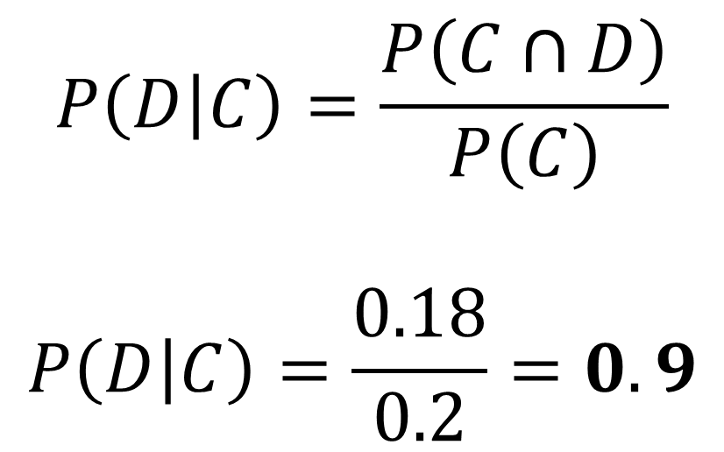
$C$ and $D$ are two events such that
$P\left(C\right)=0.2$, $P\left(D\right)=0.6$ and $P\left(C | D\right)=0.3$.
Find:
a. $P\left(C∩D\right)$ b. $P\left(D | C\right)$ c. $P\left(C∪D\right)$
$$P\left(D | C\right)=\frac{P\left(C∩D\right)}{P\left(C\right)}$$
$$P\left(D | C\right)=\frac{0.18}{0.2}=0.9$$
b

Slide 8

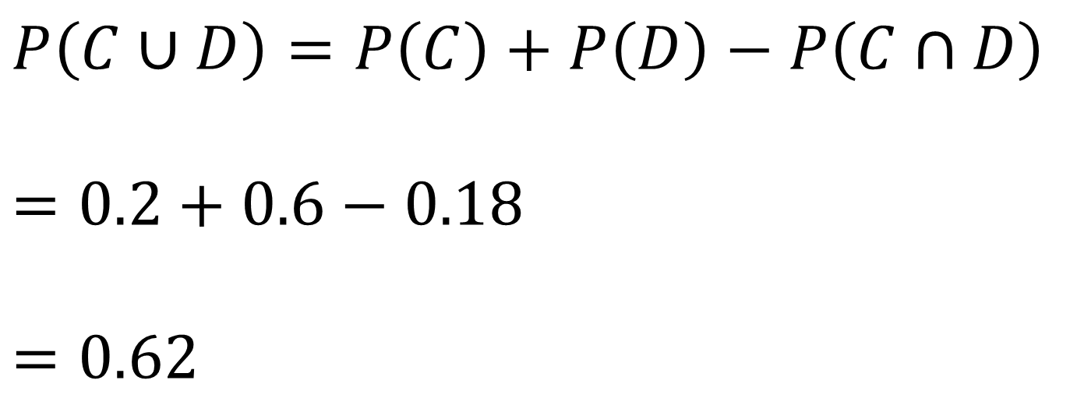
$C$ and $D$ are two events such that
$P\left(C\right)=0.2$, $P\left(D\right)=0.6$ and $P\left(C | D\right)=0.3$.
Find:
a. $P\left(C∩D\right)$ b. $P\left(D | C\right)$ c. $P\left(C∪D\right)$
$$P\left(C∪D\right)=P\left(C\right)+P\left(D\right)−P\left(C∩D\right)$$
$$=0.2+0.6−0.18$$
$$=0.62$$
c

Slide 9
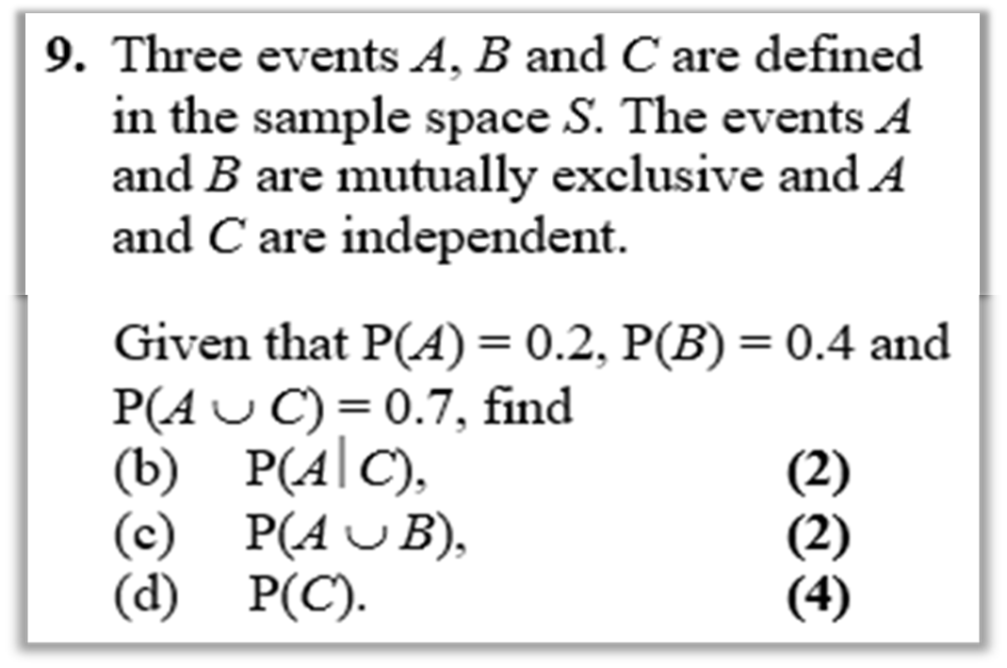
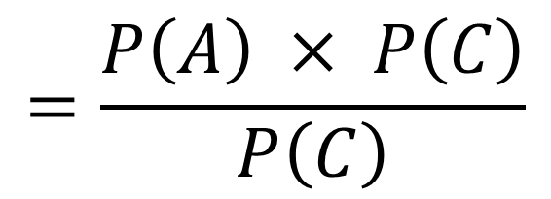
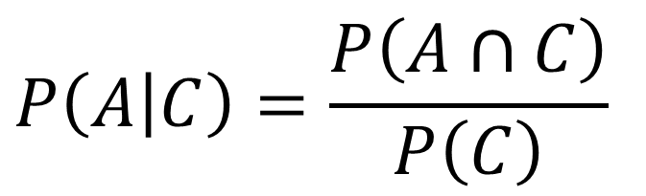
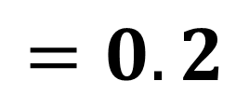
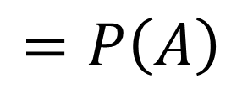
$$P\left(A | C\right)=\frac{P\left(A∩C\right)}{P\left(C\right)}$$
$$=\frac{P\left(A\right) × P\left(C\right)}{P\left(C\right)}$$
b
$$=P\left(A\right)$$
$$=0.2$$

Slide 10
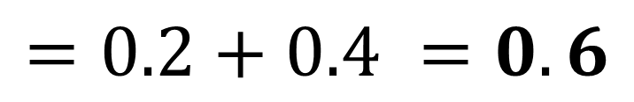
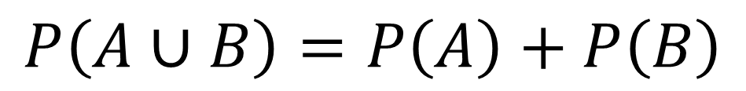
c
$$P\left(A∪B\right)=P\left(A\right)+P\left(B\right)$$
$$=0.2+0.4 =0.6$$

Slide 11
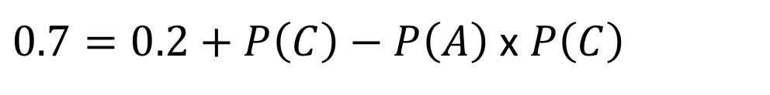
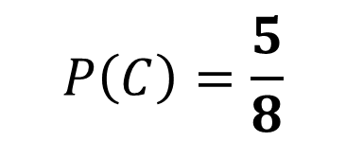

d
$$P\left(A∪C\right)=P\left(A\right)+P\left(C\right)−P\left(A∩C\right)$$
$$0.5=0.8P\left(C\right)$$
$0.7=0.2+P\left(C\right)−P\left(A\right)$ x $P\left(C\right)$
$$P\left(C\right)=\frac{5}{8}$$
$$0.7=0.2+P\left(C\right)−0.2P\left(C\right)$$

