Slide 1
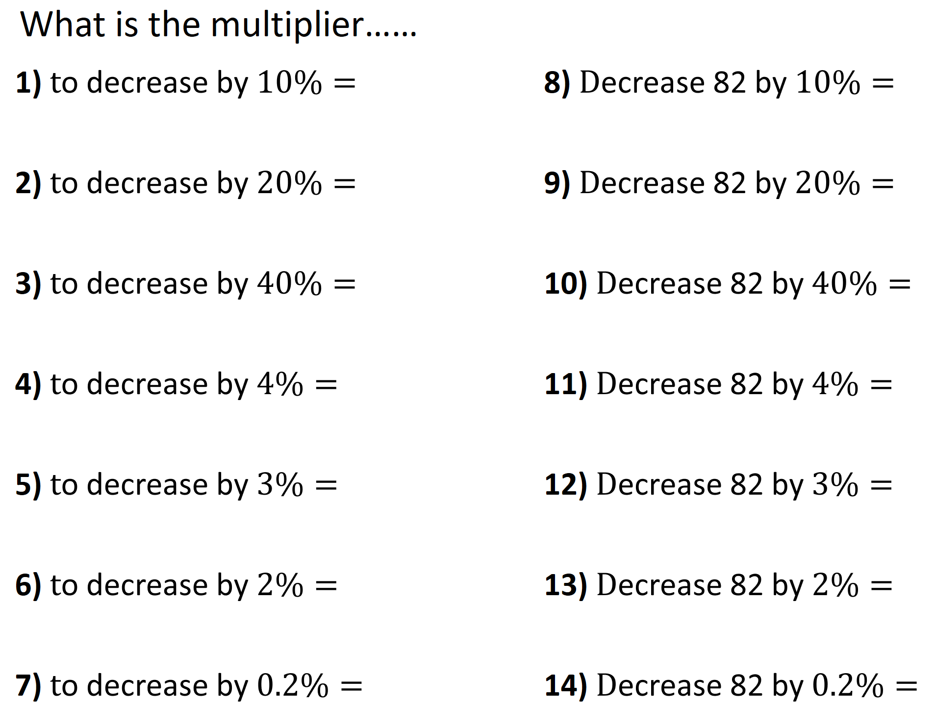

Decrease
Increase

Slide 2
ANSWERS

Slide 3

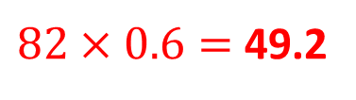
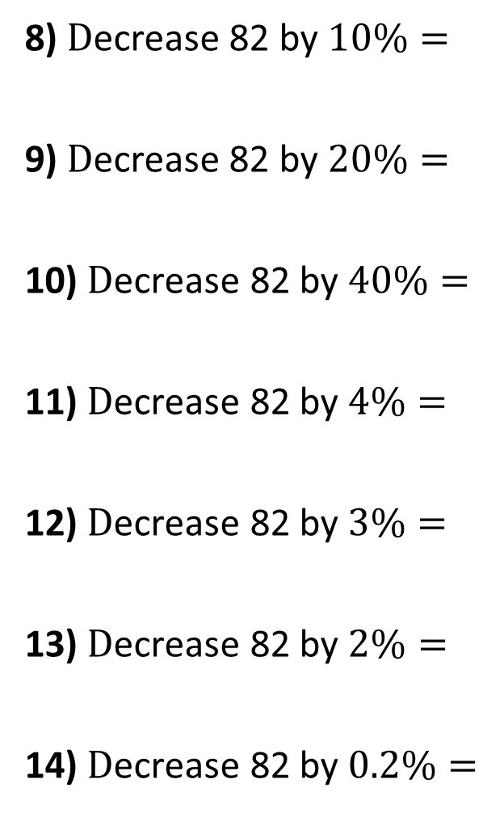



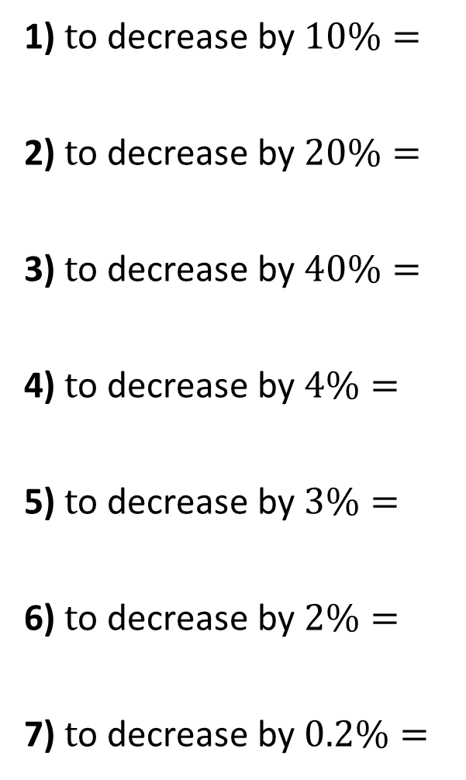


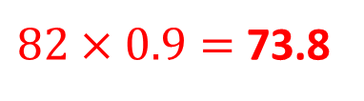





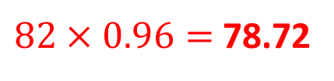
What is the multiplier……
1) $\text{t}\text{o} \text{decrease} \text{by} 10\%=$
2) $\text{t}\text{o} \text{decrease} \text{by} 20\%=$
3) $\text{t}\text{o} \text{decrease} \text{by} 40\%=$
4) $\text{t}\text{o} \text{decrease} \text{by} 4\%=$
5) $\text{t}\text{o} \text{decrease} \text{by} 3\%=$
6) $\text{t}\text{o} \text{decrease} \text{by} 2\%=$
7) $\text{t}\text{o} \text{decrease} \text{by} 0.2\%=$
$$×0.9$$
8) $\text{D}\text{ecrease}\text{ 82 }\text{by} 10\%=$
9) $\text{D}\text{ecrease}\text{ 82 }\text{by} 20\%=$
10) $\text{D}\text{ecrease}\text{ 82 }\text{by} 40\%=$
11) $\text{D}\text{ecrease}\text{ 82 }\text{by} 4\%=$
12) $\text{D}\text{ecrease}\text{ 82 }\text{by} 3\%=$
13) $\text{D}\text{ecrease}\text{ 82 }\text{by} 2\%=$
14) $\text{D}\text{ecrease}\text{ 82 }\text{by} 0.2\%=$
$82×0.9=$ 73.8
$$×0.8$$
$$82×0.8=65.6$$
$$×0.6$$
$82×0.6=$ 49.2
$$×0.96$$
$82×0.96=$ 78.72
$$×0.97$$
$$82×0.97=79.54$$
$$×0.98$$
$$82×0.98=80.36$$
$$×0.998$$
$$82×0.998=81.836$$

Slide 4

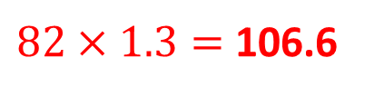
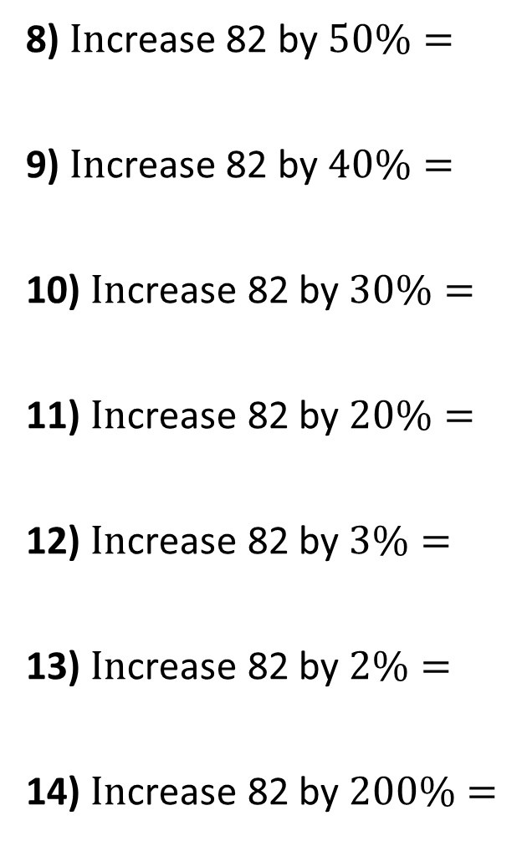



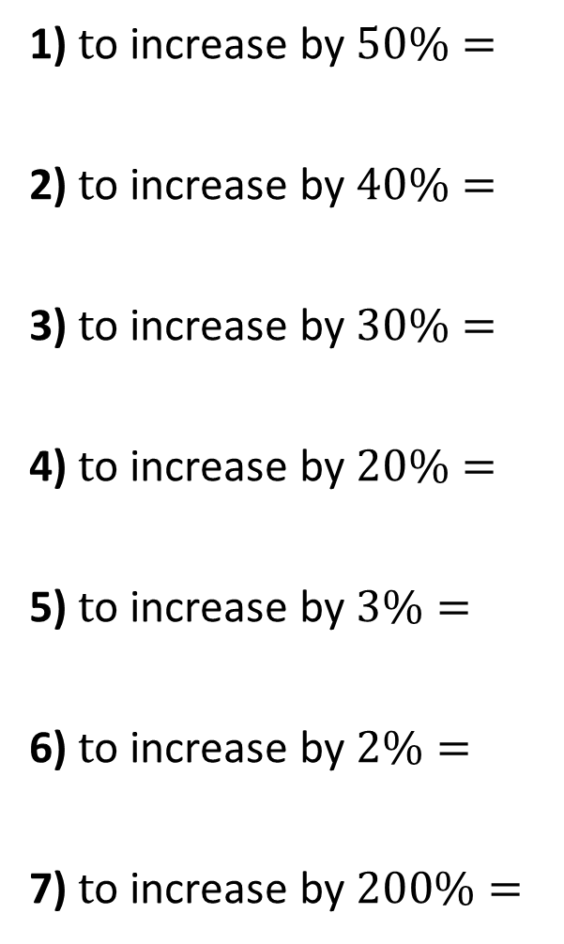


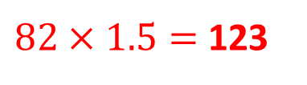





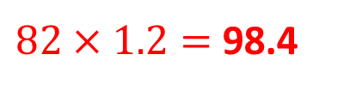
What is the multiplier……
1) $\text{t}\text{o} \text{in}\text{crease} \text{by} 50\%=$
2) $\text{t}\text{o} \text{in}\text{crease} \text{by} 40\%=$
3) $\text{t}\text{o} \text{in}\text{crease} \text{by} 30\%=$
4) $\text{t}\text{o} \text{in}\text{crease} \text{by} 20\%=$
5) $\text{t}\text{o} \text{in}\text{crease} \text{by} 3\%=$
6) $\text{t}\text{o} \text{in}\text{crease} \text{by} 2\%=$
7) $\text{t}\text{o} \text{in}\text{crease} \text{by} 200\%=$
$$×1.5$$
8) $\text{I}\text{n}\text{crease}\text{ 82 }\text{by} 50\%=$
9) $\text{I}\text{n}\text{crease}\text{ 82 }\text{by} 40\%=$
10) $\text{I}\text{n}\text{crease}\text{ 82 }\text{by} 30\%=$
11) $\text{I}\text{n}\text{crease}\text{ 82 }\text{by} 20\%=$
12) $\text{I}\text{n}\text{crease}\text{ 82 }\text{by} 3\%=$
13) $\text{I}\text{n}\text{crease}\text{ 82 }\text{by} 2\%=$
14) $\text{I}\text{n}\text{crease}\text{ 82 }\text{by} 200\%=$
$82×1.5=$ 123
$$×1.4$$
$$82×1.4=114.8$$
$$×1.3$$
$82×1.3=$ 106.6
$$×1.2$$
$82×1.2=$ 98.4
$$×1.03$$
$$82×1.03=84.46$$
$$×1.02$$
$$82×1.02=83.64$$
$$×3.00$$
$$82×3=246$$

