Slide 1

Junior Challenge 2
GOLD

Slide 2
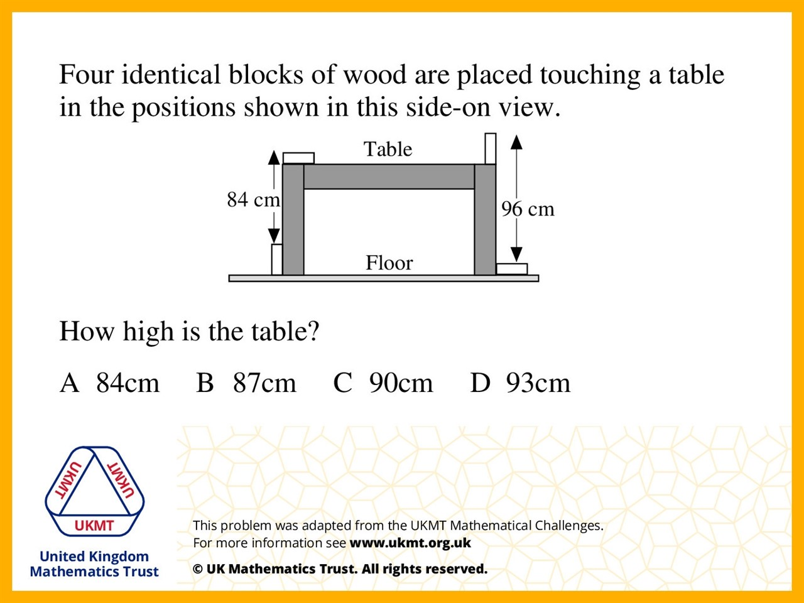
Q1.
90 – 84 = 6
84 – 6 = 78
90 – 78 = 12
84 – 6 + 12 = 90

Slide 3
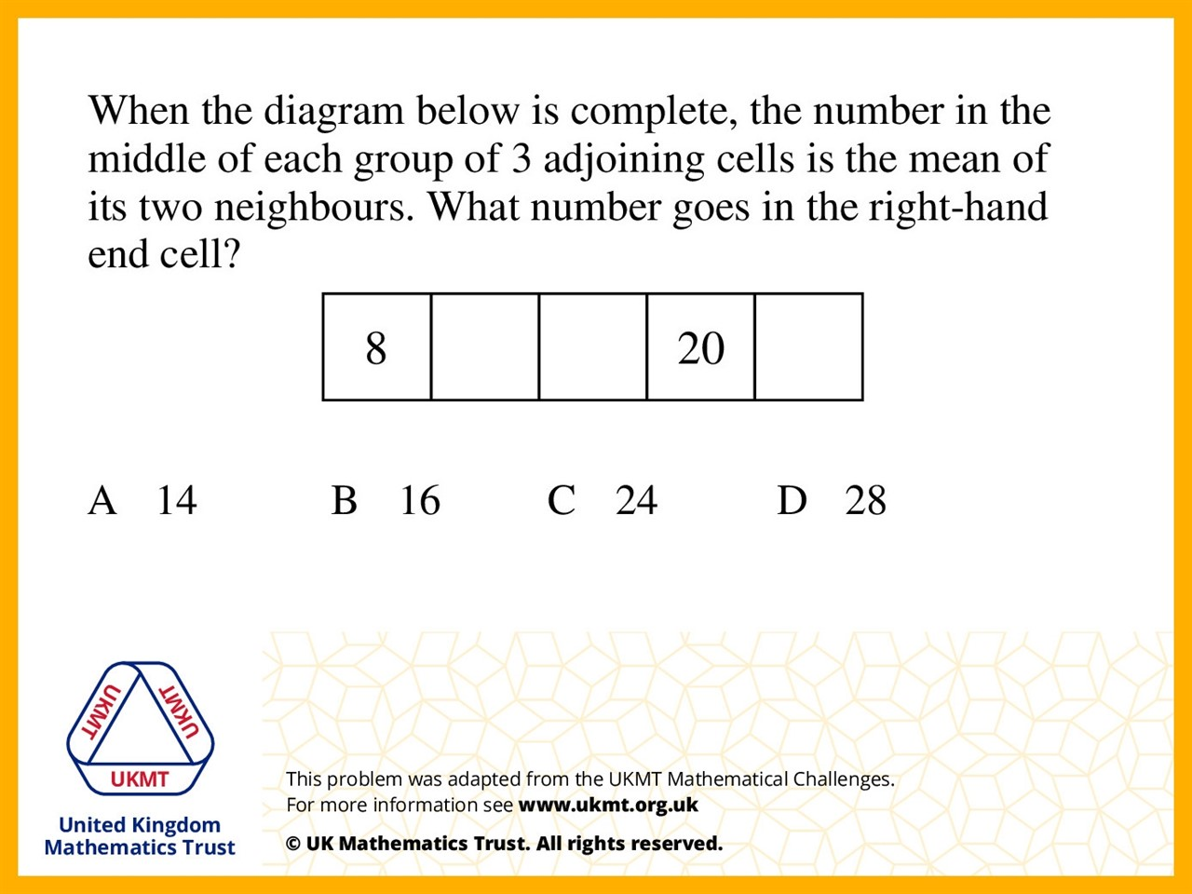
Q2.
a = (8 + b)/2
b = (20 + a)/2
therefore 2a – b = 8, 2b – a = 20.
So double the second equation and add gives
3b = 48 so b = 16.
(16 + c) ÷ 2 = 20 means 16 + c = 40 therefore c = 24.

Slide 4
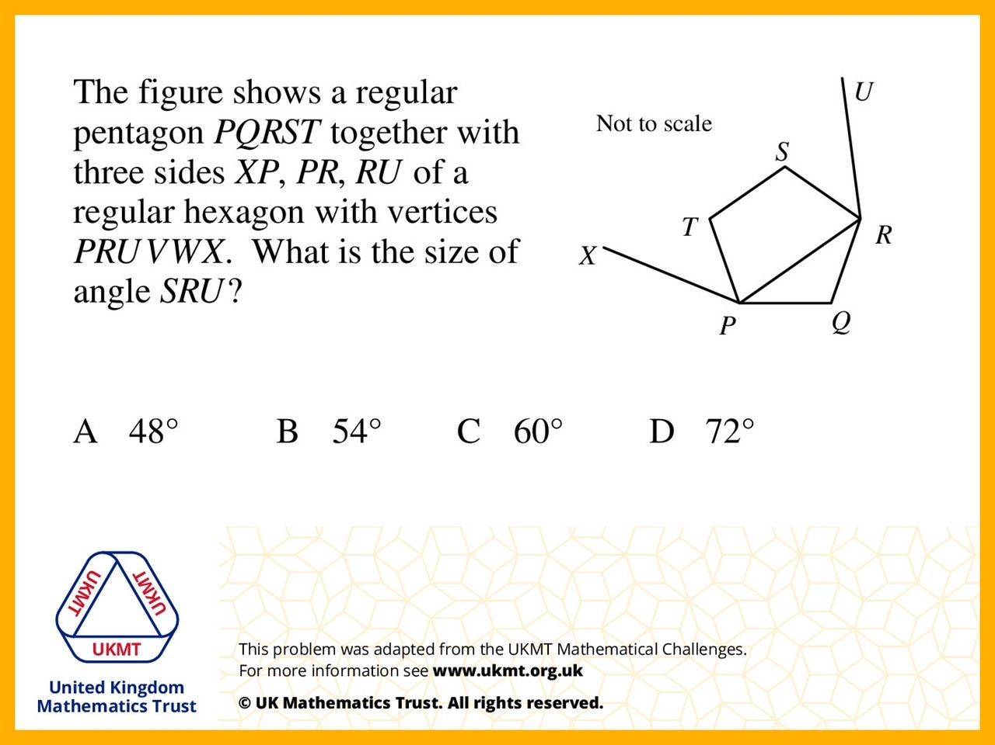
Q3.
PQR = 108˚ (Pentagon interior angel)
Tringale PRQ is an isosceles triangle
PRQ = (180 – 108) ÷ 2 = 36
QRS = 108 (Pentagon interior angle)
PRS = 108 – 36 = 72.
PRU = 120˚ (Hexagon interior angle)
SRU = 120 – 72 = 48˚

Slide 5
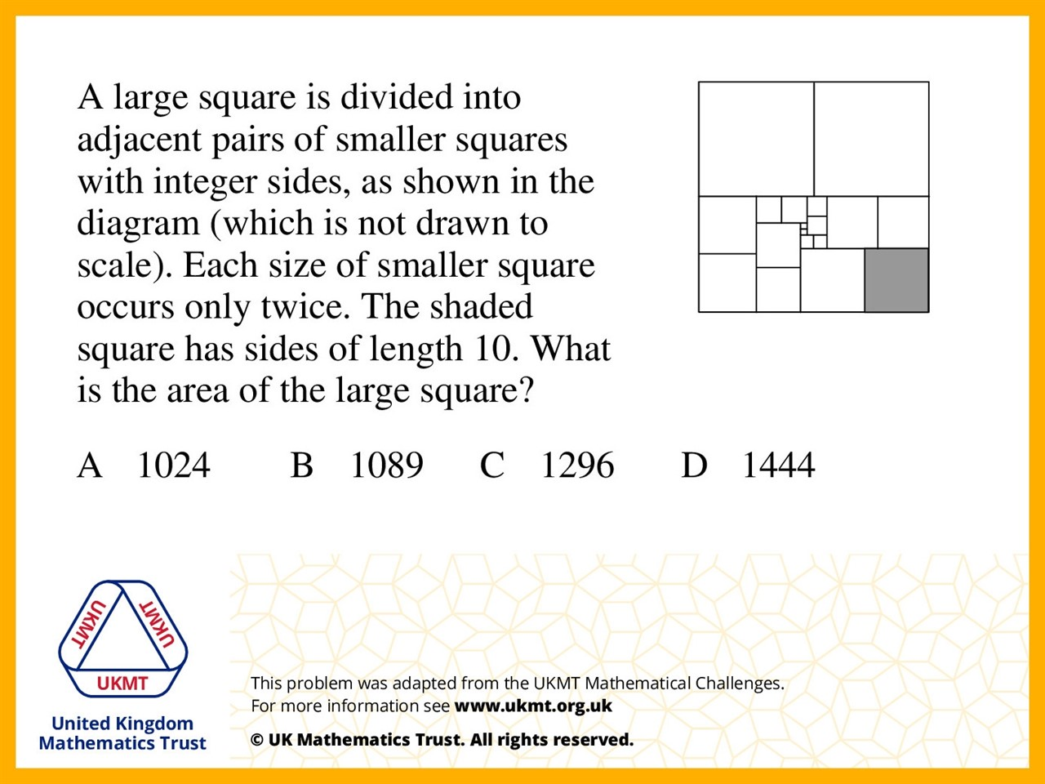
Q4.
a=1, b=4, c=9, d=16, e=49, f=64, g=81, h=100, i=324 where each letter corresponds to the areas of the small squares in increasing size. Add those areas and double equals 1296.

Slide 6
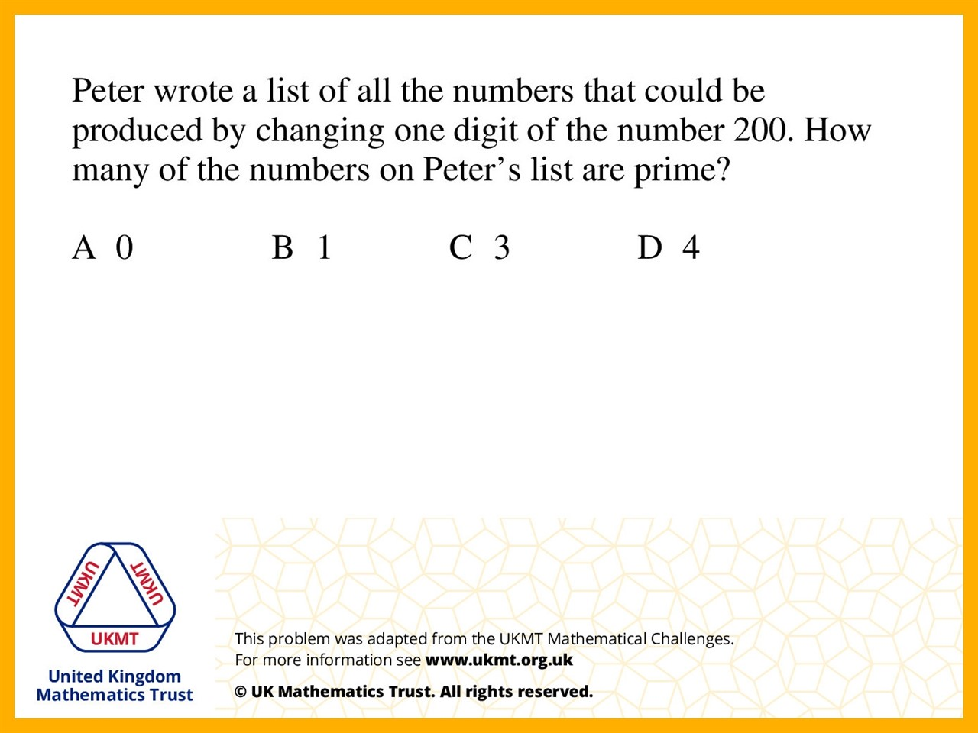
Q5.
The only digit he can change is the final digit as otherwise it will divide by 5 and 10. 201 divides by 3, 202 by 2, 203 by 7, 204 by 2, 205 by 5, 206 by 2, 207 by 9, 208 by 2, 209 by 11, so there are no prime numbers.

