Slide 1
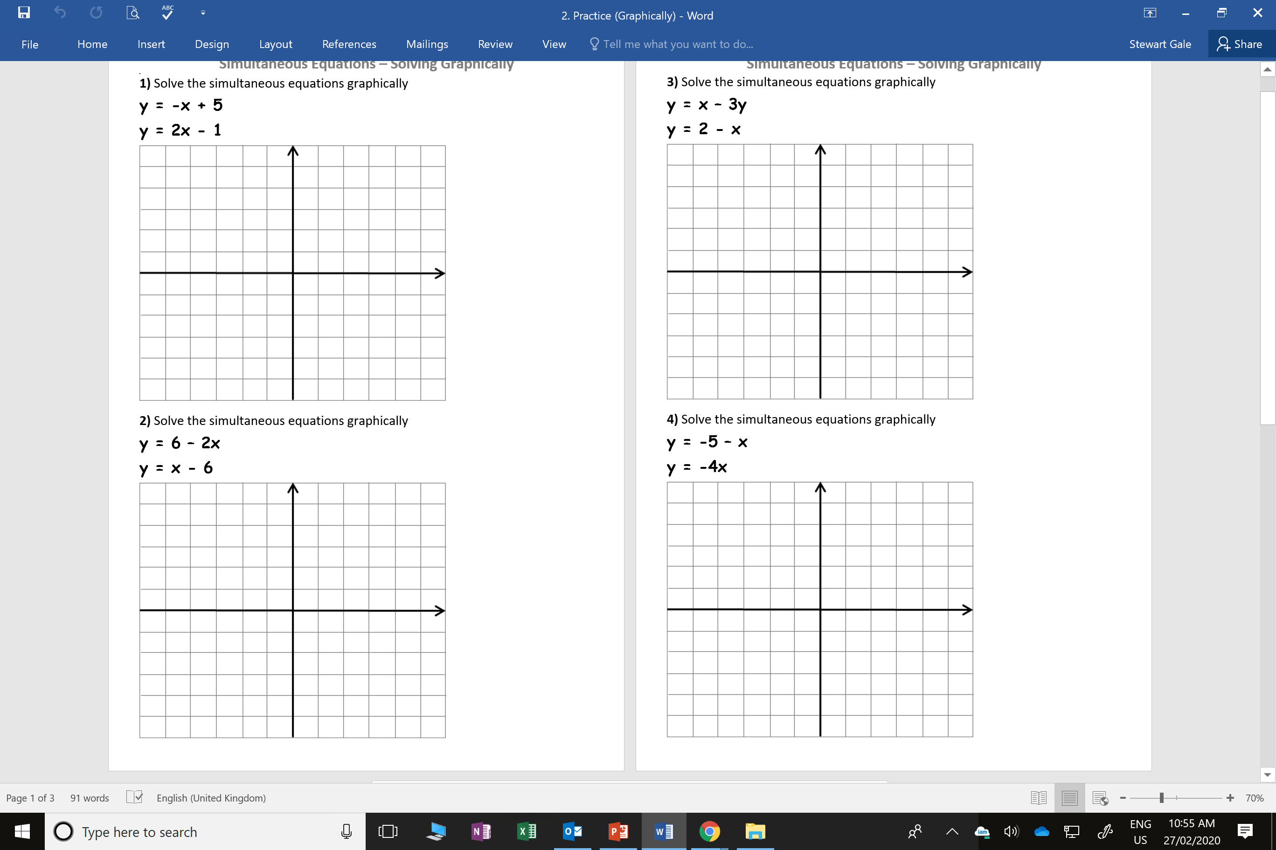
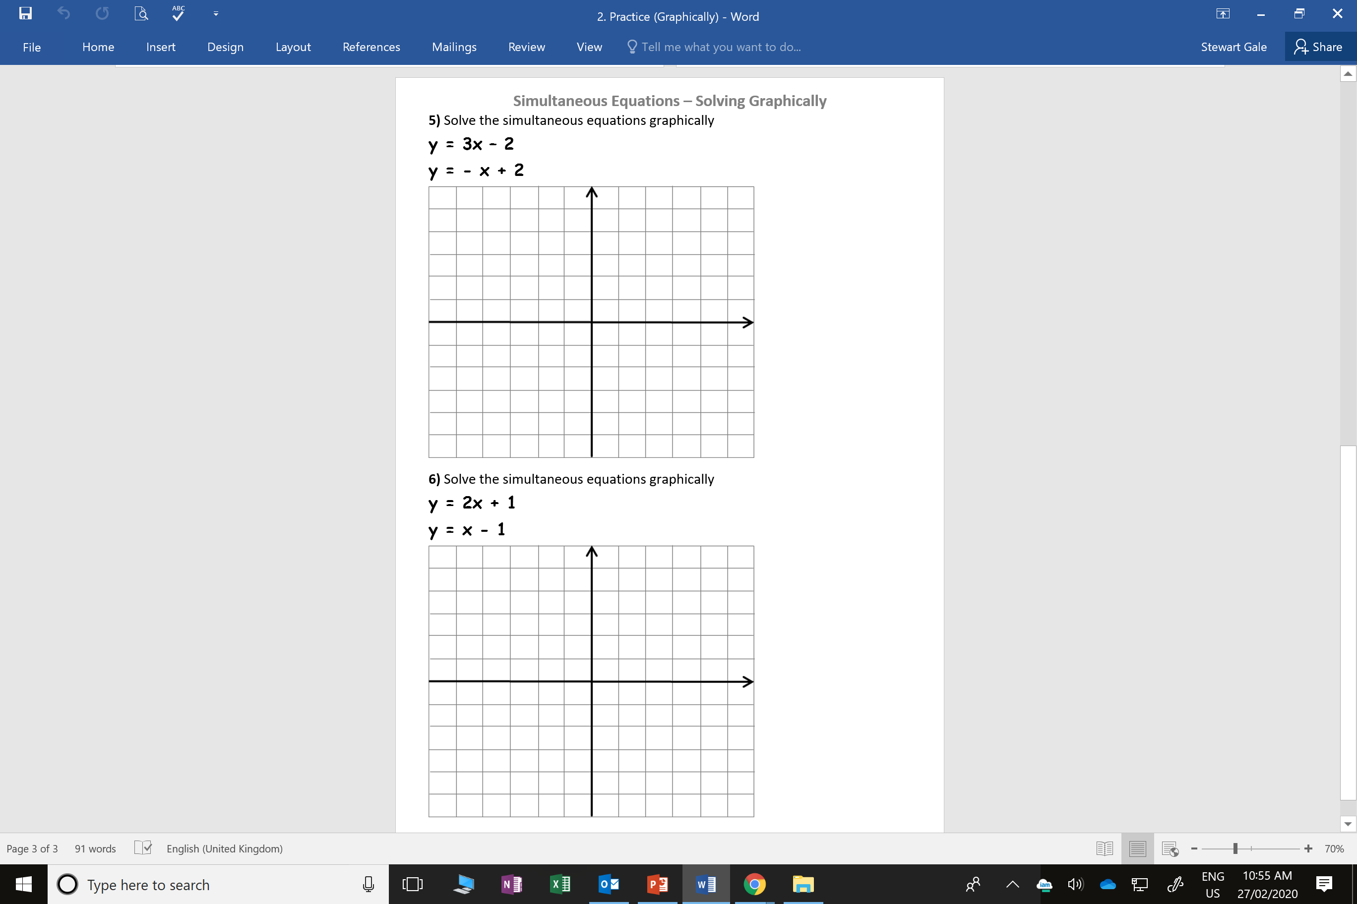

Slide 2
ANSWERS

Slide 3
x = 2 and y = 3

Slide 4
x = 4 and y = -2

Slide 5
x = 2.5 and y = -0.5

Slide 6
+
x = 1 and y = -4

Slide 7
x = 1 and y = 1

Slide 8
x = -2 and y = -3

