Slide 1
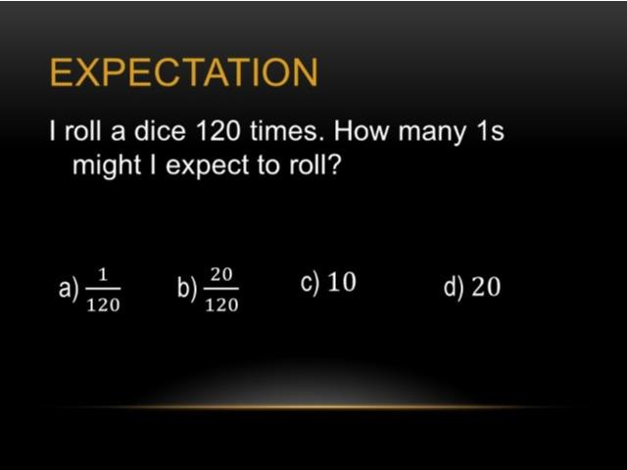
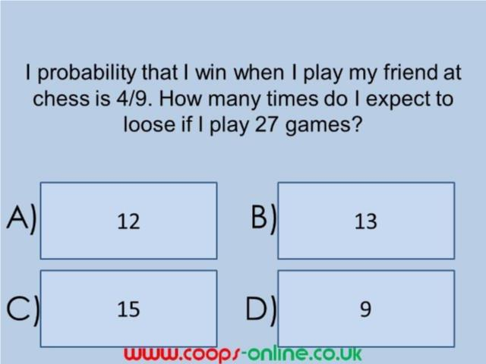
Worst answered question?
Most common wrong answer?

Slide 2
ANSWERS

Slide 3
Worst answered question?

Slide 4
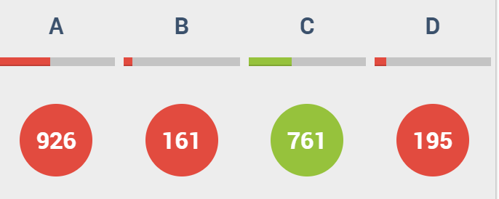
A
The found the number of times they will win.

Slide 5

B
They found the probability
but needed to give the number of outcomes.

