Slide 1
LO: Exponentials Equations

Slide 2
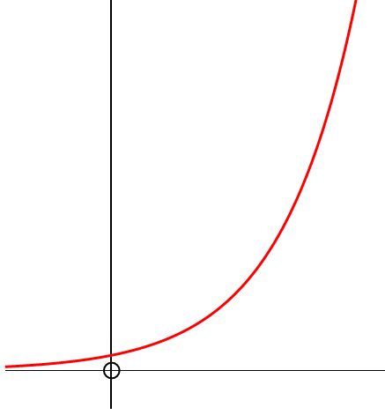
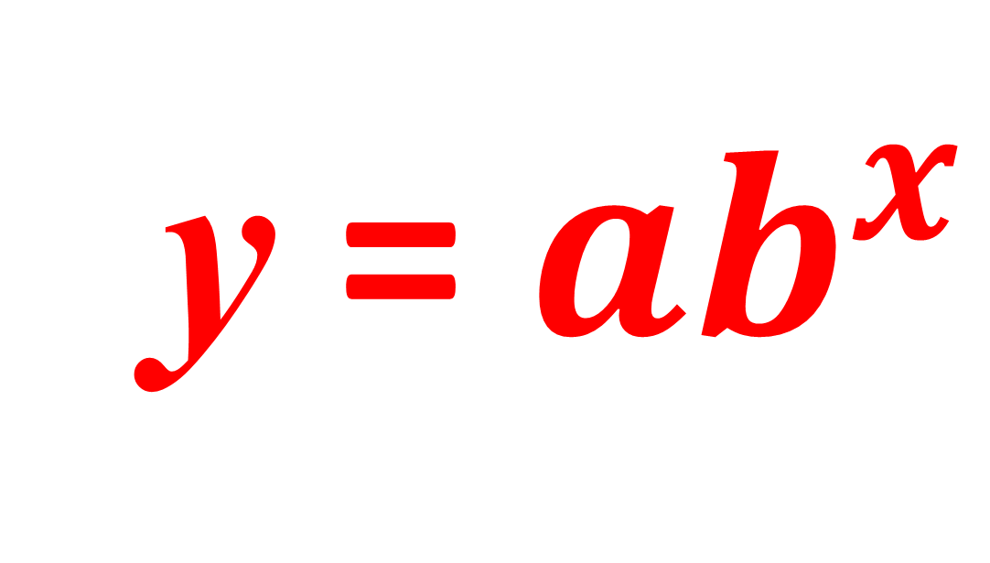
y
The general equation
for an exponential graph is:
y = ${ab}^{x}$
y and x are variable
a and b are a constant
x

Slide 3
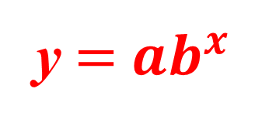
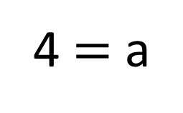
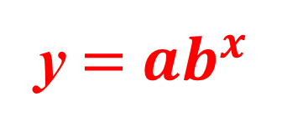


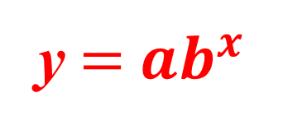

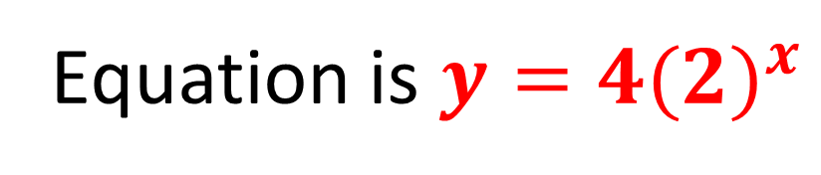

Find Equation of Graph.
Start with point A (0,4)
y $=$ ${ab}^{x}$
y $=$ ${ab}^{x}$
$$4=ab^{0}$$
4 $=$ a
Now use point B(2,16)
y $=$ ${ab}^{x}$
$$16=4×b^{2}$$
$$4=b^{2}$$
A (0,4)
B (2,16)
A (0, 4)
$$b=2$$
Equation is ${y=4(2)}^{x}$

Slide 4
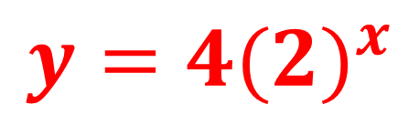
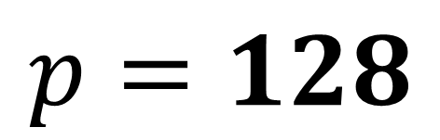
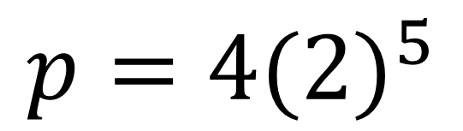
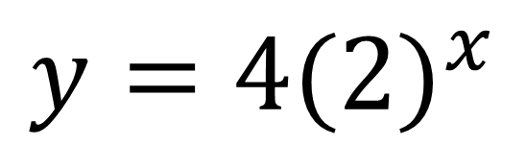
Find the value of p.
$${y=4(2)}^{x}$$
$${y=4(2)}^{x}$$
C (5, p)
$${p=4(2)}^{5}$$
$$p=128$$
A (0, 4)

Slide 5

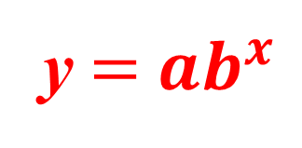
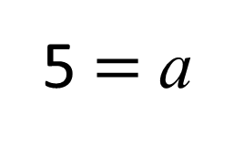
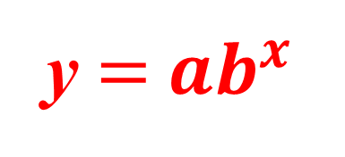




Find the value of p.
Start with point A (0,5)
y $=$ ${ab}^{x}$
y $=$ ${ab}^{x}$
$$5=ab^{0}$$
5 $=$ a
C (4,1280)
Now use point C (4,1280)
y $=$ ${ab}^{x}$
$$1280=5×b^{4}$$
A (0,5)
B (3, p)
A (0, 4)
$$256=b^{4}$$
$$b=4$$

Slide 6
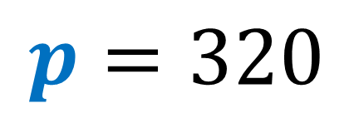
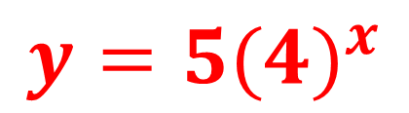
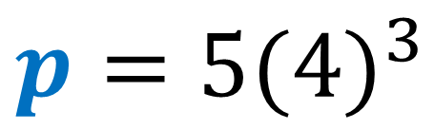
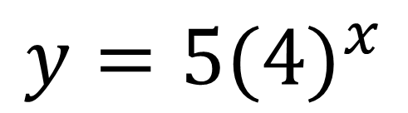
Find the value of p.
$${y=5(4)}^{x}$$
$${y=5(4)}^{x}$$
$${p=5(4)}^{3}$$
B (3, p)
$$p=320$$
A (0, 4)

Slide 7

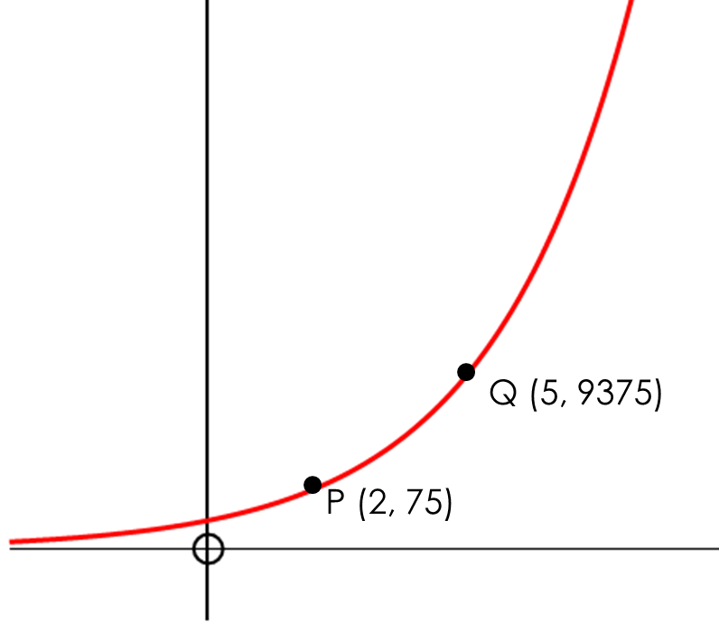
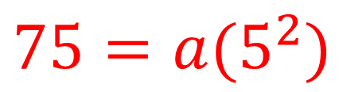
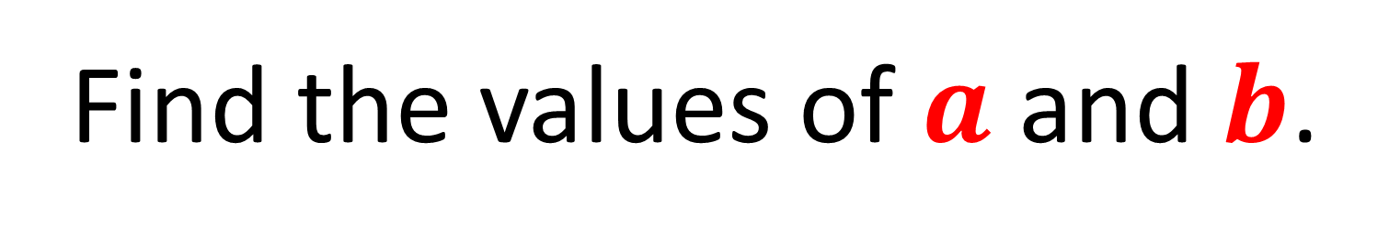
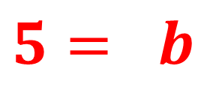
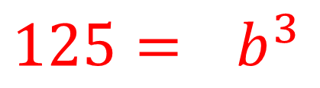
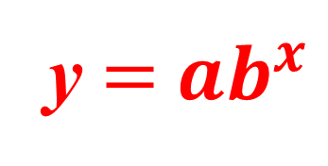
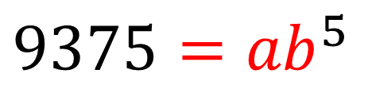
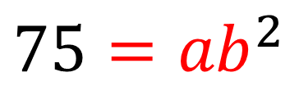
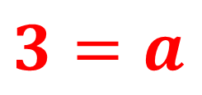
Find the values of $a$ and $b$.
y $=$ ${ab}^{x}$
$${9375=ab}^{5}$$
$${75=ab}^{2}$$
$${125=ab}^{3}$$
$$5= b$$
$${75=a(5}^{2})$$
$$3=a$$

