Slide 1
FM: Parallel and Perpendicular

Slide 2
What do you know about the gradients of parallel lines?
The gradients are equal.

Slide 3

What do you know about the gradients of perpendicular lines?
The gradients multiply to give minus one.
$$m_{1}m_{2}=−1$$

Slide 4

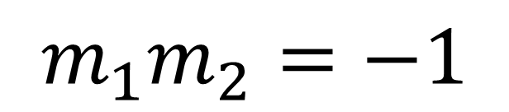

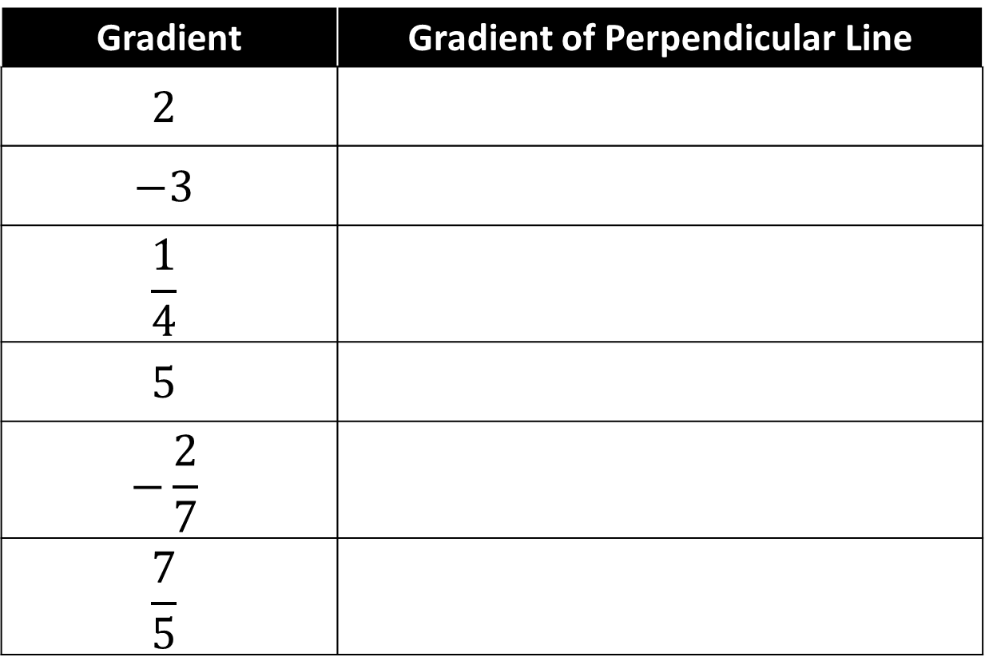




$$m_{1}m_{2}=−1$$
(One is the negative reciprocal of the other)
Gradient | Gradient of Perpendicular Line
$$2$$ | $$−\frac{1}{2}$$
$$−3$$ | $$\frac{1}{3}$$
$$\frac{1}{4}$$
$$5$$ | $$−\frac{1}{5}$$
$$−\frac{2}{7}$$ | $$\frac{7}{2}$$
$$\frac{7}{5}$$ | $$−\frac{5}{7}$$
$$−\frac{1}{2}$$
$$\frac{1}{3}$$
$−$4
$$−\frac{1}{5}$$
$$\frac{7}{2}$$
$$−\frac{5}{7}$$

Slide 5
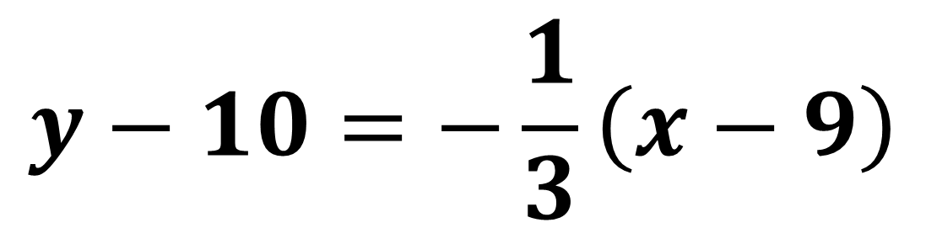
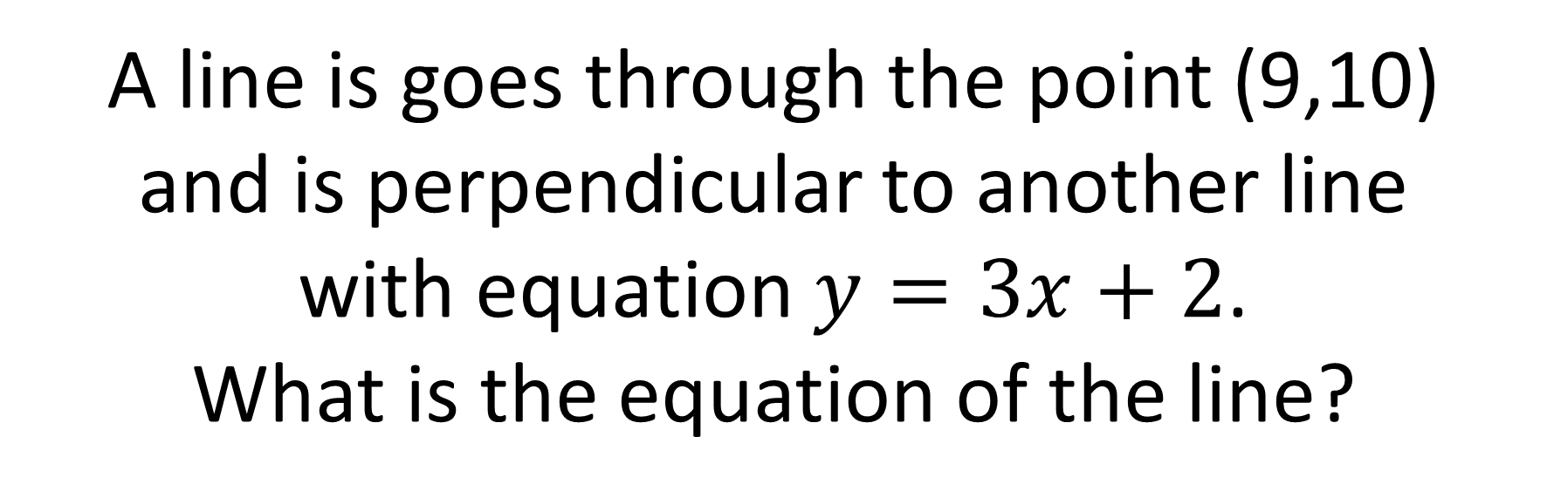
A line is goes through the point (9,10)
and is perpendicular to another line
with equation $y=3x+2$.
What is the equation of the line?
$$y−10=−\frac{1}{3}\left(x−9\right)$$

Slide 6
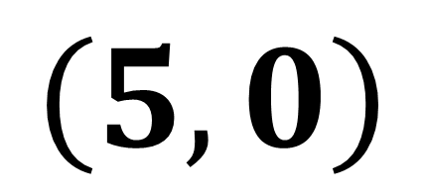
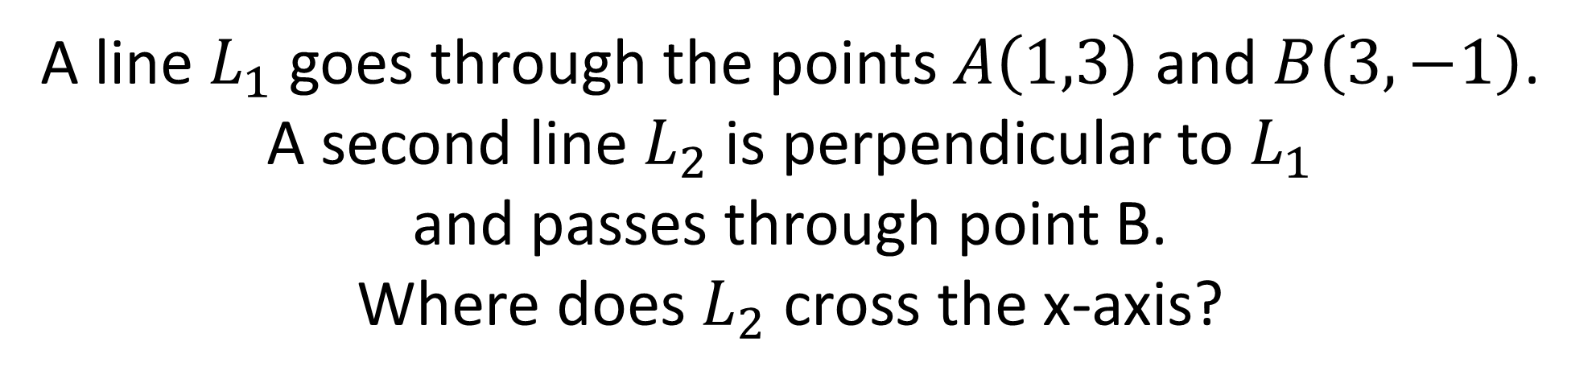
A line $L_{1}$ goes through the points $A\left(1,3\right)$ and $B\left(3,−1\right)$. A second line $L_{2}$ is perpendicular to $L_{1}$
and passes through point B.
Where does $L_{2}$ cross the x-axis?
$$\left(5,0\right)$$

Slide 7
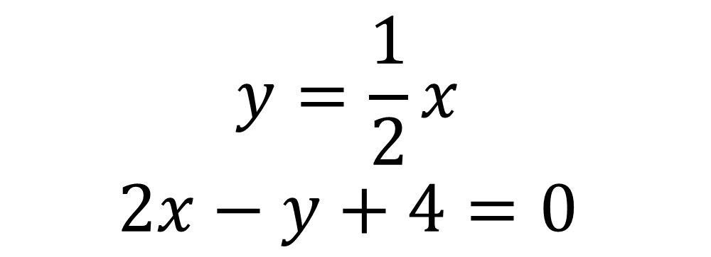
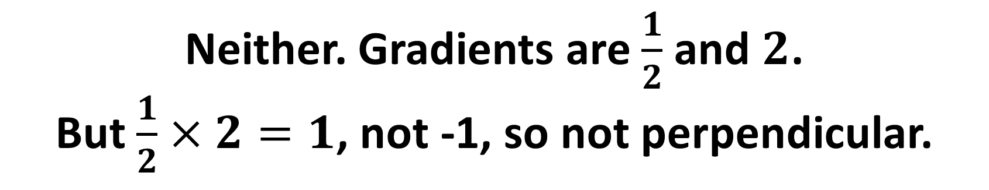
Are the following lines parallel, perpendicular, or neither?
$$y=\frac{1}{2}x$$
$$2x−y+4=0$$
Neither. Gradients are $\frac{1}{2}$ and $2$.
But $\frac{1}{2}×2=1$, not -1, so not perpendicular.

Slide 8
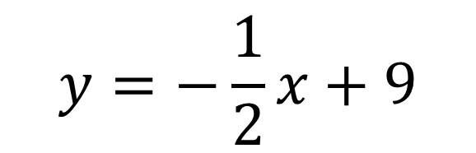
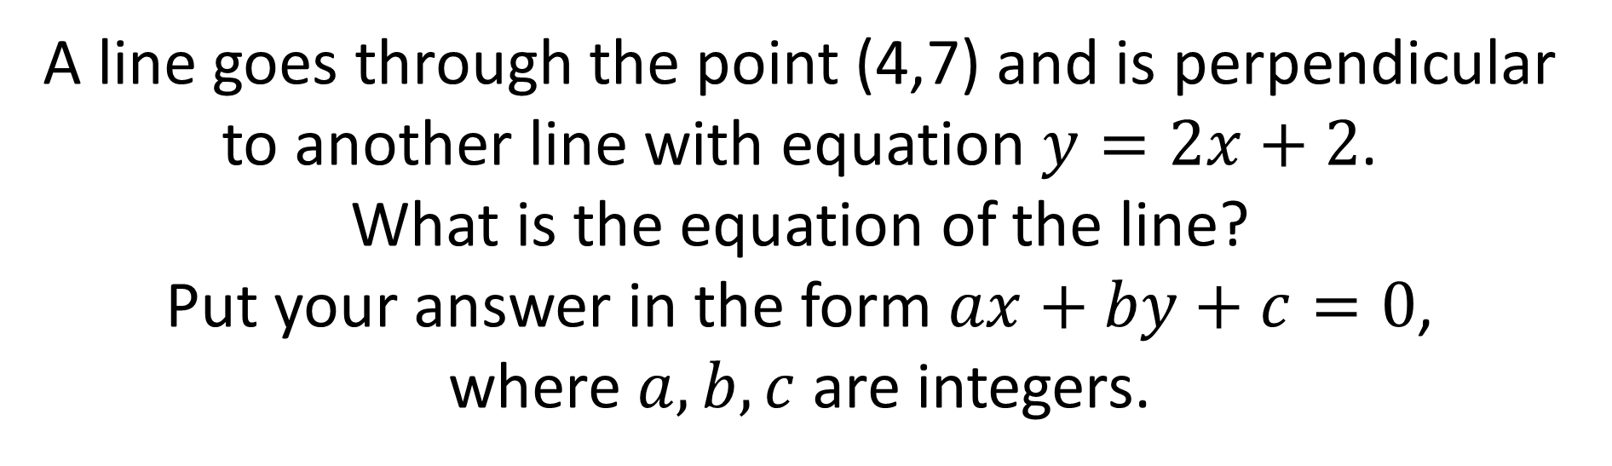
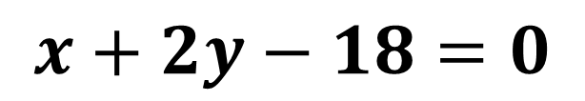
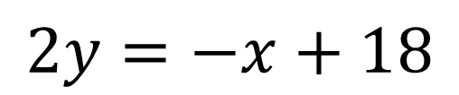
A line goes through the point (4,7) and is perpendicular to another line with equation $y=2x+2$.
What is the equation of the line?
Put your answer in the form $ax+by+c=0$,
where $a,b,c$ are integers.
$$y=−\frac{1}{2}x+9$$
$$2y=−x+18$$
$$x+2y−18=0$$

Slide 9
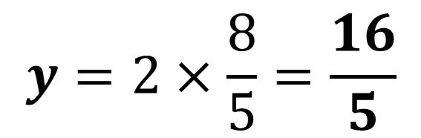

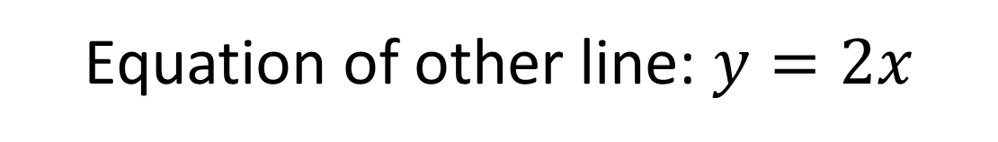
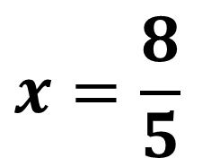


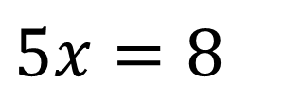
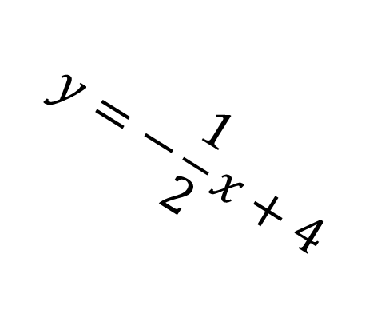
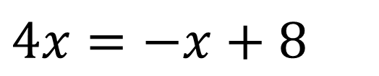

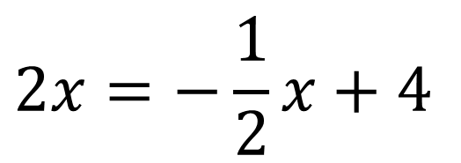
Find the co-ordinate of point $A$.
Equation of other line: $y=2x$
$$y$$
$$2x=−\frac{1}{2}x+4$$
$$A$$
$$4x=−x+8$$
$$5x=8$$
$$y=−\frac{1}{2}x+4$$
$$x=\frac{8}{5}$$
$$y=2×\frac{8}{5}=\frac{16}{5}$$
$$x$$

