Slide 1
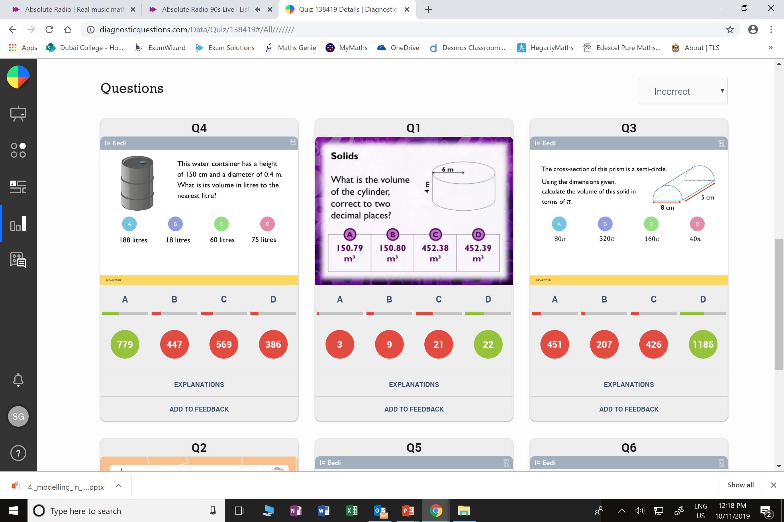
Which question had the lowest percentage of
correct answers?
For each question, what was the most common
wrong answer?

Slide 2
ANSWERS

Slide 3
Which question had the lowest percentage of
correct answers?
For each question, what was the most common
wrong answer?

Slide 4
C
Students did not round to
2 decimal places correctly.

Slide 5
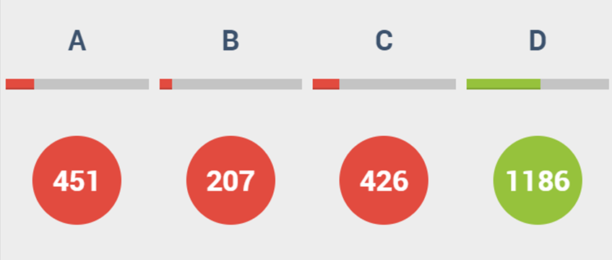
A
Students forgot
to half the
volume of a cylinder.

