Slide 1
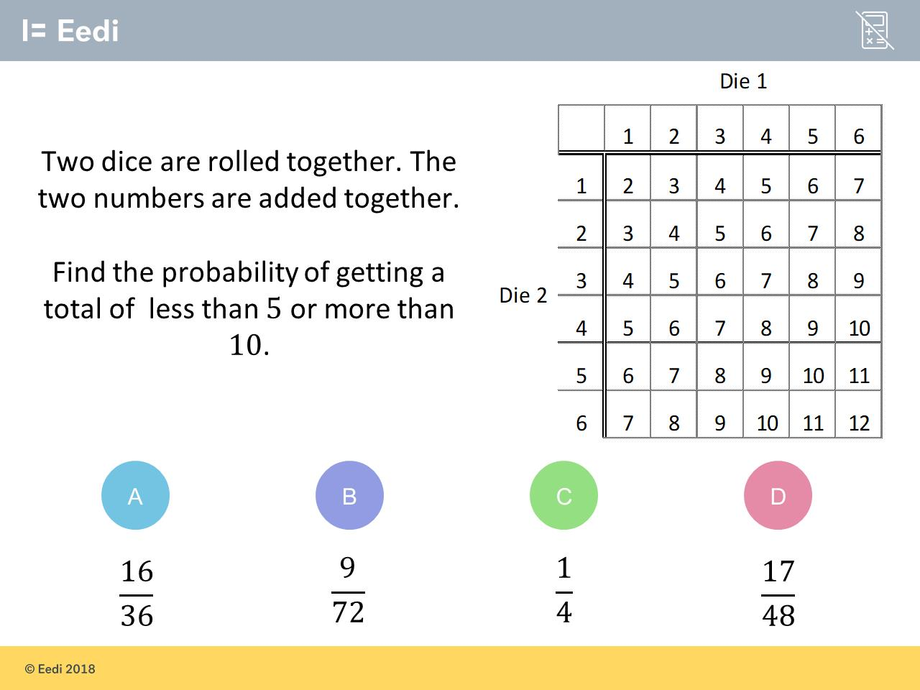
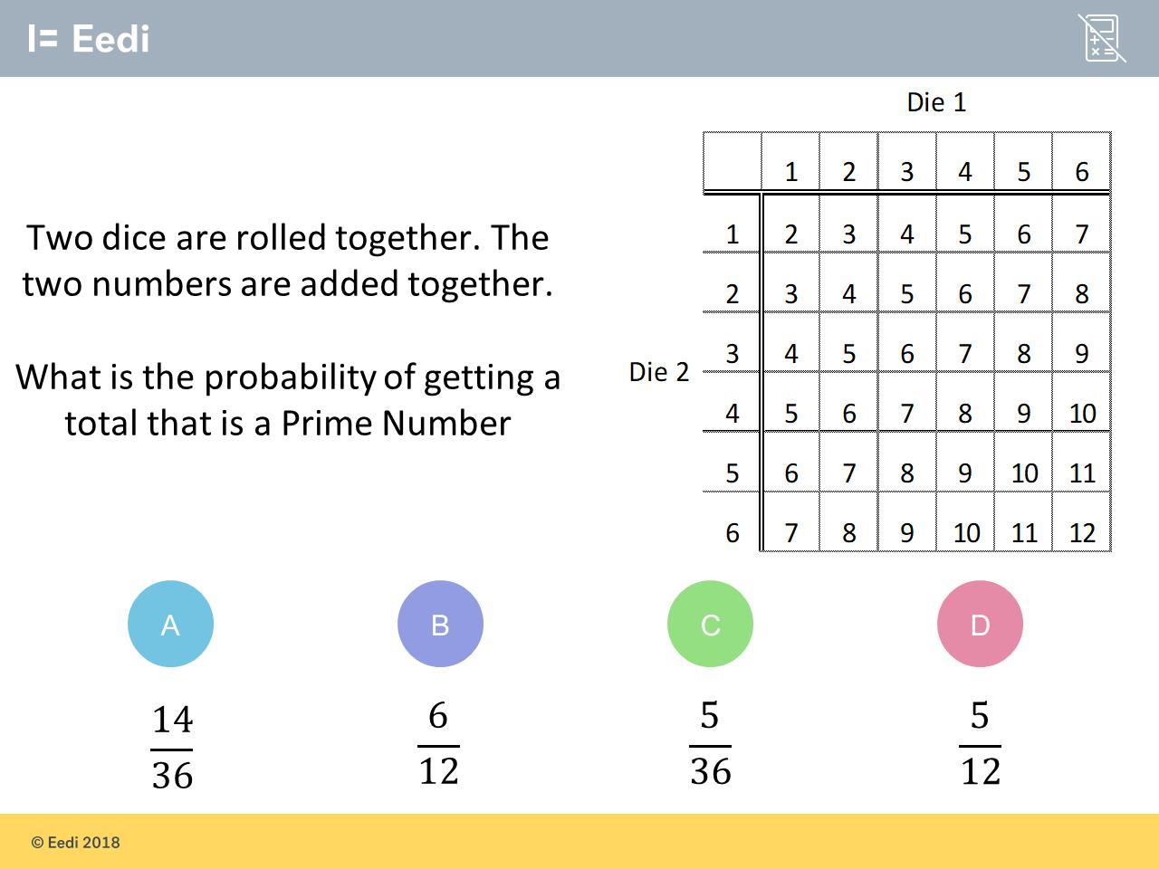
Worst answered question?
Most common wrong answer?

Slide 2
ANSWERS

Slide 3
Worst answered question?

Slide 4
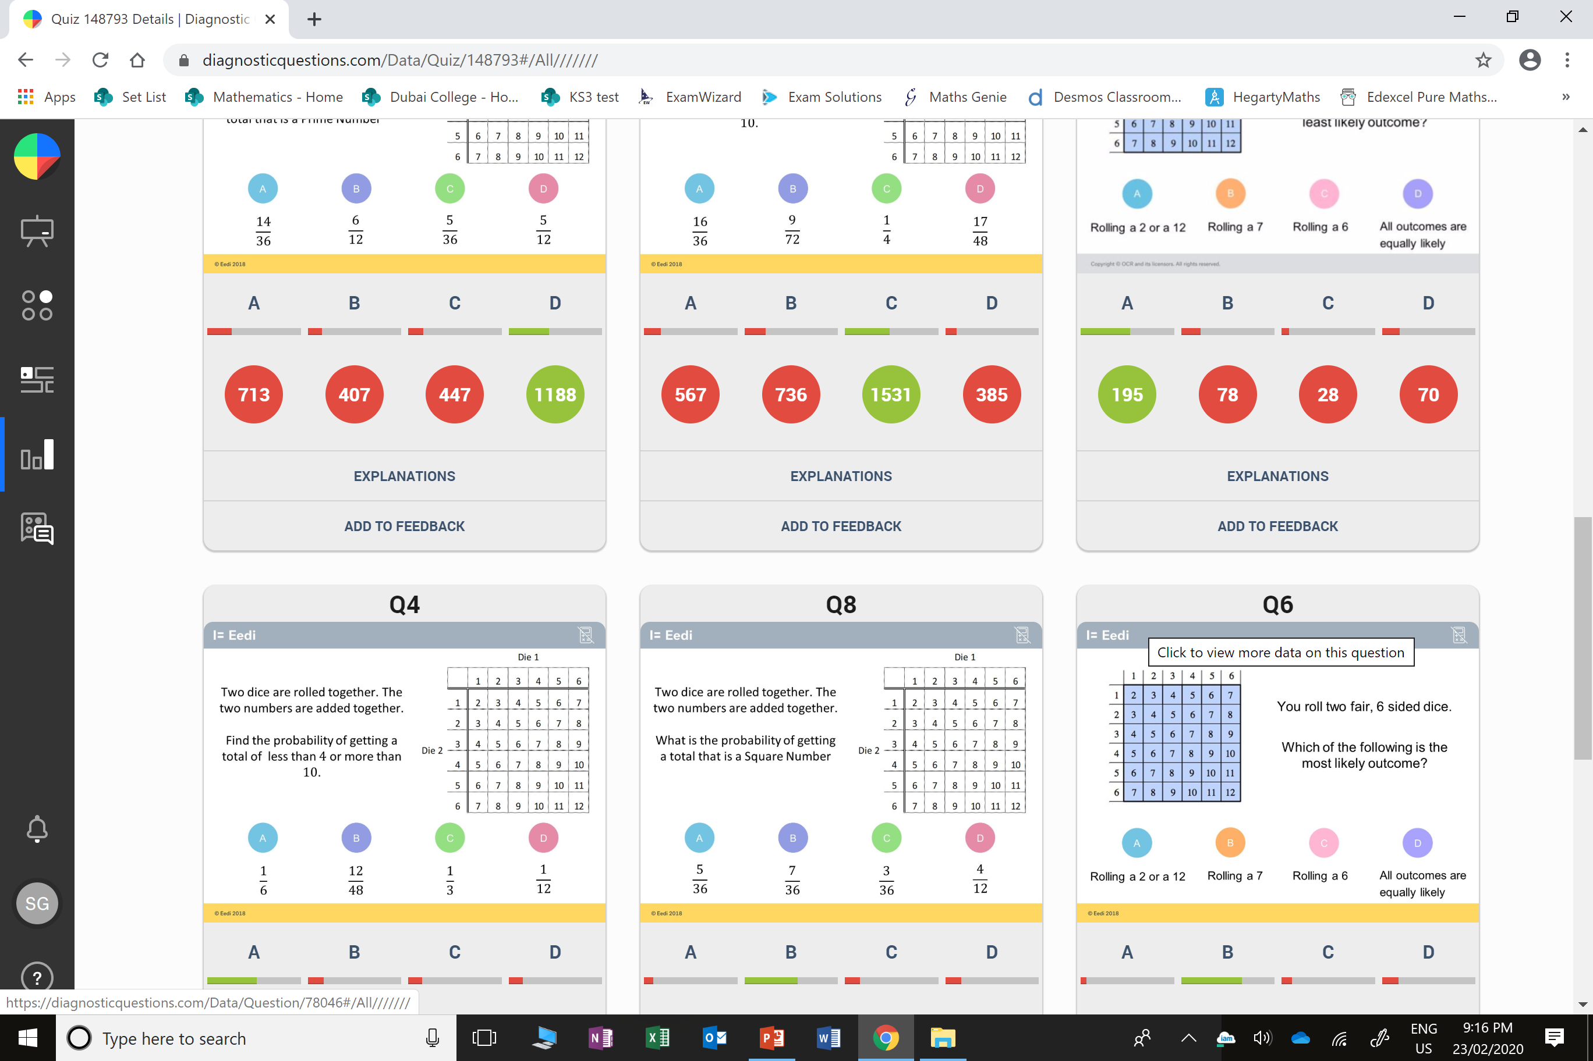
A
The student may not recognise that 2 is a prime number.

Slide 5
B
The student has identified
6/36 for less than 5
and
3/36 for more than 10,
but has added the denominators
as well as the numerators.

