Slide 1
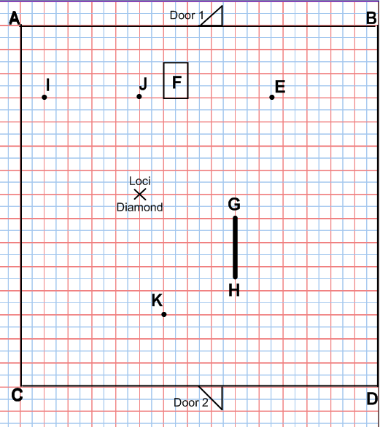

Laser Challenge
You must enter the room at Door 1,
collect the diamond, and exit at Door 2.
Laser 1 is always 2.5 metres from the line BD.
Laser 2 is equidistant from AB and AC.
Laser 2 is beamed from point A.
Laser 3 is always 4.5 metres from D.
Laser 4 is always 2 metres from post E.
Laser 5 is always 1 metre away from the rectangular table F.
Laser 6 is 2.5 metres away from the solid wooden bar GH.
Laser 7 is equidistant from the statues I and J.
Laser 8 is always 2 metres from point K.

Slide 2
ANSWERS

Slide 3
