Slide 1
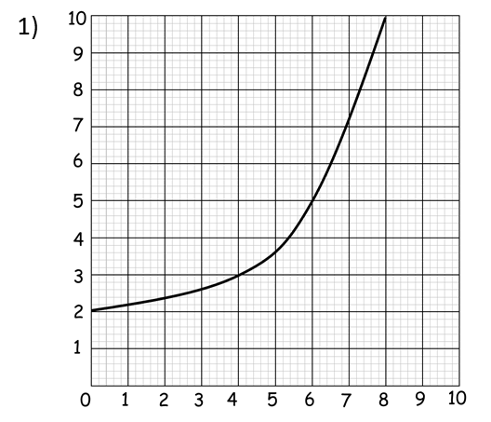
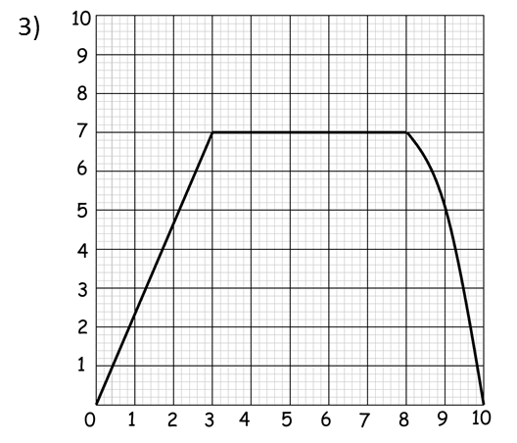
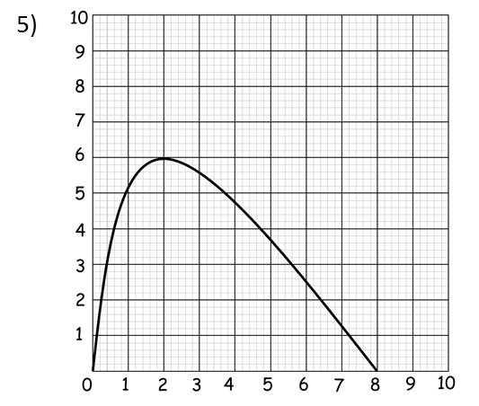
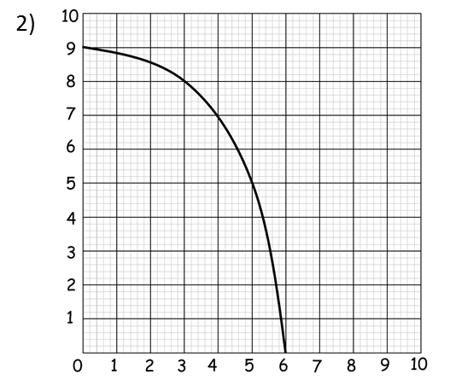
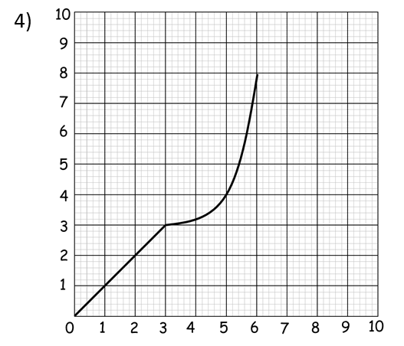
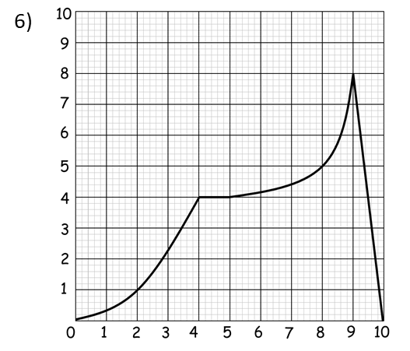

Slide 2
ANSWERS

Slide 3
33.75
Overestimate
15
11.25
7.5

Slide 4
40
Underestimate
17.5
15.5
7

Slide 5
52.5
Underestimate
35
10.5
7

Slide 6
17.5
Overestimate
6
7
4.5

Slide 7
26.4
Underestimate
14.7
6
5.7

Slide 8
42
Over estimate
30
8
4

