Slide 1

Senior Challenge 3
GOLD

Slide 2
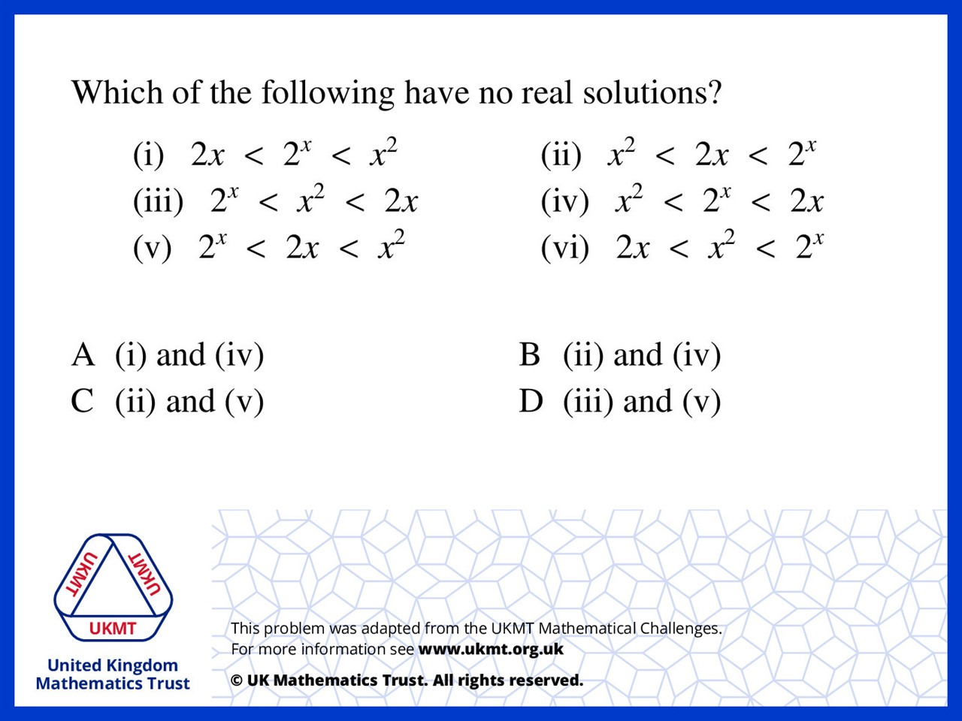
Q1.
i and ii have real solutions such as x = 3 and x = 0.5 respectively so by process of elimination the answer is D

Slide 3
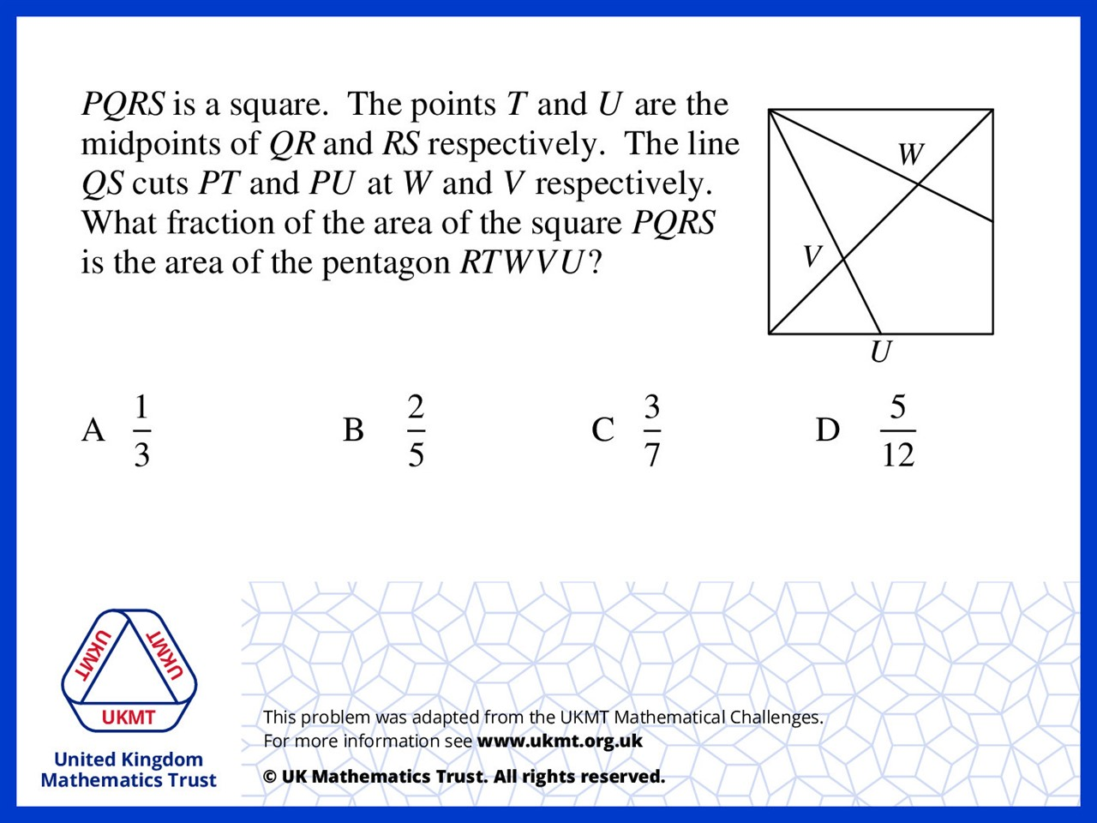
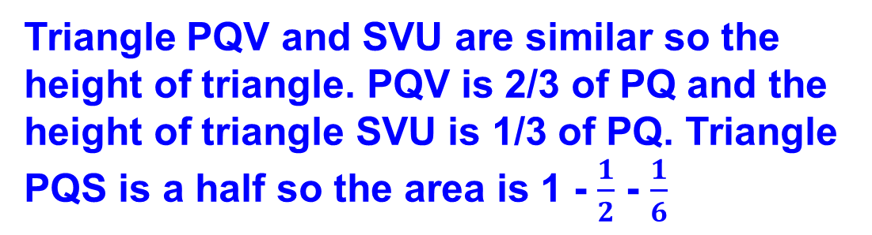
Q2.
Triangle PQV and SVU are similar so the height of triangle. PQV is 2/3 of PQ and the height of triangle SVU is 1/3 of PQ. Triangle PQS is a half so the area is 1 - $\frac{1}{2}$ - $\frac{1}{6}$

Slide 4
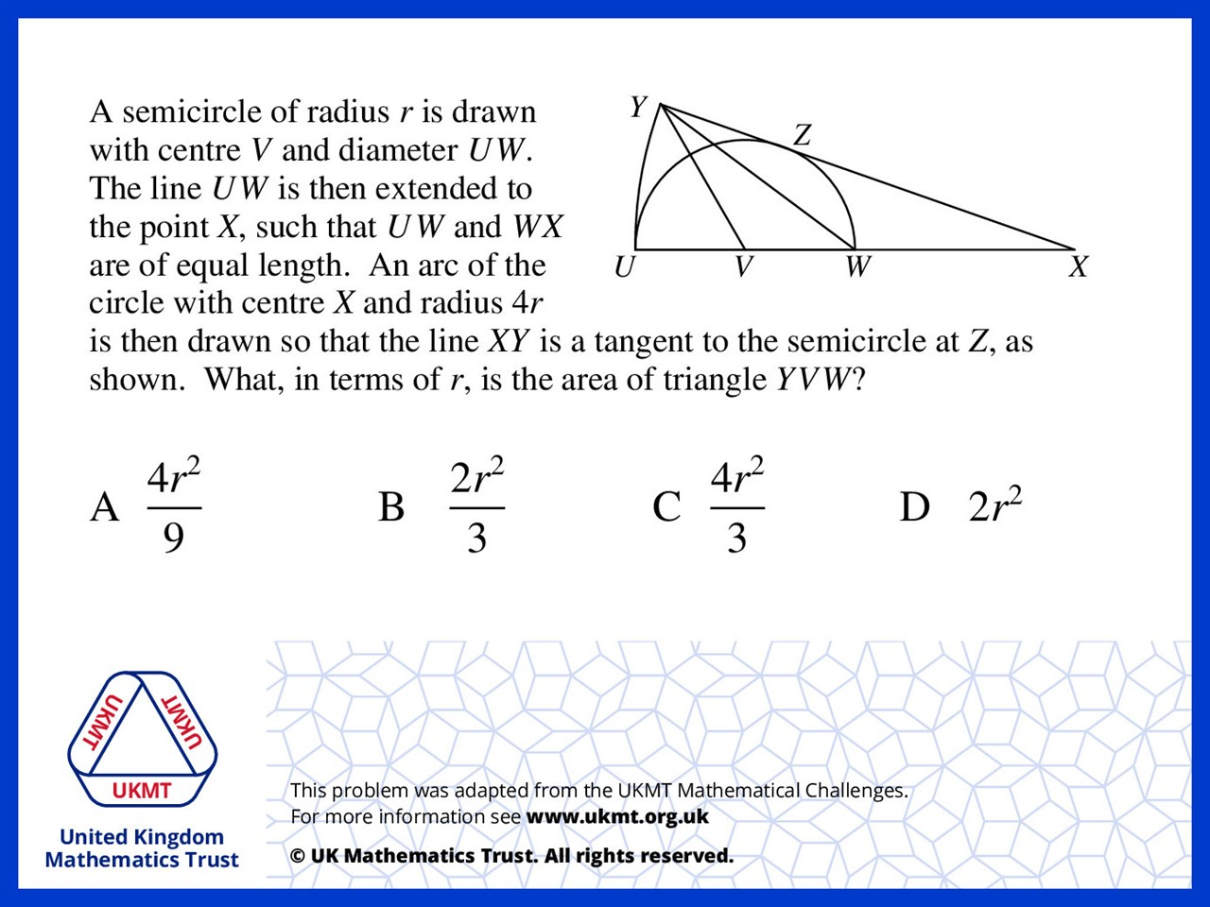
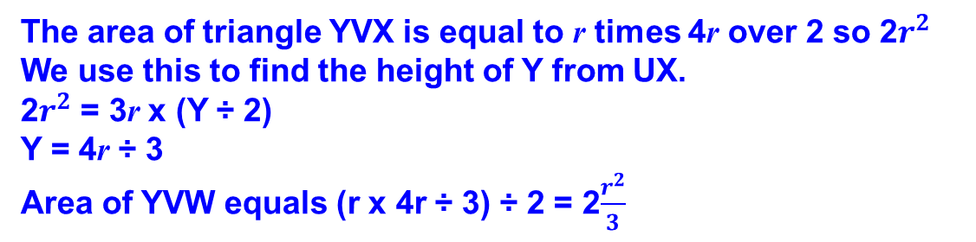
Q3.
The area of triangle YVX is equal to r times 4r over 2 so 2$r^{2}$
We use this to find the height of Y from UX.
2$r^{2}$ = 3r x (Y ÷ 2)
Y = 4r ÷ 3
Area of YVW equals (r x 4r ÷ 3) ÷ 2 = 2$\frac{r^{2}}{3}$

Slide 5
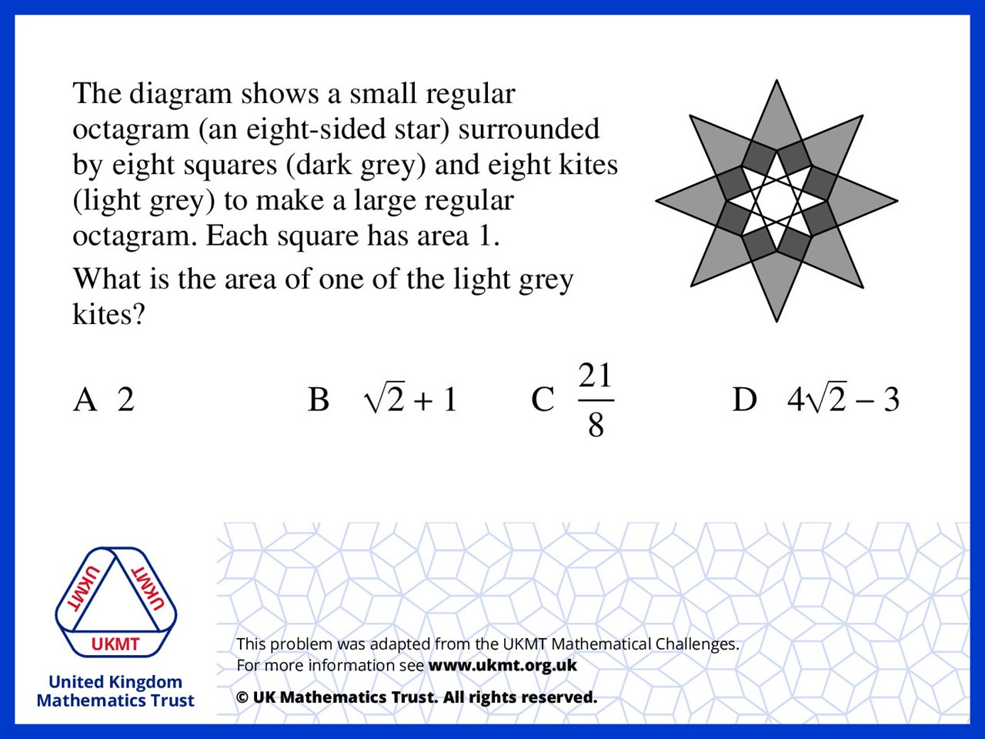
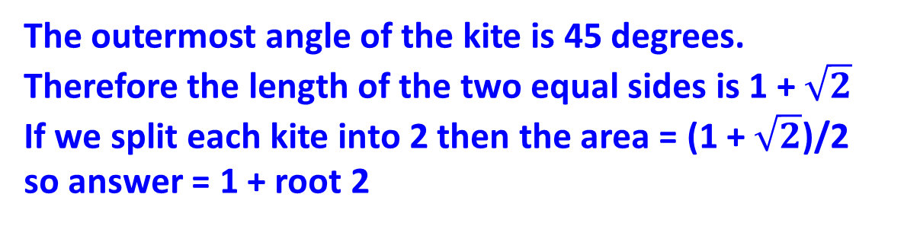
Q4.
The outermost angle of the kite is 45 degrees.
Therefore the length of the two equal sides is 1 + $\sqrt{2}$
If we split each kite into 2 then the area = (1 + $\sqrt{2}$)/2
so answer = 1 + root 2

Slide 6
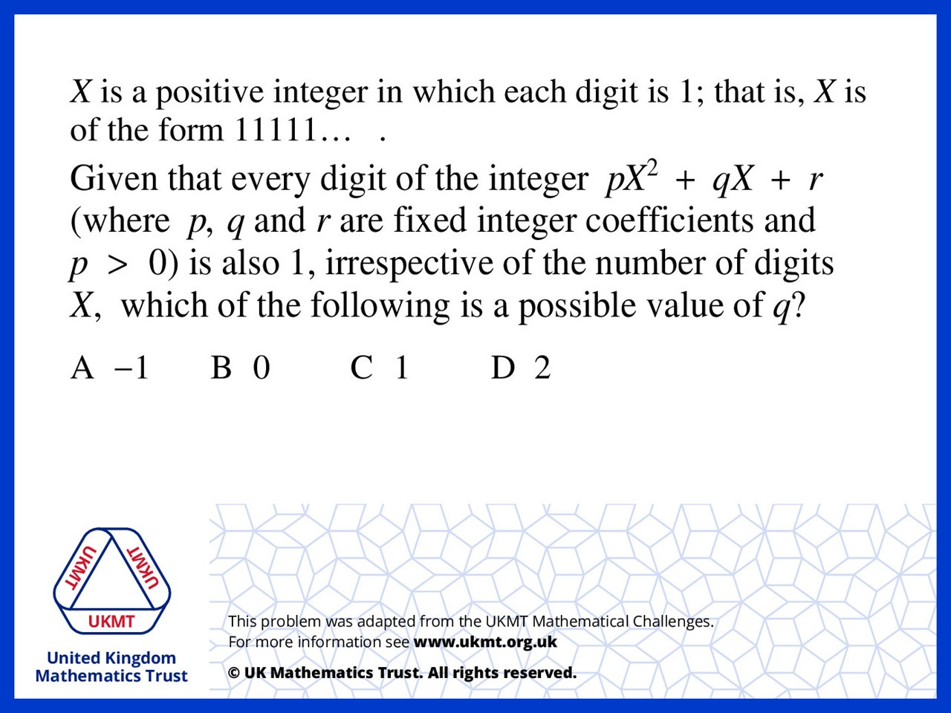
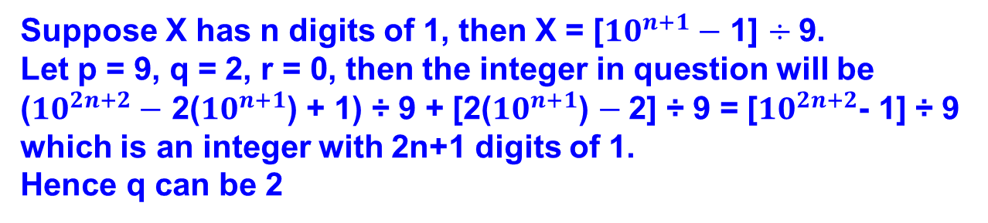
Q5.
Suppose X has n digits of 1, then X = [${10}^{n+1}−$ 1] $÷$9.
Let p = 9, q = 2, r = 0, then the integer in question will be
(${10}^{2n+2}−$ 2(${10}^{n+1}$) + 1) ÷ 9 + [2(${10}^{n+1}$) $−$2] ÷ 9 = [${10}^{2n+2}$- 1] ÷ 9
which is an integer with 2n+1 digits of 1.
Hence q can be 2

