Slide 1
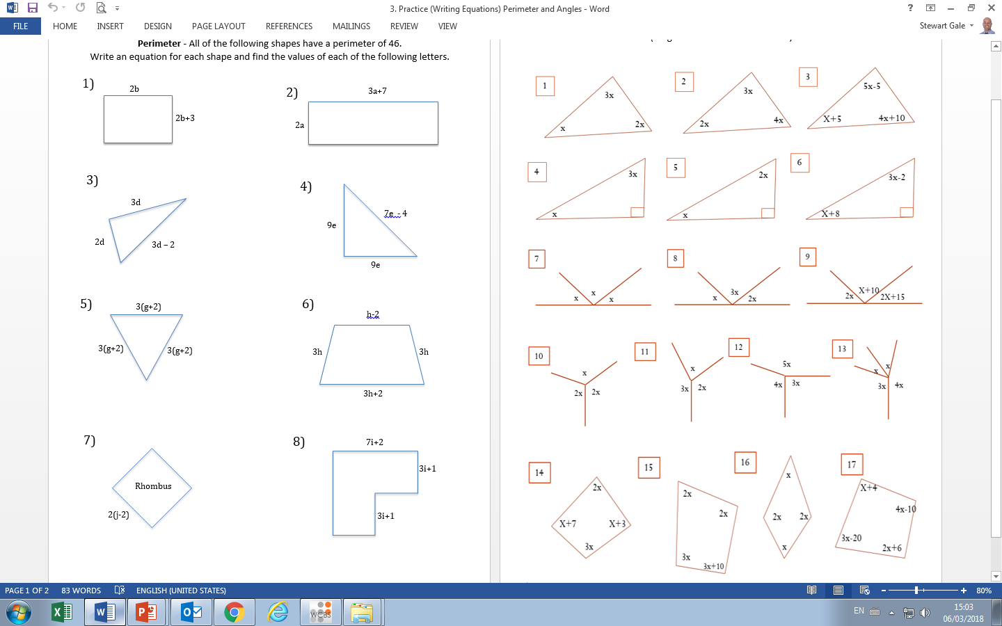

Slide 2
ANSWERS

Slide 3
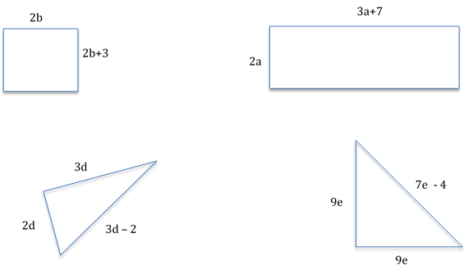
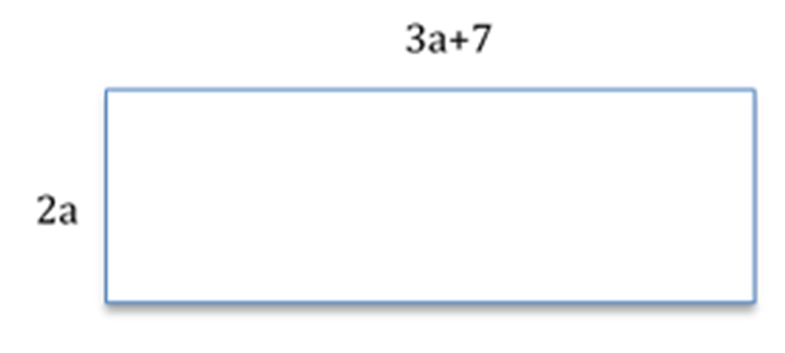
8b + 6 = 46
8b + 6 = 45
10a + 14 = 46
81a + 64 = 3.2

Slide 4
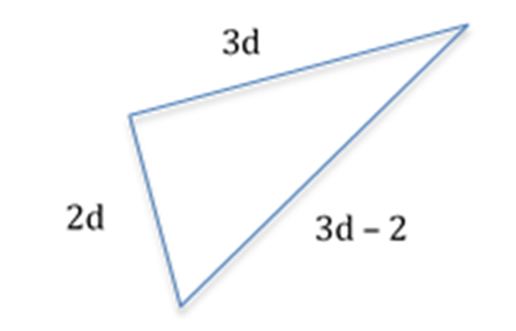
18d - 12 = 46
81d + 64 = 36
25e - 14 = 46
81e + 64 = 2

Slide 5
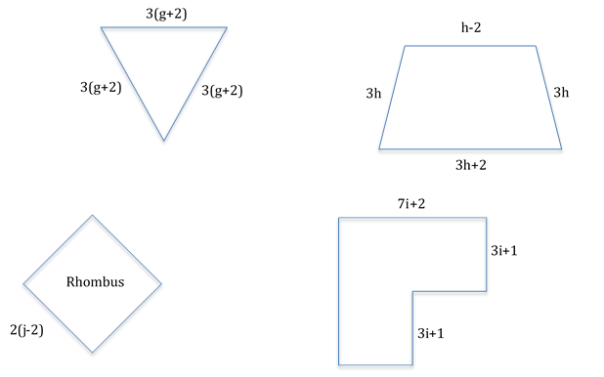
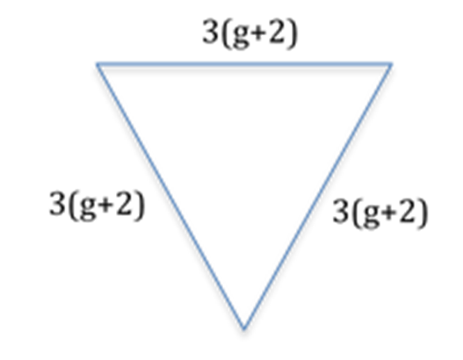
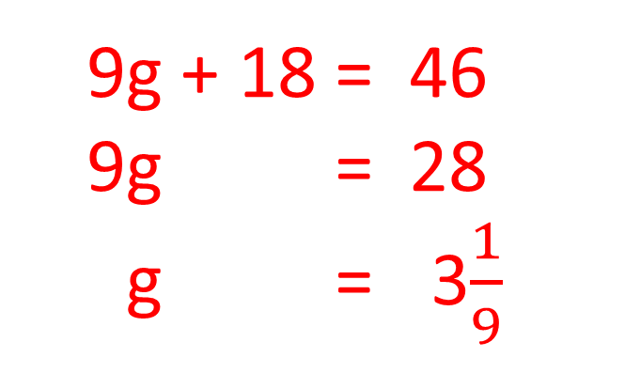
19g + 18 = 46
19g + 46 = 28
81g + 64 = 33$\frac{1}{9}$
10h = 46
10h = 4.6

Slide 6
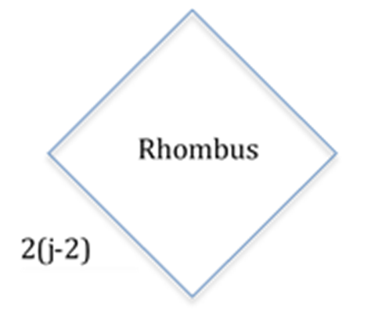
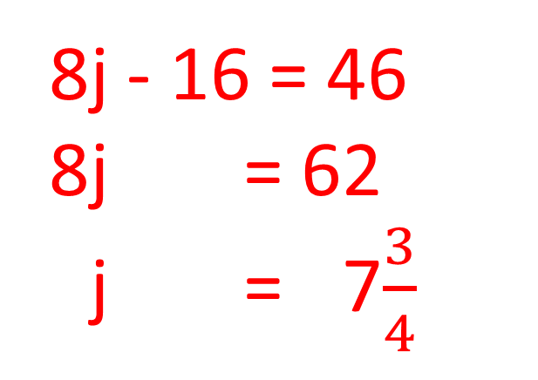
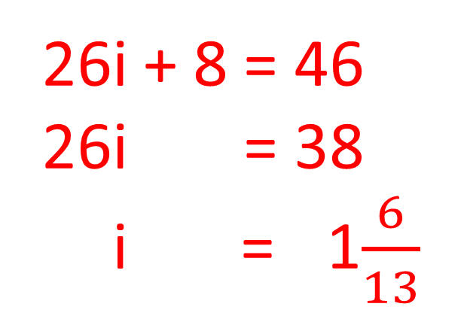
8j - 16 = 46
8j + 6 = 62
8j + 6 = 47$\frac{3}{4}$
26i + 8 = 46
26i + 6 = 38
20i 6 = 41$\frac{6}{13}$

Slide 7
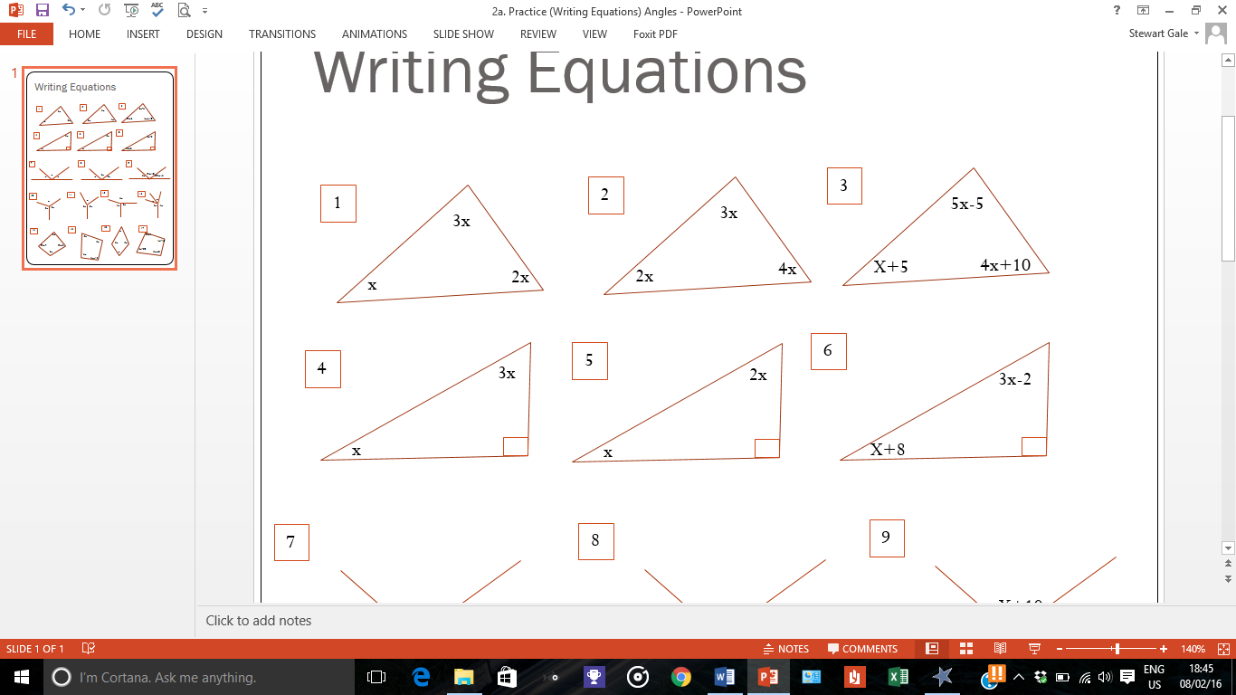
6x + = 180
6x + = 130
9x + = 180
6x + = 120
10x + 10 = 180
10x + 10 = 170
10x + 10 = 117

Slide 8
3x + = 190
6x + = 130
4x + 6 = 90
4x + 8 = 84
10x +8= 21
4x + = 190
6x + = 122.5

Slide 9
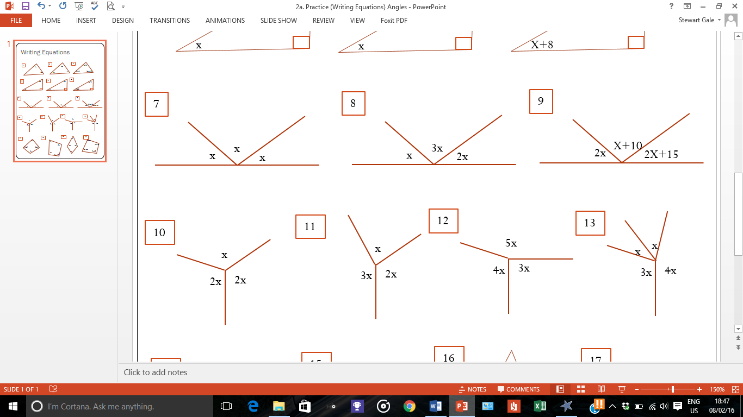
3x + = 180
6x + = 160
6x + = 180
6x + = 130
5x + 25 = 180
5x + 10 = 155
1x +25= 131

Slide 10
5x + = 360
6x + = 172
6x + = 360
6x + = 60
12x + = 360
6 x + = 130
9x + = 360
6x + = 140

Slide 11
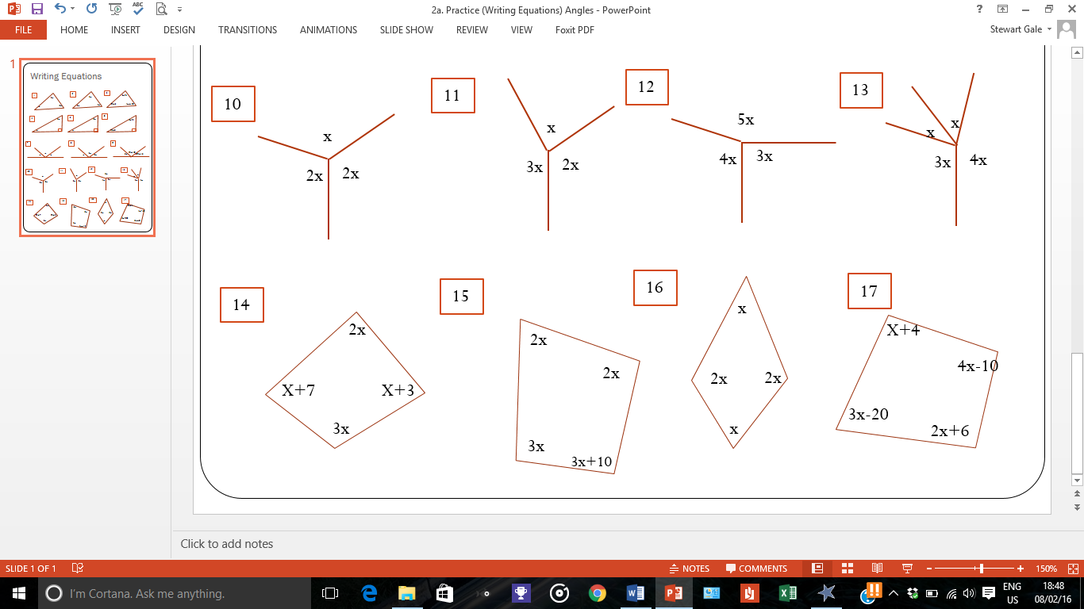
7x + 10 = 360
7x + 10 = 350
1x + 10 = 150
6x + = 360
6x + = 360
10x + 10 = 360
10x + 10 = 350
1x + 10 = 135
10x - 20 = 360
10x + 10 = 380
1x + 10 = 138

