Slide 1
LO: Multiplying and
Dividing Expressions

Slide 2

What is the correct answer?
x x x = 2x
x x x = x²

Slide 3
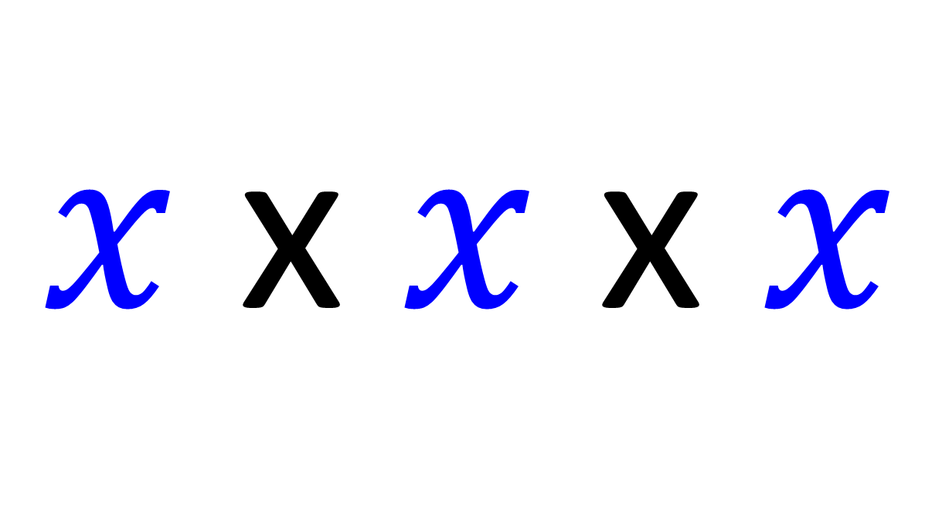
Simplify
$x$ x $x$ x $x$
= x³

Slide 4
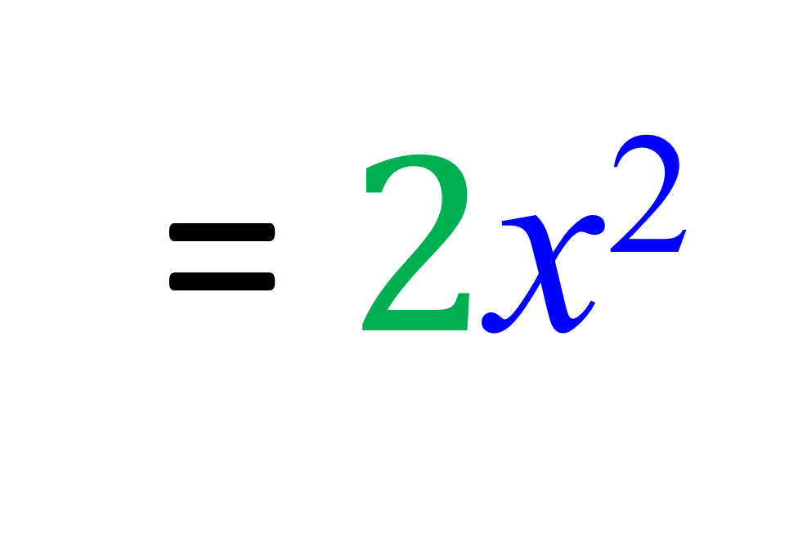
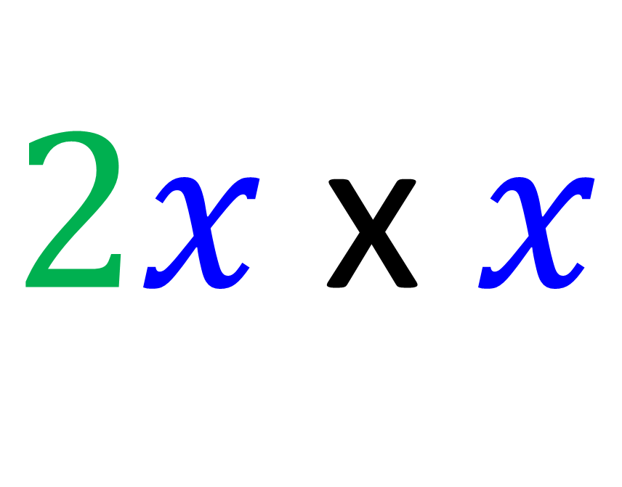
Simplify
$2x$ x $x$
= $2$x²

Slide 5
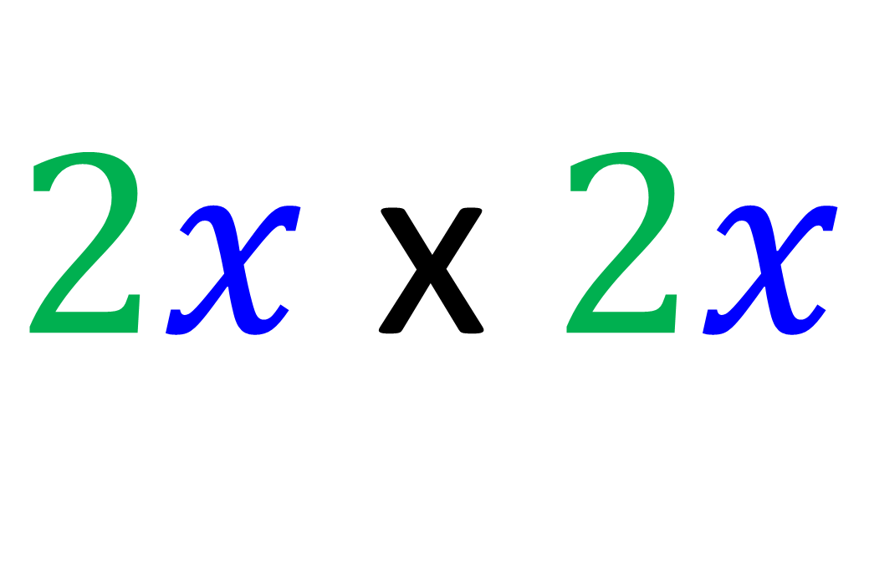
Simplify
$2x$ x $2x$
= 4x²

Slide 6
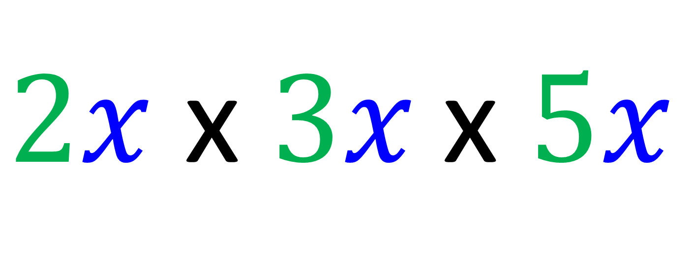
Simplify
$2x$ x $3x \text{x} 5x$
= 30x³

Slide 7
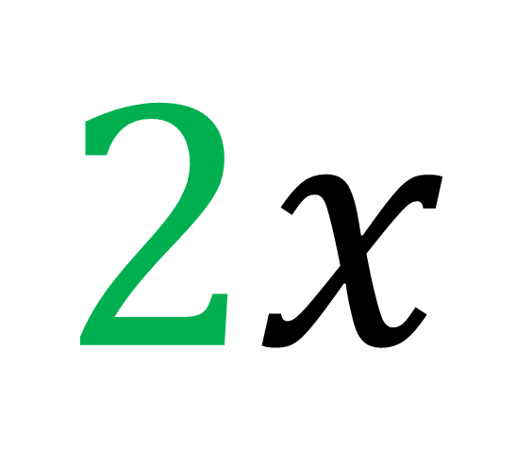
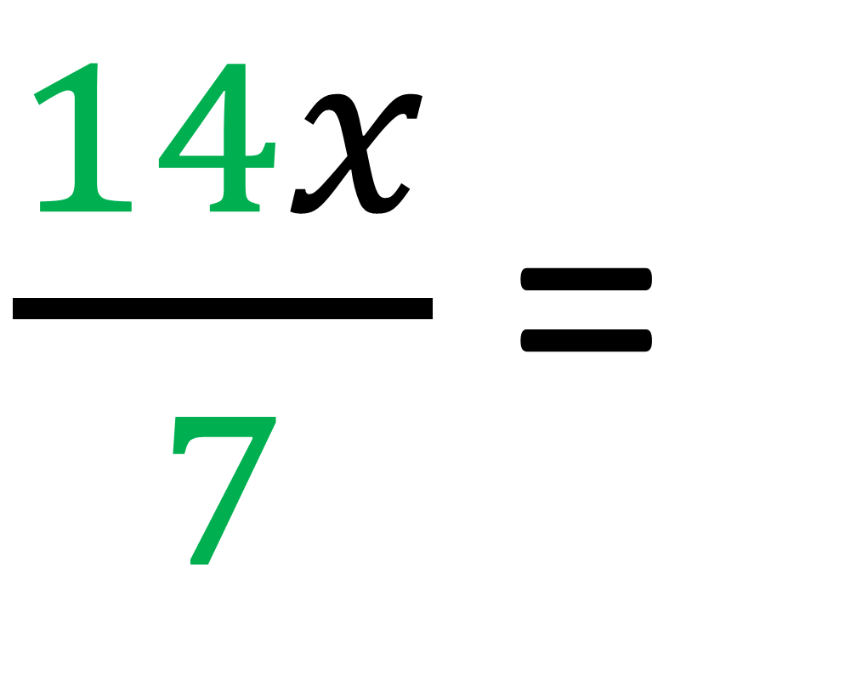
Simplify
$\frac{14x}{7}$ =
$$2x$$

Slide 8
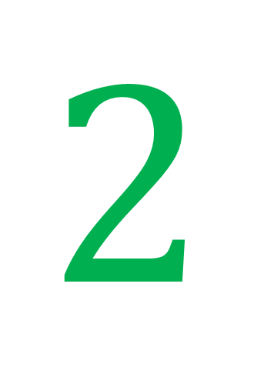
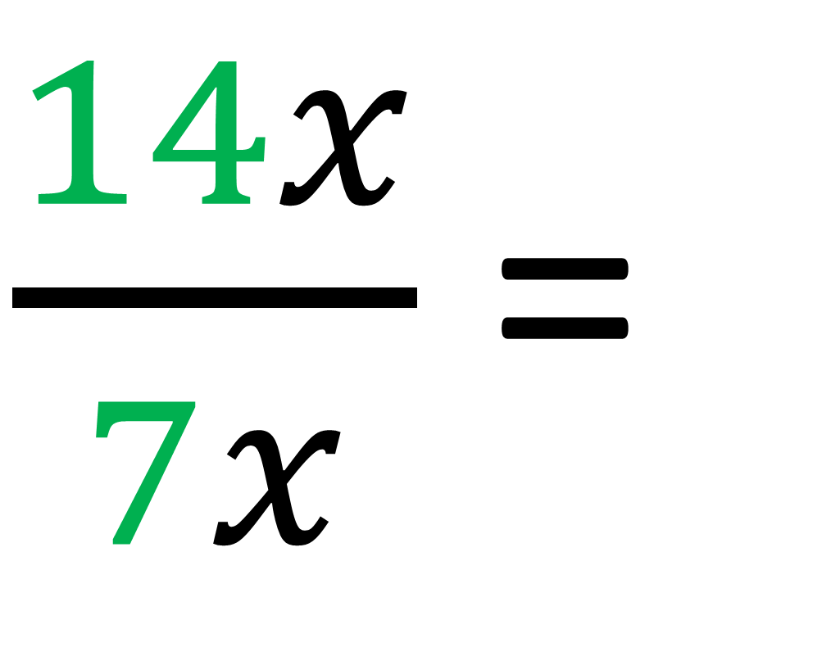
Simplify
$\frac{14x}{7x}$ =
$$2$$

Slide 9
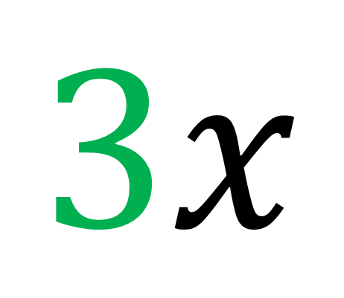
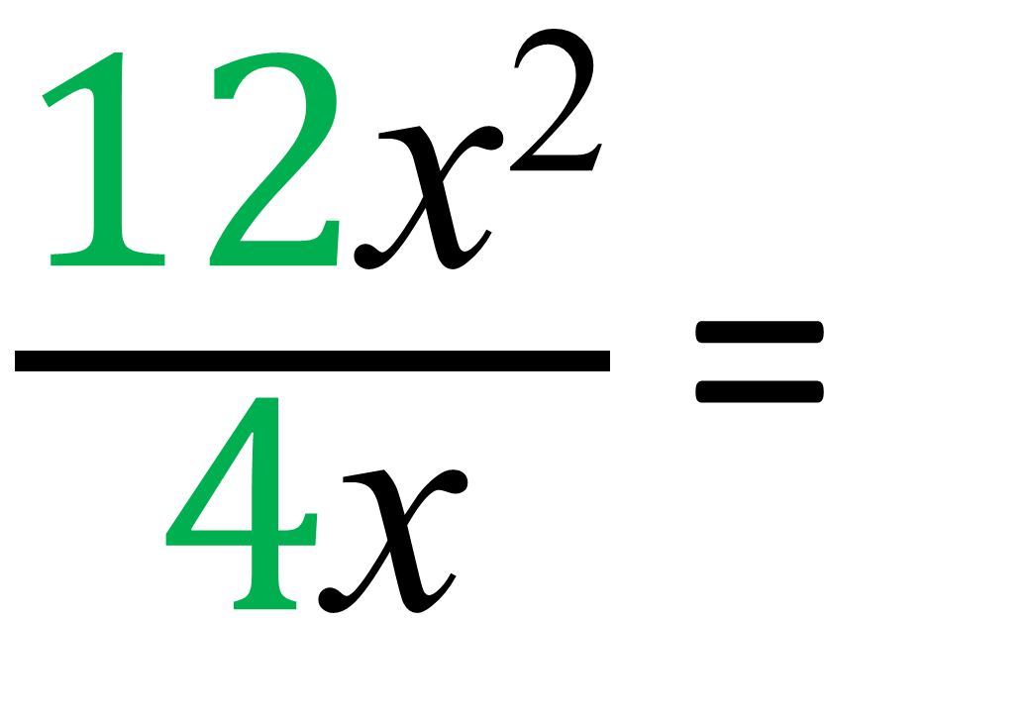
Simplify
$\frac{\text{12}\text{x}\text{2}}{\text{4}\text{x}}$ =
$$3x$$

Slide 10

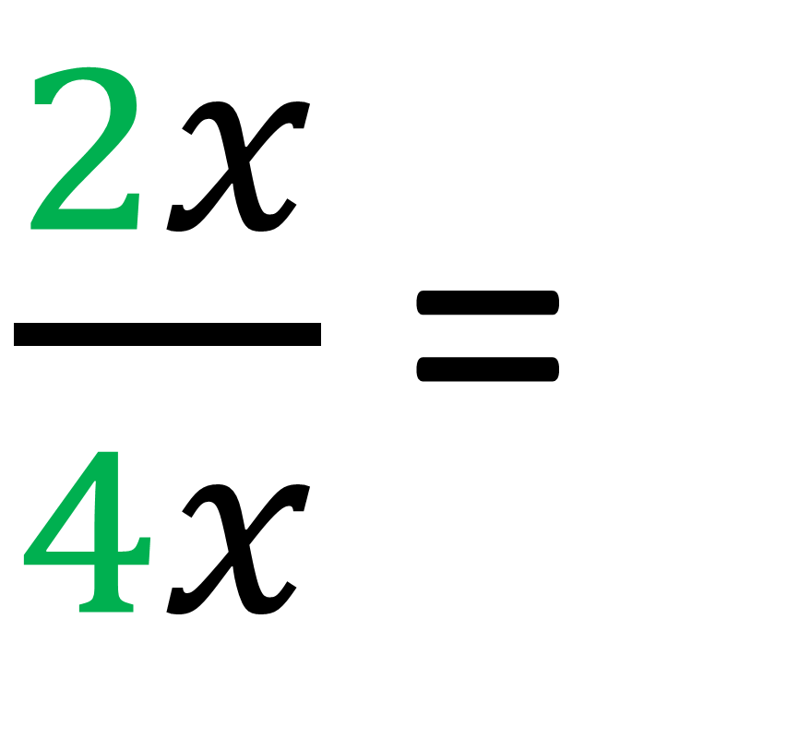
Simplify
$\frac{2x}{4x}$ =
$$\frac{1}{2}$$

Slide 11
Which has been simplified correctly?
a x b = ab
a x b = a^{b}

Slide 12
Which has been simplified correctly?
a x a = aa
a x a = a²

Slide 13
Which has been simplified correctly?
2x x 3x = 6x²
2x x 3x = 23x²

Slide 14
Which has been simplified correctly?
2x x 3x x 7 = 6x² x 7
2x x 3x x 7 = 42x²

Slide 15
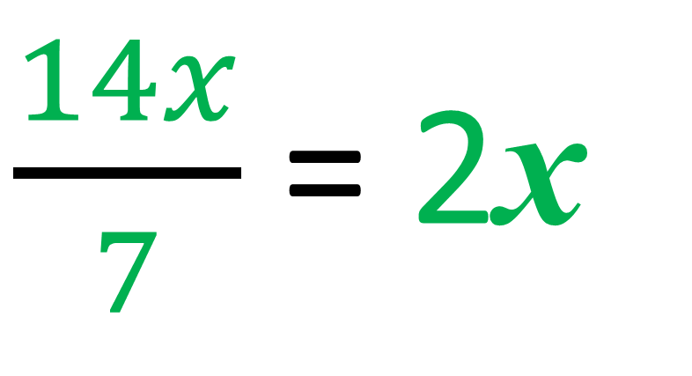
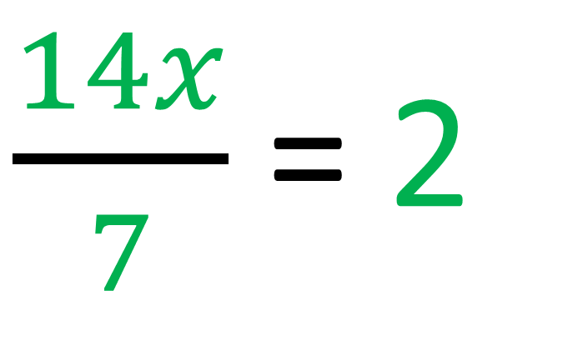
Which has been simplified correctly?
$\frac{14x}{7}$ = 2
$\frac{14x}{7}$ = 2x

Slide 16
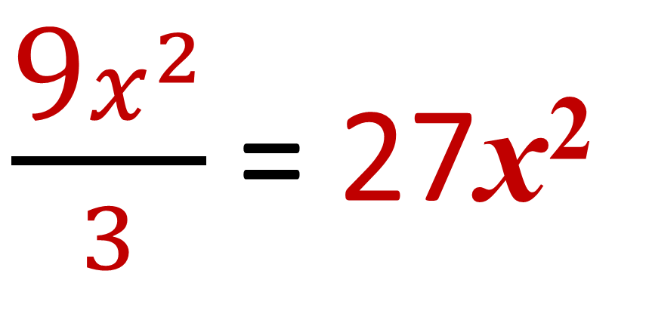
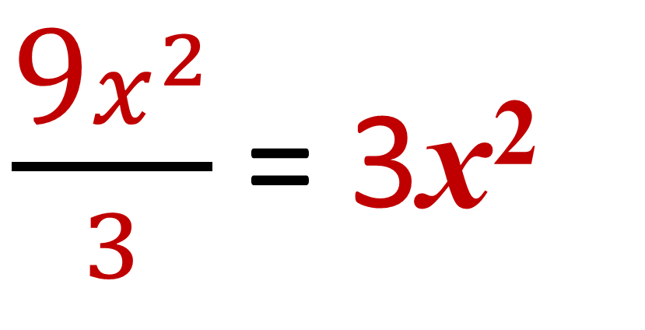
Which has been simplified correctly?
$\frac{\text{9}x^{2}}{3}$ = 3x²
$\frac{\text{9}x^{2}}{3}$ = 27x²

Slide 17
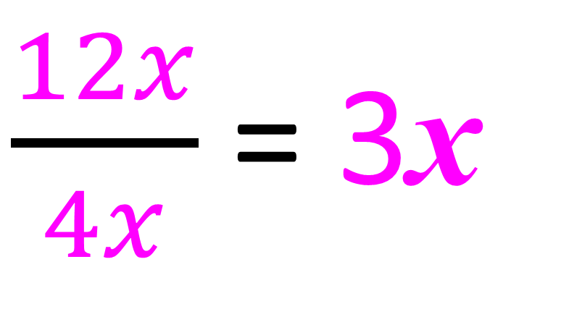
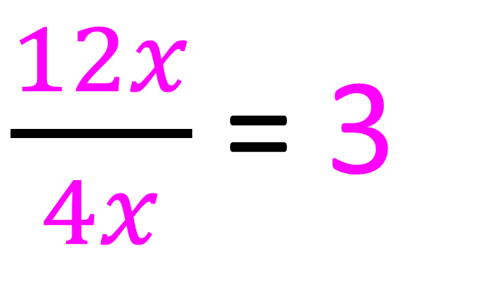
Which has been simplified correctly?
$\frac{12x}{4x}$ = 3
$\frac{12x}{4x}$ = 3x

Slide 18
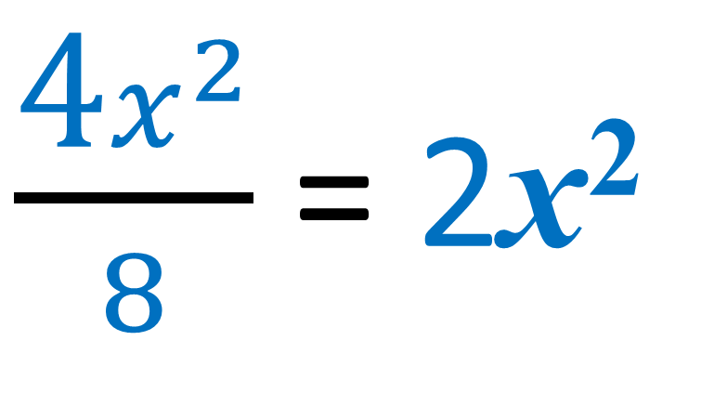
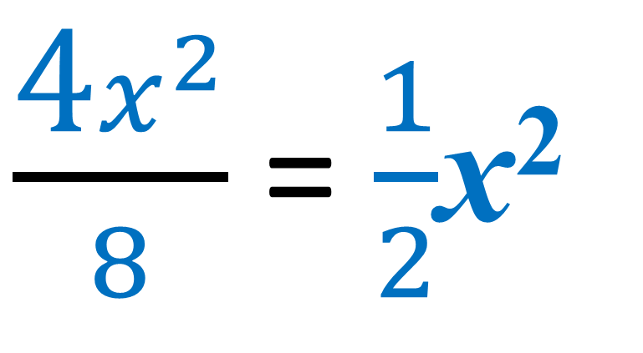
Which has been simplified correctly?
$\frac{\text{4}x^{2}}{8}$ = $\frac{1}{2}$x²
$\frac{\text{4}x^{2}}{8}$ = 2x²

Slide 19
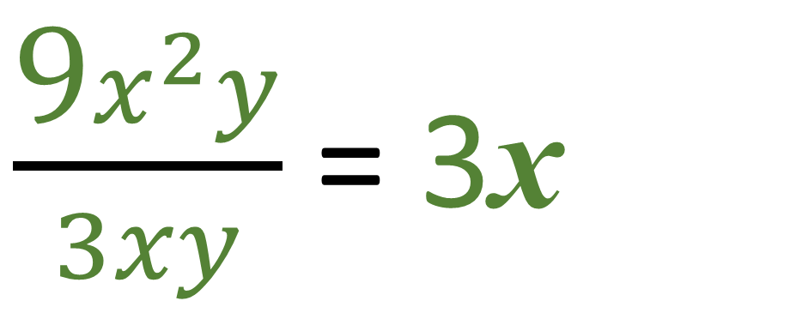
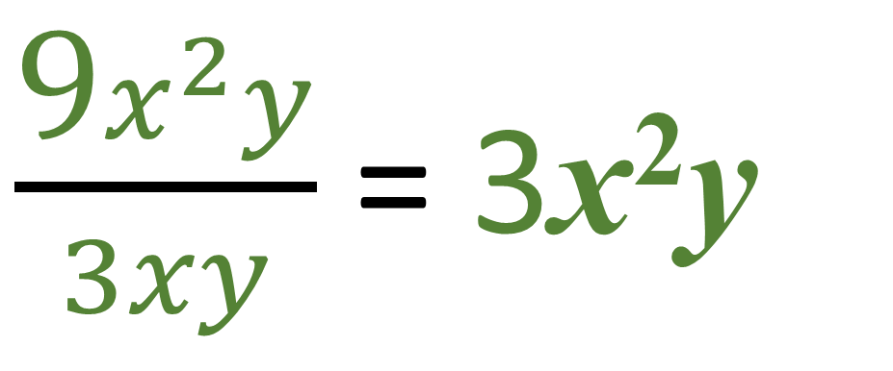
Which has been simplified correctly?
$\frac{\text{9}x^{2}y}{3xy}$ = 3x
$\frac{\text{9}x^{2}y}{3xy}$ = 3x²y

Slide 20
What is the area of the rectangle?
3x
Area = 15x²
5x

Slide 21
What is the area of the triangle?
Area = 2b x 3b
2
2b
Area = 3b²
3b

