Slide 1
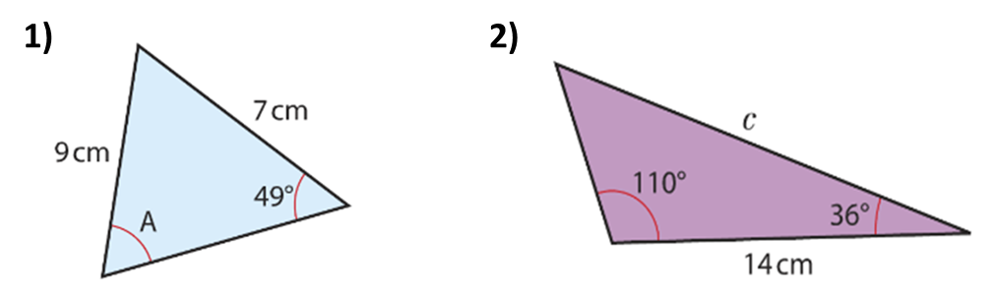
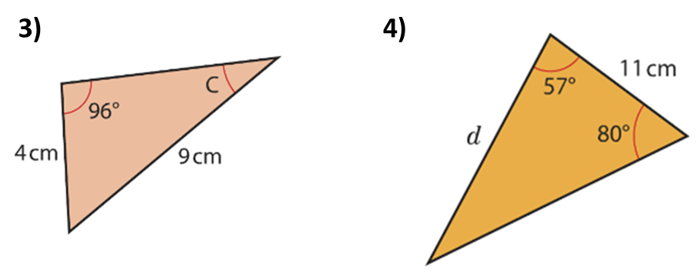
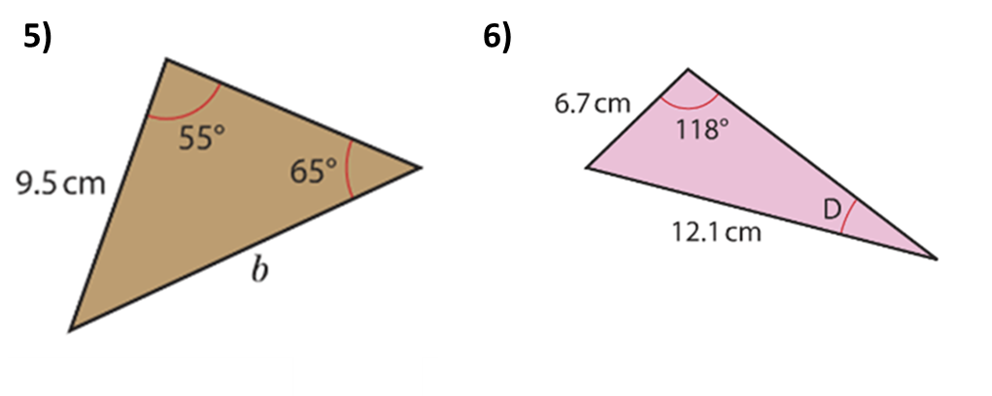

Slide 2
ANSWERS

Slide 3
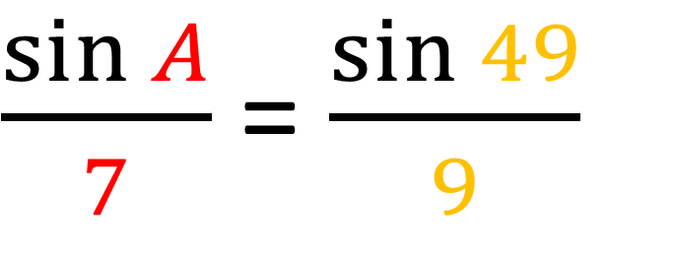
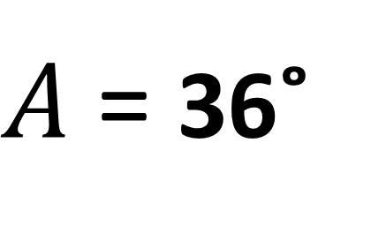
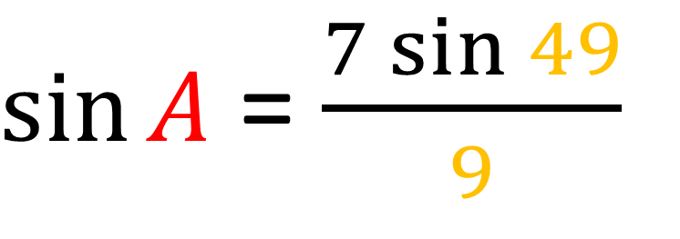
$\frac{\sin{A}}{7}$ = $\frac{\sin{49}}{9}$
$\sin{A}$ = $\frac{7\sin{49}}{9}$
$A$ = 36˚

Slide 4
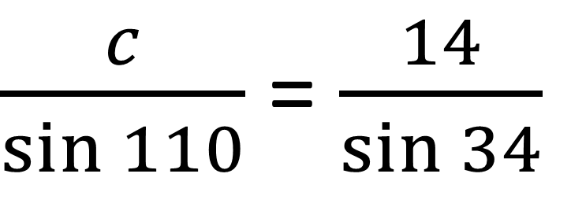
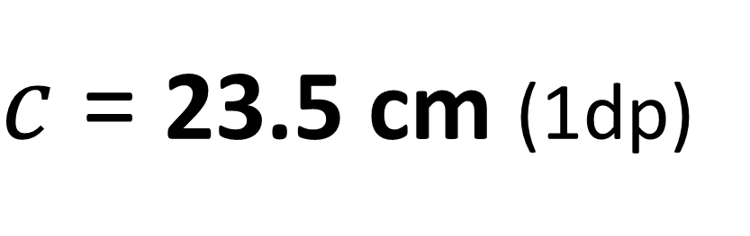
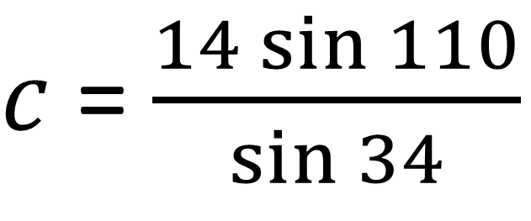
$\frac{c}{\sin{110}}$ = $\frac{14}{\sin{34}}$
$c$ = $\frac{14\sin{110}}{\sin{34}}$
$c$ = 23.5 cm (1dp)

Slide 5
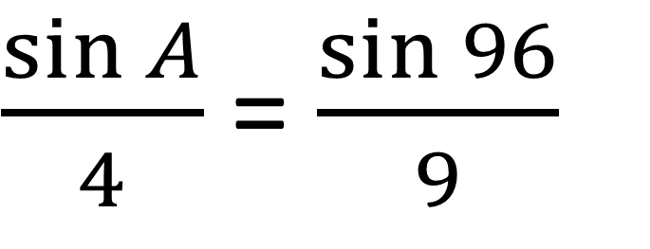
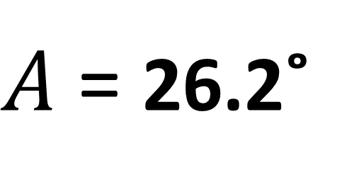
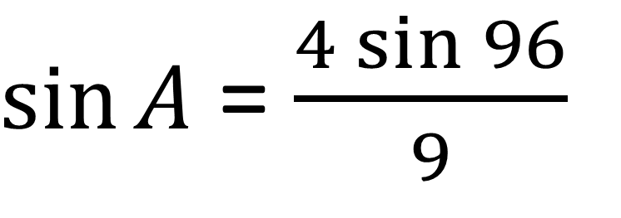
$\frac{\sin{A}}{4}$ = $\frac{\sin{96}}{9}$
$\sin{A}$ = $\frac{4\sin{96}}{9}$
$A$ = 26.2˚

Slide 6
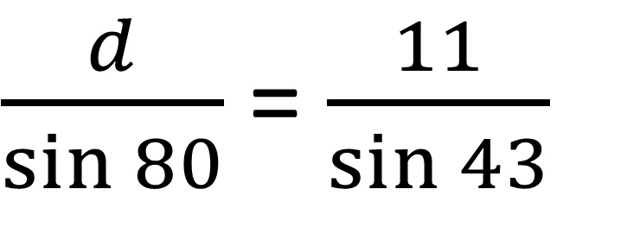
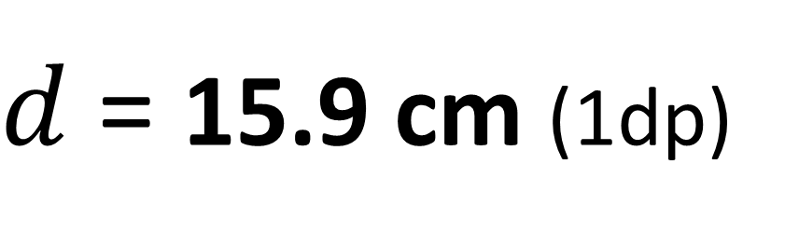
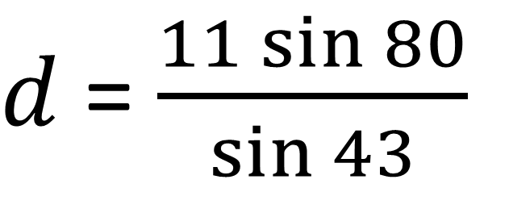
$\frac{d}{\sin{80}}$ = $\frac{11}{\sin{43}}$
$d$ = $\frac{11\sin{80}}{\sin{43}}$
$d$ = 15.9 cm (1dp)

Slide 7
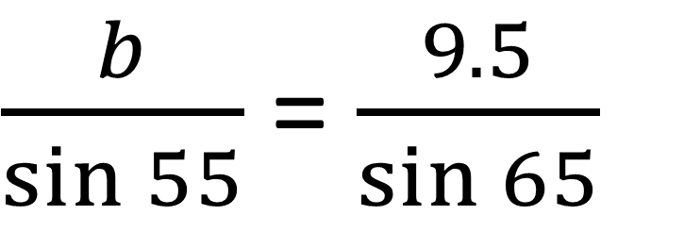
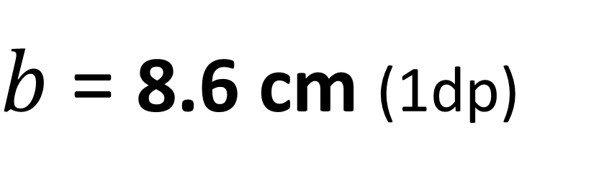
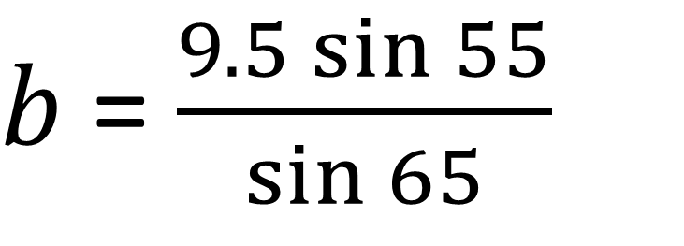
$\frac{b}{\sin{55}}$ = $\frac{9.5}{\sin{65}}$
$b$ = $\frac{9.5\sin{55}}{\sin{65}}$
$b$ = 8.6 cm (1dp)

Slide 8
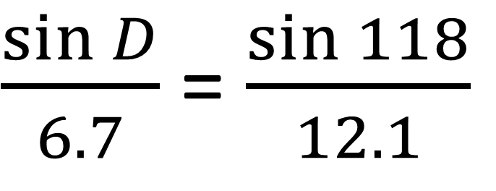
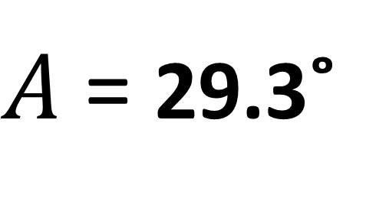
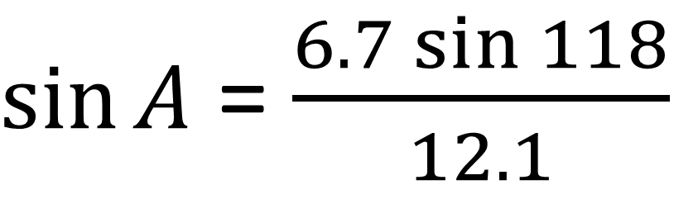
$\frac{\sin{D}}{6.7}$ = $\frac{\sin{118}}{12.1}$
$\sin{A}$ = $\frac{6.7\sin{118}}{12.1}$
$A$ = 29.3˚

