Slide 1

Diagnostic Assessment .Delta 1
Unit 9
Perimeter and Area
Nets
3D Shapes
Surface Area
Volume
Capacity
Unit Conversion

Slide 2
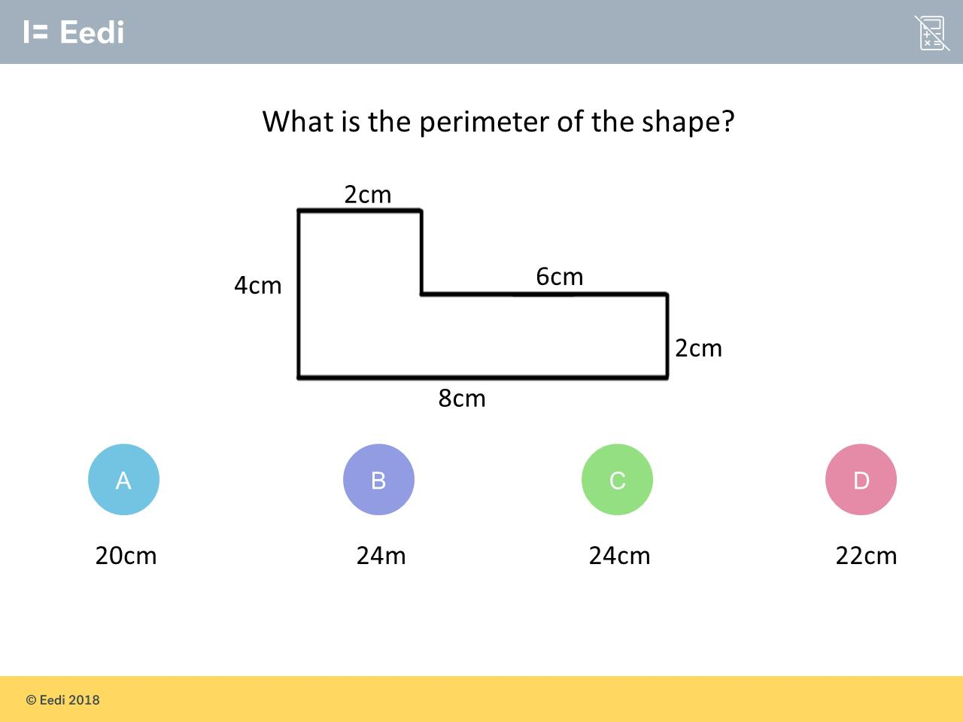
Question 1 – Perimeter

Slide 3
Answer 1 – Perimeter
CORRECT ANSWER | CORRECT EXPLANATION
24cm | The missing side length is 4 - 2 = 2, so we have 4 + 2 + 2 + 6 + 2 + 8 = 24 cm.
COMMON MISTAKES | WHAT MIGHT BE YOUR MISTAKE
20cm | The student has found the area.
24m | The student has used the wrong units.
2cm | The student has not included the missing side length.

Slide 4
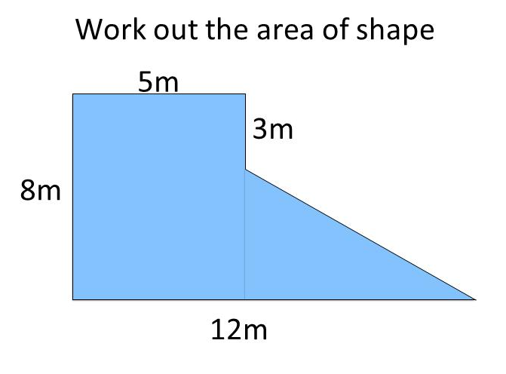
Question 2 – Area

Slide 5
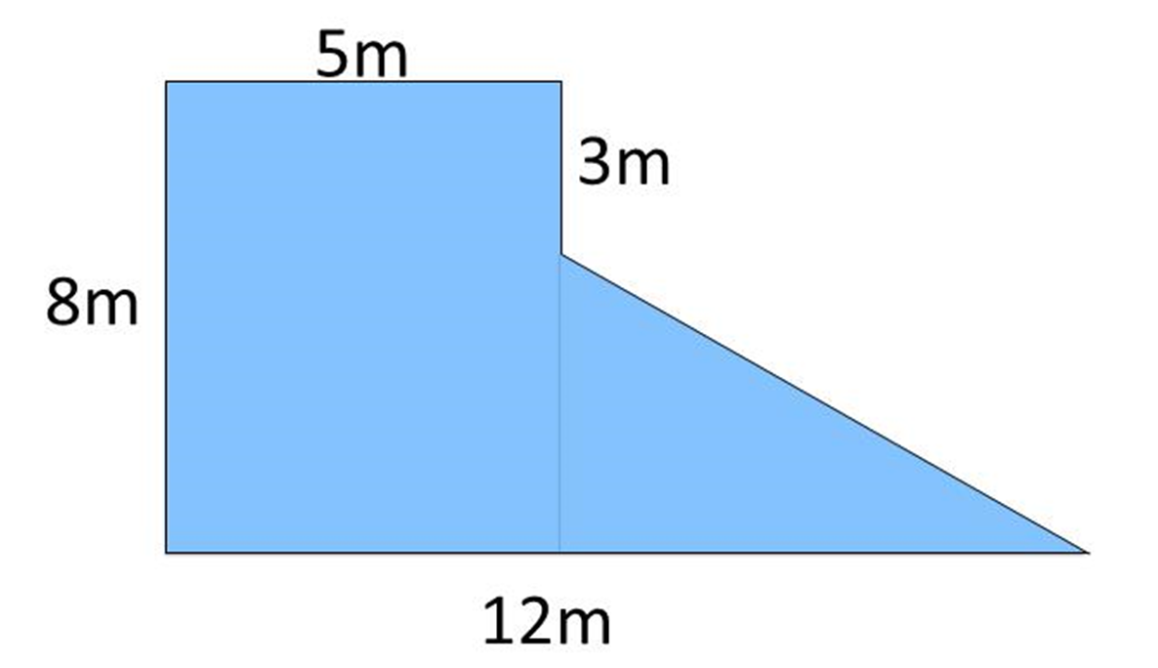

Answer 2 – Area
CORRECT ANSWER | CORRECT EXPLANATION
57.5 | The shape can be split up into 2 parts; a rectangle with area 8 × 5 = 40, and a triangle with area (12 - 5) × (8 - 3)/2 =17.5. Adding these together gives the answer.
COMMON MISTAKES | WHAT MIGHT BE YOUR MISTAKE
88 | The student has used the wrong base for the triangle.
55.5 | The student has split the shape into 2 triangles.
111 | The student has split the shape into two triangles, and has forgotten to divide by 2.

Slide 6
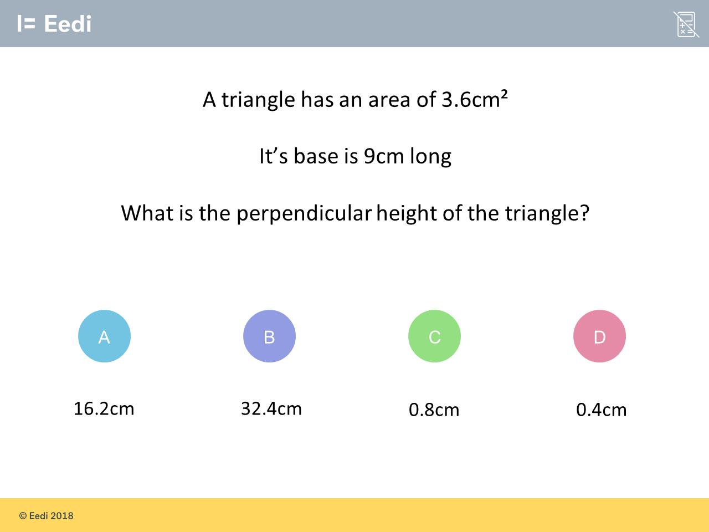
Question 3 – Area

Slide 7
Answer 3 – Area
CORRECT ANSWER | CORRECT EXPLANATION
0.8cm | We have 3.6/9 × 2 = 0.8 cm.
COMMON MISTAKES | WHAT MIGHT BE YOUR MISTAKE
16.2cm | The student has worked out the area of a triangle with base 9 cm and height 3.6.
32.4cm | The student has worked out the area of a triangle with base 9 cm and height 3.6, but has not halved their answer.
0.4cm | The student has not multiplied by 2.

Slide 8
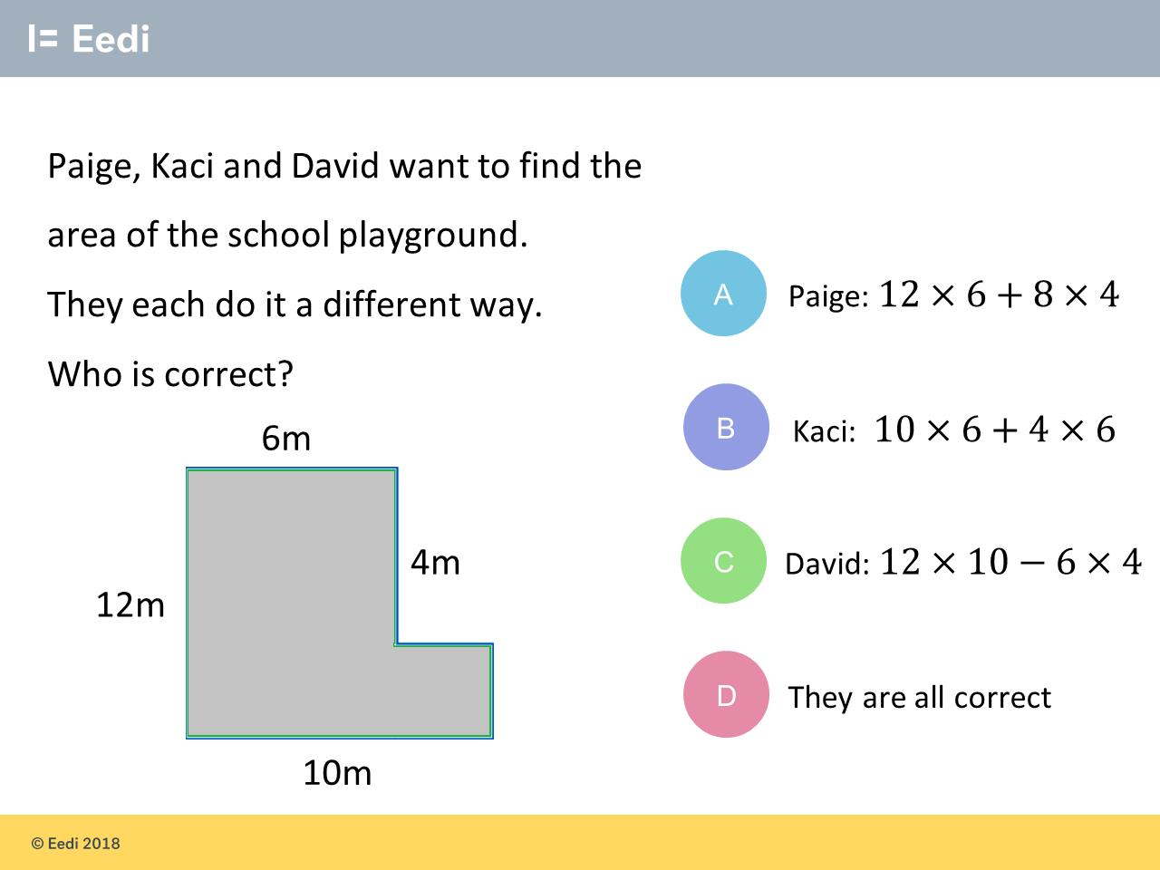
Question 4 – Area

Slide 9
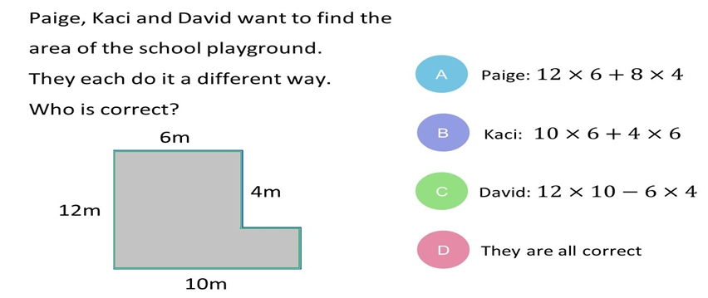
Answer 4 – Area
CORRECT ANSWER | CORRECT EXPLANATION
A | We split the shape into two parts; one with area 12 × 6 and the other with area (10 - 6) × (12 - 4) = 4 × 8.
COMMON MISTAKES | WHAT MIGHT BE YOUR MISTAKE
B | The student has calculated the missing length incorrectly.
C | The student has not calculated the missing lengths of the part to be subtracted.
D | The student may have guessed.

Slide 10
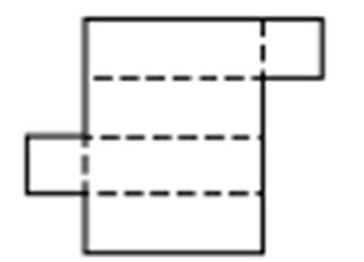
Question 5 – Nets
Name the 3D Shape that can be made from this net.

Slide 11
Answer 5 – Nets
Name the 3D Shape that can be made from this net.
CORRECT ANSWER | CORRECT EXPLANATION
Cuboid | This net forms a cuboid, or a rectangular prism.
COMMON MISTAKES | WHAT MIGHT BE YOUR MISTAKE
Cylinder | The student may have guessed. They may benefit from revising these 3D shapes.
Rectangular Pyramid | The student may have guessed. They may benefit from revising these 3D shapes.
Cube | The student has not recognised that 4 of the faces are rectangular, not square.

Slide 12
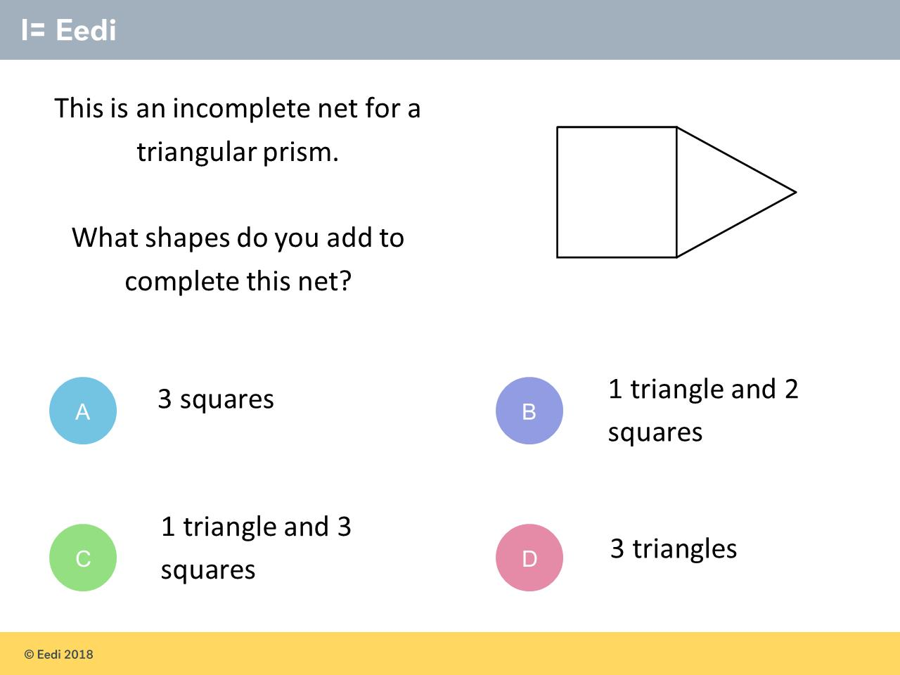
Question 6 – Nets

Slide 13
Answer 6 – Nets
CORRECT ANSWER | CORRECT EXPLANATION
1 triangle 2 squares | A triangular prism has 3 square faces and 2 triangular faces. So we need to include another 2 squares and 1 triangle.
COMMON MISTAKES | WHAT MIGHT BE YOUR MISTAKE
3 squares | The student may have guessed. They may benefit from revising nets.
1 triangle 3 squares | The student has not realised that we only require 2 squares, as there is one already.
3 triangles | The student may be trying to form a square based pyramid.

Slide 14
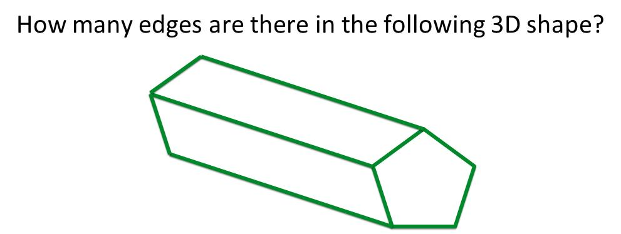
Question 7 – 3D Shapes

Slide 15
Answer 7 – 3D Shapes
CORRECT ANSWER | CORRECT EXPLANATION
15 | There are 5 edges on each end face, and 5 connecting each end. That gives 5 + 5 + 5 = 15.
COMMON MISTAKES | WHAT MIGHT BE YOUR MISTAKE
10 | The student has given the number of vertices
7 | The student has given the number of faces.
8 | The student has given the number of visible edges.

Slide 16
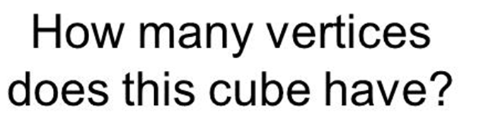
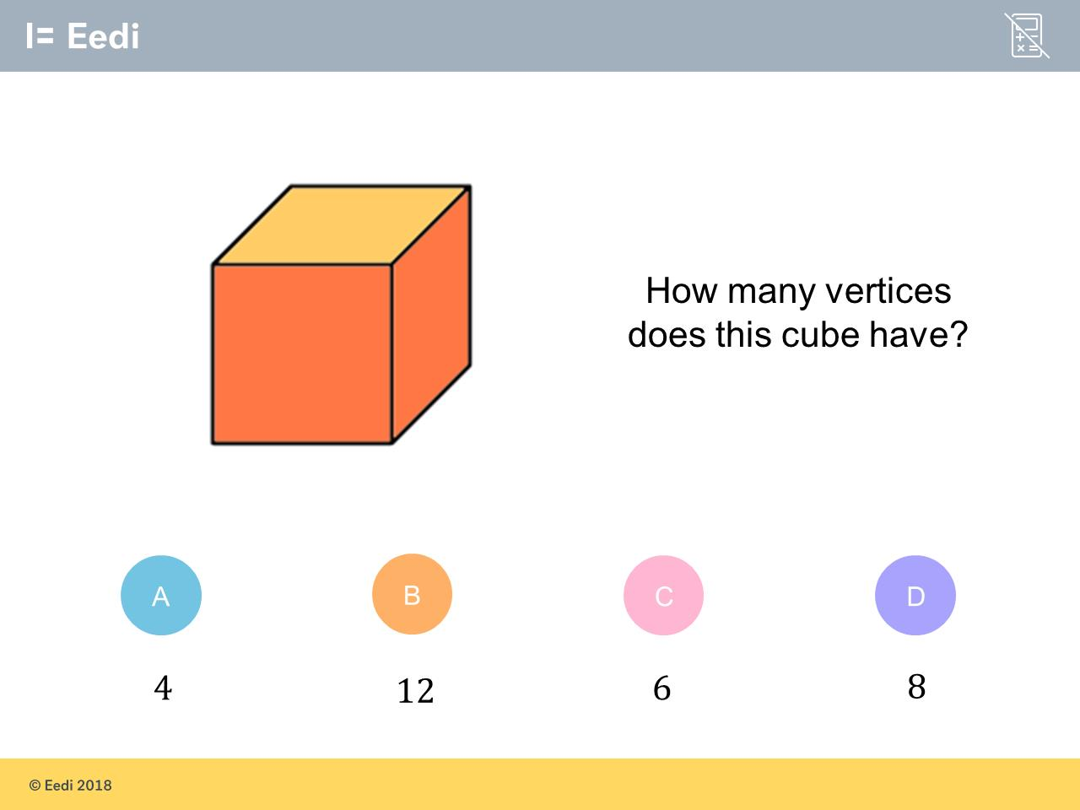
Question 8 – 3D Shapes

Slide 17

Answer 8 – 3D Shapes
CORRECT ANSWER | CORRECT EXPLANATION
8 | We have 12 + 8 = 20 people who bought just food and 4 + 6 = 10 people who just bought drinks. Adding them together gives 30.
COMMON MISTAKES | WHAT MIGHT BE YOUR MISTAKE
4 | The student has found the number of people who just ordered food.
12 | The student has found the number of people who ordered nothing.
6 | The student has found the number of people who just ordered drinks.

Slide 18
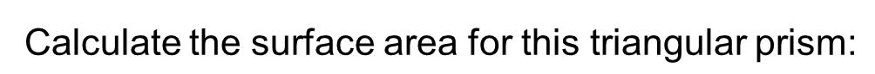
Question 9 – Surface Area

Slide 19
Answer 9 – Surface Area
CORRECT ANSWER | CORRECT EXPLANATION
148 | We have two triangular faces and 3 rectangular faces, so the surface area is (4 ×2 / 2) × 2 + 8 × 10 + 2 × 10 + 4 × 10 = 148.
COMMON MISTAKES | WHAT MIGHT BE YOUR MISTAKE
88 | The student may have tried to find the surface area of the visible faces only, but has not divided by 2 for the triangle.
40 | The student has found the volume.
156 | The student may not have halved the area for each triangle.

Slide 20
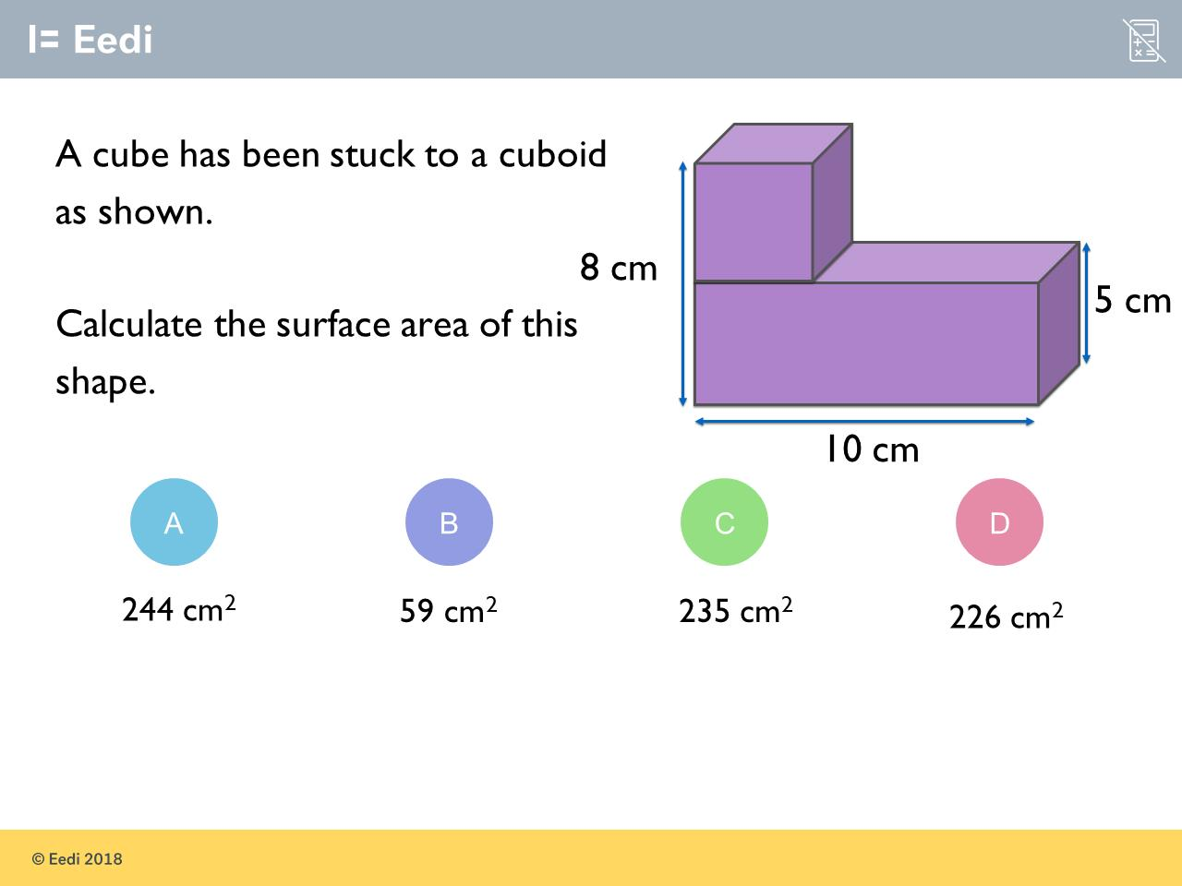
Question 10 – Surface Area

Slide 21
Answer 10 – Surface Area
CORRECT ANSWER | CORRECT EXPLANATION
226 | The cube has sides 8 - 5 = 3, so it has surface area 6 × 3 × 3 = 54. The cuboid has surface area 2 × (10 × 5 + 10 × 3 + 5 × 3) = 190. Adding these together gives 244. However, we need to remove the 2 joined sides from 244, so we have 244 - 2 × 3 × 3 = 226.
COMMON MISTAKES | WHAT MIGHT BE YOUR MISTAKE
244 | The student has not removed the joined sides.
59 | The student may have guessed.
235 | The student has only removed one joining side.

Slide 22
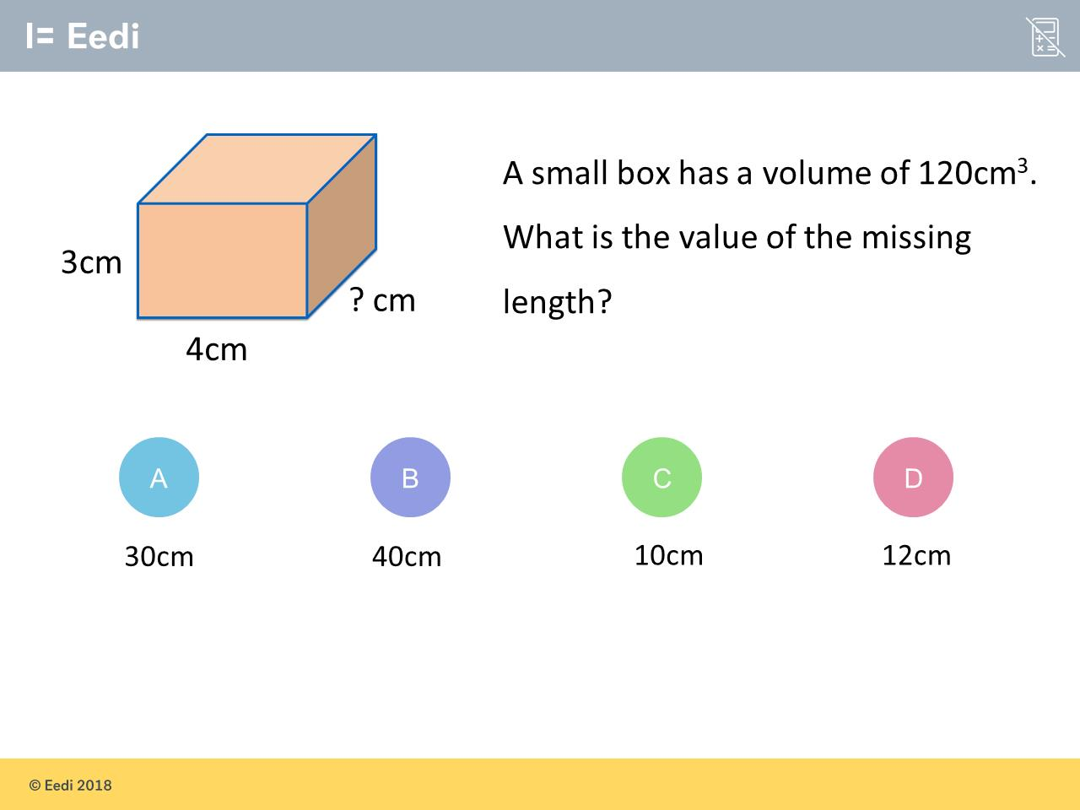
Question 11 – Volume

Slide 23
Answer 11 – Volume
CORRECT ANSWER | CORRECT EXPLANATION
10cm | We have 12 + 8 = 20 people who bought just food and 4 + 6 = 10 people who just bought drinks. Adding them together gives 30.
COMMON MISTAKES | WHAT MIGHT BE YOUR MISTAKE
30cm | The student has found the number of people who just ordered food.
40cm | The student has found the number of people who ordered nothing.
12cm | The student has found the number of people who just ordered drinks.

Slide 24
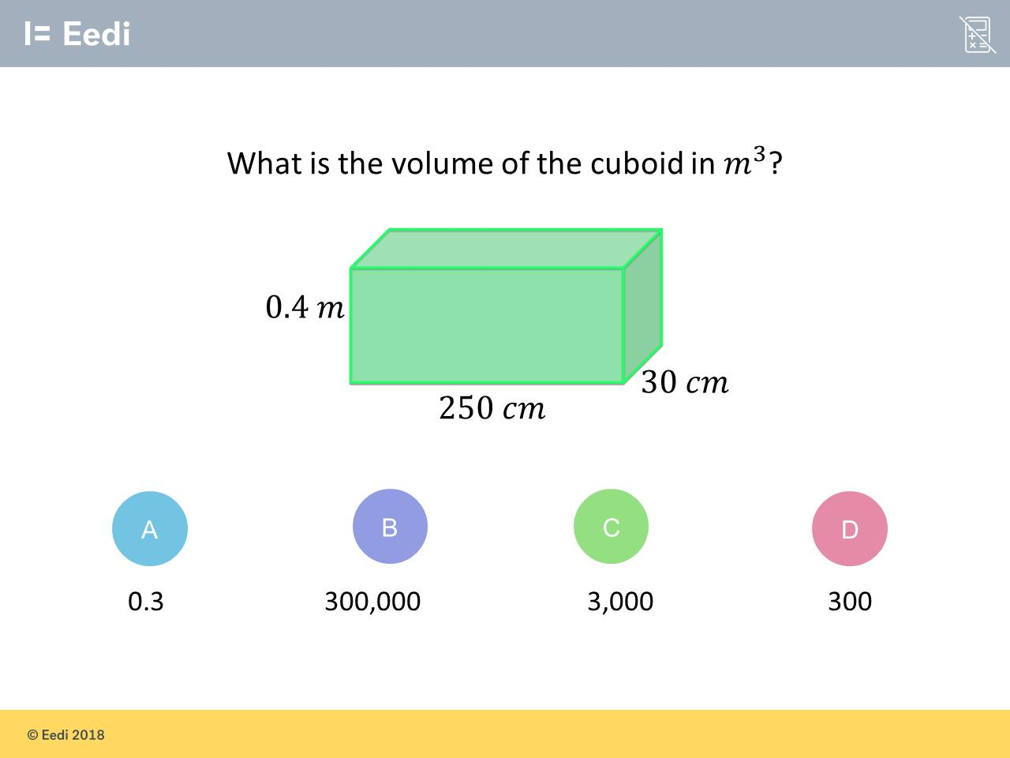
Question 12 – Volume

Slide 25
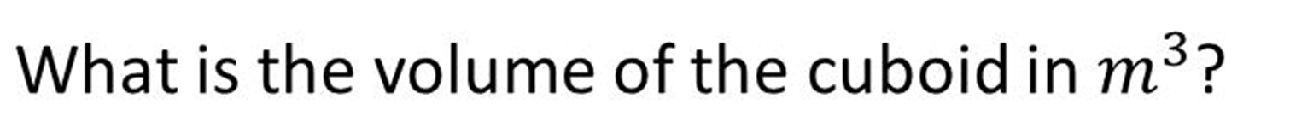
Answer 12 – Volume
CORRECT ANSWER | CORRECT EXPLANATION
0.3 | 250 cm = 2.5m, and 30 cm = 0.3cm, so we have 2.5 × 0.4 × 0.3 = 0.3 m³.
COMMON MISTAKES | WHAT MIGHT BE YOUR MISTAKE
300000 | The student has found the volume in cm³.
3000 | The student has not converted the units before multiplying.
300 | The student may believe that there are 10 cm in a metre.

Slide 26
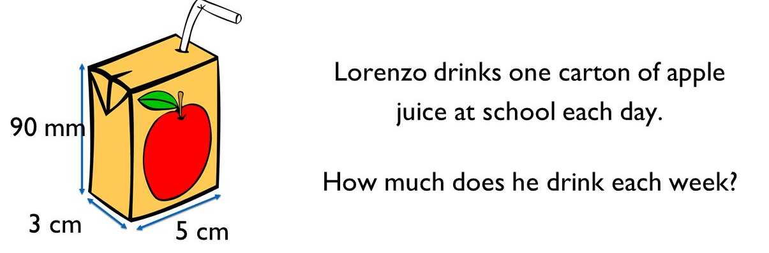
Question 13 – Capacity

Slide 27
Answer 13 – Capacity
CORRECT ANSWER | CORRECT EXPLANATION
675ml | 90mm = 9cm, so the volume of one carton is 9 × 3 × 5 = 135 cm³. Multiplying by 5 for a five day week gives 675 cm³. This converts to 675 ml.
COMMON MISTAKES | WHAT MIGHT BE YOUR MISTAKE
1350ml | The student has not converted the units, and has found the liquid in one carton only.
135ml | The student has found the liquid in one carton.
None of these are correct | The student may have used a 7 day week.

Slide 28
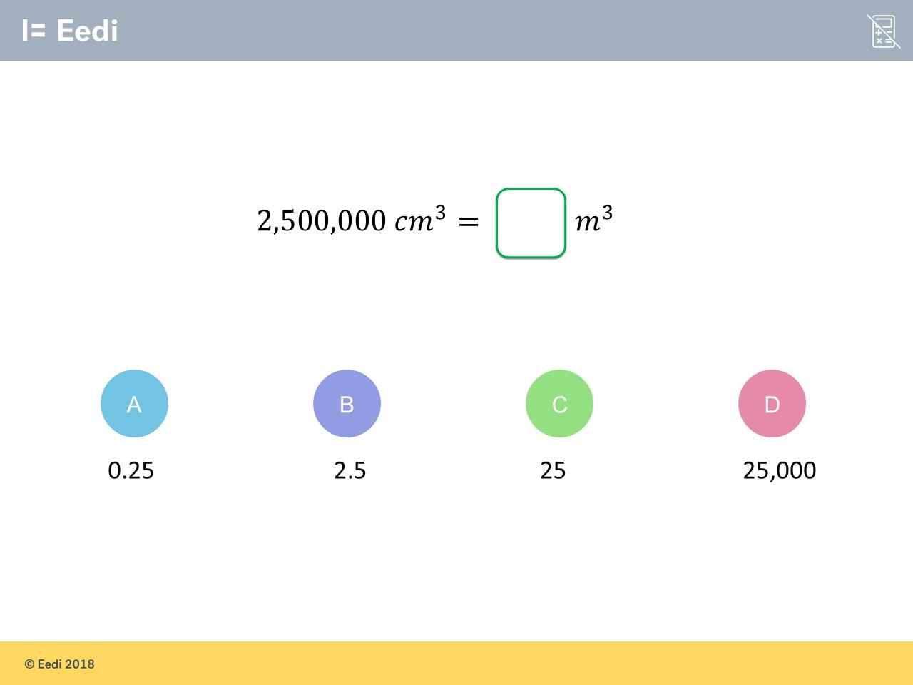
Question 14 – Converting Units

Slide 29
Answer 14 – Converting Units
CORRECT ANSWER | CORRECT EXPLANATION
2.5 | There are 100 cm in a metre, so there are 100³ =1,000,000 cm³ in a m³. We can divide 2,500,000 by 1,000,000 to get 2.5.
COMMON MISTAKES | WHAT MIGHT BE YOUR MISTAKE
0.25 | The student has used the wrong conversion.
25 | The student has used the wrong conversion.
25000 | The student may be converting from centimetres to metres.

Slide 30
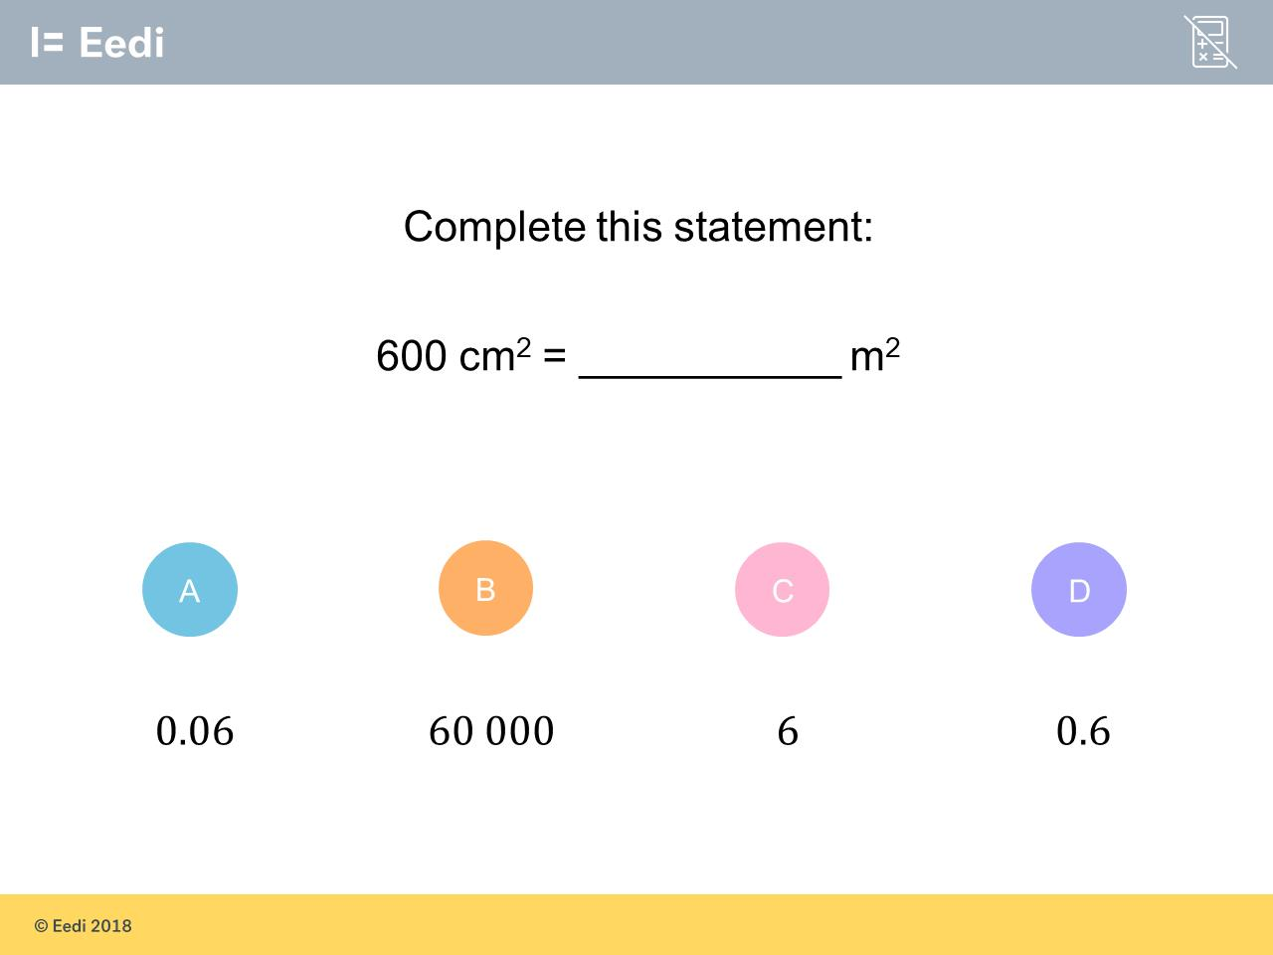
Question 15 – Converting Units

Slide 31
Answer 15 – Converting Units
CORRECT ANSWER | CORRECT EXPLANATION
0.06 | There are 100² = 10,000 cm² in 1 m², so we divide 600 by 10,000 to get 0.06 m².
COMMON MISTAKES | WHAT MIGHT BE YOUR MISTAKE
60000 | The student has multiplied, rather than dividing, and has ignored the cm².
6 | The student has ignored the squared sign.
0.6 | The student may believe that 1000cm² = 1 m².

