Slide 1
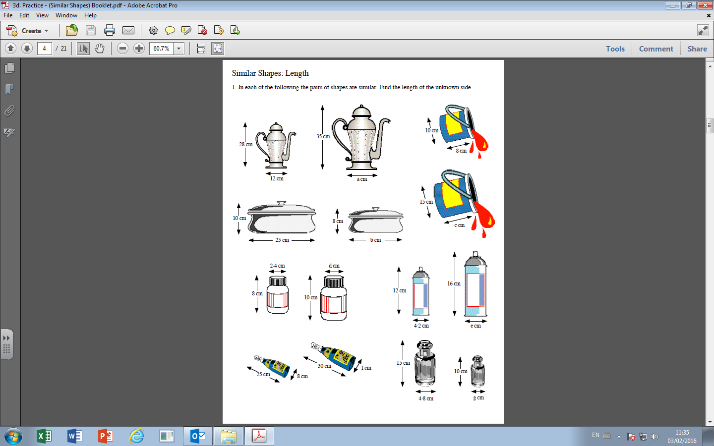
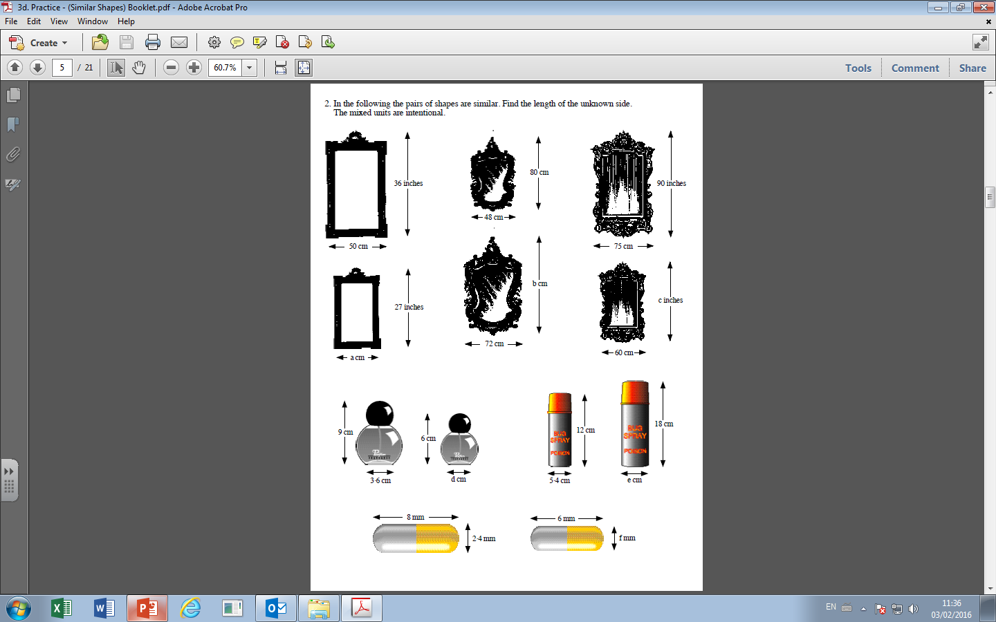

Slide 2
Answers

Slide 3
15 cm
20 cm
12 cm

Slide 4
3 cm
5.6 cm
9.6 cm
3.2 cm

Slide 5
120 cm
72
37.5

Slide 6
2.4 cm
8.1 cm
1.8 mm

