Slide 1
LO: Direct Proportion
(Involving Powers)

Slide 2
The kinetic energy of an object is
proportional to the square of its speed.
That means if the speed of an object doubles
its kinetic energy will be four times greater.

Slide 3
x | 2 | 5 | 8 | 10 | 20
y | 8 | 50 | 128 | 200 | 800
Are x and y in direct proportion?
NO

Slide 4
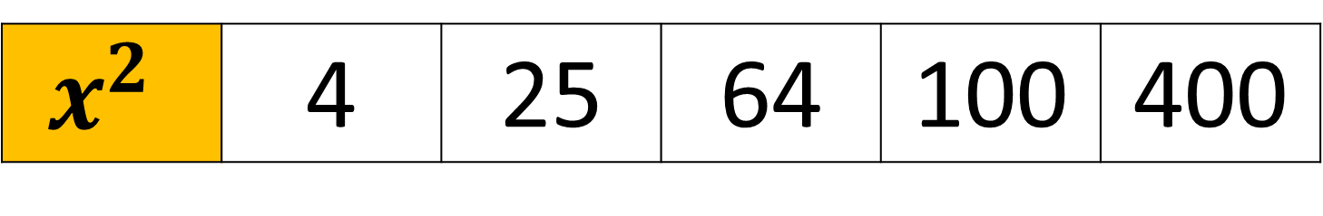

x | 2 | 5 | 8 | 10 | 20
$$x^{2}$$ | 4 | 25 | 64 | 100 | 400
y | 8 | 50 | 128 | 200 | 800
Are $x^{2}$ and y in direct proportion?
YES

Slide 5

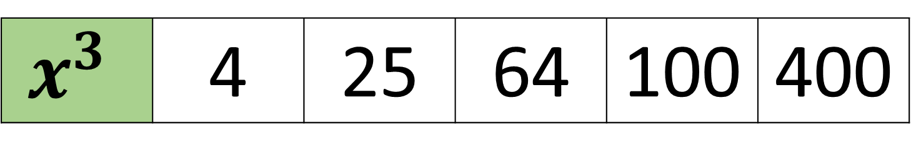
$$x^{3}$$ | 4 | 25 | 64 | 100 | 400
y | 8 | 50 | 128 | 200 | 800
Are $x^{3}$ and y in direct proportion?
YES

Slide 6
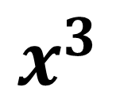
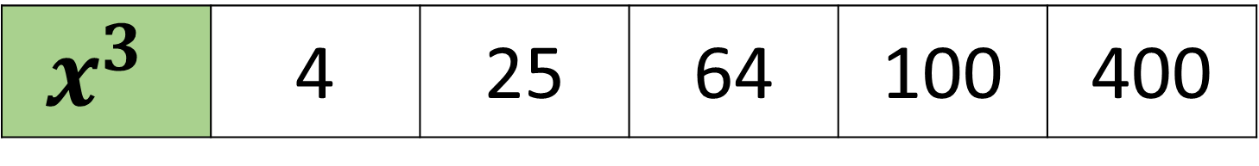
$$x^{3}$$ | 4 | 25 | 64 | 100 | 400
y | 8 | 50 | 128 | 200 | 800
What would the graph look like?
y
$$x^{3}$$

Slide 7
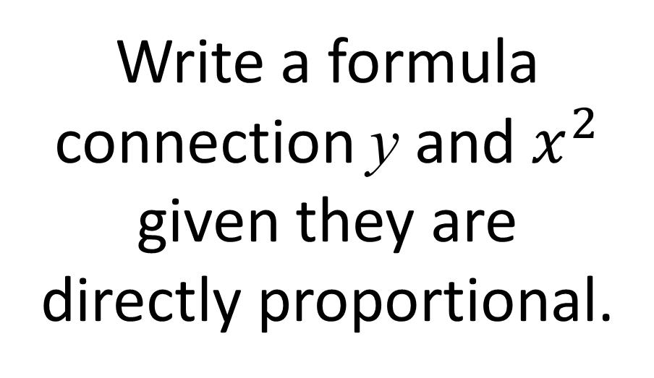
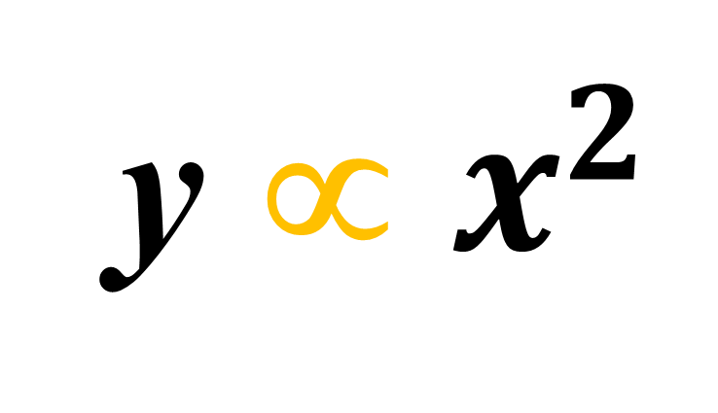
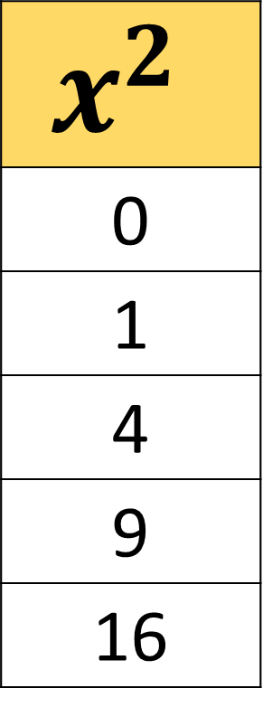
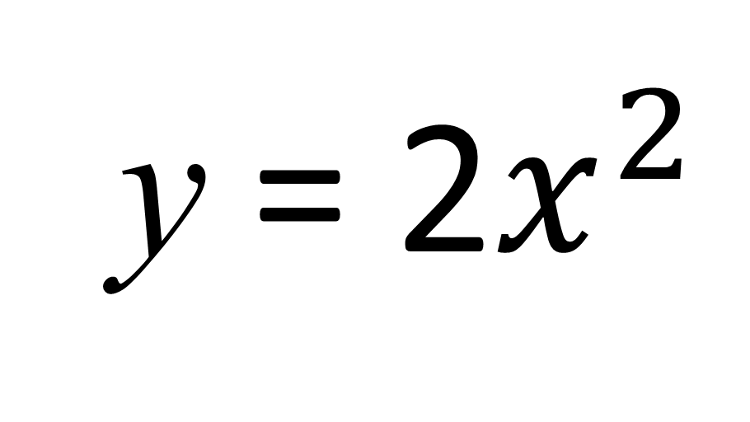
y ∝ $x^{2}$
Write a formula connection y and $x^{2}$ given they are
directly proportional.
x | y
0 | 0
1 | 2
2 | 8
3 | 18
4 | 32
$$x^{2}$$
0
1
4
9
16
y = 2$x^{2}$

Slide 8
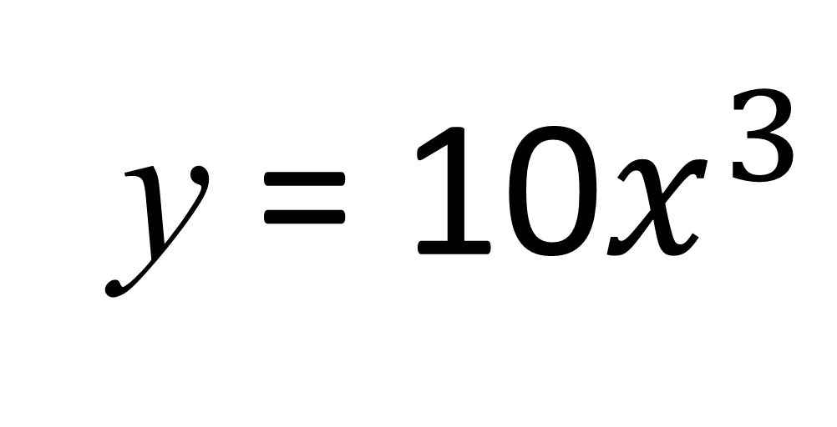

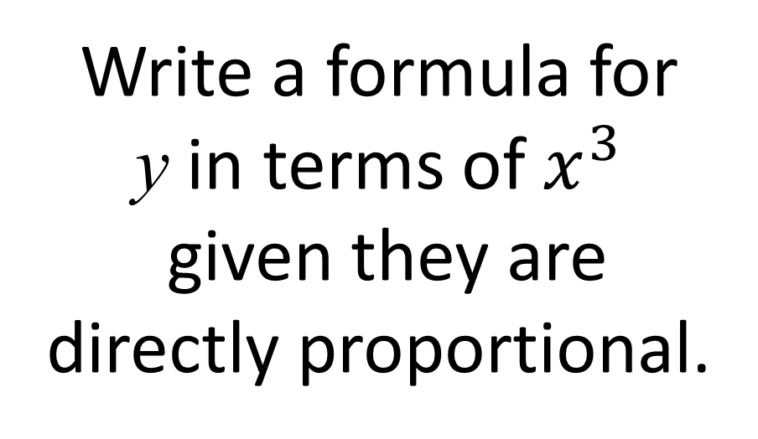
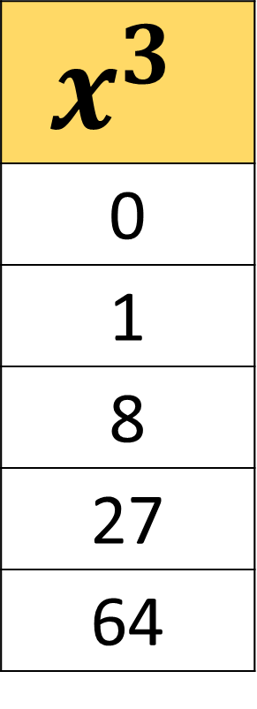
y ∝ $x^{3}$
Write a formula for
y in terms of $x^{3}$
given they are
directly proportional.
x | y
0 | 0
1 | 10
2 | 80
3 | 270
4 | 640
$$x^{3}$$
0
1
8
27
64
y = 10$x^{3}$

Slide 9
k = common multiplier
y = kx
If y is directly proportional to x
y = kx²
If y is directly proportional to the x squared
If y is directly proportional to the x cube
y = kx³
y = kx⁴
If y is directly proportional to x to the power of 4

Slide 10
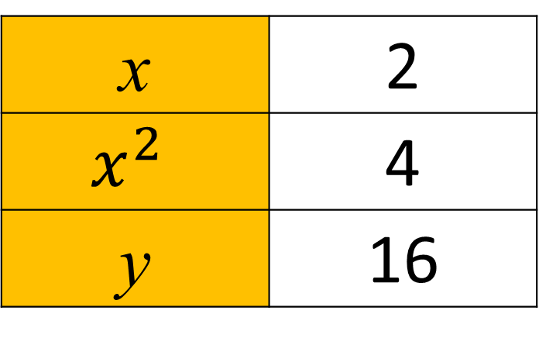
Write an equation for y in terms of x
Given that when x = 2, y = 16 and that y is proportional x²
x | 2
$$x^{2}$$ | 4
y | 16
y = 4x²
x4

Slide 11
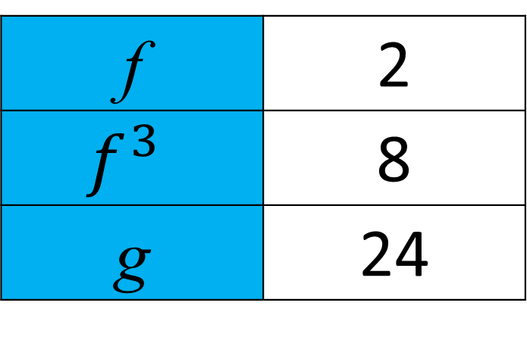
Write an equation for g in terms of f
Given that when f = 2, g = 24 and that g is proportional to f cubed.
f | 2
$$f^{3}$$ | 8
g | 24
g = 3f³
x3

Slide 12
g = 3f³
Find the missing information.
f | g
5
 | 81
375
3

Slide 13
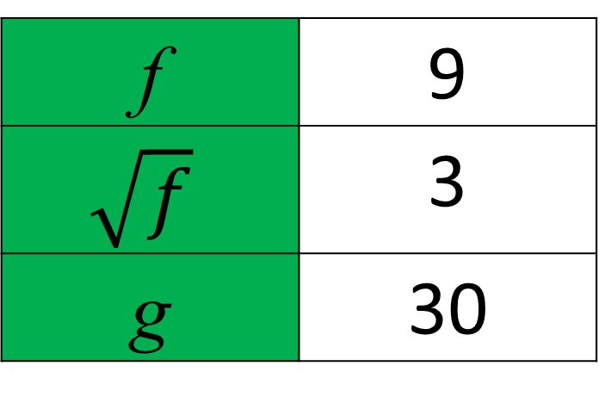
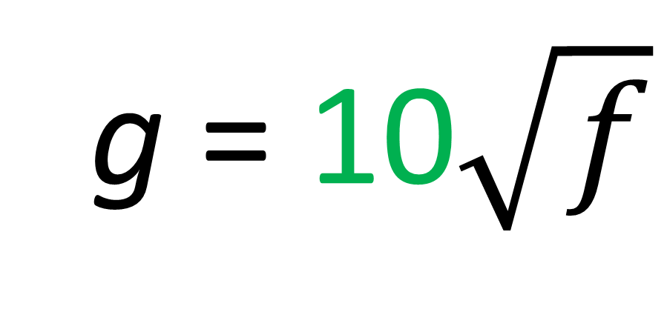
Write an equation for g in terms of f
Given that when f = 9, g = 30 and that g is proportional to square root of f.
f | 9
$$\sqrt{f}$$ | 3
g | 30
g = 10$\sqrt{f}$
x10

