Slide 1
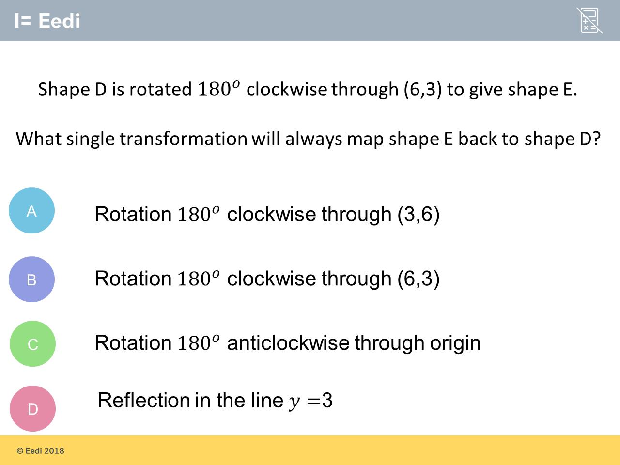
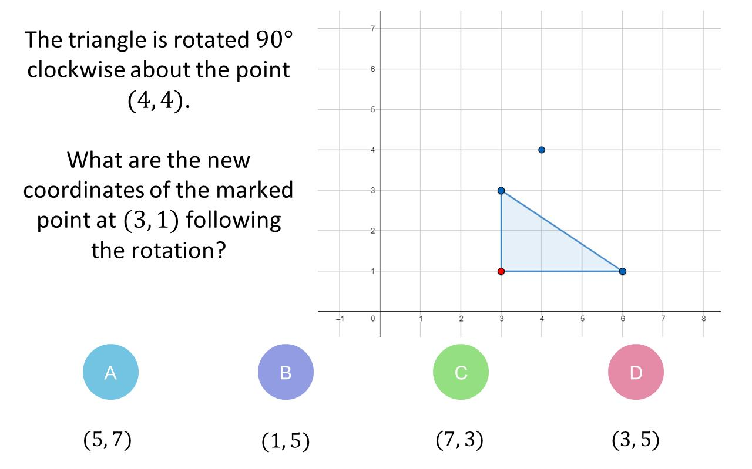
Worst answered question?
Most common wrong answer?

Slide 2
ANSWERS

Slide 3
Worst answered question?

Slide 4
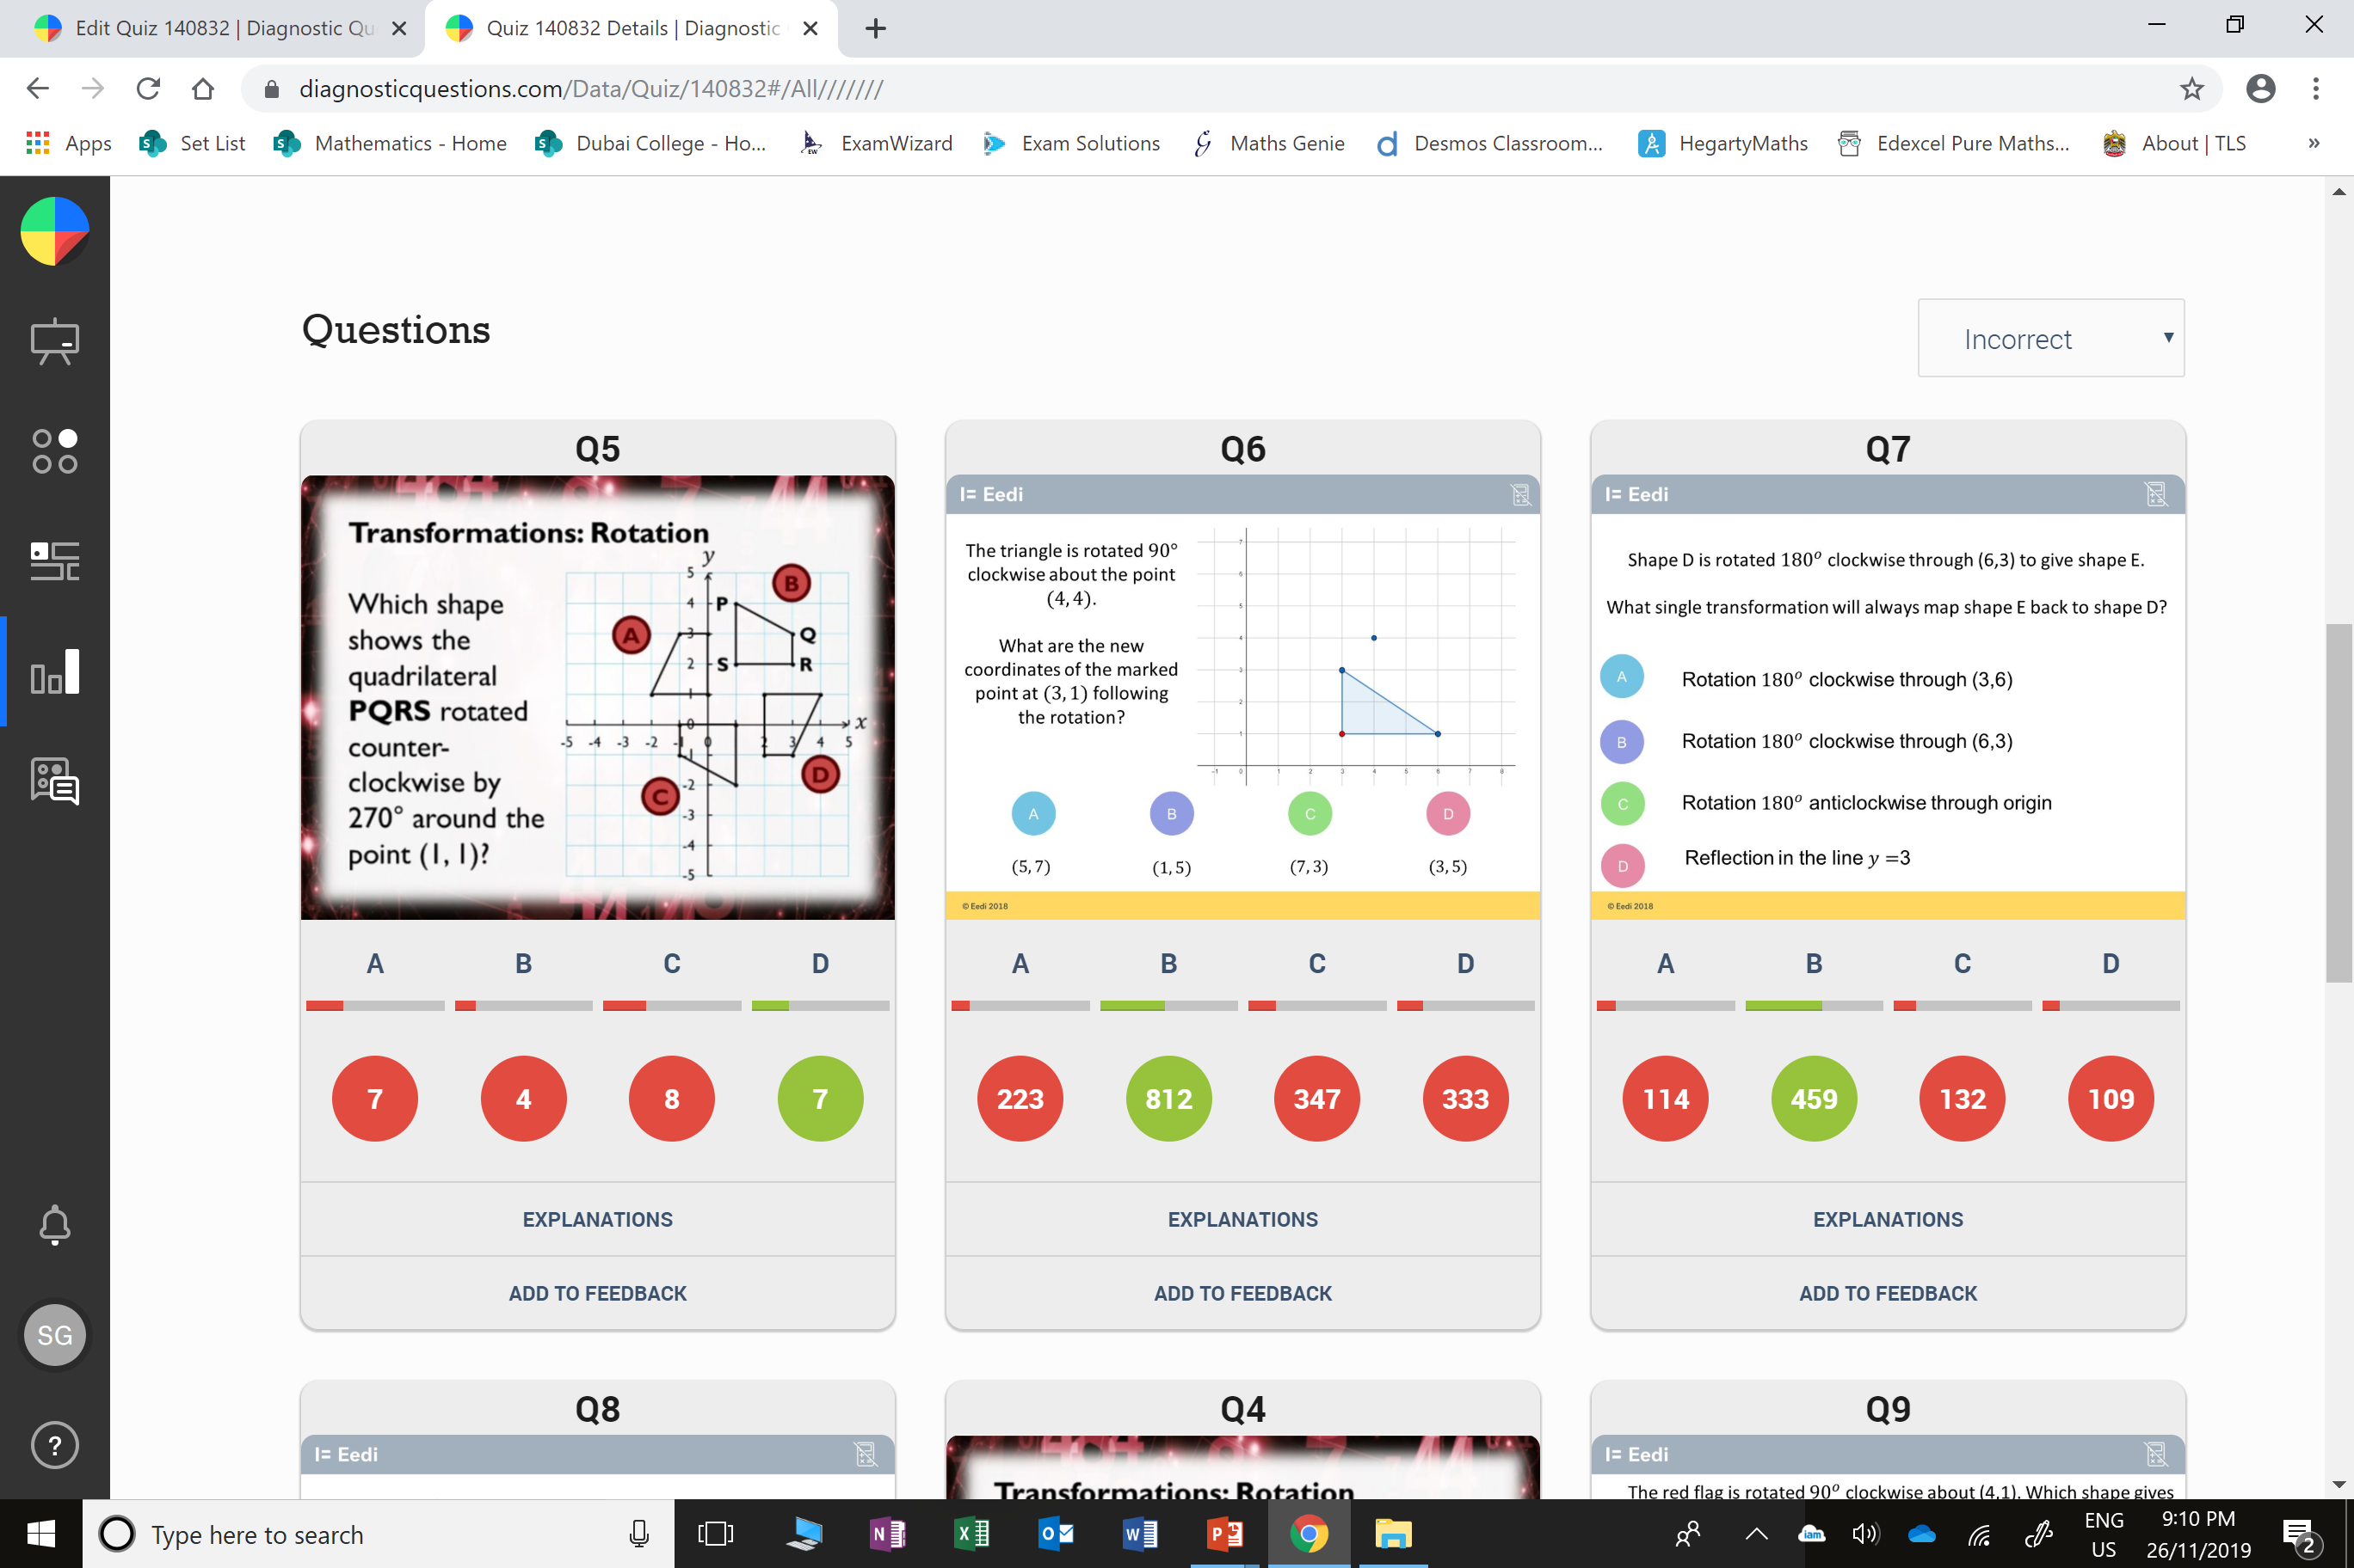
C
They rotated it anti-clockwise.

Slide 5
C
They went with the most common
centre of rotation.

