Slide 1

https://www.calormen.com/jslogo/
You are going to use logo
to draw different shapes.
Guide the turtle
around the screen to draw shapes.

Slide 2
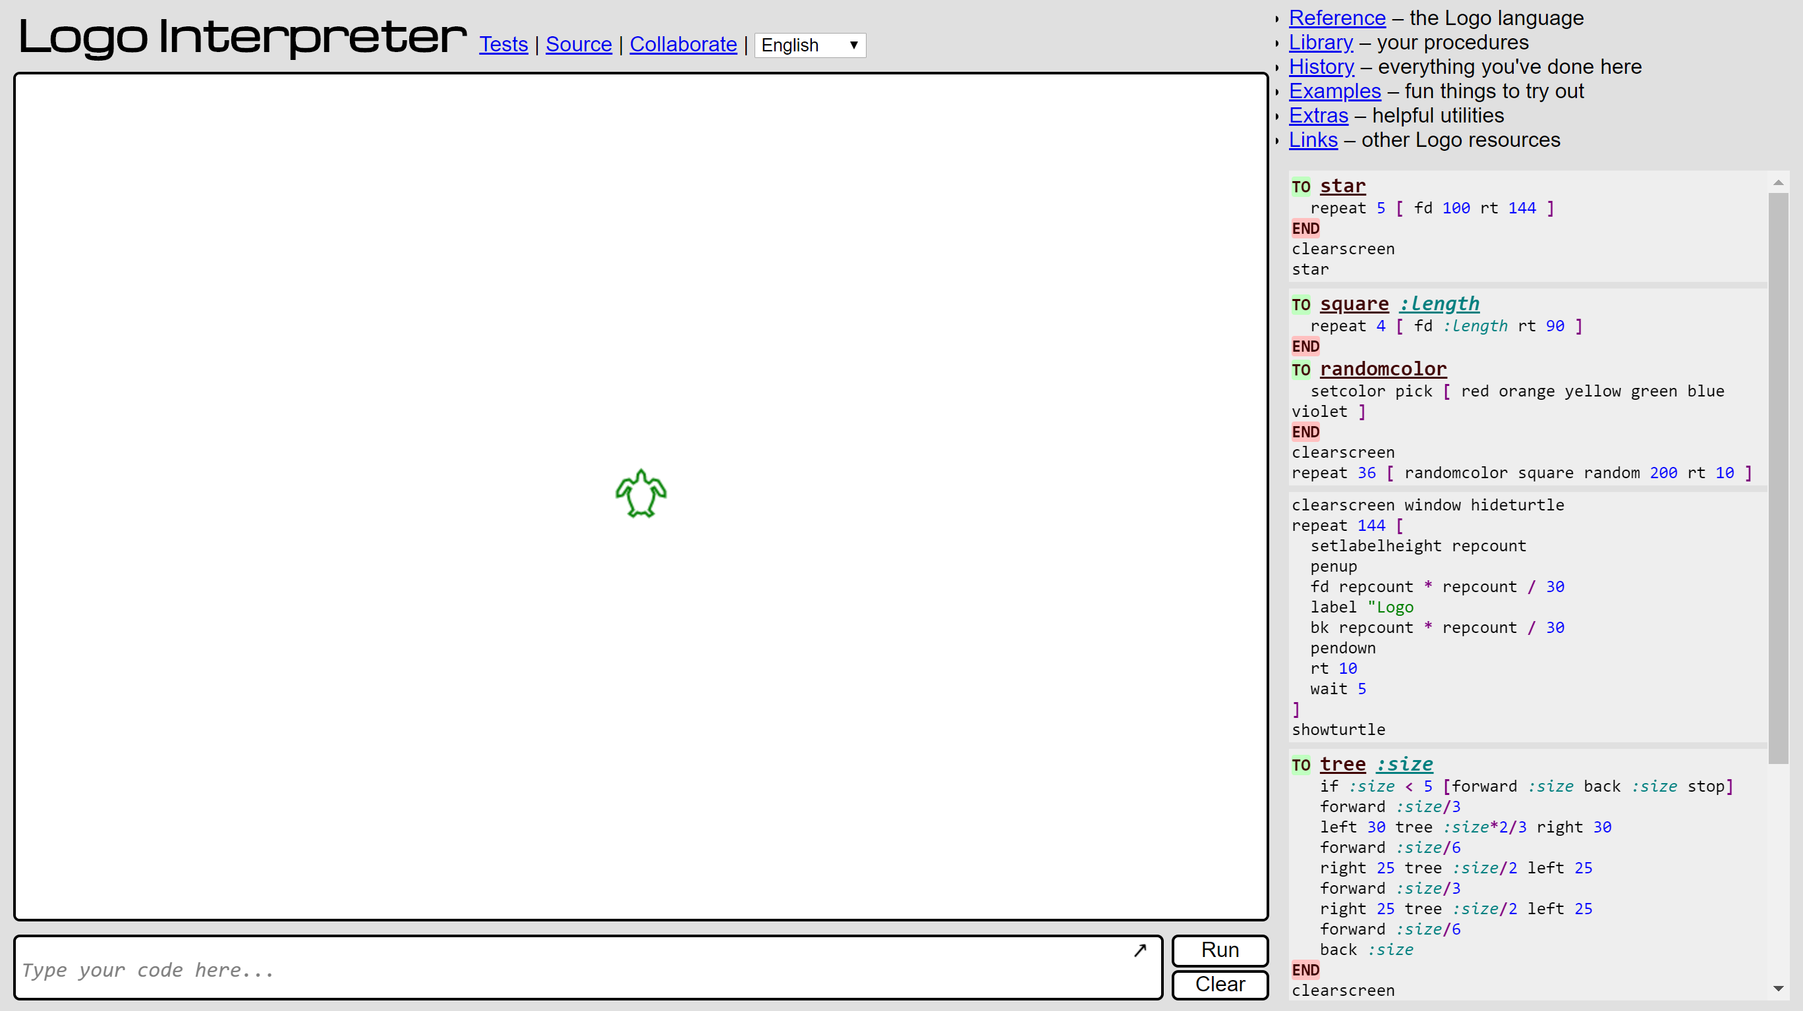

Slide 3
Logo Instructions
Forward 100
Right 90
Forward 100

Slide 4
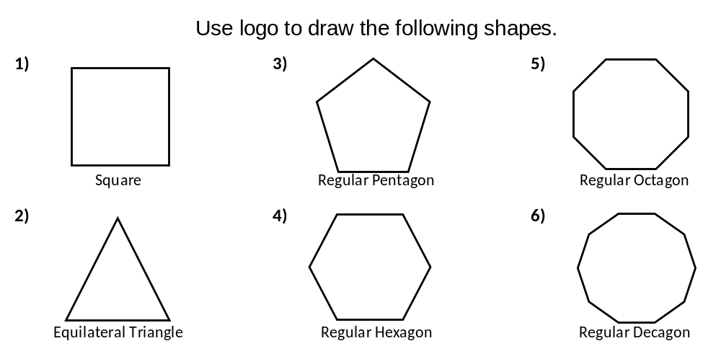
https://www.calormen.com/jslogo/
100
200
50
200
50
100

