Slide 1
LO: Rearranging Formula
(Powers and Roots)

Slide 2
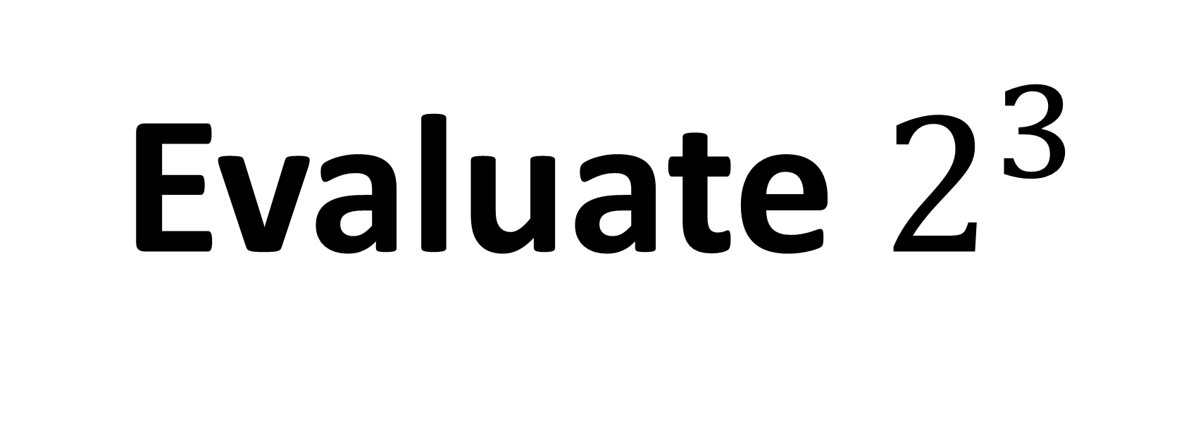
Evaluate $2^{3}$
8

Slide 3
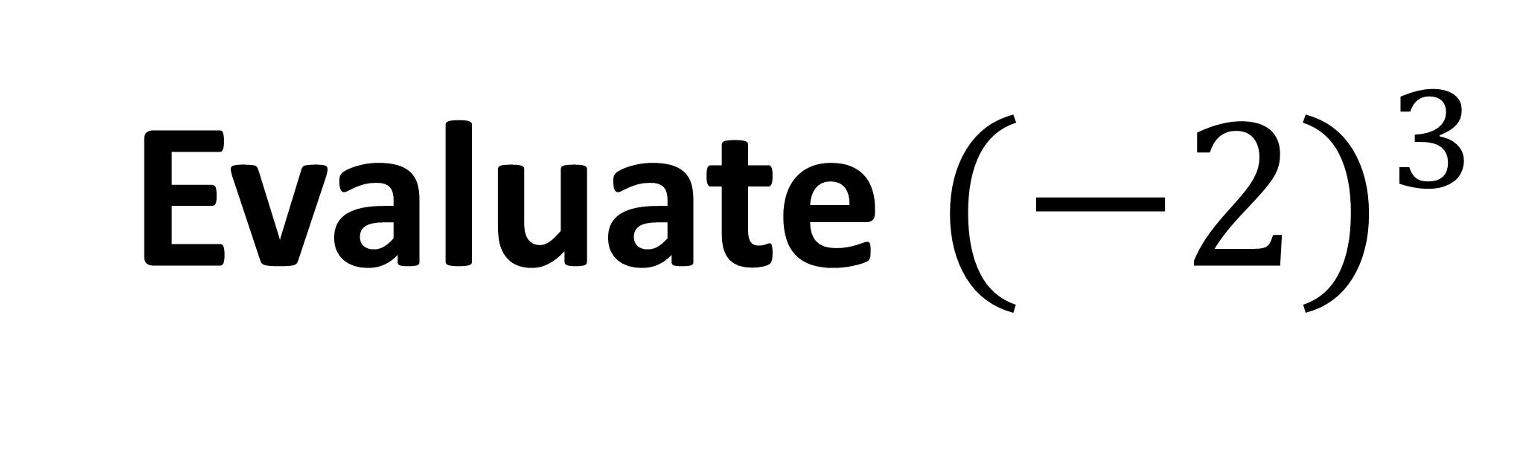
Evaluate ${(−2)}^{3}$
-8

Slide 4
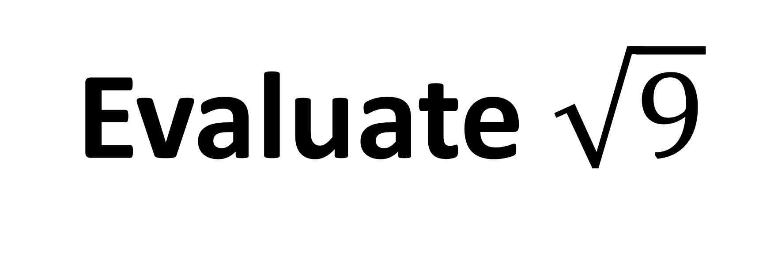
Evaluate $\sqrt{9}$
3

Slide 5
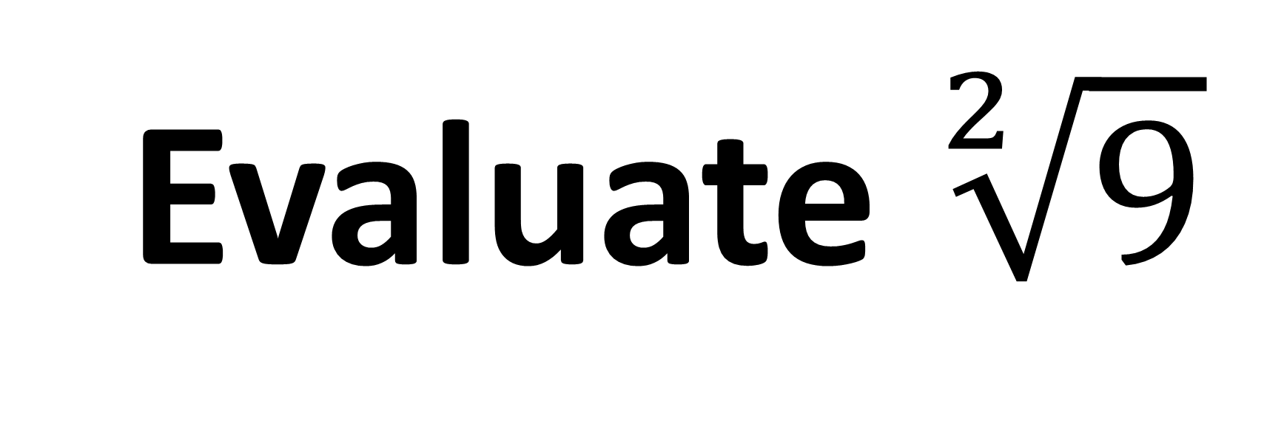
Evaluate $\sqrt[2]{9}$
3

Slide 6
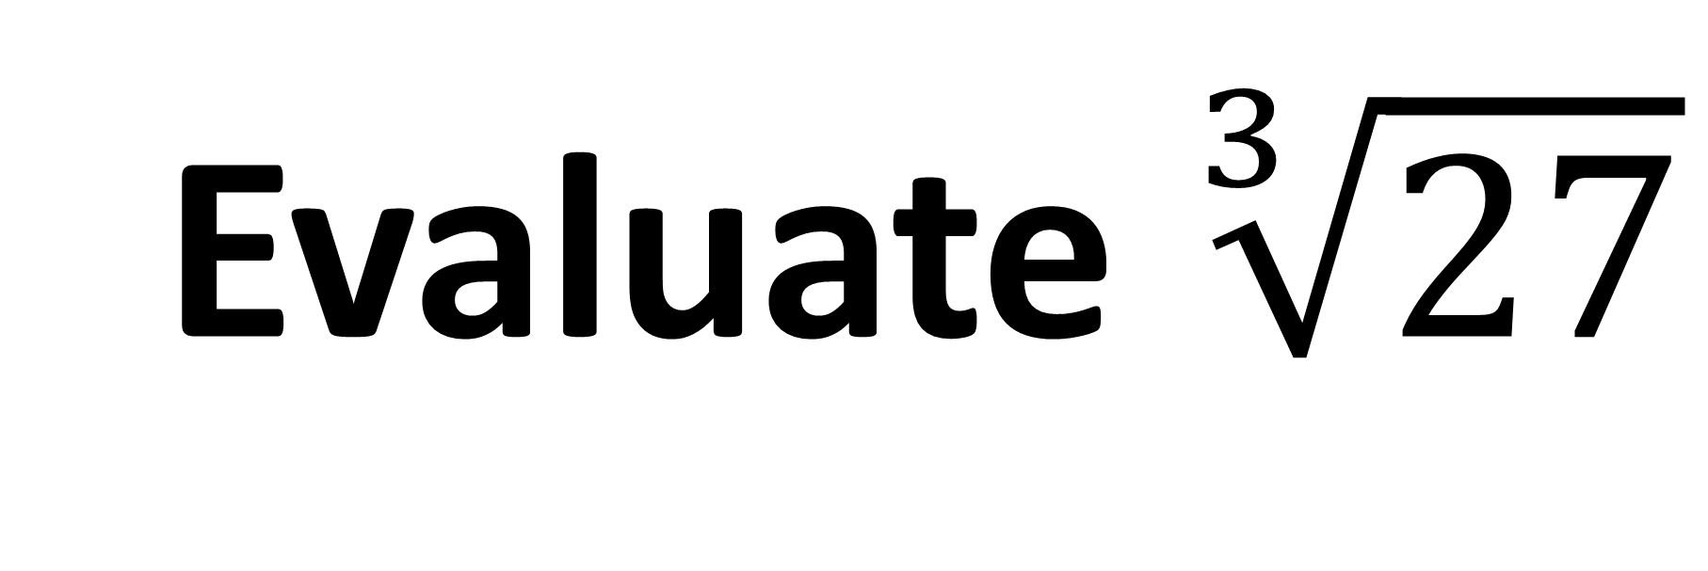
Evaluate $\sqrt[3]{27}$
3

Slide 7
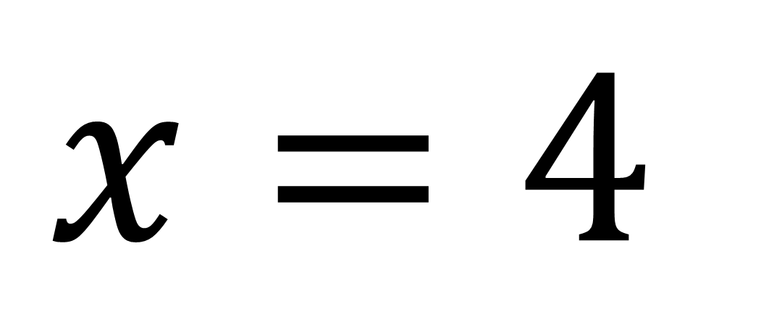
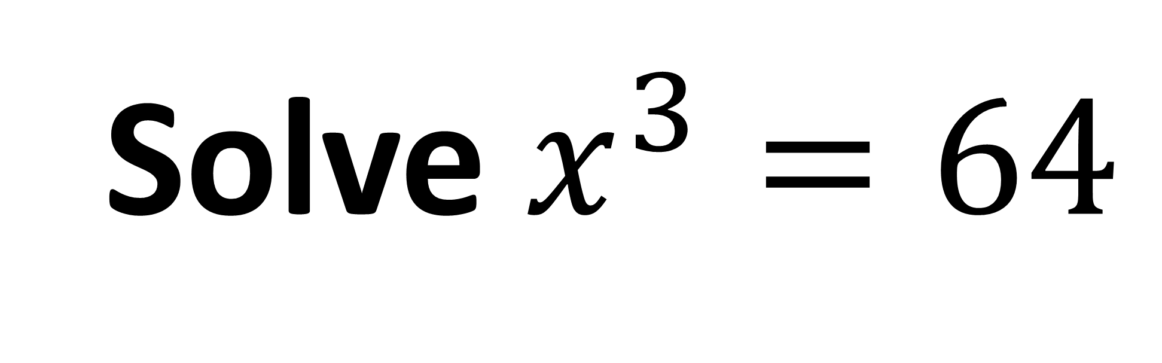
Solve $x^{3}=64$
$$x=4$$

Slide 8
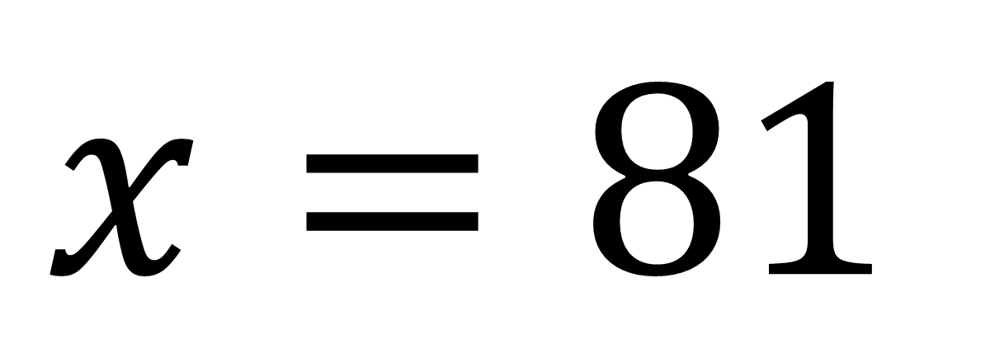
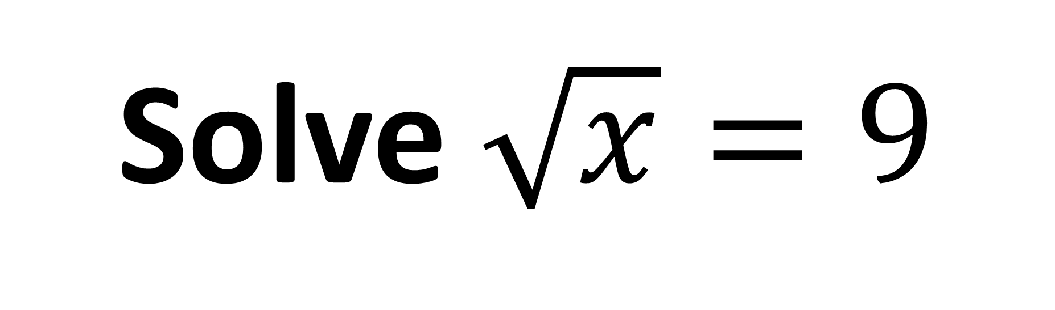
Solve $\sqrt{x}=9$
$$x=81$$

Slide 9
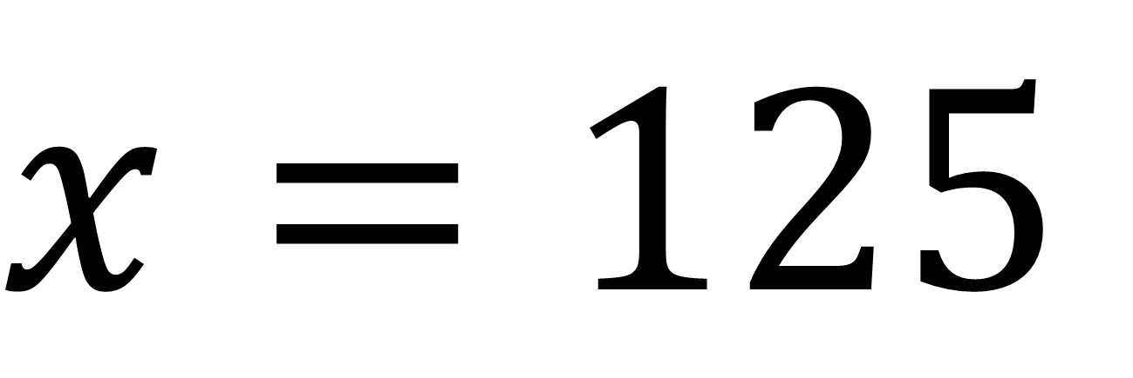
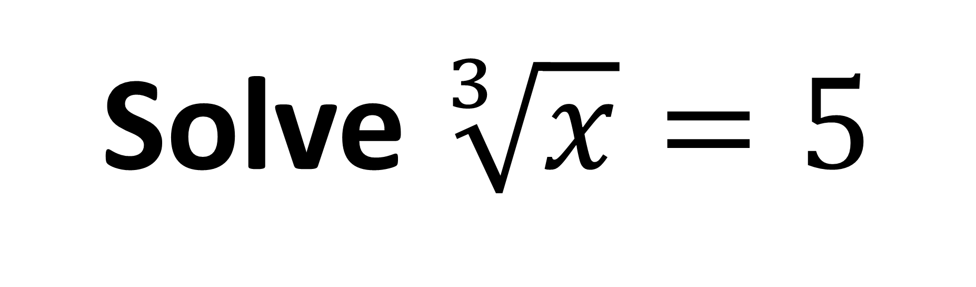
Solve $\sqrt[3]{x}=5$
$$x=125$$

Slide 10
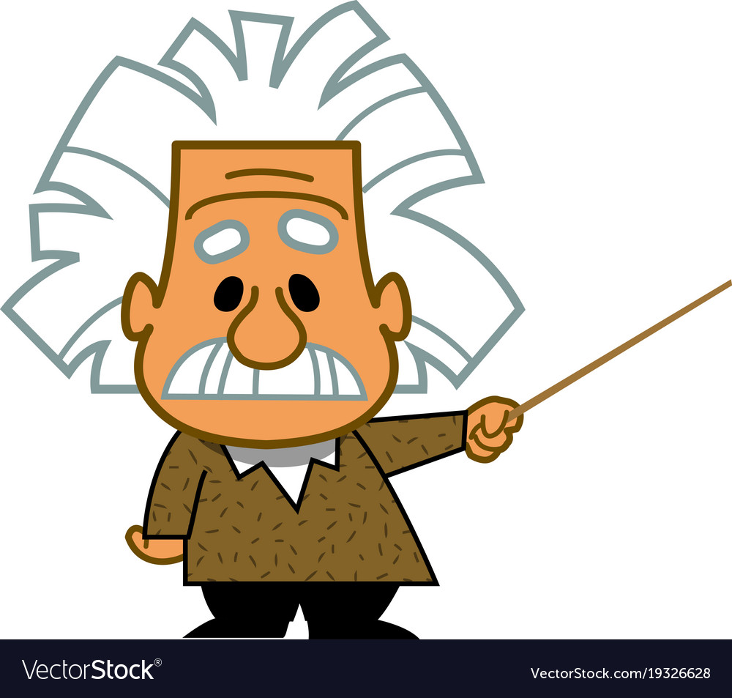
Can you think of a famous formula that contains a power?
E = mc²

Slide 11
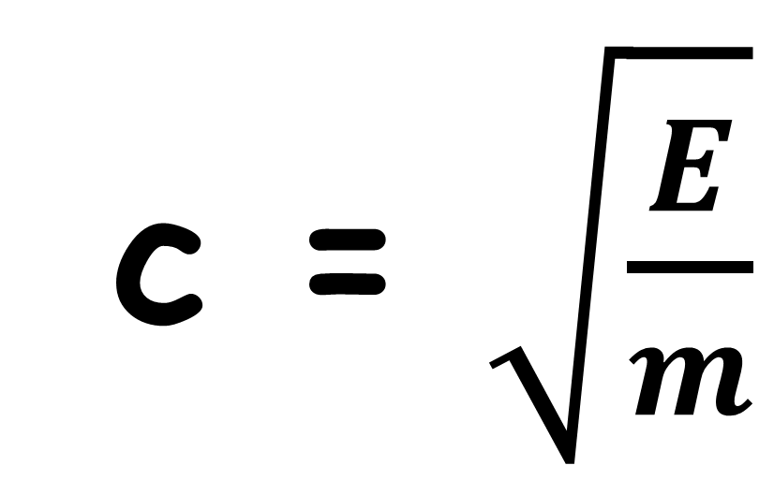
E = mc²
E (energy) M (mass) C (speed of light)
How would you calculate the speed of light?
c = $\sqrt{\frac{E}{m}}$

Slide 12
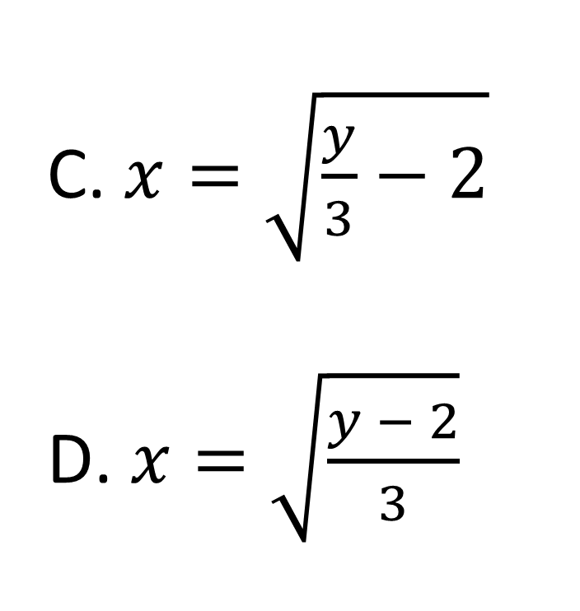
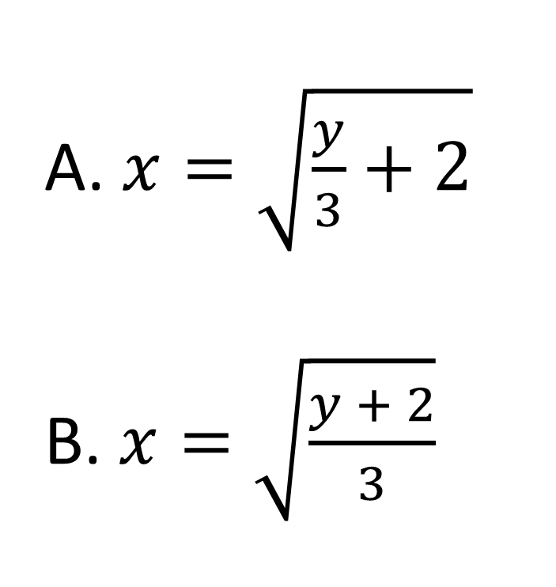
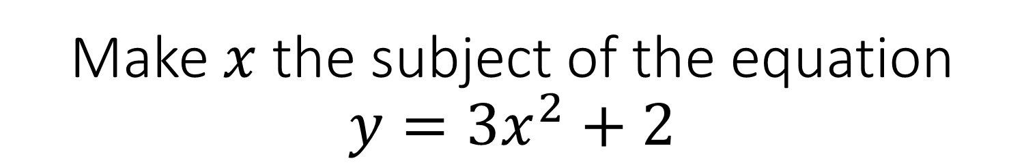
Make $x$ the subject of the equation $y={3x}^{2}+2$
A. $x=\sqrt{\frac{y}{3}+2}$
B. $x=\sqrt{\frac{y + 2}{3}}$
$x=\sqrt{\frac{y}{3}−2}$
$x=\sqrt{\frac{y − 2}{3}}$

Slide 13
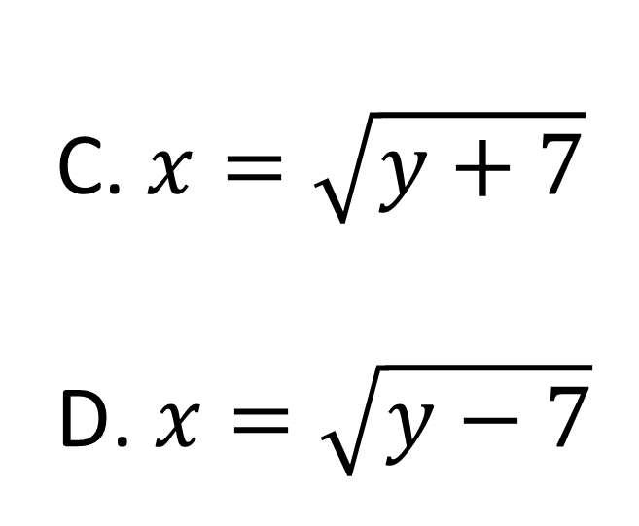
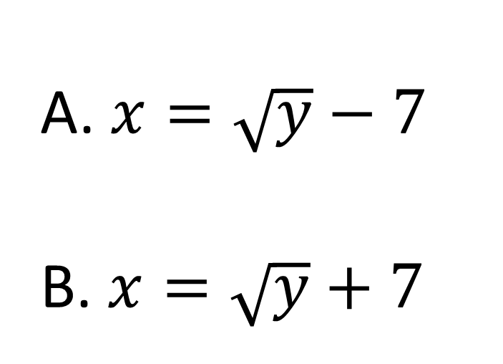

Make $x$ the subject of the equation
$y={(x+7)}^{2}$?
$x=\sqrt{y+7}$
$x=\sqrt{y−7}$
A. $x=\sqrt{y}−7$
B. $x=\sqrt{y}+7$

Slide 14
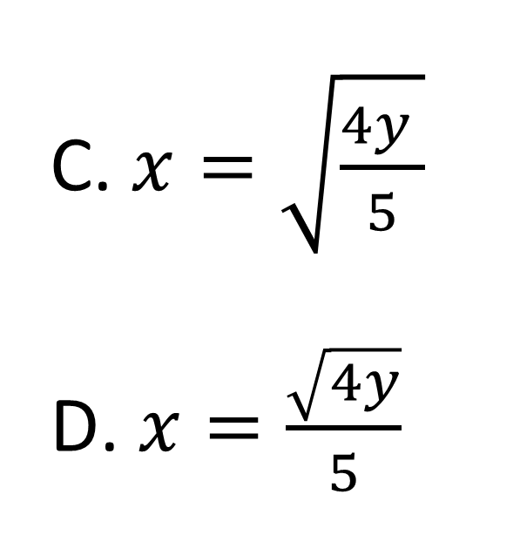
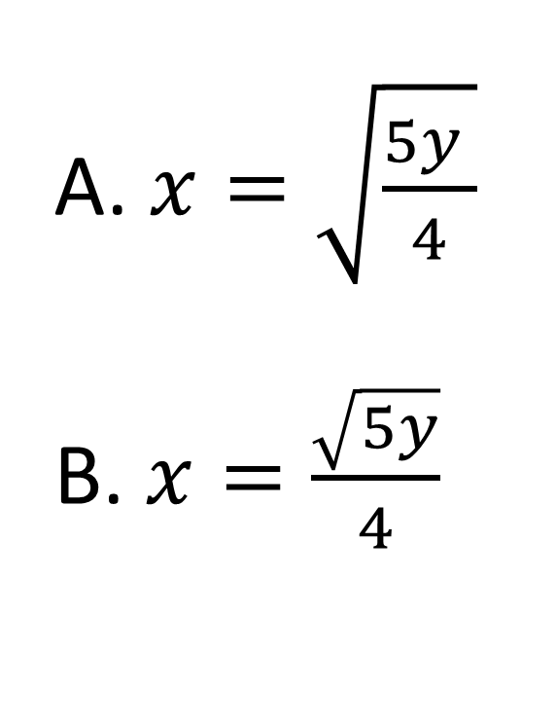
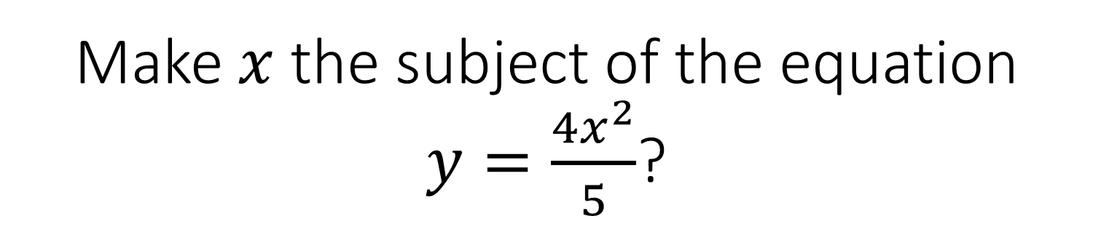
Make $x$ the subject of the equation $y=\frac{4x^{2}}{5}$?
A. $x=\sqrt{\frac{5y }{4}}$
B. $x=\frac{\sqrt{5y}}{4}$
$x=\sqrt{\frac{4y }{5}}$
$x=\frac{\sqrt{4y}}{5}$

Slide 15
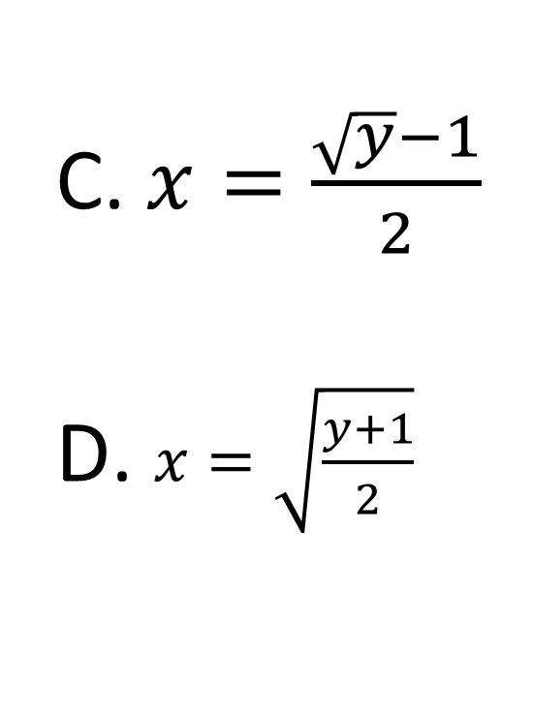
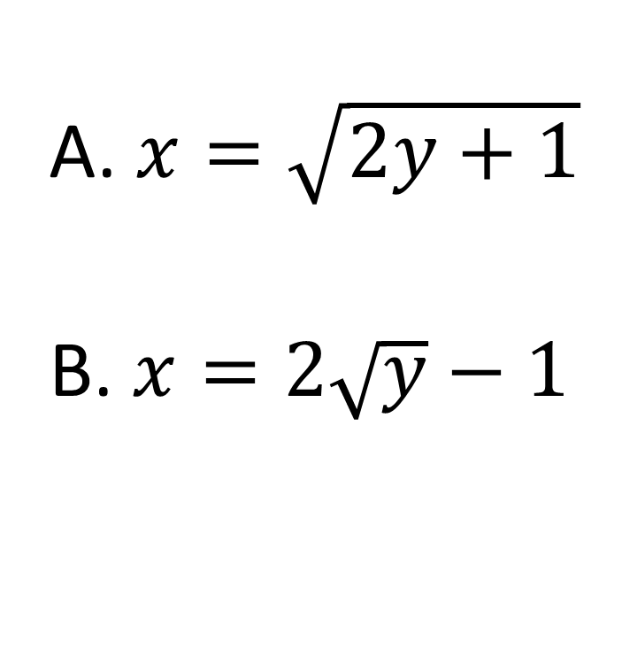

Make $x$ the subject of the equation
$y={2x}^{2}−1$?
$x=\frac{\sqrt{y}−1}{2}$
$x=\sqrt{\frac{y+1}{2}}$
A. $x=\sqrt{2y+1}$
B. $x=2\sqrt{y}−1$

Slide 16
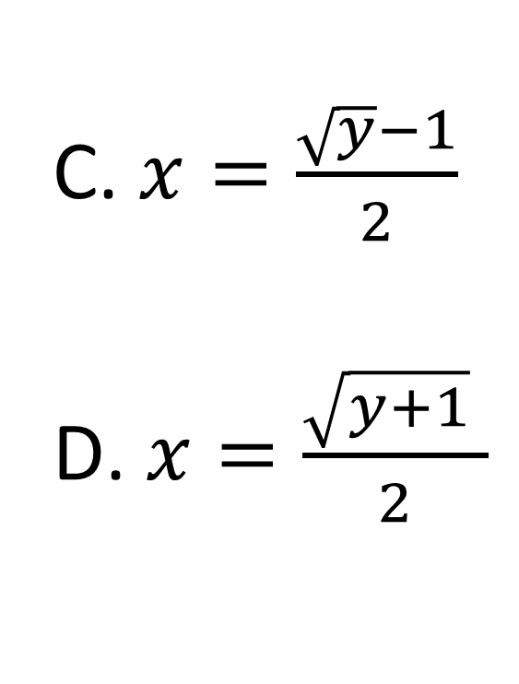
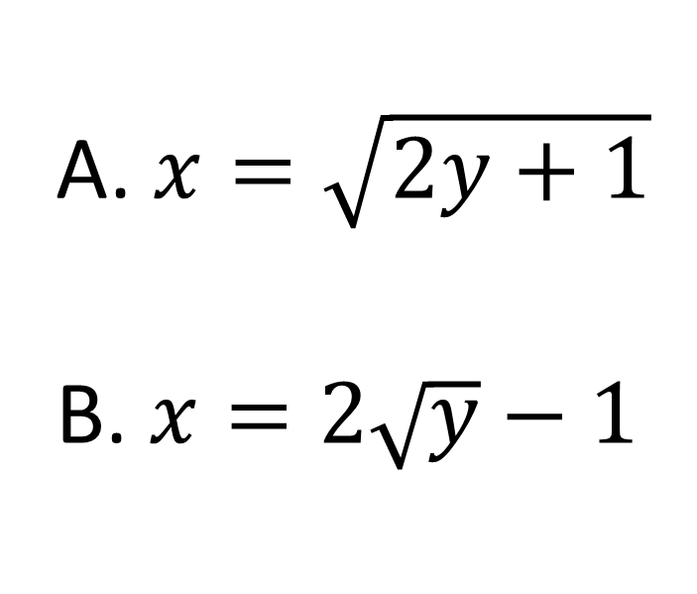

Make $x$ the subject of the equation $y={(2x+1)}^{2}$?
$x=\frac{\sqrt{y}−1}{2}$
$x=\frac{\sqrt{y+1} }{2}$
A. $x=\sqrt{2y+1}$
B. $x=2\sqrt{y}−1$

Slide 17
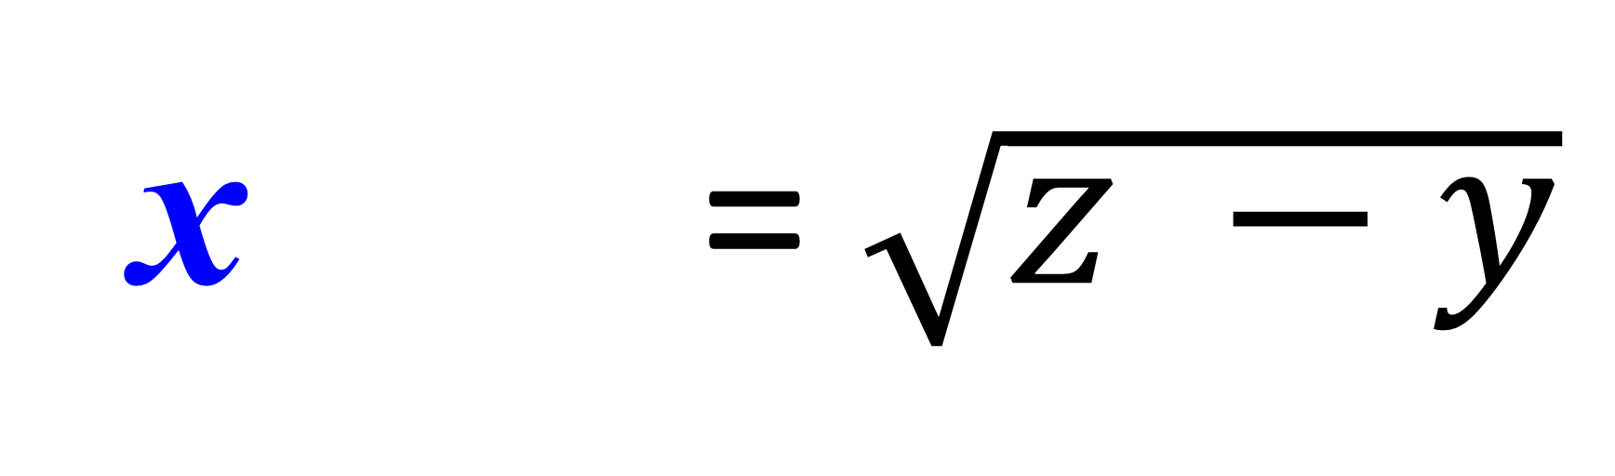
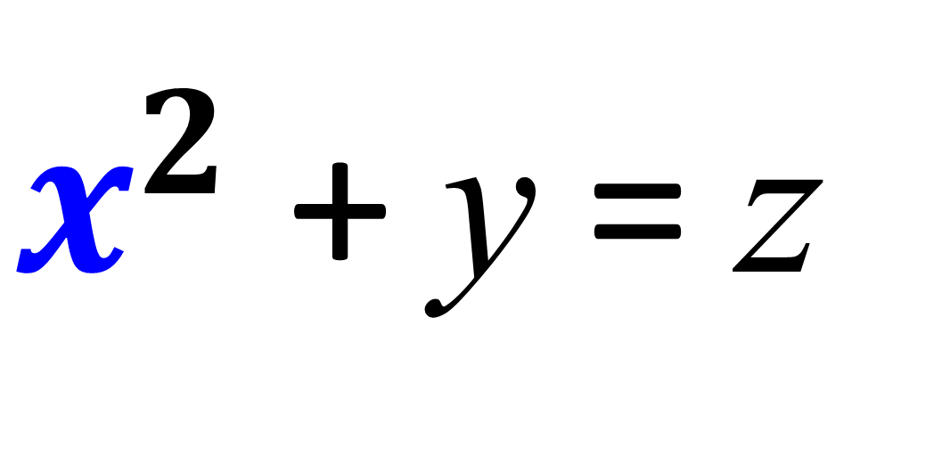
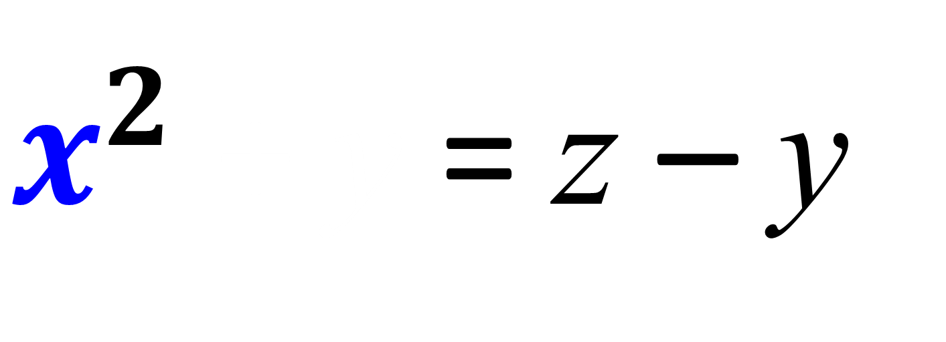
Make x the subject
$x^{2}$ + y = z
$x^{2}$ + y = z – y
x = $\sqrt{z −y}$

Slide 18
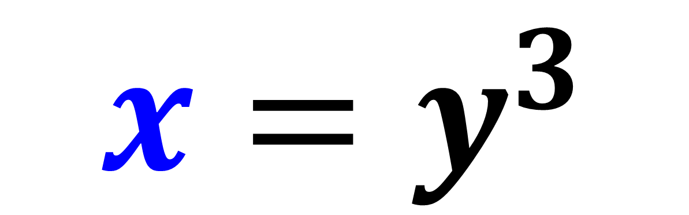
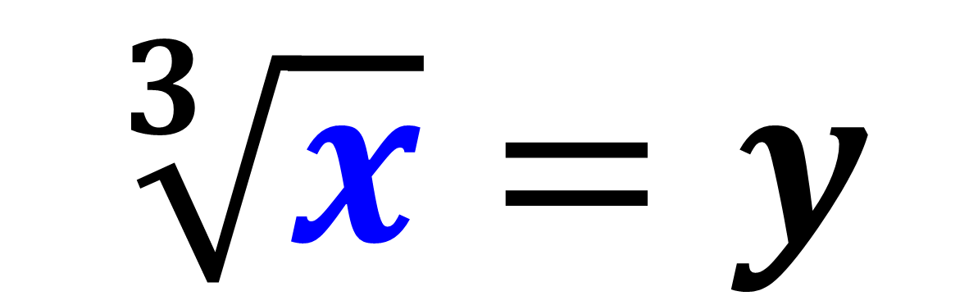
Make x the subject
$$\sqrt[3]{x}=y$$
$$x=y^{3}$$

Slide 19
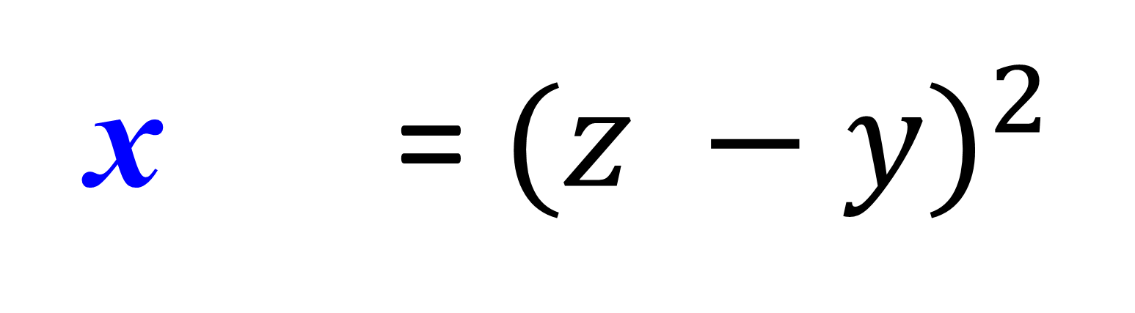
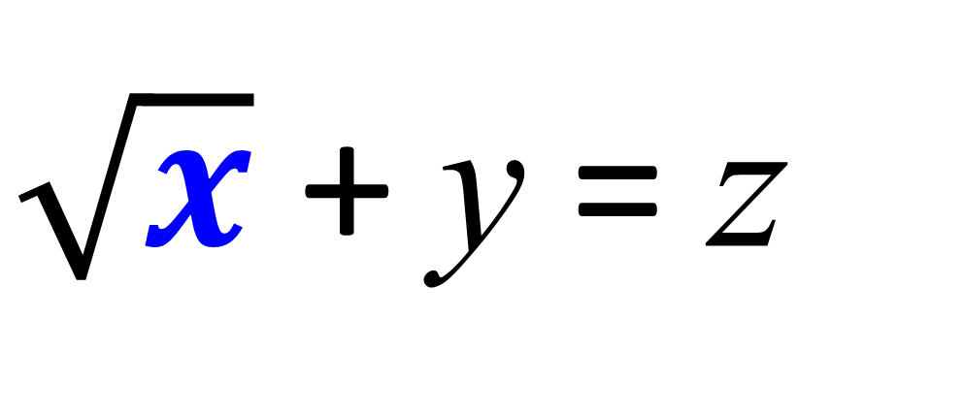
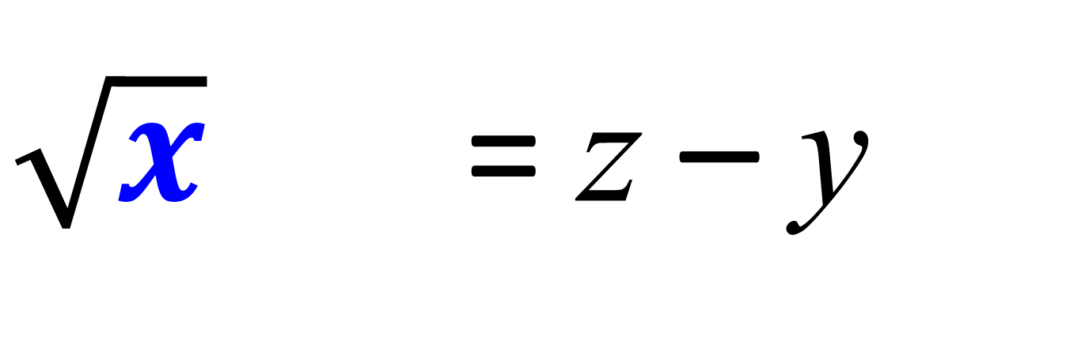
Make x the subject
$\sqrt{x}$ + y = z
$\sqrt{x}$+ y = z – y
x = ${(z −y)}^{2}$

Slide 20
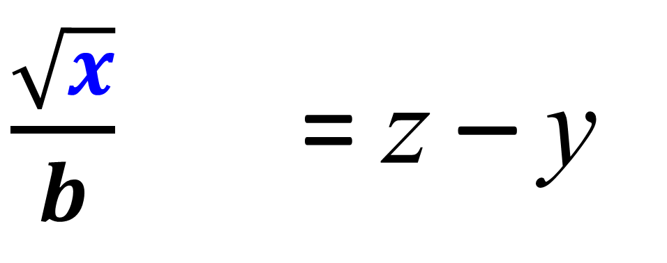
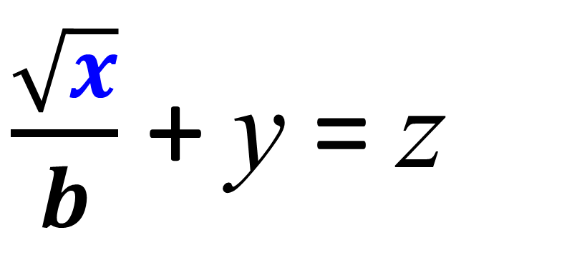
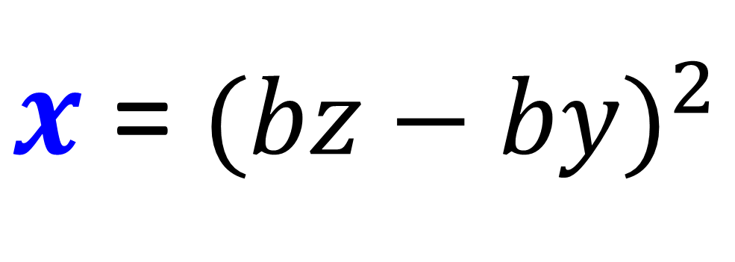
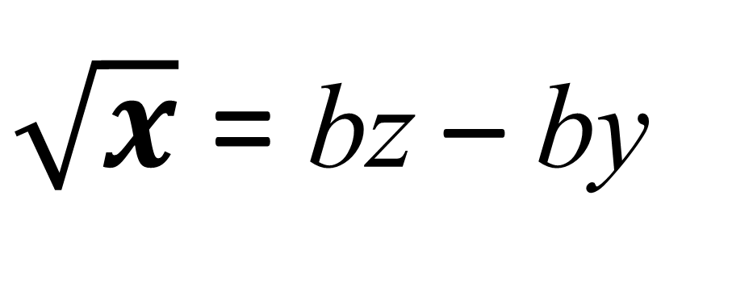
Make x the subject
$\frac{\sqrt{x}}{b}$ + y = z
$\sqrt{x}$ = bz – by
$x$ = ${(bz−by)}^{2}$
$\frac{\sqrt{x}}{b}$ = z – y

Slide 21
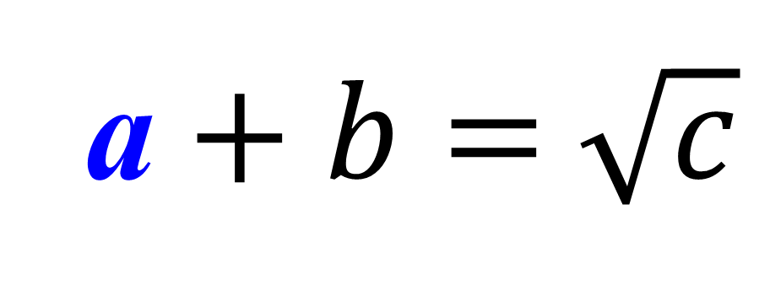
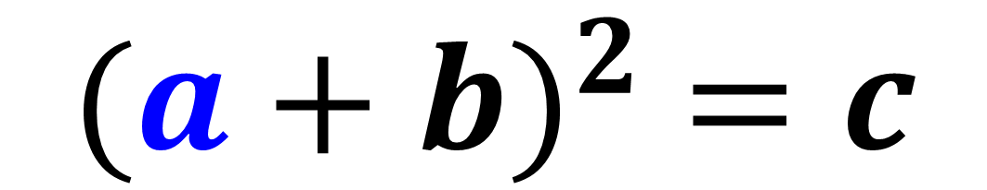
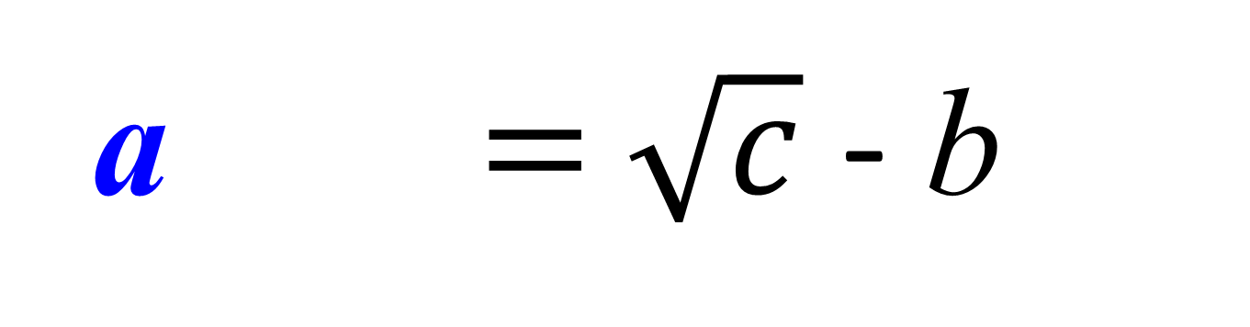
Make a the subject
$${(a+b)}^{2} =c$$
a $+ b=$ $\sqrt{c}$
a $+ b=$ $\sqrt{c}$ - b

Slide 22
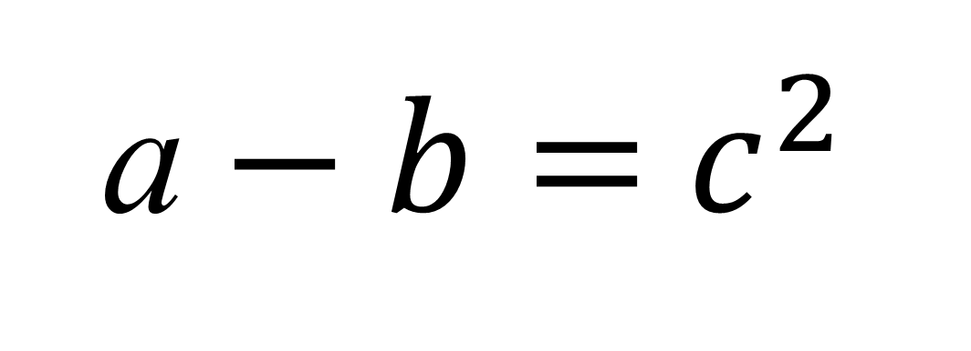
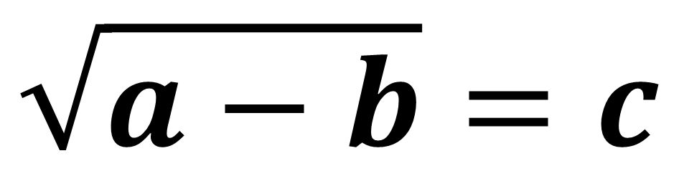
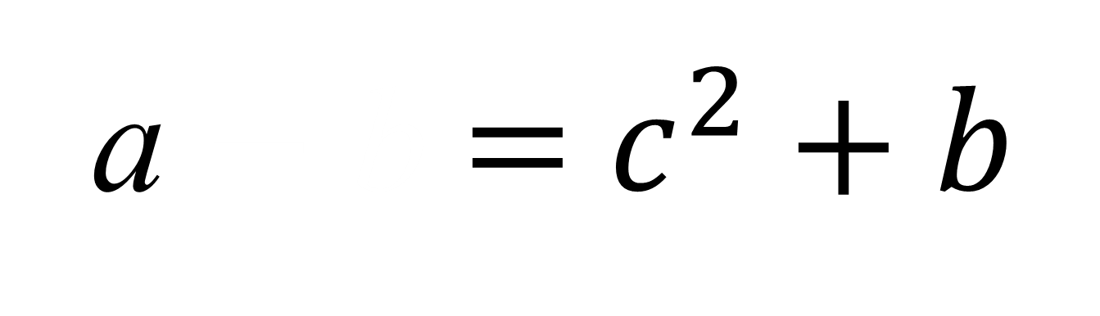
Make a the subject
$$\sqrt{a−b}=c$$
a $− b=$ $c^{2}$
a $−$ b $=$ $c^{2}+b$

