Slide 1
LO: Circle Theorem Proofs

Slide 2
What is the Angle
and which Theorems?
1) Angle in semicircle is 90°
2) Angle between tangent and radius is 90°
3) Opposite angles of cyclic quadrilateral add to 180°
4) Angles in same segment are equal
O
5) Angle at centre is twice angle at circumference
160°
?
6) Lengths of the tangents from a point to the circle are equal
100°
7) Two angles in isosceles triangle the same
8) Angles of quadrilateral add to 360°

Slide 3
What is the Angle
and which Theorems?
1) Angle in semicircle is 90°
2) Angle between tangent and radius is 90°
3) Opposite angles of cyclic quadrilateral add to 180°
70°
4) Angles in same segment are equal
70°
?
60°
5) Angle at centre is twice angle at circumference
6) Lengths of the tangents from a point to the circle are equal
7) Two angles in isosceles triangle the same
8) Angles of quadrilateral add to 360°

Slide 4
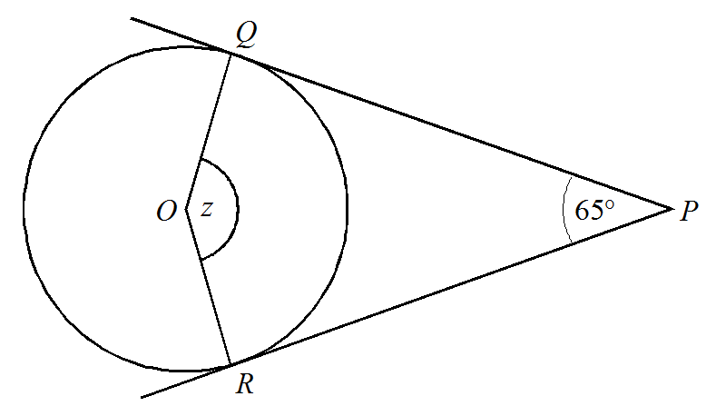
What is the Angle
and which Theorems?
1) Angle in semicircle is 90°
2) Angle between tangent and radius is 90°
3) Opposite angles of cyclic quadrilateral add to 180°
4) Angles in same segment are equal
?
115°
5) Angle at centre is twice angle at circumference
6) Lengths of the tangents from a point to the circle are equal
7) Two angles in isosceles triangle the same
8) Angles of quadrilateral add to 360°

Slide 5
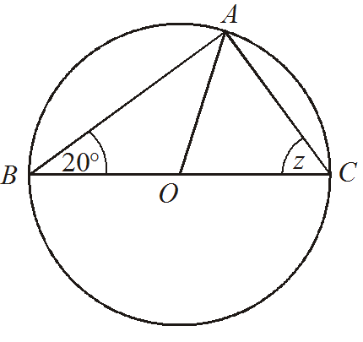
What is the Angle
and which Theorems?
1) Angle in semicircle is 90°
2) Angle between tangent and radius is 90°
3) Opposite angles of cyclic quadrilateral add to 180°
4) Angles in same segment are equal
?
70°
5) Angle at centre is twice angle at circumference
6) Lengths of the tangents from a point to the circle are equal
7) Two angles in isosceles triangle the same
8) Angles of quadrilateral add to 360°

Slide 6
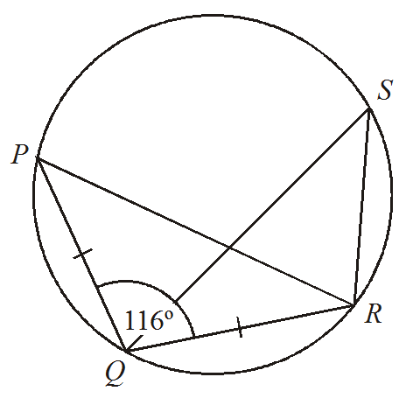
What is the Angle
and which Theorems?
1) Angle in semicircle is 90°
2) Angle between tangent and radius is 90°
3) Opposite angles of cyclic quadrilateral add to 180°
4) Angles in same segment are equal
?
32°
5) Angle at centre is twice angle at circumference
6) Lengths of the tangents from a point to the circle are equal
7) Two angles in isosceles triangle the same
8) Angles of quadrilateral add to 360°

Slide 7
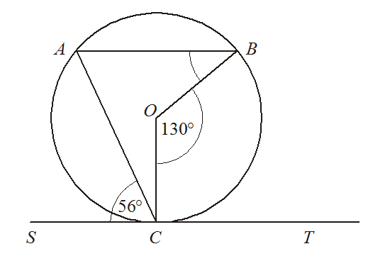
What is the Angle
and which Theorems?
1) Angle in semicircle is 90°
2) Angle between tangent and radius is 90°
3) Opposite angles of cyclic quadrilateral add to 180°
31°
?
4) Angles in same segment are equal
5) Angle at centre is twice angle at circumference
6) Lengths of the tangents from a point to the circle are equal
7) Two angles in isosceles triangle the same
8) Angles of quadrilateral add to 360°

Slide 8
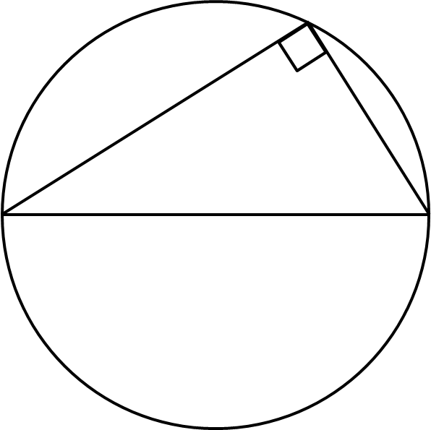
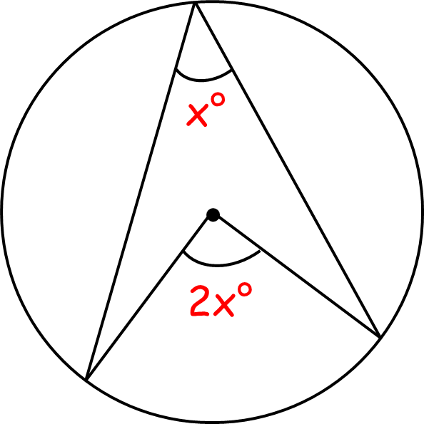
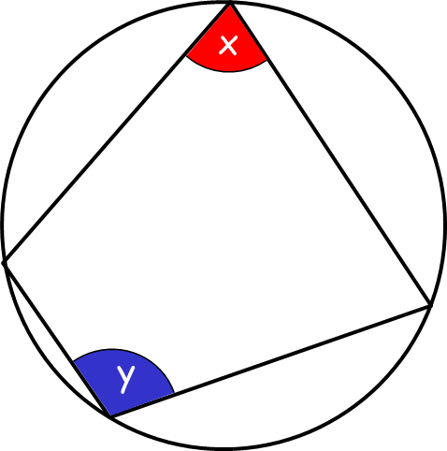
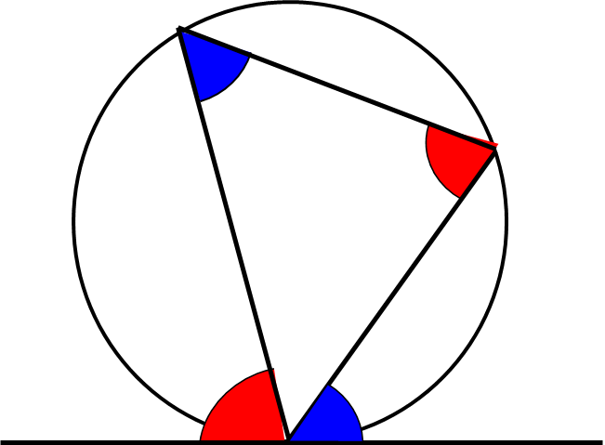
Use algebra and angle facts
to prove circle theorems

Slide 9

Proof
Angles in a Semi-Circle
Click for Proof

Slide 10
Proof
Angles at Centre and Circumference
Click for Proof

Slide 11
Proof
Angles in Cyclic Quadrilateral
Click for Proof

Slide 12
Proof
Same Segment
Click for Proof

Slide 13
Proof
Alternate Segment
Click for Proof

Slide 14
Proof
Radius Tangent
Click for Proof

Slide 15
Prove Angles at the circumference from the same chord are equal
Find angle ABD and ACD in terms of θ.
C
θ
B
θ
D
ABD = ACD
90 – θ
θ
A

Slide 16
Prove Angle at the centre is twice the angle at the circumference
Find angle BOC and BAC in terms of x
A
90 – x
90 – x
360 – 4x = 2(180 – 2x)
2x
2x
BOC = 2 x BAC
O
360 – 2x
C
B

Slide 17
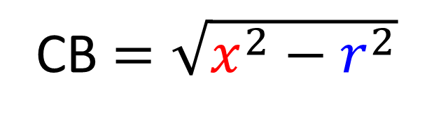
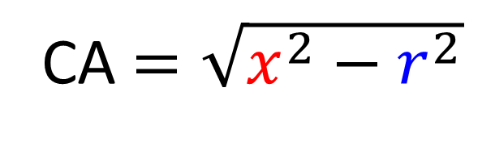
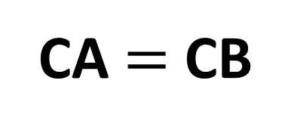
Prove Tangents are equal when drawn from the same point
Find the length of CA and CB
A
r
C
x
x
O
CA $=\sqrt{x^{2}−r^{2}}$
r
CB $=\sqrt{x^{2}−r^{2}}$
B
CA $=$ CB

Slide 18
Prove Angles in opposite segments are equal
Find angle ABC in terms of x
B
x
C
OAC = ABC
90 – x
x
A
O

Slide 19
Prove Opposite angles of a cyclic quadrilateral add up to 180
Show that BAC + BDC = 180˚
D
x
2x + 2y = 360˚
2y
x + y = 180˚
B
2x
C
y
A

Slide 20
Prove Angle at the circumference in a semicircle is 90
Find angle ABC in terms of x
B
x
90 – x
ABC = x + 90 – x = 90°
180 – 2x
2x
A
x
C
O

