Slide 1
Forces and Friction
Inclined Slope
Chapter 5
(Part 2 of 3)

Slide 2
Resolving Forces On a Slope
The golden rule to dealing
with problems that involve forces on a slope is to deal only with
parallel and perpendicular forces
to the slope.

Slide 3




Labelling the forces acting on the particle that are parallel and perpendicular to the slope.
Reaction to the slope
R
Weight
a
10kg
$$Ө$$
$$mg\cos{Ө}$$
mg
$$mg\sin{Ө}$$
$$Ө$$

Slide 4



Inclined Slopes – Angle at the particle
m
$$Ө$$
$$90−Ө$$
$$Ө$$
90

Slide 5
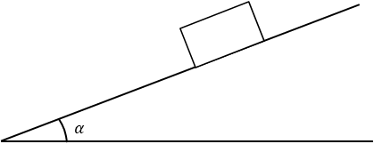
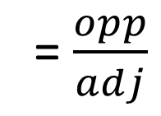
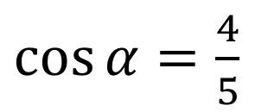
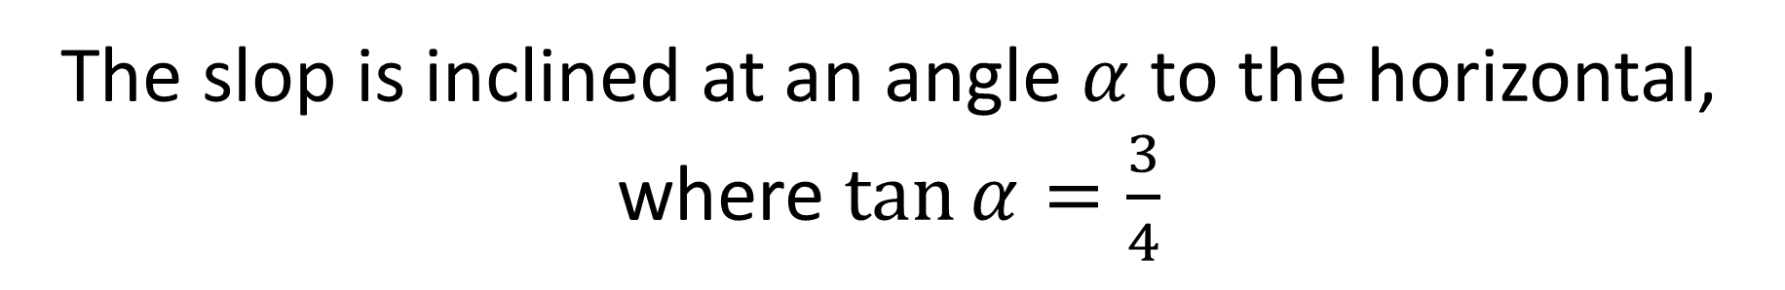
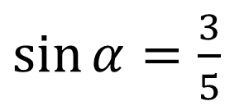
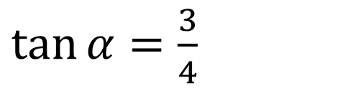

Inclined Slope – Calculating with Angles
The slop is inclined at an angle $α$ to the horizontal,
where $\tan{α}=\frac{3}{4}$
$\tan{α}=\frac{3}{4}$ = $\frac{opp}{adj}$
= $\frac{opp}{adj}$
5
3
$$α$$
4
$\sin{α}=\frac{3}{5}$
$\cos{α}=\frac{4}{5}$

Slide 6
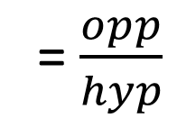
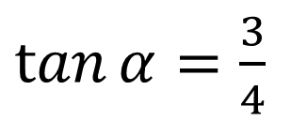
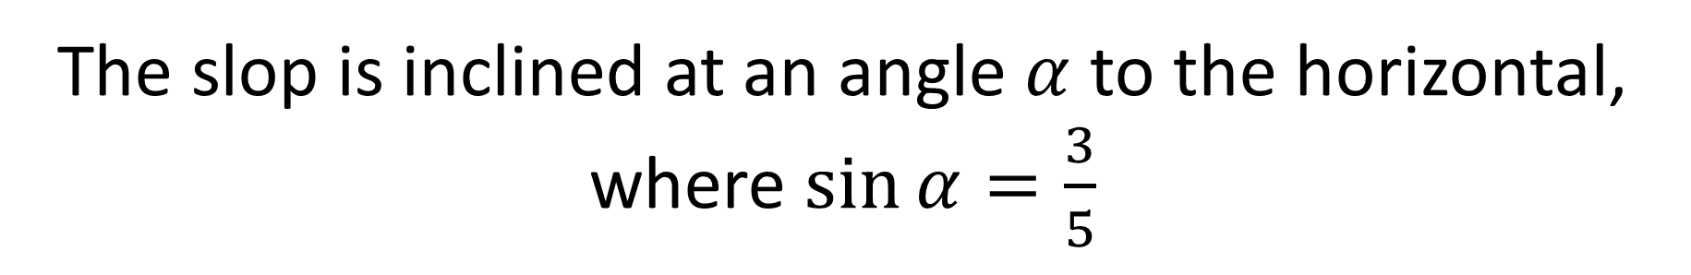
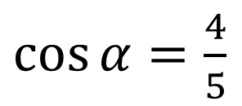
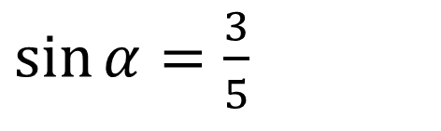

The slop is inclined at an angle $α$ to the horizontal,
where $\sin{α}=\frac{3}{5}$
$\sin{α}=\frac{3}{5}$ = $\frac{opp}{adj}$
= $\frac{opp}{hyp}$
5
3
$$α$$
4
$\cos{α}=\frac{4}{5}$
$\tan{α}=\frac{3}{4}$

Slide 7
Inclined Slopes and F = ma
When calculating the acceleration on a slope the direction of the particle
it is moving matters.

Slide 8


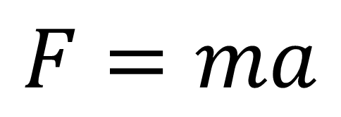
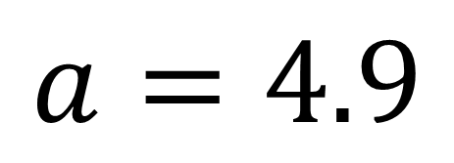
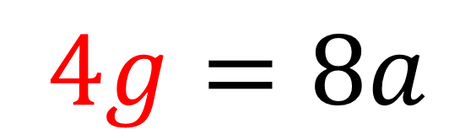
Calculate the acceleration.
$$F=ma$$
a
8kg
$$4g=8a$$
$$4gN$$
$$a=4.9$$
$$30°$$

Slide 9
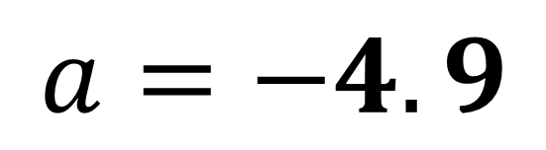
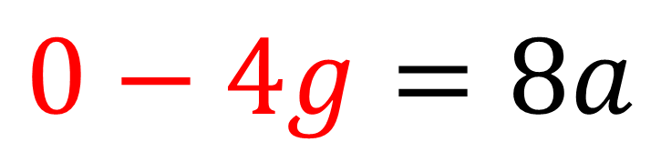
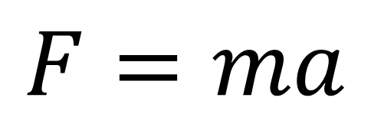


Calculate the acceleration.
$$F=ma$$
a
8kg
$$0−4g=8a$$
$$4gN$$
$$a=−4.9$$
$$30°$$

Slide 10
Types of questions you will have to deal with:
No External Forces
External Forces
which are parallel to the slope
External Forces
at an angle to the slope

Slide 11
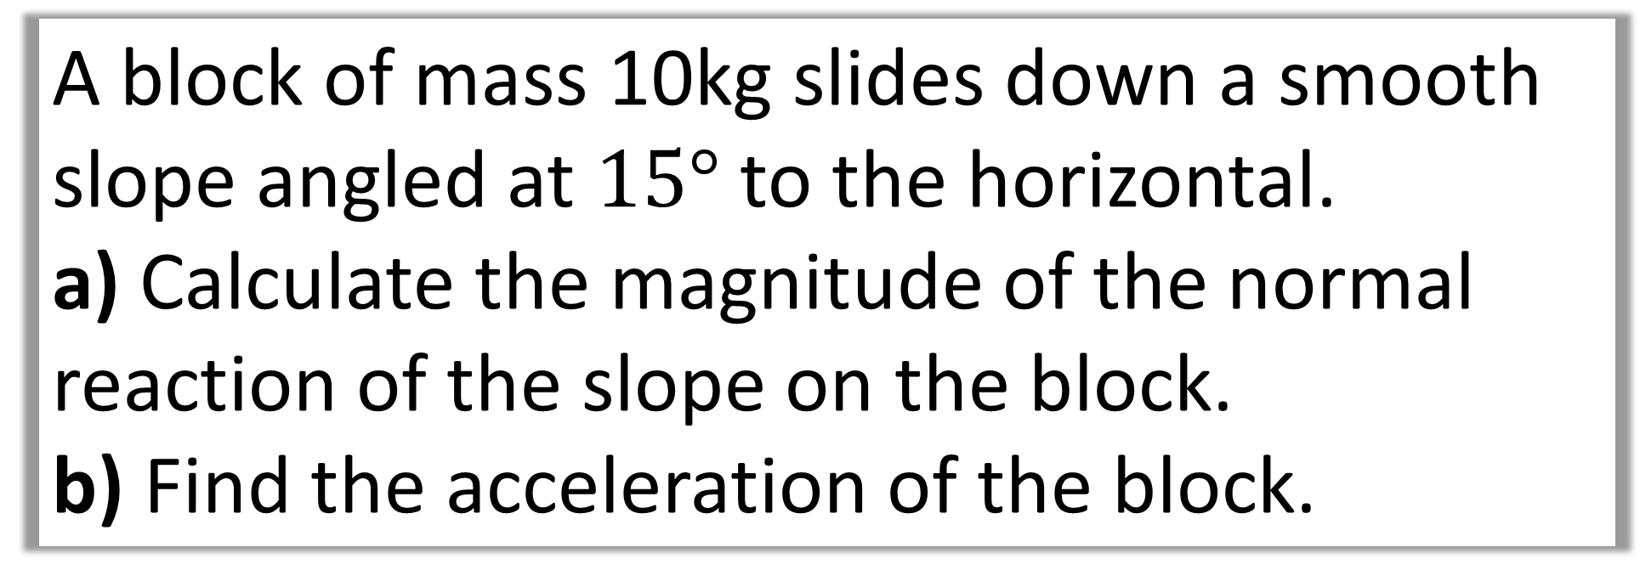
No External Forces
A block of mass 10kg slides down a smooth slope angled at $15°$ to the horizontal.
a) Calculate the magnitude of the normal reaction of the slope on the block.
b) Find the acceleration of the block.

Slide 12
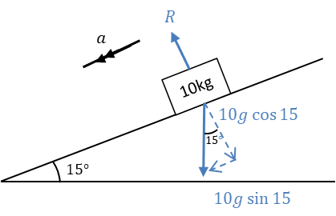
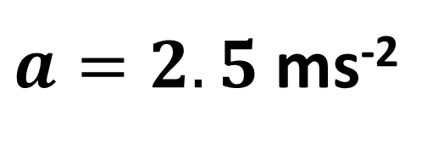
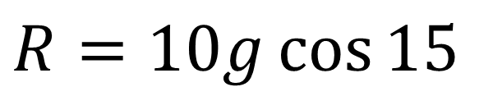
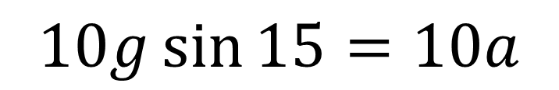
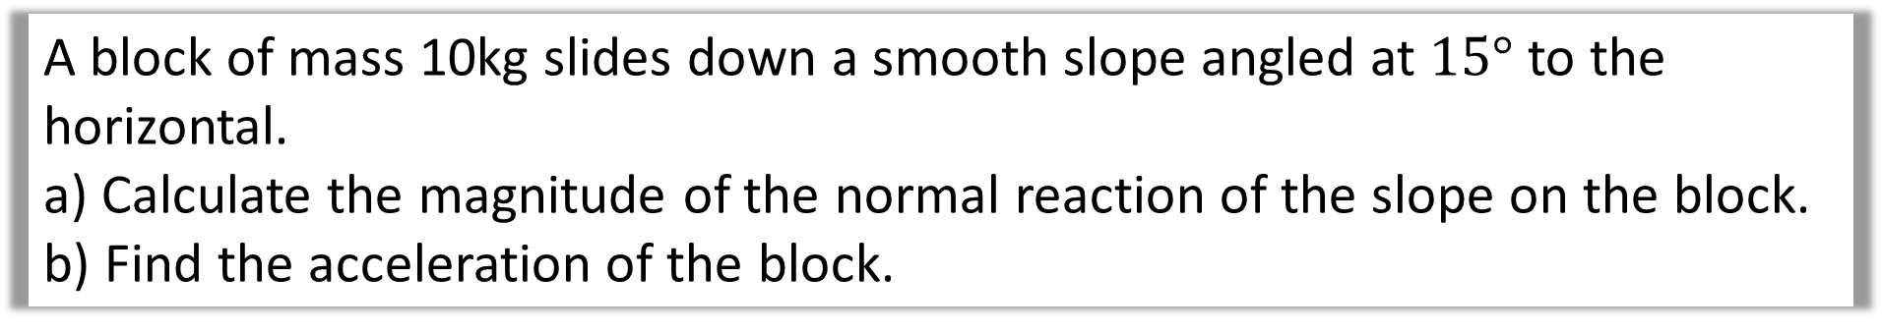
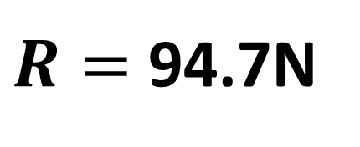
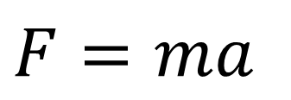
No External Forces
A block of mass 10kg slides down a smooth slope angled at $15°$ to the horizontal.
a) Calculate the magnitude of the normal reaction of the slope on the block.
b) Find the acceleration of the block.
a
$$R=10g\cos{15}$$
$R=$ 94.7N
b
$$F=ma$$
$$10g\sin{15}=10a$$
$a=2.5$ms⁻²

Slide 13
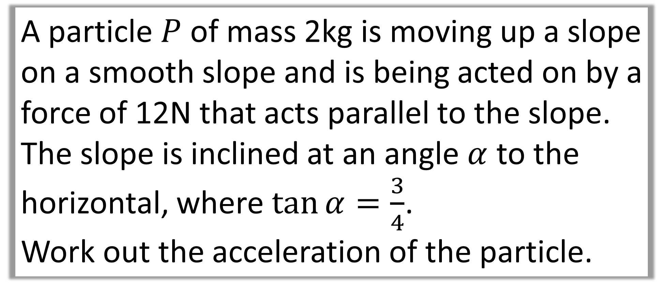
External Forces – Parallel to the Slope
A particle $P$ of mass 2kg is moving up a slope on a smooth slope and is being acted on by a force of 12N that acts parallel to the slope.
The slope is inclined at an angle $α$ to the horizontal, where $\tan{α}=\frac{3}{4}$.
Work out the acceleration of the particle.

Slide 14
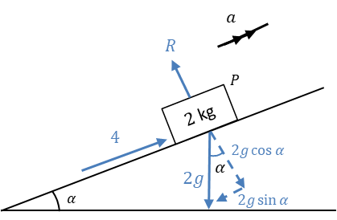
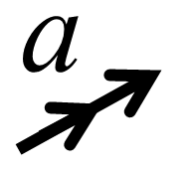
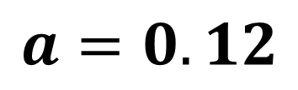
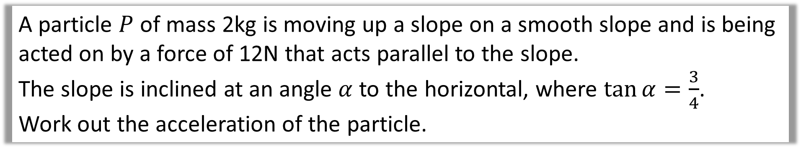
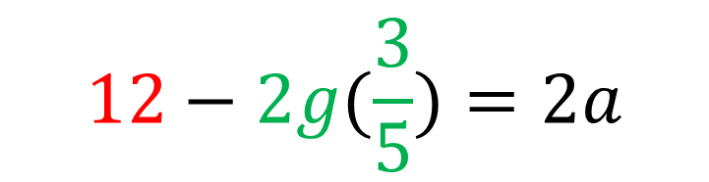
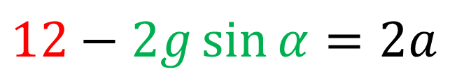
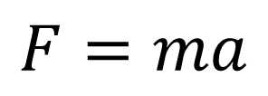

External Forces – Parallel to the Slope
A particle $P$ of mass 2kg is moving up a slope on a smooth slope and is being acted on by a force of 12N that acts parallel to the slope.
The slope is inclined at an angle $α$ to the horizontal, where $\tan{α}=\frac{3}{4}$.
Work out the acceleration of the particle.
$$F=ma$$
$$12−2g\sin{α}=2a$$
$$12−2g(\frac{3}{5})=2a$$
$$12$$
$$a=0.12$$

Slide 15




External Forces at an angle to the slope
E
m
$$α$$
$$E\sin{α }$$
$$E\cos{α}$$
$$Ө$$

Slide 16








What is the calculation needed to find R?
$$R$$
E
m
$$α$$
$$E\sin{α }$$
$$mg\cos{Ө}$$
$$E\cos{α}$$
$$mg\sin{Ө}$$
$$Ө$$
$$R=E\sin{α+mg\sin{Ө}}$$

Slide 17








What is the calculation needed to find R?
E
$$E\sin{α }$$
$$R$$
$$α$$
$$E\cos{α}$$
m
$$mg\cos{Ө}$$
$$mg\sin{Ө}$$
$$Ө$$
$$R=mg\cos{Ө}−E\sin{α}$$

Slide 18
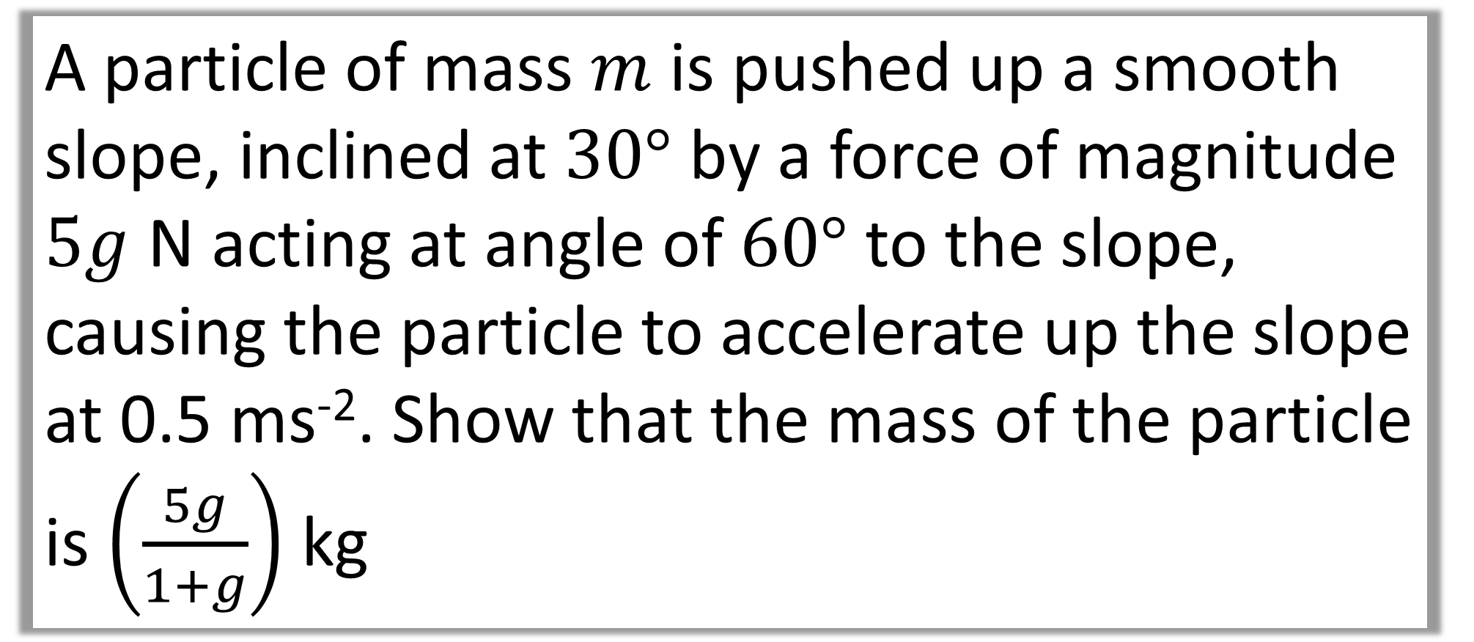
External Forces at an angle to the slope
A particle of mass $m$ is pushed up a smooth slope, inclined at $30°$ by a force of magnitude $5g$ N acting at angle of $60°$ to the slope, causing the particle to accelerate up the slope at 0.5 ms⁻². Show that the mass of the particle is $\left(\frac{5g}{1+g}\right)$ kg

Slide 19
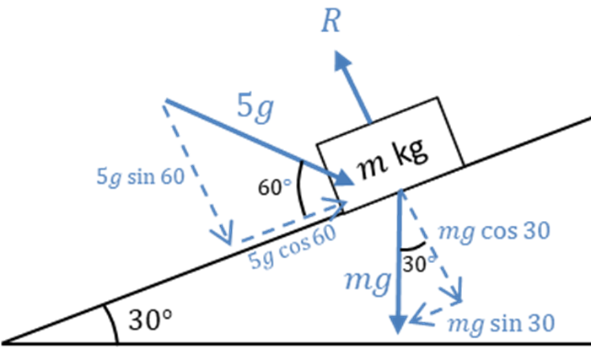
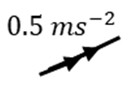
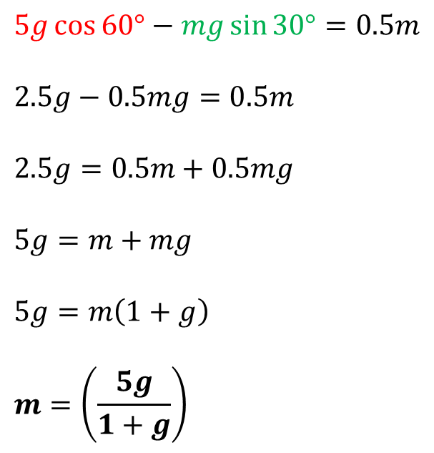
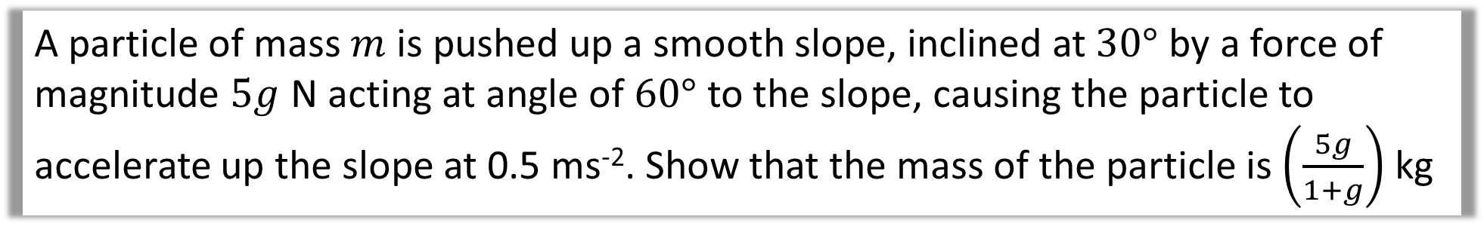

External Forces at an angle to the slope
A particle of mass $m$ is pushed up a smooth slope, inclined at $30°$ by a force of magnitude $5g$ N acting at angle of $60°$ to the slope, causing the particle to accelerate up the slope at 0.5 ms⁻². Show that the mass of the particle is $\left(\frac{5g}{1+g}\right)$ kg
$$F=ma$$
$$5g\cos{60°}−mg\sin{30°}=0.5m$$
$$2.5g−0.5mg=0.5m$$
$$2.5g=0.5m+0.5mg$$
$$5g=m+mg$$
$$5g=m\left(1+g\right)$$
$$m=\left(\frac{5g}{1+g}\right)$$

