Slide 1
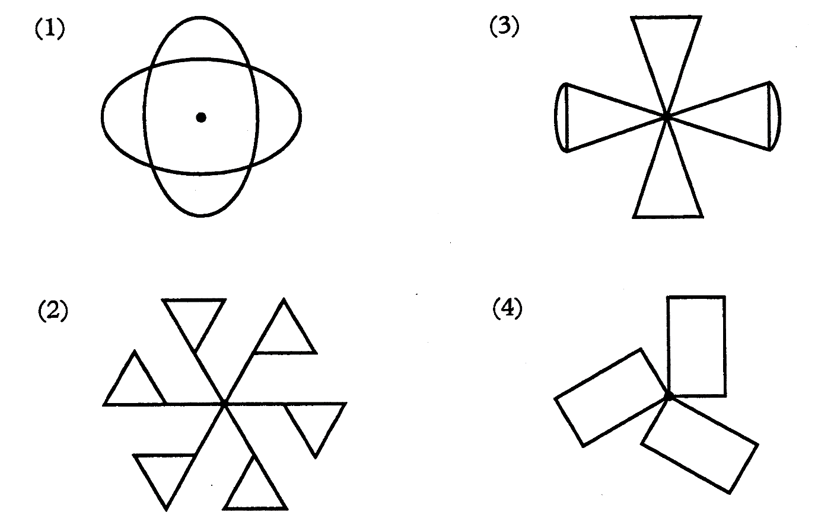
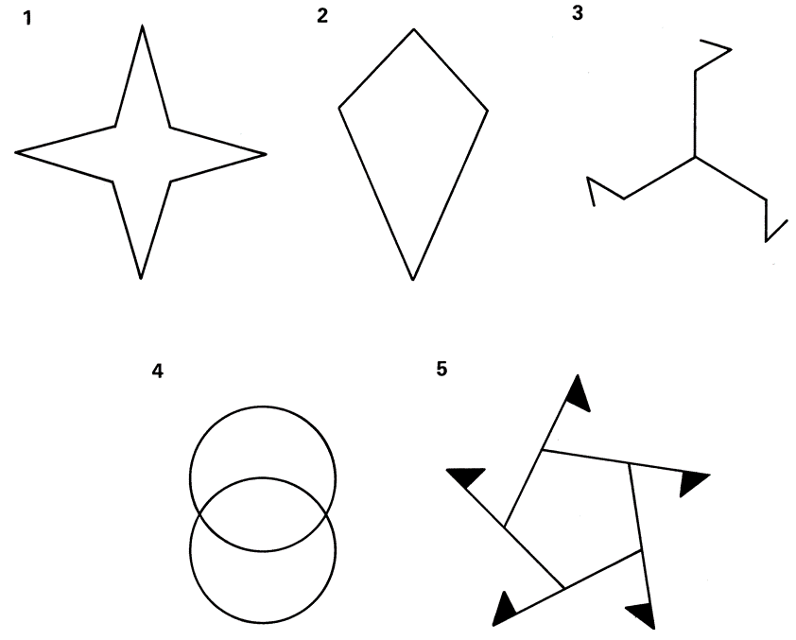
1)
2)
5)
6)
7)
3)
4)
8)
9)

Slide 2
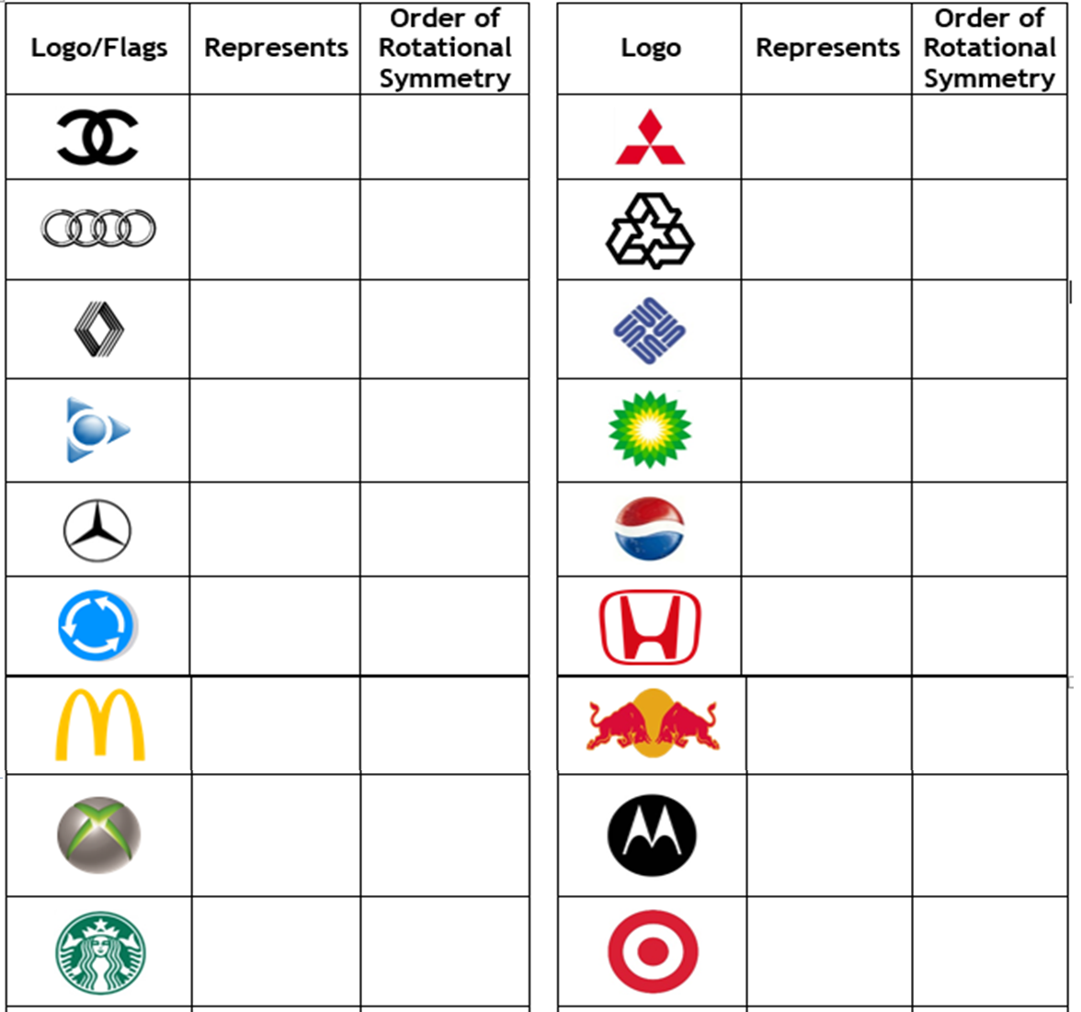
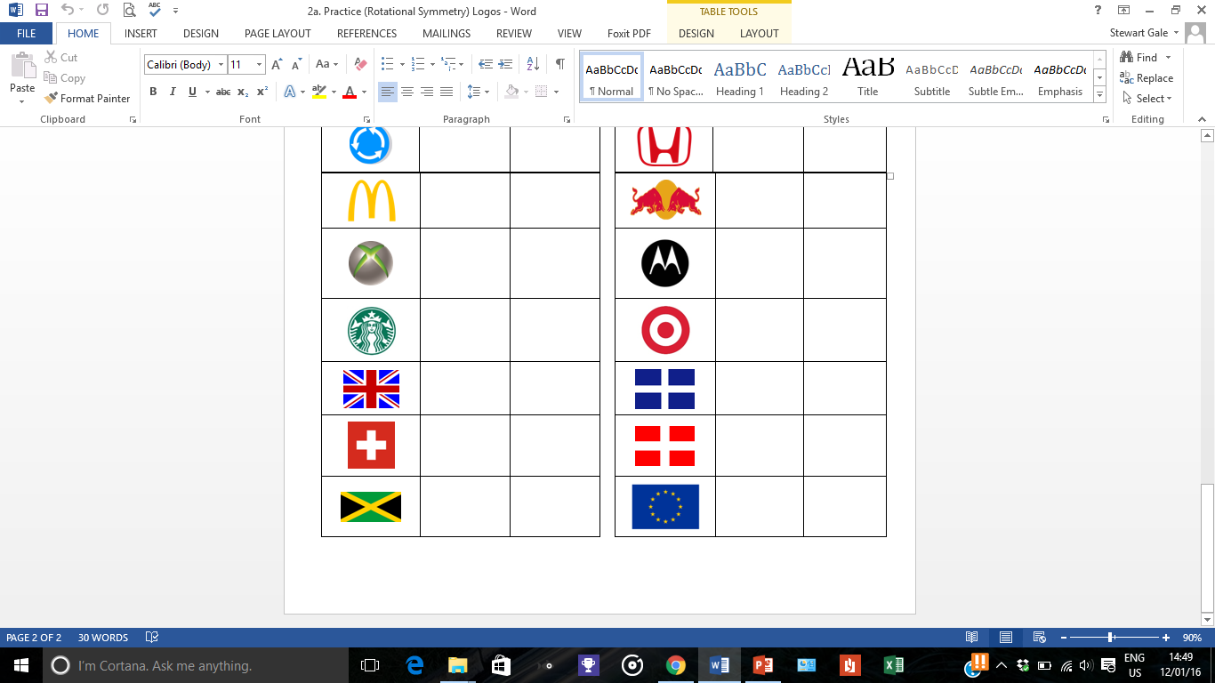
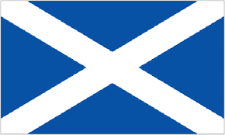

Slide 3
ANSWERS

Slide 4
1)
2)
5)
6)
7)
4
2
4
1
3
3)
4)
8)
9)
6
3
2
5

Slide 5
Chanel | 2
Mitsudbishi | 3
Audi | 2
Recycling | 3
Renault | 2
Sun Mircosystems | 4
AOL | 3
BP | 18
Mercedes | 3
Pepsi | 1
Roundabout | 3
Honda | 1
McDonalds | 1
Red Bull | 1
Xbox | 1
Motorolla | 1
Starbucks | 1
Target | ꝏ

Slide 6
British | 2
Scotland | 2
Switzerland | 4
Denmark | 2
Jamaica | 2
EU | 2

