Slide 1
Binomial Expansion
Factorials
Chapter 8
(Part 4 of 4)

Slide 2
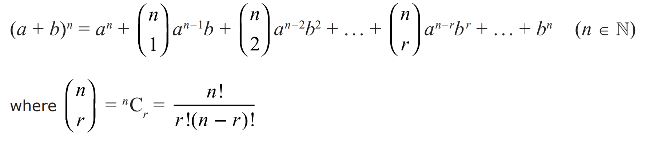

Binomial Expansion Formula
This can be found in the formula booklet.
n!
n Factorial
$nCr$ is said as “$n$ choose $r$”,
is the number of ways of ‘choosing’ $r$ things from $n$ items.

Slide 3
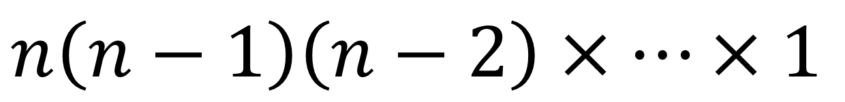
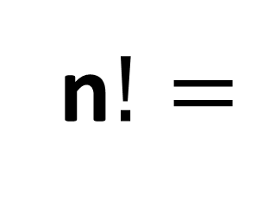
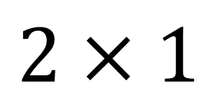
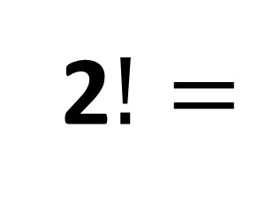
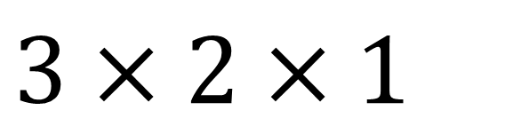

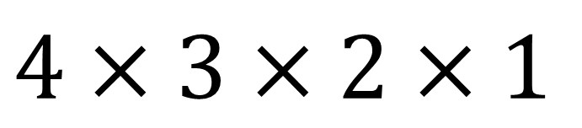

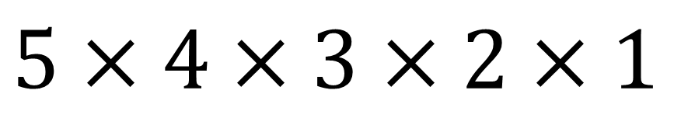

Factorials
2$!=$
$$2×1$$
$$3!=$$
$$3×2×1$$
$$4!=$$
$$4×3×2×1$$
$$5!=$$
$$5×4×3×2×1$$
n$!=$
$$n\left(n−1\right)\left(n−2\right)×…×1$$

Slide 4

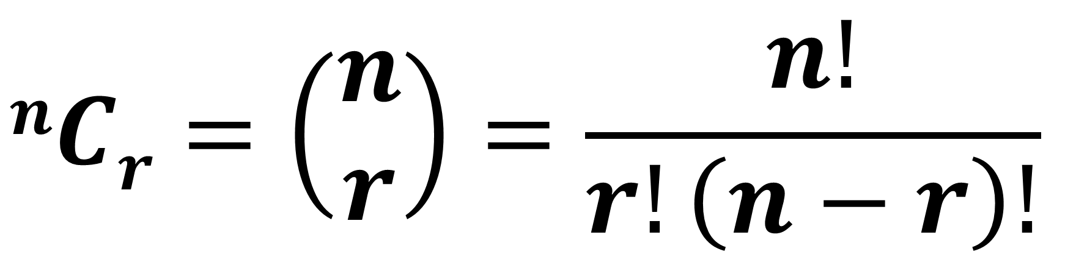
$$nCr=\left(\begin{matrix}n \\ r\end{matrix}\right)=\frac{n!}{r!\left(n−r\right)!}$$
said “$n$ choose $r$”,
is the number of ways of ‘choosing’
$r$ things from $n$ items,
such that the order in our selection does not matter.

Slide 5
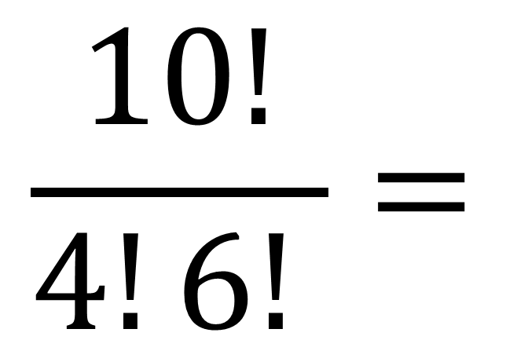
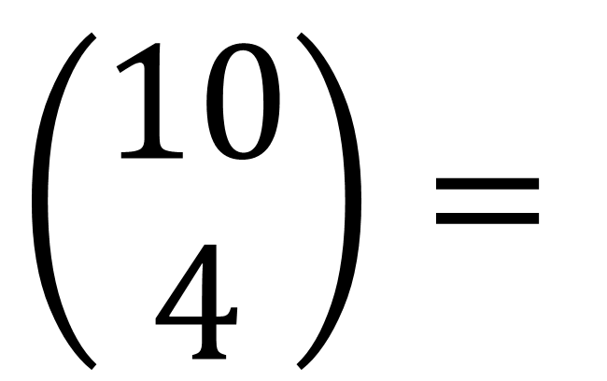
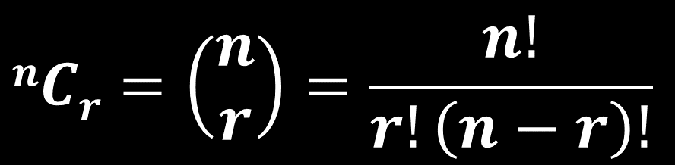

Choose 4 people from amongst 10 people. How many possible selections?
$$nCr=\left(\begin{matrix}n \\ r\end{matrix}\right)=\frac{n!}{r!\left(n−r\right)!}$$
$$\frac{10!}{4!6! }=$$
$$\left(\begin{matrix}10 \\ 4\end{matrix}\right)=$$
$$210$$

Slide 6
Challenge!
Work out the value of the following slides using factorials and no calculator.

Slide 7
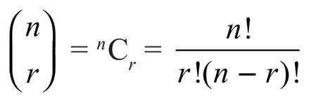
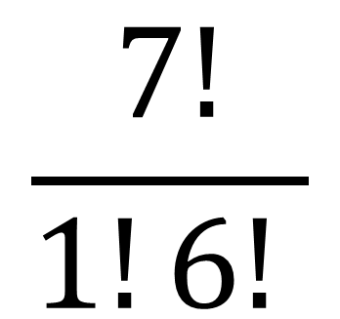
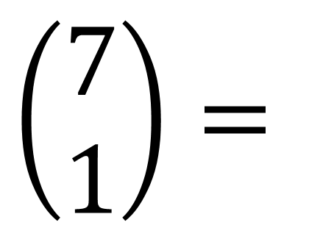
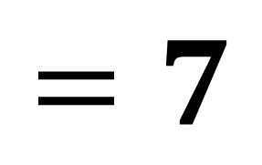
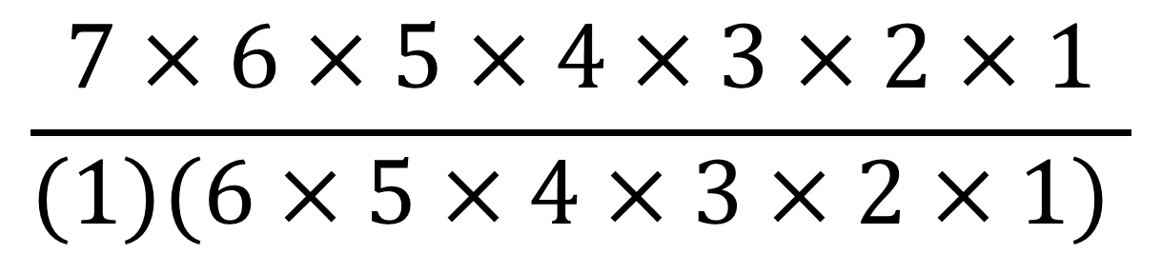
$$\left(\begin{matrix}7 \\ 1\end{matrix}\right)=$$
$$\frac{7!}{1!6! }$$
$$\frac{7×6×5×4×3×2×1}{(1)(6×5×4×3×2×1) }$$
$$=7$$

Slide 8
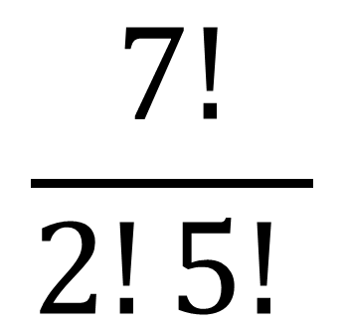
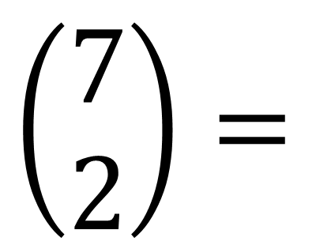
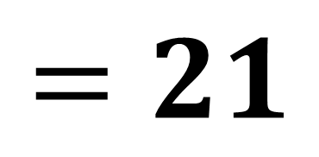
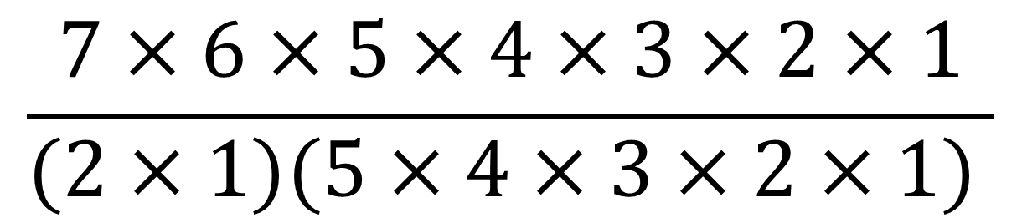
$$\left(\begin{matrix}7 \\ 2\end{matrix}\right)=$$
$$\frac{7!}{2!5! }$$
$$\frac{7×6×5×4×3×2×1}{(2×1)(5×4×3×2×1) }$$
$$=21$$

Slide 9
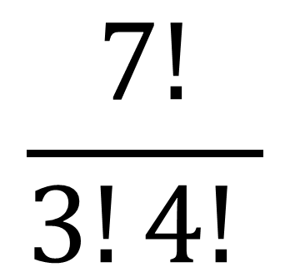
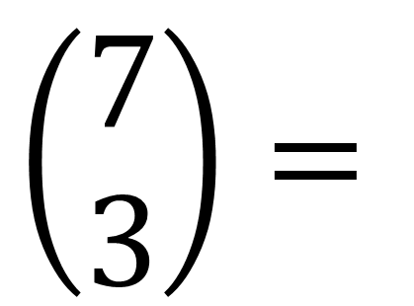
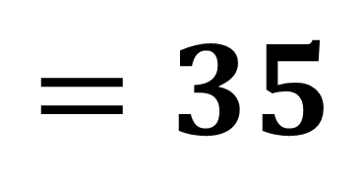
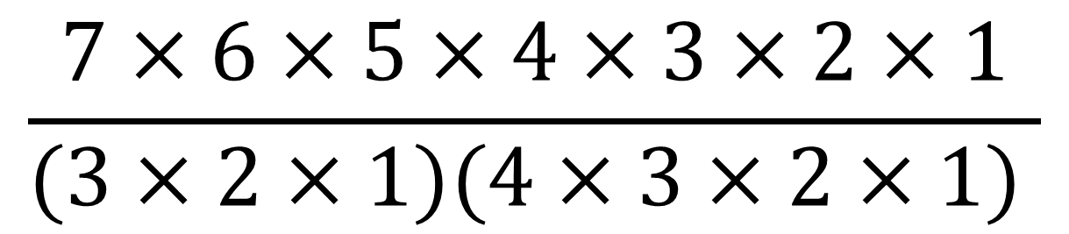
$$\left(\begin{matrix}7 \\ 3\end{matrix}\right)=$$
$$\frac{7!}{3!4! }$$
$$\frac{7×6×5×4×3×2×1}{(3×2×1)(4×3×2×1) }$$
$$=35$$

Slide 10
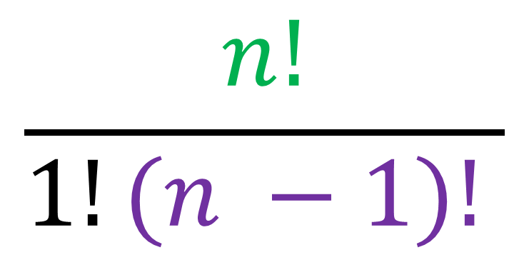
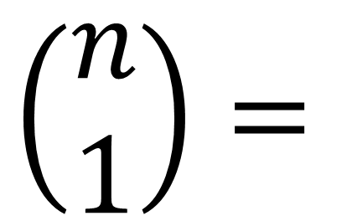
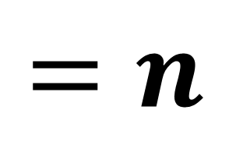
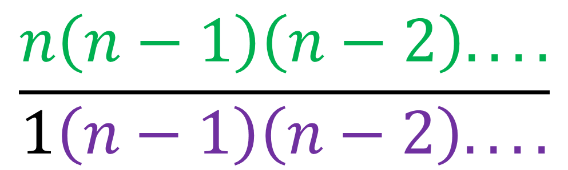
$$\left(\begin{matrix}n \\ 1\end{matrix}\right)=$$
$$\frac{n!}{1!(n −1)! }$$
$$\frac{n\left(n−1\right)\left(n−2\right). ...}{1\left(n−1\right)\left(n−2\right). ...}$$
$$=n$$

Slide 11
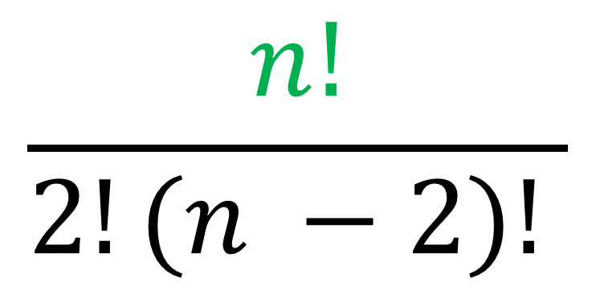
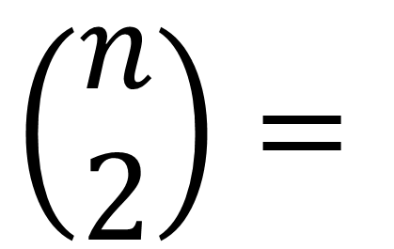
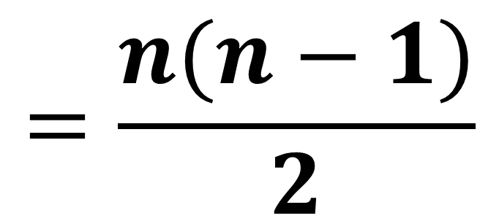
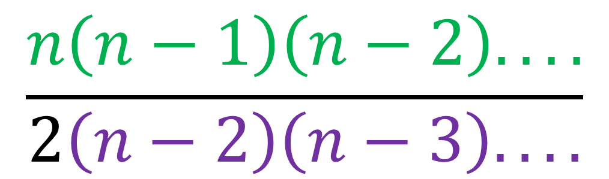
$$\left(\begin{matrix}n \\ 2\end{matrix}\right)=$$
$$\frac{n!}{2!(n −2)! }$$
$$\frac{n\left(n−1\right)\left(n−2\right). ...}{2\left(n−2\right)\left(n−3\right). ...}$$
$$=\frac{n(n−1)}{2}$$

Slide 12
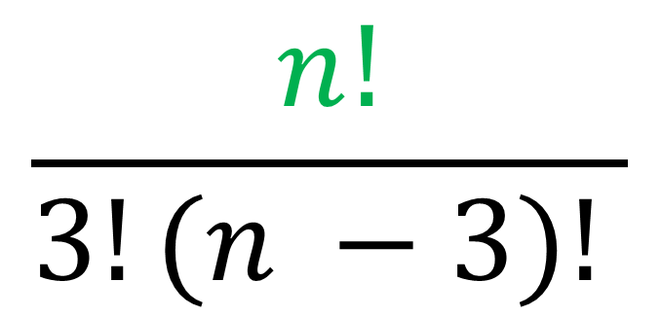
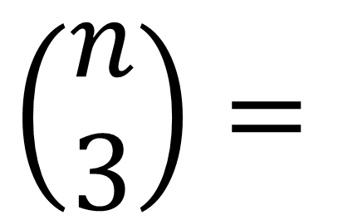
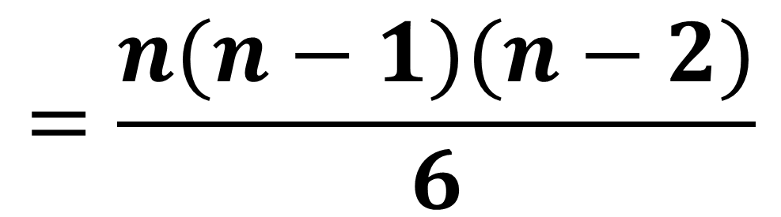
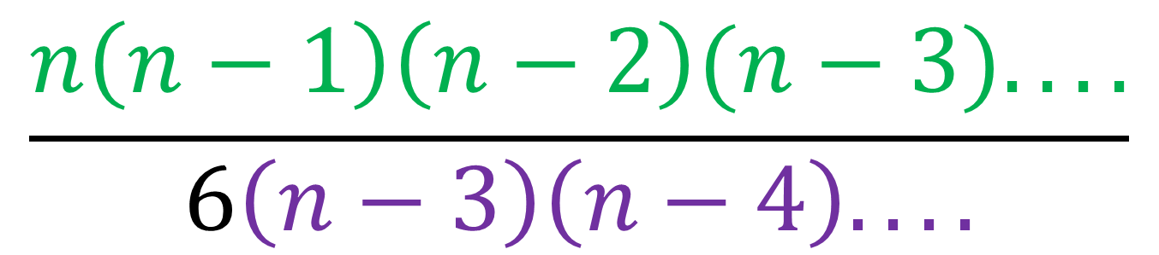
$$\frac{n!}{3!(n −3)! }$$
$$\left(\begin{matrix}n \\ 3\end{matrix}\right)=$$
$$\frac{n\left(n−1\right)\left(n−2\right)(n−3). ...}{6\left(n−3\right)\left(n−4\right). ...}$$
$$=\frac{n(n−1)(n−2)}{6}$$

Slide 13
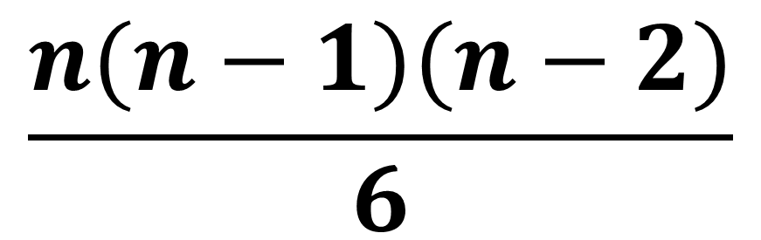

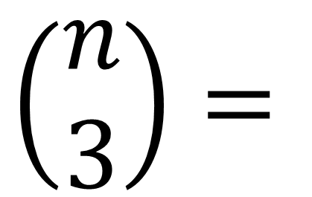
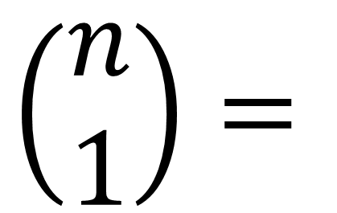
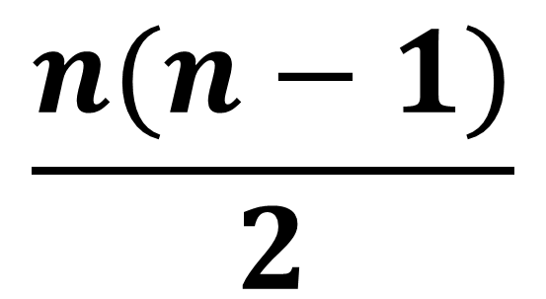
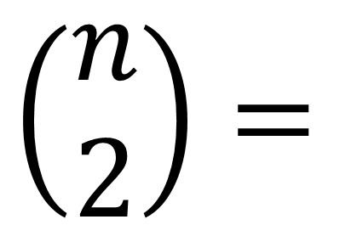
$$\left(\begin{matrix}n \\ 1\end{matrix}\right)=$$
$$n$$
$$\frac{n(n−1)}{2}$$
$$\left(\begin{matrix}n \\ 2\end{matrix}\right)=$$
$$\left(\begin{matrix}n \\ 3\end{matrix}\right)=$$
$$\frac{n(n−1)(n−2)}{6}$$

Slide 14
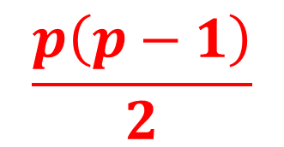
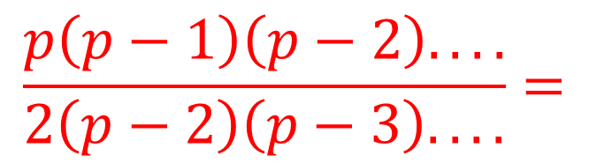

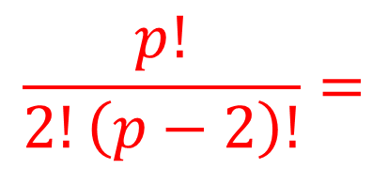
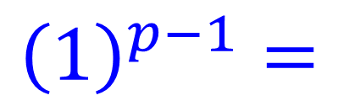
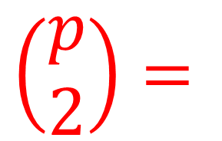
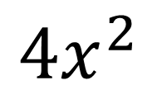

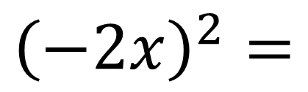
The coefficient of $x^{2}$ in the expansion of ${\left(1−2x\right)}^{p}$ is 40.
Given $p>0,$ use this information to find the value of the constant p.
$${\left(1−2x\right)}^{p}=\left(\begin{matrix}p \\ 0\end{matrix}\right){\left(1\right)}^{p}{\left(−2x\right)}^{0}+\left(\begin{matrix}p \\ 1\end{matrix}\right){\left(1\right)}^{p−1}{\left(−2x\right)}^{1}+\left(\begin{matrix}p \\ 2\end{matrix}\right){\left(1\right)}^{p−2}{\left(−2x\right)}^{2}+…$$
$$\left(\begin{matrix}p \\ 2\end{matrix}\right)=$$
$$\frac{p!}{2!\left(p−2\right)!}=$$
$$\frac{p\left(p−1\right)\left(p−2\right). ...}{2\left(p−2\right)\left(p−3\right). ...}=$$
$$\frac{p\left(p−1\right)}{2}$$
$${\left(1\right)}^{p−1}=$$
$$1$$
$${\left(−2x\right)}^{2}=$$
$${4x}^{2}$$

Slide 15
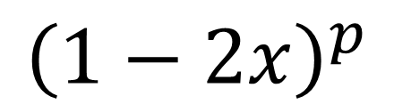


The coefficient of $x^{2}$ in the expansion of ${\left(1−2x\right)}^{p}$ is 40.
Given $p>0,$ use this information to find the value of the constant p.
$${\left(1−2x\right)}^{p}$$
$$=\left(\begin{matrix}p \\ 0\end{matrix}\right){\left(1\right)}^{p}{\left(−2x\right)}^{0}+\left(\begin{matrix}p \\ 1\end{matrix}\right){\left(1\right)}^{p−1}{\left(−2x\right)}^{1}+\left(\begin{matrix}p \\ 2\end{matrix}\right){\left(1\right)}^{p−2}{\left(−2x\right)}^{2}+…$$
$$+\frac{p\left(p−1\right)}{2} (1)(4x^{2})+…$$
$$+\frac{4p\left(p−1\right)}{2}x^{2}+…$$

Slide 16







The coefficient of $x^{2}$ in the expansion of ${\left(1−2x\right)}^{p}$ is 40.
Given $p>0,$ use this information to find the value of the constant p.
$+$ $\frac{4p\left(p−1\right)}{2}x^{2}+…$
$$\frac{4p\left(p−1\right)}{2}=40$$
$$p=−4 and p=5$$
$$p>0$$
$${4p}^{2}− 4p=80$$
$$p=5$$
$${4p}^{2}− 4p−80=0$$

Slide 17









The coefficient of $x$ in the expansion of ${(1−\frac{3}{2}x)}^{p}$ is $−24$.
Use this information to find the value of the constant p.
$${\left(1−2x\right)}^{p}=\left(\begin{matrix}p \\ 0\end{matrix}\right){\left(1\right)}^{p}{\left(−\frac{3}{2}x\right)}^{0}+\left(\begin{matrix}p \\ 1\end{matrix}\right){\left(1\right)}^{p−1}{\left(−\frac{3}{2}x\right)}^{1}+\left(\begin{matrix}p \\ 2\end{matrix}\right){\left(1\right)}^{p−2}{\left(−\frac{3}{2}x\right)}^{2}+…$$
$$\left(\begin{matrix}p \\ 1\end{matrix}\right)=$$
$$\frac{p!}{1!\left(p−1\right)!}=$$
$$\frac{p\left(p−1\right)\left(p−2\right). ...}{2\left(p−1\right)\left(p−2\right). ...}=$$
$$\frac{p}{2}$$
$${\left(1\right)}^{p−1}=$$
$$1$$
$${\left(−\frac{3}{2}x\right)}^{1}=$$
$$−\frac{3}{2}x$$

Slide 18





The coefficient of $x$ in the expansion of ${(1−\frac{3}{2}x)}^{p}$ is $−24$.
Use this information to find the value of the constant p.
$$−\frac{3p}{2}x+…$$
$$−\frac{3p}{2}=−24$$
$$3p=48$$
$$p=16$$

