Slide 1
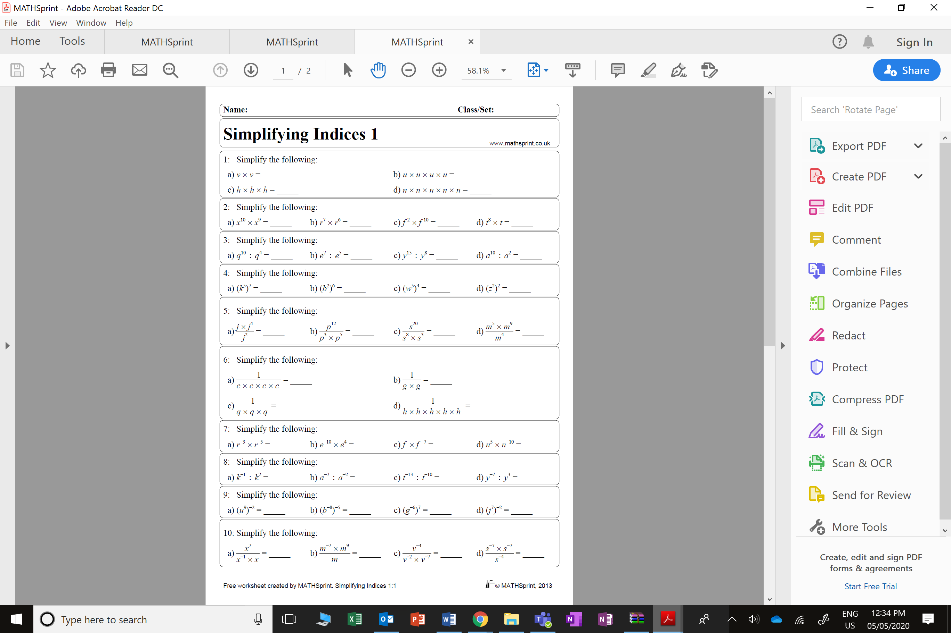
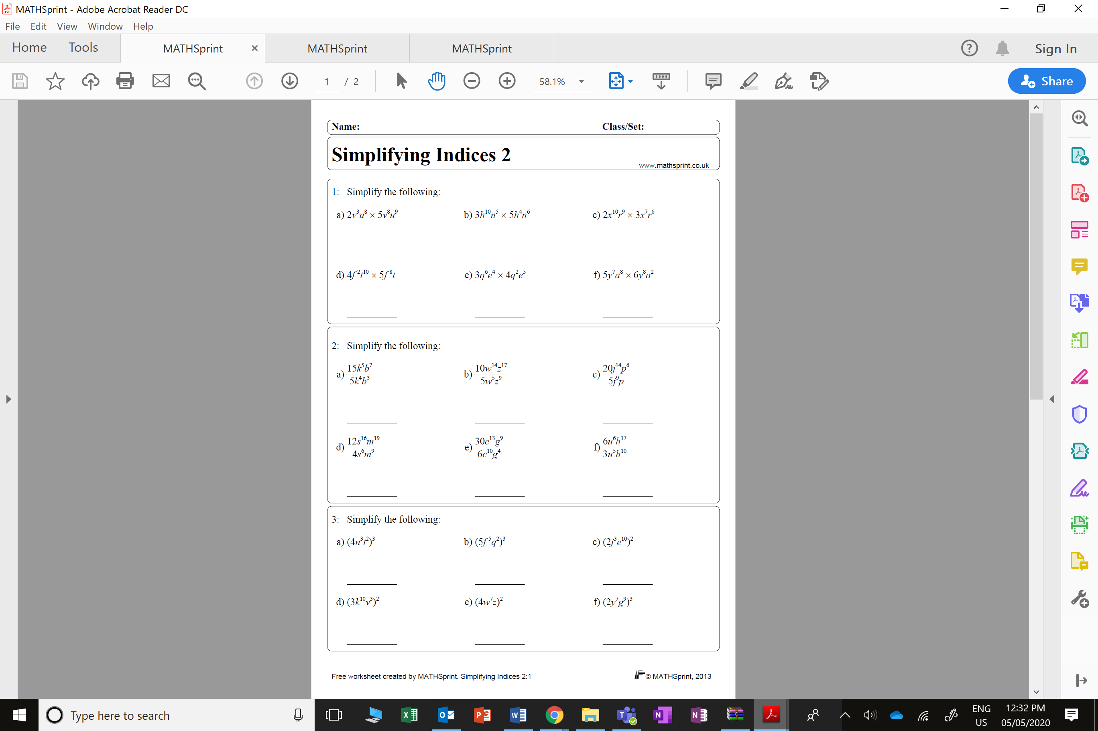

Slide 2
ANSWERS

Slide 3




















$$v^{2}$$
$$u^{4}$$
$$h^{3}$$
$$n^{5}$$
$$x^{19}$$
$$r^{13}$$
$$f^{12}$$
$$t^{9}$$
$$q^{6}$$
$$e^{2}$$
$$y^{7}$$
$$a^{8}$$
$$k^{35}$$
$$b^{12}$$
$$w^{20}$$
$$z^{4}$$
$$j^{3}$$
$$p^{4}$$
$$s^{9}$$
$$m^{10}$$

Slide 4



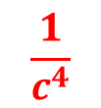






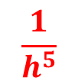

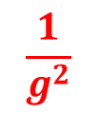



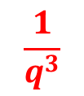



$$\frac{1}{c^{4}}$$
$$\frac{1}{g^{2}}$$
$$\frac{1}{q^{3}}$$
$$\frac{1}{h^{5}}$$
$$r^{−8}$$
$$e^{−6}$$
$$f^{−6}$$
$$n^{−5}$$
$$k^{−3}$$
$$a^{−5}$$
$$t^{−3}$$
$$y^{−10}$$
$$g^{−42}$$
$$j^{−14}$$
$$u^{−18}$$
$$b^{40}$$
$$x^{7}$$
$$m^{1}$$
$$v^{5}$$
$$s^{−10}$$

Slide 5
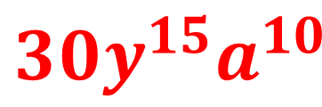
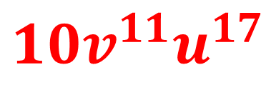
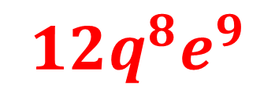
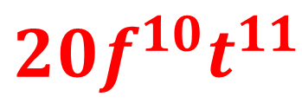
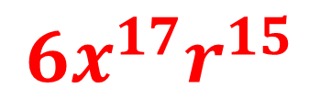
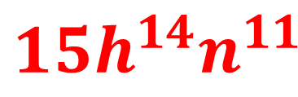
$${10v^{11}u}^{17}$$
$${15h^{14}n}^{11}$$
$${6x^{17}r}^{15}$$
$${20f^{10}t}^{11}$$
$${12q^{8}e}^{9}$$
$${30y^{15}a}^{10}$$

Slide 6
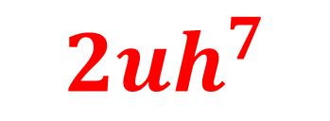
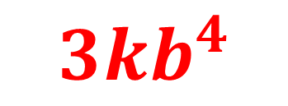
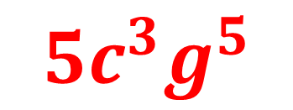
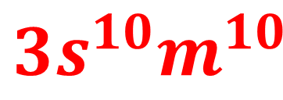
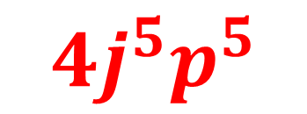
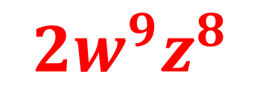
$${3kb}^{4}$$
$${2w^{9}z}^{8}$$
$${4j^{5}p}^{5}$$
$${3s^{10}m}^{10}$$
$${5c^{3}g}^{5}$$
$${2uh}^{7}$$

Slide 7
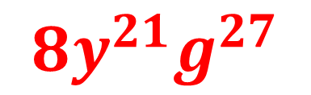
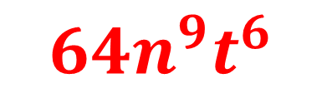
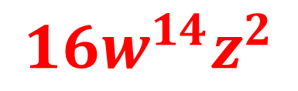
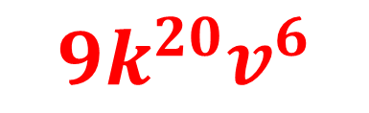
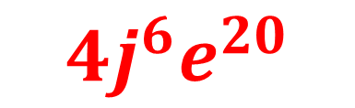
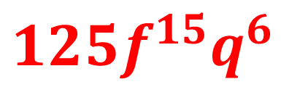
$${64n^{9}t}^{6}$$
$${125f^{15}q}^{6}$$
$${4j^{6}e}^{20}$$
$${9k^{20}v}^{6}$$
$${16w^{14}z}^{2}$$
$${8y^{21}g}^{27}$$

